Slide 1
42 Abu Dhabi Cursus’ Final Project:
ft_transcendence
Malik Alzubaidi (maalzuba)
Paula Balbino (pbalbino)
Samih Abdelrahman (sabdelra)
Tanvir Ahmed Anas (tanas)
Tehuan De Melo (tde-melo)

Slide 2
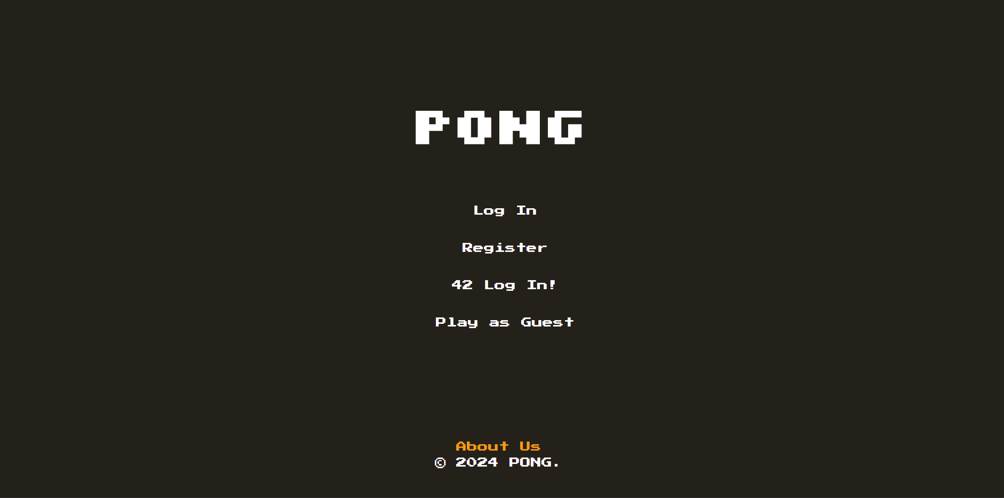
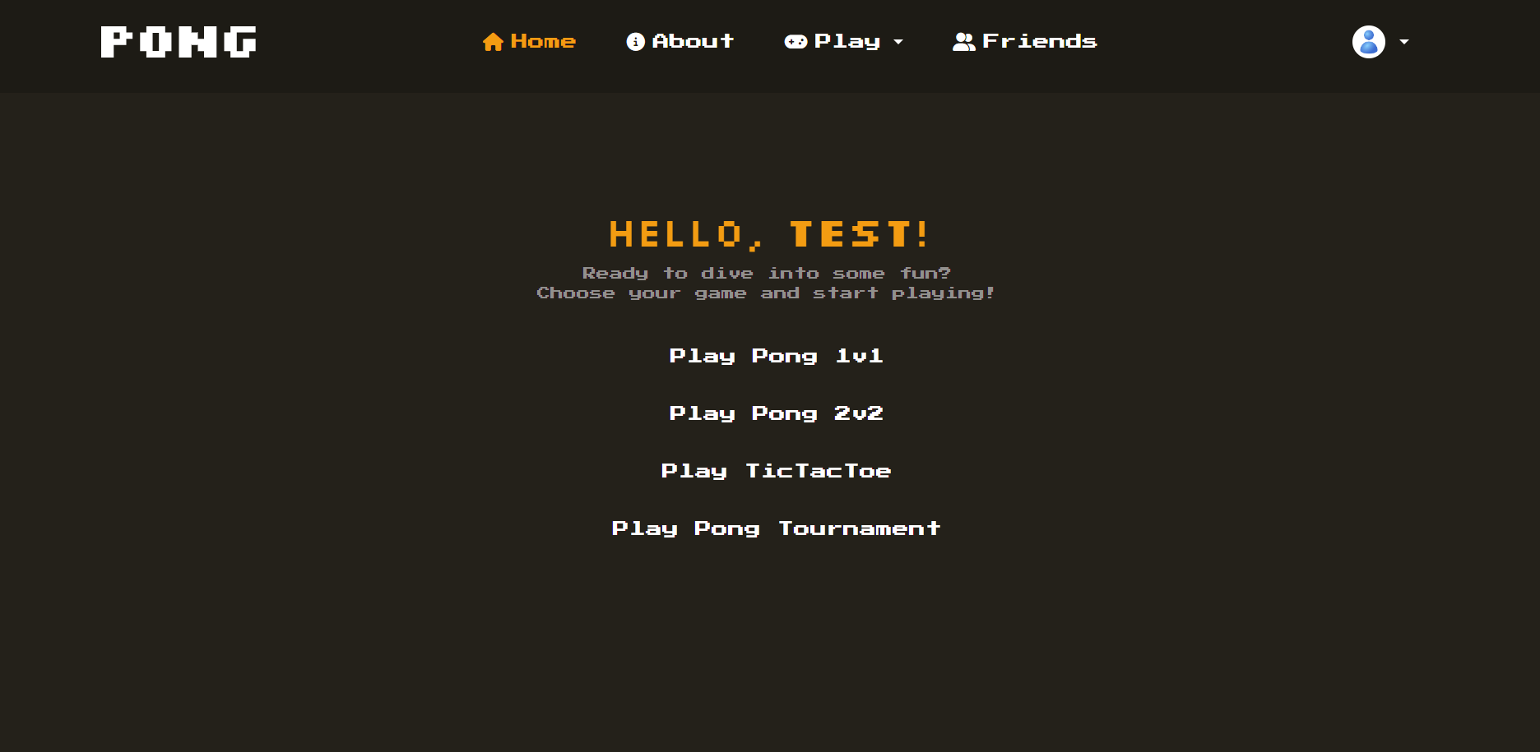
Introduction
Home Page
Home Page after login
Notes:
Here we have the pictures of both the home screen when not logged in and when logged in.

Slide 3


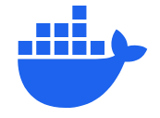
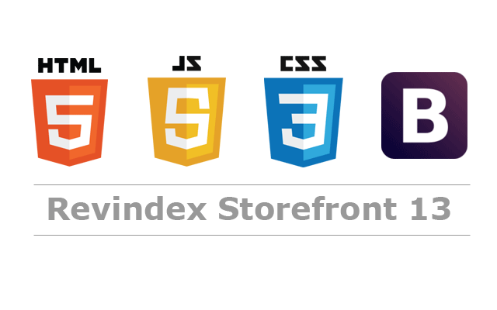
Introduction
Technology Stack:
Docker & Docker Compose
Django (backend)
PostgreSQL (database)
HTML 5, CSS 3, JS and Bootstrap (frontend)
Notes:
The ft_transcendence project involves making a web application that delivers a multiplayer gaming experience focused on Pong, with the choice of an additional game such as Tic-Tac-Toe. The project integrates modern web development practices to enhance user interaction and create a secure, responsive environment.
Technologies Used
"We used Django as our primary backend framework due to its security features and scalability. PostgreSQL is our choice for the database because of its robust data handling capabilities. We deployed the app using Nginx to efficiently serve static files, and Bootstrap was used for frontend styling, ensuring a responsive and user-friendly interface. For added security, we implemented JWT and Two-Factor Authentication to keep user data safe."

Slide 4
Use a front-end framework or toolkit. | 0.5
Use a database for the backend. | 0.5
Server-Side Rendering (SSR) Integration. | 0.5
Game Customization Options. | 0.5
Expanding Browser Compatibility. | 0.5
Add accessibility for Visually Impaired Users. | 0.5
Support on all devices. | 0.5
Use a Framework as a backend. | 1
Multiplayers (more than 2 in the same game). | 1
Implement Two-Factor Authentication (2FA) and JWT. | 1
Implementing a remote authentication. | 1
Standard user management, authentication, users across tournaments. | 1
Add Another Game with User History and Matchmaking. | 1
Selected
Modules:
9.5 pts
Notes:
Introduce each major module and briefly explain its role in the platform.

Slide 5
Software Development Life Cycle (SDLC)
Methodology: A modified Waterfall model with Agile elements.
Phases:
Requirement Analysis
System Design
Implementation (Backend, Frontend, Game Mechanics)
Testing
Bug fixing
Workflow: Version control via GitHub, with peer-reviewed merges to the main branch.
Notes:
Explain that the project used a structured SDLC with a modified Waterfall model to allow flexibility while keeping the project on track.
Talk about our weekly meetings on weekends to accommodate everyone’s schedules.

Slide 6
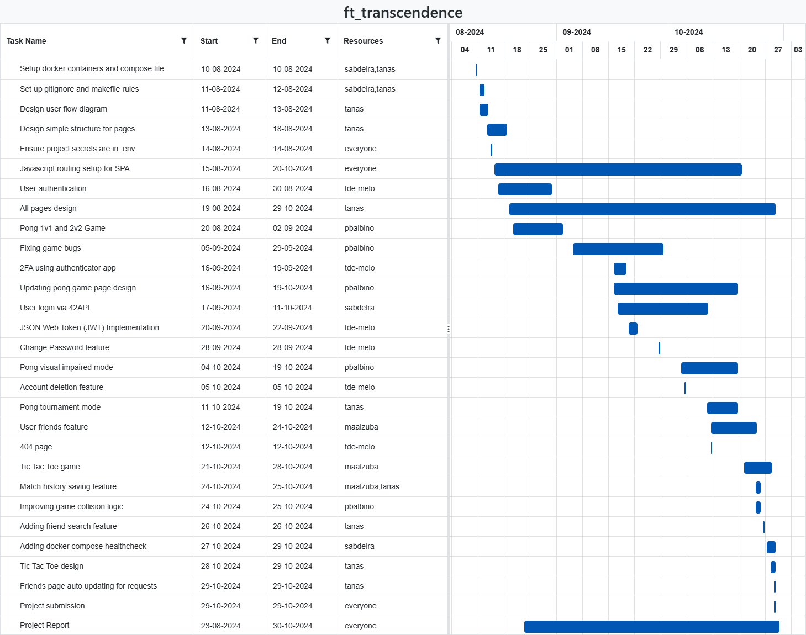
Software Development Life Cycle (SDLC)
Image of the project gantt chart
Notes:
Talk about how the project started and how tasks were done in what order.

Slide 7
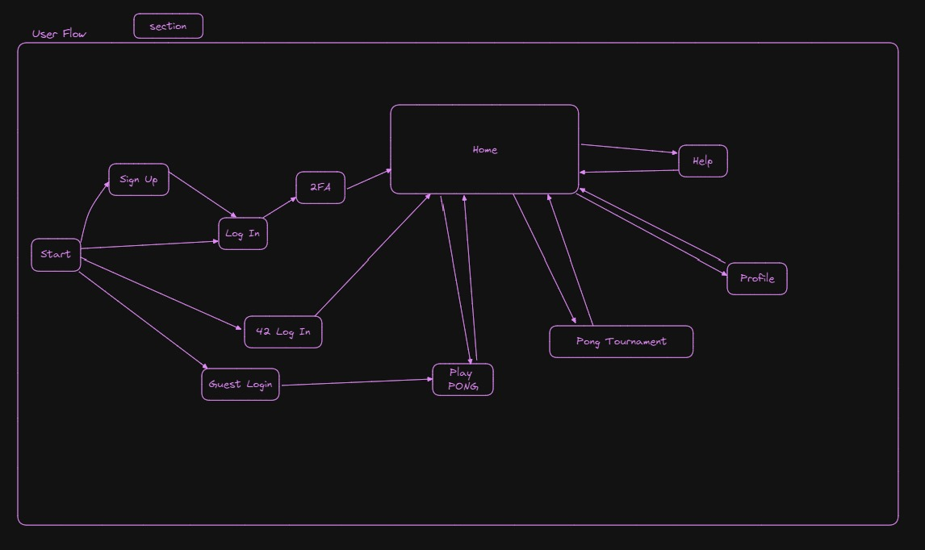
Software Development Life Cycle (SDLC)
Image of the initial draft of the website user flow

Slide 8
Application Features
User Authentication:
42 Login, username-based login using JSON Web Token for managing user sessions, Two-Factor Authentication (2FA).
Game Customization Options:
Adjustable paddle and ball speed, difficulty levels, sound options.
Accessibility Options:
High-contrast visuals, keyboard navigation.
Game Modes:
Pong 1v1, 2v2 or Guest mode
Pong Tournament mode
Tic-Tac-Toe (1v1)
Notes:
Give a demo if necessary.

Slide 9
Member contributions
Malik: Implemented user friendships, match history and Tic-Tac-Toe game.
Paula: Developed Pong game, including a visually impaired mode.
Samih: Set up backend infrastructure, containerization, and 42 API login.
Tanvir: Handled all frontend design.
Tehuan: Built the user authentication system with JWT and implemented 2FA login using authenticator apps.

Slide 10
Application Limitations
Only two games are currently available.
Pong's Tournament mode supports up to 4 players at a time.
Matches must be hosted locally, as there is no option to play with remote players online.
Chat functionality is not yet implemented, so users cannot communicate with friends.
Games are not compatible with mobile touch screens.

Slide 11
Recommended Further Improvements
Expanding the game portfolio to offer a more diverse user experience.
Enhancing accessibility with additional features.
Developing a matchmaking system powered by AI-driven algorithms to optimize player pairing and engagement.
Introducing an AI opponent, allowing users to enjoy solo gameplay.

Slide 12
That is all!
Any questions?

