Slide 1
C++ (and C) Programming
Rommel García Hernández
Senior Cybersecurity Engineer
Hardware Design Engineer
Software Developer End-to-End

Slide 2
Agenda
Introduction
The Basics
Hello, World!
Types, variables and Arithmetic
Constants
Arrays
Pointers
User-Defined Types
Structures
Classes
Enumerations
Modularity
Separate Compilation
Namespaces
Error Handling
Advice

Slide 3

Introduction
C++ is a compiled language. For a program to run, its source text has to be processed by a compiler, producing object files, which are combined by a linker yielding an executable program. A C++ program typically consists of many source code files (usually simply called source files).
C++ was developed by Bjarne Stroustrup starting in 1979 at Bell Labs in Murray Hill, New Jersey, as an enhancement to the C language and originally named C with Classes but later it was renamed C++ in 1983.

Slide 4
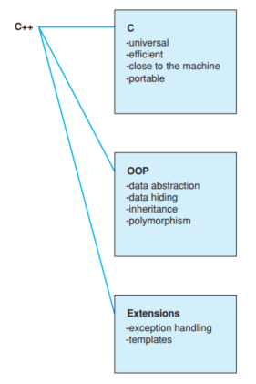
Introduction
An executable program is created for a specific hardware or system combination; it is not portable, say, from a Mac to a Windows PC. When we talk about portability of C++ programs, we usually mean portability of source code; that is, the source code can be successfully compiled and run on a variety of systems.
The assumption is that you have programmed before. If not, please consider reading a textbook, such as Programming: Principles and Practice Using C++ [Stroustrup,2009], before continuing here [1].

Slide 5
Introduction
A C++ program can be defined as a collection of objects that communicate via invoking each other's methods.
Object − Objects have states and behaviors. Example: A cat has states - color, name, breed as well as behaviors - meowing, eating. An object is an instance of a class.
Class − A class can be defined as a template that describes the behaviors/states that object of its type support.
Methods − A method is basically a behavior.
Instance Variables − Each object has its unique set of instance variables. An object's state is created by the values assigned to these instance variables.

Slide 6
The Basics

Slide 7
Hello World
The minimal C++ program is
int main() { } // the minimal C++ program
Every C++ program must have exactly one global function named main(). The program starts by executing that function. If no value is returned, the system will receive a value indicating successful completion.
00_hello_world.cpp is a program that writes Hello, World!. (5 mins practice).
Essentially all executable code is placed in functions and called directly or indirectly from. 01_main_function.cpp is a program that shows the structure of a c++ program. (5 mins practice).

Slide 8
Hello World
02_program_with_errors.cpp is a program with several syntax errors, you have to correct this program in order to compile it and show the following message:
“If this text appears on your display, you can pat yourself on the back!”
Use all the examples we have seen to solve the problem. ☺

Slide 9
Types, Variables and Arithmetic
Every name and every expression has a type that determines the operations that may be performed on it. For example, the declaration
int inch;
A declaration is a statement that introduces a name into the program. It specifies a type for the named entity:
A type defines a set of possible values and a set of operations (for an object).
An object is some memory that holds a value of some type.
A value is a set of bits interpreted according to a type.
A variable is a named object.
Fundamental types:
bool // Boolean, possible values are true and false
char // character, for example, 'a', ' z', and '9'
int // integer, for example, 1, 42, and 1066
double // double-precision floating-point number, for example, 3.14 and 299793.0

Slide 10
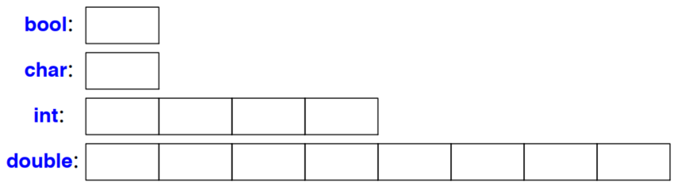
Types, Variables and Arithmetic
Each fundamental type corresponds directly to hardware facilities and has a fixed size that determines the range of values that can be stored in it.
A char variable is of the natural size to hold a character on a given machine (typically an 8-bit byte), and the sizes of other types are quoted in multiples of the size of a char.

Slide 11
Types, Variables and Arithmetic
C++ offers a variety of notations for expressing initialization, such as the = used above, and a universal form based on curly-brace-delimited initializer lists:
double d1 = 2.3;
double d2 {2.3};
complex<double> z = 1; // a complex number with double-precision floating-point scalars
complex<double> z2 {d1,d2};
complex<double> z3 = {1,2}; // the = is optional with { ... }
vector<int> v {1,2,3,4,5,6}; // a vector of ints

Slide 12
Types, Variables and Arithmetic
When defining a variable, you don’t actually need to state its type explicitly when it can be deduced from the initializer:
auto b = true; // a bool
auto ch = 'x'; // a char
auto i = 123; // an int
auto d = 1.2; // a double
auto z = sqrt(y); // z has the type of whatever sqr t(y) retur ns
Using auto, we avoid redundancy and writing long type names. This is especially important in generic programming.

Slide 13
Types, Variables and Arithmetic
The arithmetic operators can be used for appropriate combinations of these types:
x+y // plus
+x // unar y plus
x−y // minus
−x // unar y minus
x∗y // multiply
x/y // divide
x%y // remainder (modulus) for integers
Comparison operators:
x==y // equal
x!=y // not equal
x<y // less than
x>y // greater than
x<=y // less than or equal
x>=y // greater than or equal

Slide 14
Types, Variables and Arithmetic
In addition to the conventional arithmetic and logical operators, C++ offers more specific operations for modifying a variable:
x+=y // x = x+y
++x // increment: x = x+1
x−=y // x = x-y
−−x // decrement: x = x-1
x∗=y // scaling: x = x*y
x/=y // scaling: x = x/y
x%=y // x = x%y

Slide 15
Types, variables and Arithmetic
Write a program that extends the sign of an unsigned integer from 10 bit representation to 32 bit representation.
03_sign_extension.cpp
Hint: If ten bits are used to represent the value "11 1111 0001" (decimal negative 15) using two's complement, and this is sign extended to 16 bits, the new representation is "1111 1111 1111 0001". Thus, by padding the left side with ones, the negative sign and the value of the original number are maintained.

Slide 16
Constants
C++ supports two notions of immutability
const: ‘‘I promise not to change this value’’. Used to specify interfaces, so that data can be passed to functions without fear of it being modified.
constexpr: ‘‘to be evaluated at compile time’’. Used to specify constants, to allow placement of data in memory where it is unlikely to be corrupted, and for performance.
Examples:
const int dmv = 17; // dmv is a named constant
int var = 17; // var is not a constant
constexpr double max1 = 1.4∗square(dmv); // OK if square(17) is a constant expression
constexpr double max2 = 1.4∗square(var); // error : var is not a constant expression
const double max3 = 1.4∗square(var); // OK, may be evaluated at run time

Slide 17
Constants
double sum(const vector<double>&); // sum will not modify its argument
vector<double> v {1.2, 3.4, 4.5}; // v is not a constant
const double s1 = sum(v); // OK: evaluated at run time
constexpr double s2 = sum(v); // error : sum(v) not constant expression
For a function to be usable in a constant expression, that is, in an expression that will be evaluated by the compiler, it must be defined constexpr. For example:
constexpr double square(double x) {
return x∗x;
}
Now, you do an experiment !!

Slide 18
Arrays
An array of elements of type char can be declared like this:
char v[6]; // array of 6 characters
In declarations, [] means ‘‘array of’’ All arrays have 0 as their lower bound, so v has six elements, v[0] to v[5]. The size of an array must be a constant expression.
Consider copying ten elements from one array to another. See program 04_copying_array.cpp.

Slide 19
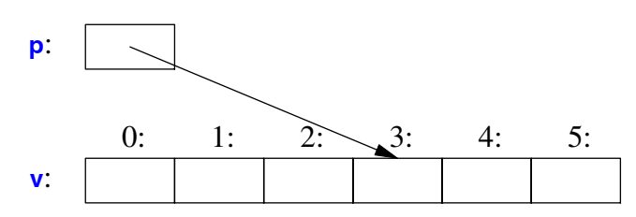
Pointers
A pointer variable can hold the address of an object of the appropriate type:
char∗ p = &v[3]; // p points to v’s four th element
char x = ∗p; // *p is the object that p points to when declaring a pointer ∗ means “pointer to”.
In an expression, prefix unary ∗ means ‘‘contents of’’ and prefix unary & means ‘‘address of.’’ We can represent the result of that initialized definition graphically:

Slide 20
Pointers
A pointer always points to an object, so that dereferencing it is valid. When we don’t have an object to point to or if we need to represent the notion of ‘‘no object available’’ (e.g., for an end of a list), we give the pointer the value nullptr (‘‘the null pointer’’):
double∗ pd = nullptr; Link<Record>∗ lst = nullptr; // pointer to a Link to a Record int x = nullptr; // error : nullptr is a pointer not an integer It is often wise to check that a pointer argument that is supposed to point to something, actually points to something (See program 05).

Slide 21
User-Defined Types

Slide 22
Structures
The first step in building a new type is often to organize the elements it needs into a data structure, a struct:
struct Vector { int sz; // number of elements double∗ elem; // pointer to elements
};
We must give v some elements to point to. For example, we can construct a Vector like this:
void vector_init(Vector& v, int s) { v.elem = new double[s]; // allocate an array of s doubles v.sz = s; }

Slide 23
Structures
In vector_init, v’s elem member gets a pointer produced by the new operator and v’s size member gets the number of elements.
The & in Vector& indicates that we pass v by non-const reference; that way, vector_init() can modify the vector passed to it. The new operator allocates memory from an area called the free store (also known as dynamic memory and heap).
Take a look at the program 06_structures.cpp to see a basic aplication of the Vector structure.

Slide 24
Classes
Having the data specified separately from the operations on it has advantages, such as the ability to use the data in arbitrary ways.
A tighter connection between the representation and the operations is needed for a user-defined type to have all the properties expected of a ‘‘real type.’’
To do that we have to distinguish between the interface to a type (to be used by all) and its implementation (which has access to the otherwise inaccessible data).
The language mechanism for that is called a class.

Slide 25
Classes
A class is defined to have a set of members, which can be data, function, or type members.
The interface is defined by the public members of a class, and private members are accessible only through that interface, see the program 07_classes.cpp.
Given the class Vector from the example, we can define a variable of our new type Vector as follows:
Vector v(6); // a Vector with 6 elements

Slide 26
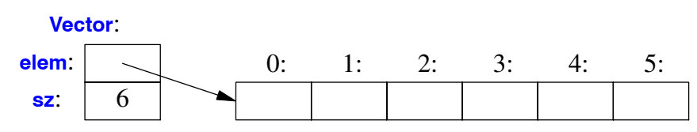
Classes
We can illustrate a Vector object graphically:
Basically, the Vector object is a ‘‘handle’’ containing a pointer to the elements (elem) plus the number of elements (sz).
The number of elements (6 in the example) can vary from Vector object to Vector object, and a Vector object can have a different number of elements at different times.

Slide 27
References
[1] Stroustrup, Bjarne (2012-12-09). "The C++ Programming Language (Fourth Edition)”

