Slide 1
AT
AiTask
From Manual Operations
to Digital Transformation
Fragmented
operations
Shared
workflows
The AiTask journey: connecting people, processes and management
Connected
data
A business transformation case study
Better
behaviour
AiTask
Structure / Process / Applications / Data / Behaviour
Notes:
Main point: Digital transformation changes how the organization operates, not just where it stores information.
Practical example: A company moves from scattered messages and manual follow-ups to one shared operational rhythm through AiTask.
Lesson for Malaysian SMEs: Start with the operating model and the daily work, then choose the technology that makes the model easier to run.

Slide 2
AT
AiTask
02
THE OPERATING MODEL
Digital transformation is a progression
The value increases when technology changes the workflow, not just the format.
01
02
03
Digitization
Digitalization
Digital transformation
Paper task lists become spreadsheets.
Tasks move into an online workflow.
The company works through connected roles, processes and data.
Information becomes digital.
Existing work becomes easier to coordinate.
The operating model changes.
AiTask case study
Management, departments and staff operate through one coordinated project and task system.
Notes:
Main point: Digitization, digitalization and transformation describe different levels of change.
Practical example: Moving a paper list into a spreadsheet is useful, but it does not clarify ownership or review responsibilities.
Lesson for Malaysian SMEs: For an SME, the question is whether the system makes the business easier to run, not whether the business has adopted a new tool.

Slide 3
AT
AiTask
03
FIRST PRINCIPLES
Start with the organization, not the software
A digital system should reflect how the organization needs to operate.
Organizational structure
1
Why does the organization operate this way?
Responsibilities and decisions
2
Who owns each decision?
Operational workflows
3
What information does each role need?
Digital applications
4
Where does information originate and move?
Connected data
5
What behaviour should the system make easier?
Working behaviour
The design sequence matters.
Notes:
Main point: First principles thinking reduces the risk of choosing software before understanding the operating model.
Practical example: AiTask begins with role relationships and responsibility boundaries, then turns those into workflows.
Lesson for Malaysian SMEs: SMEs get better digital outcomes when they make ownership and information flow explicit before configuring a platform.

Slide 4
AT
AiTask
04
LAYER 1: STRUCTURE
Structure creates clarity
The system starts with the people who own the work.
BK
Boss Koo
Company-wide visibility
PM
Project Manager
Owns project direction
H
HOD
Owns departmental execution
PM → Department → HOD → Staff
Clients sit in the business context. Ownership stays inside the operating team.
S
Staff
Executes assigned work
Notes:
Main point: Structure defines authority, ownership and reporting relationships.
Practical example: AiTask reflects a practical SME hierarchy where the PM routes work to a department, the HOD coordinates execution, and staff complete the work.
Lesson for Malaysian SMEs: Make the ownership model visible. A digital system cannot repair an operating model that nobody has defined.

Slide 5
AT
AiTask
05
LAYER 2: PROCESS DESIGN
Business discovery reveals the real work
The first deliverable is understanding how work actually moves.
1
Listen
2
Observe
3
Map
4
Define
Interview management and department leads
Follow daily work and repeated handoffs
Identify approvals, bottlenecks and information flow
Agree what good execution should look like
Representative SME challenge
Tasks arrive through WhatsApp, email and verbal instructions. The issue is not a lack of communication. It is a lack of one connected process.
Notes:
Main point: Process design starts with discovery, not configuration.
Practical example: A marketing deliverable may move from a PM to a HOD to a designer, then back for review. Mapping that reality exposes where the workflow needs clarity.
Lesson for Malaysian SMEs: Treat the existing business as the source of truth. The system should simplify it without hiding the accountability behind it.

Slide 6
AT
AiTask
06
WHY FIRST PRINCIPLES MATTERS
The design approach determines the outcome
Both approaches may use existing software. The difference is where the design begins.
Conventional implementation
First-principles transformation
1
Identify a problem
1
Understand structure
2
Purchase software
2
Define responsibilities
3
Configure it
3
Redesign workflows
4
Ask employees to use it
4
Build or integrate applications
5
Discover workflow gaps
5
Use data to improve behaviour
AiTask follows the second sequence.
Notes:
Main point: First principles is a design method, not a requirement to build everything from scratch.
Practical example: AiTask could use existing components or integrate future applications, as long as the result fits the organization’s responsibility and process model.
Lesson for Malaysian SMEs: The decision is about fit and operating logic. Custom software is not automatically better, and off-the-shelf software is not automatically wrong.

Slide 7
AT
AiTask
07
LAYER 3: APPLICATIONS
The operating model becomes a digital workflow
AiTask translates role relationships into repeatable actions.
PM
Department
HOD
Staff
Review
Complete
Creates task
Receives work
Assigns staff
Performs work
Checks output
Records result
Technology supports the organizational structure. It does not erase the roles that make the process accountable.
Notes:
Main point: AiTask is a practical example of structure becoming workflow.
Practical example: A PM selects the responsible department, the HOD assigns staff, staff performs the work, and review actions remain visible.
Lesson for Malaysian SMEs: Start with the sequence of work. Then decide which parts the system should automate, record or surface to the next role.

Slide 8
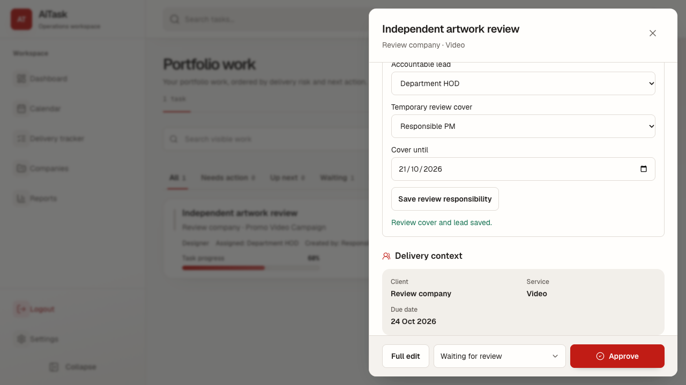
AT
AiTask
08
WORKFLOW SIMPLIFICATION
Users take actions. The system manages states
A good workflow makes the next useful action obvious.
Start task
→
In progress
Send for review
→
Awaiting review
Request revision
→
Needs action
Approve
→
Completed
Example: review responsibility is visible in the task context.
Illustrative AiTask interface
Notes:
Main point: Workflow simplicity helps adoption because people can focus on the next action rather than internal status logic.
Practical example: AiTask uses actions such as start, send for review and approve to move work through a configured lifecycle.
Lesson for Malaysian SMEs: Hide unnecessary complexity from employees. Keep the system’s rules explicit enough to preserve accountability and history.

Slide 9
AT
AiTask
09
CROSS-DEPARTMENT COLLABORATION
One project can coordinate multiple departments
Digital transformation breaks information silos without removing accountability.
Content
Video
Brief and copy
Short-form edit
Marketing project
One shared outcome
Design
PM / client
Visual assets
Direction and review
Shared project context / Department ownership / Clear review path
Notes:
Main point: Cross-department collaboration works when the shared project context is visible but responsibility remains local.
Practical example: A marketing project can route content, design and video tasks to separate departments while the PM keeps the project outcome in view.
Lesson for Malaysian SMEs: Use one account and one project context where useful, but preserve the department boundaries that make ownership clear.

Slide 10
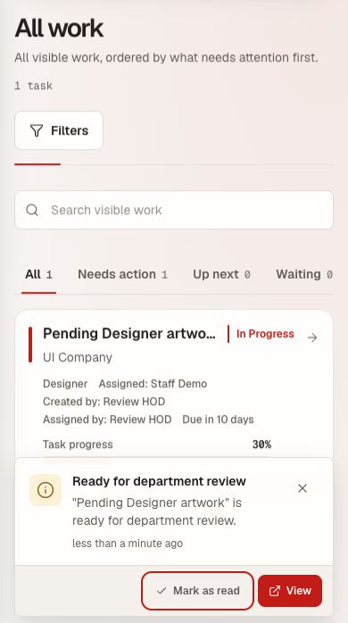
AT
AiTask
10
OPERATIONAL COMMUNICATION
Notifications replace repeated follow-ups
The right information reaches the right person at the right time.
Before
After
• Manager asks for an update
• Employee searches messages
• Review request may be missed
• Assignment notification
• Review request
• Revision or deadline update
Manual follow-up
Action-based updates
AiTask evidence
Notes:
Main point: Notifications turn workflow events into timely prompts instead of relying on memory and repeated messaging.
Practical example: A review-ready task can surface an in-app alert with the task name, timing and a direct action.
Lesson for Malaysian SMEs: Use alerts to reinforce the process. Notifications should point people to useful work, not create a second stream of noise.

Slide 11
AT
AiTask
11
ONGOING BUSINESS COMMITMENTS
Recurring services become structured operations
A monthly service is a cycle of commitments, not a pile of unrelated tasks.
Service plan
Operational memory
Renewal
Monthly cycle
• Previous deliverables remain visible
• Deadlines connect to the monthly plan
• Review and renewal history stays together
Review
Deliverables
Tasks
Notes:
Main point: Recurring service plans connect daily work to ongoing client commitments.
Practical example: A monthly social media service can create a cycle of deliverables, tasks, reviews and renewal decisions.
Lesson for Malaysian SMEs: The SME gains consistency without rebuilding the entire coordination process every month.

Slide 12
AT
AiTask
12
LAYER 3: MODULARITY
One organizational foundation, multiple applications
AiTask can be one operational application within a broader digital ecosystem.
AiTask
CRM
Project + task work
Client context
Shared organizational
foundation
Users / roles / departments / authorization
HR
Finance
People records
Commercial tracking
Documents
AI automation
Shared records
Future opportunity
Potential integrations, not existing AiTask features
Notes:
Main point: Modularity means applications share the organizational foundation without forcing every function into one oversized product.
Practical example: AiTask can remain focused on projects and tasks while future HR, CRM, finance or document applications exchange authorized data.
Lesson for Malaysian SMEs: Build reusable foundations first. Add applications when the business need is clear, not because a platform can theoretically do everything.

Slide 13
AT
AiTask
13
LAYER 4 → 5: DATA TO BEHAVIOUR
From operational data to organizational behaviour
Data matters when it helps people make a better next decision.
Activity
Insight
Behaviour
Staff completes a task
A recurring delay becomes visible
Assignments become clearer and intervention happens earlier
Data
Decision
Improvement
Completion time, history and result are recorded
PM and HOD adjust allocation or timing
The next project benefits from the change
Avoid using employee monitoring or punitive scoring as the primary example.
Notes:
Main point: Connected data should improve decisions and behaviours, not become surveillance for its own sake.
Practical example: If a workflow repeatedly stalls at review, the PM and HOD can adjust allocation, timing or the review rule.
Lesson for Malaysian SMEs: Choose data that serves an operational purpose, protect it with permissions and governance, and connect it to a decision people can act on.

Slide 14
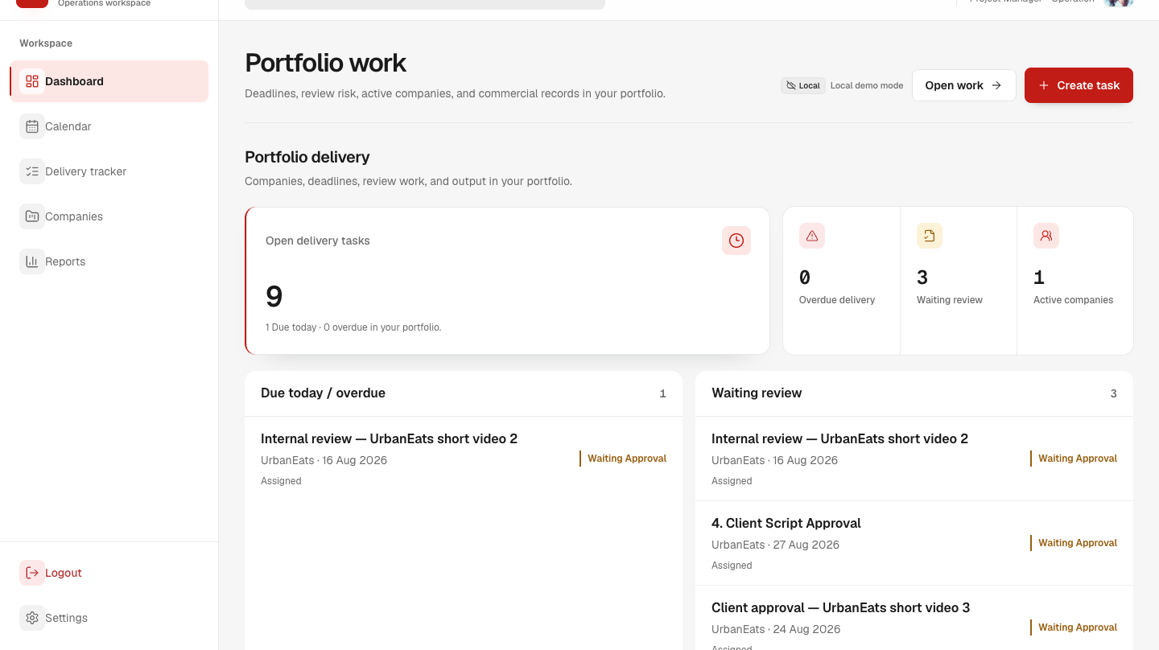
AT
AiTask
14
LAYER 4: VISIBILITY
One operational record, different management questions
The same data becomes useful at different levels of the organization.
Staff
What should I work on today?
HOD
Which tasks need assignment or review?
PM
Which projects need attention?
Boss Koo
Where are delays or workload risks?
Role-based dashboards
Illustrative dashboard view
Notes:
Main point: Management visibility comes from structured operational records presented to the right role.
Practical example: A staff member needs today’s work, while a PM needs project health and Boss Koo needs company-wide attention points.
Lesson for Malaysian SMEs: Do not give every user every detail. Give each role enough context to make the next responsible decision.

Slide 15
AT
AiTask
15
LAYER 6: IMPROVEMENT
Connected data needs governance and feedback
Better processes create better data. Better data enables better decisions. The loop continues.
Better data
Better decisions
Better processes
Better behaviour
Better processes
Governance: collect data for a clear operational purpose, with appropriate permissions, privacy and accountability.
Notes:
Main point: Continuous improvement needs a feedback loop and guardrails for data use.
Practical example: A recurring delay can trigger a workflow simplification, a change in workload distribution or a targeted automation.
Lesson for Malaysian SMEs: Treat data quality and privacy as part of the operating model. The goal is improvement, not collection for its own sake.

Slide 16
AT
AiTask
16
FROM DESIGN TO ADOPTION
The implementation journey is iterative
AiTask develops as the organization learns what needs to be clearer, faster or safer.
1
3
5
Process discovery
Platform development
Management intelligence
Roles and current work
Projects, tasks and access
Visibility and dashboards
2
4
6
Workflow design
Operational integration
Stabilization and adoption
Delegation and approval rules
Reviews, notifications and cycles
Testing, permissions and daily use
Iteration is part of the method, not a sign that the transformation failed.
Notes:
Main point: Transformation stabilizes through repeated design, implementation, testing and adoption.
Practical example: AiTask examples include refining PM to HOD delegation, simplifying task statuses, improving HOD permissions and making notifications more visible.
Lesson for Malaysian SMEs: Expect the first operating version to teach the organization where rules are unclear. Use that learning to improve the system deliberately.

Slide 17
AT
AiTask
17
INTENDED OPERATIONAL IMPROVEMENTS
The operating model changes in practical ways
The comparison below describes intended improvements, not measured outcomes.
Business area | Before | After
Task assignment | Messages and verbal instructions | Structured delegation
Responsibility | Sometimes unclear | Role-based ownership
Progress tracking | Manual follow-ups | Centralized task tracking
Approval | Scattered communication | Recorded workflow
Notifications | Manual reminders | Automated in-app alerts
Monthly services | Repeated manual coordination | Structured monthly cycles
Management reporting | Manual consolidation | Operational dashboards
Historical records | Scattered information | Centralized audit history
Representative case-study framing; validate outcomes with client data before making performance claims.
Notes:
Main point: Digital transformation shows up in daily operating choices: who owns work, how progress is seen and how history is retained.
Practical example: The table contrasts manual coordination with structured delegation, review history, in-app alerts and operational dashboards.
Lesson for Malaysian SMEs: Use the comparison as a design target. Measure outcomes later rather than presenting intended improvements as verified results.

Slide 18
AT
AiTask
Digital transformation is the redesign of how an organization operates
Structure creates clarity. Processes create consistency. Applications enable execution. Data creates visibility. Behaviour creates lasting transformation.
Structure
Process
Applications
Data
Behaviour
Improvement
Digital transformation succeeds when technology becomes part of how people naturally work, rather than another system they are forced to manage.
AiTask case study
Notes:
Main point: The conclusion returns to the design philosophy: structure to process to applications to data to behaviour to improvement.
Practical example: AiTask demonstrates how a focused operational platform can help a company make responsibility, progress and review part of normal work.
Lesson for Malaysian SMEs: The long-term goal is a more connected, accountable organization, with technology supporting the way people already need to work.

