Slide 1
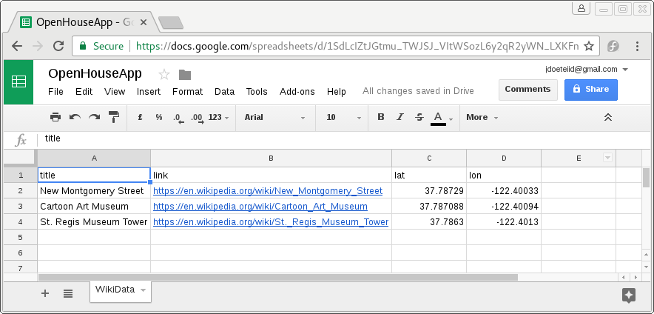
Google Spreadsheet Export
Add new line to google spreadsheet
INSERT INTO WikiData VALUES (‘St. Regis Museum Tower’, ‘https://...’)

Slide 2
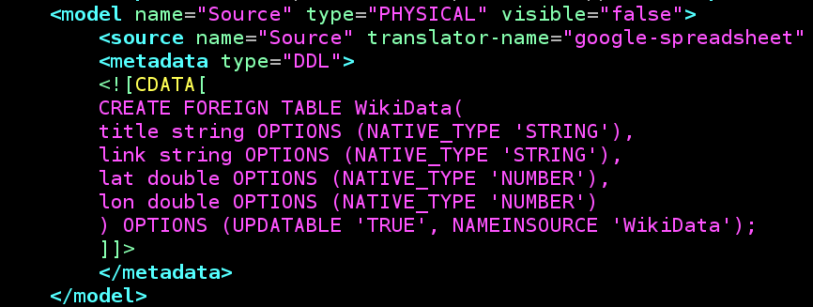
Google Spreadsheet Export

Slide 3
Google Spreadsheet Export
Server configuration
<resource-adapter id="gs-export">
...
<connection-definitions>
<connection-definition jndi-name="java:/gs-export" enabled="true" use-java-context="true" pool-name="gs-export">
...
<config-property name="RefreshToken">
1/I7E2bY1sarocXXX
</config-property>
<config-property name="SpreadsheetName">
OpenHouseApp
</config-property>
...
</connection-definition>
</connection-definitions>
</resource-adapter>
Credential which enables DV server to access user’s spreadsheet
Name of user’s spreadsheet

