Slide 1
生物資訊 期末專題
資工碩一 60547047S 羅天宏
資工碩一 60547052S 林奕儒
資工大四 40247043S 劉慈恩

Slide 2
大綱
使用的database
系統介紹
功能demo

Slide 3
Database
The GO database is generated from the most recent version of the ontology and the annotation files contributed by members of the GO Consortium.
There are a number of different sets of data available for download.
This build is NOT manually checked; the build is automated, and there is always a small possibility that problems could arise during the build process.

Slide 4
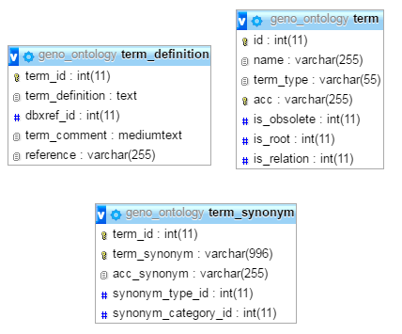
Database

Slide 5
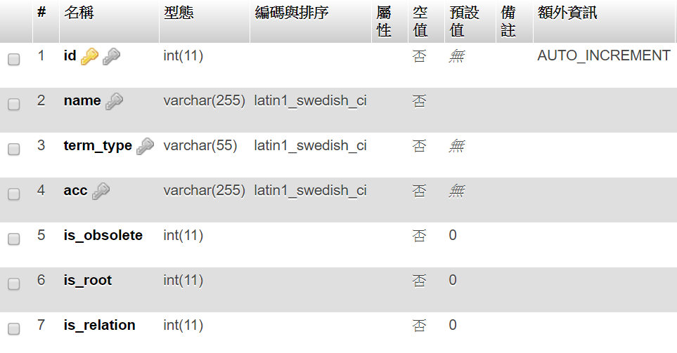
Database

Slide 6
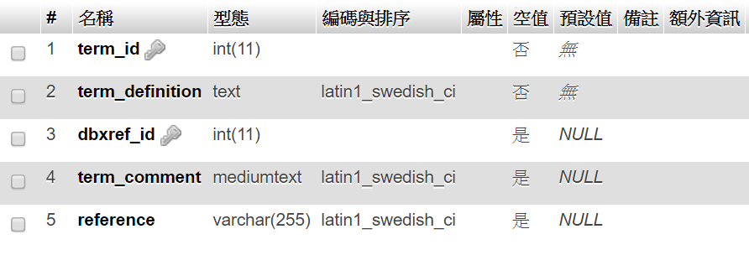
Database

Slide 7
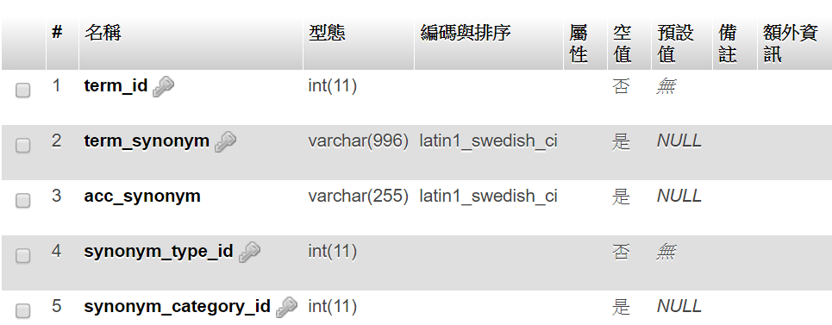
Database

Slide 8
系統介紹
PHP 5.6.25
MySQL 5.7.14
Apache 2.4.23

Slide 9
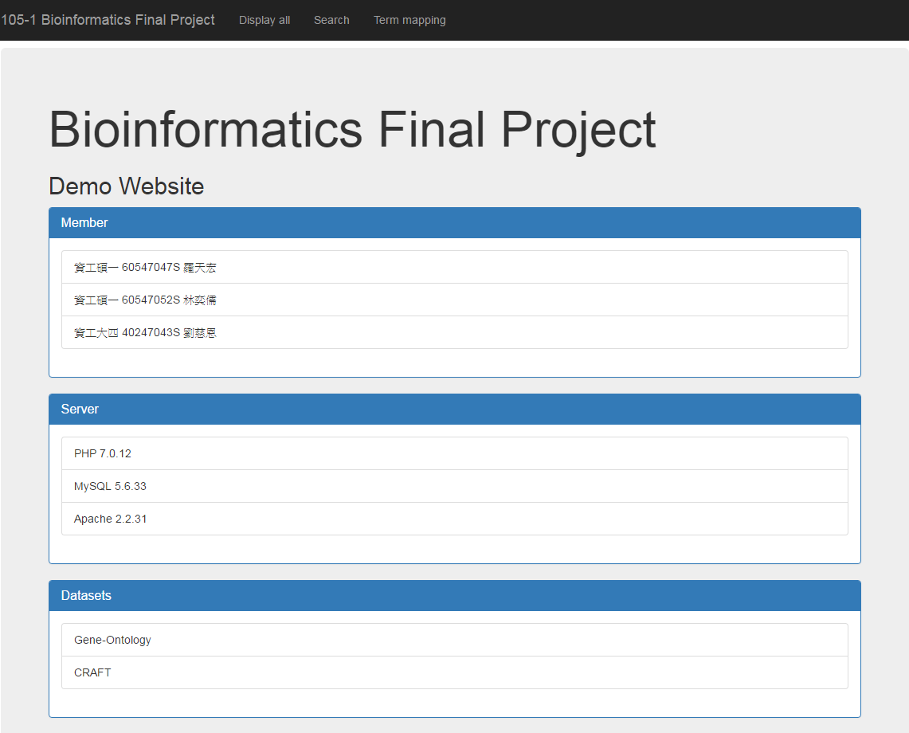
系統介紹

Slide 10
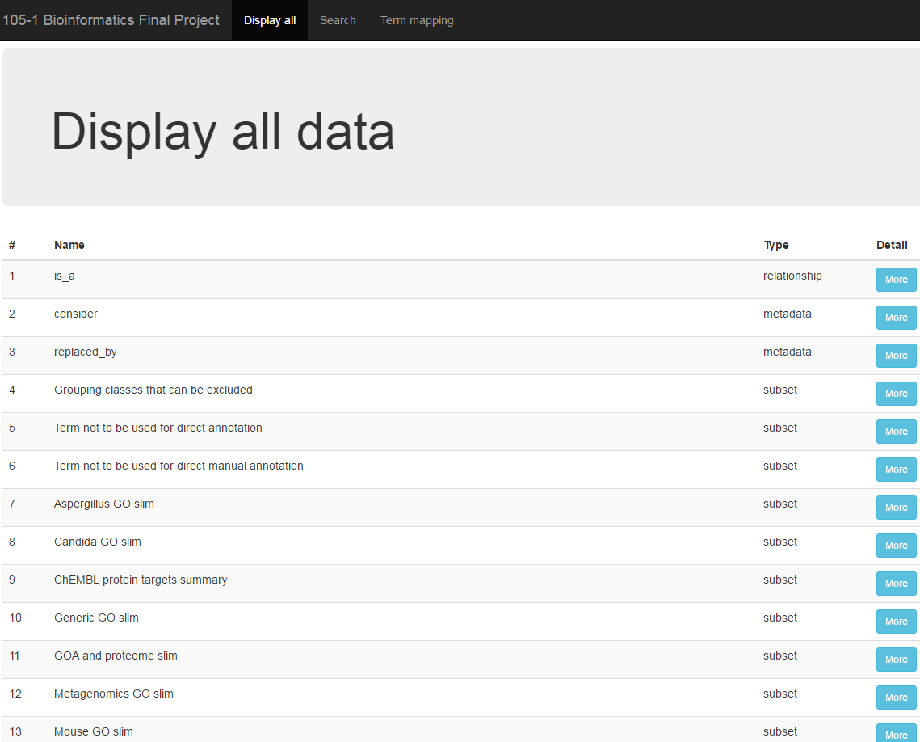
系統介紹

Slide 11
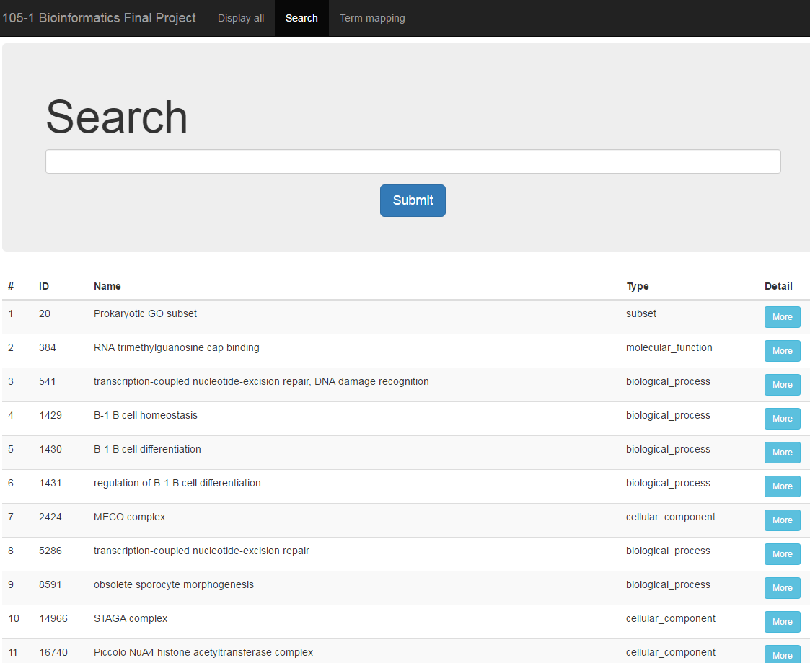
系統介紹

Slide 12
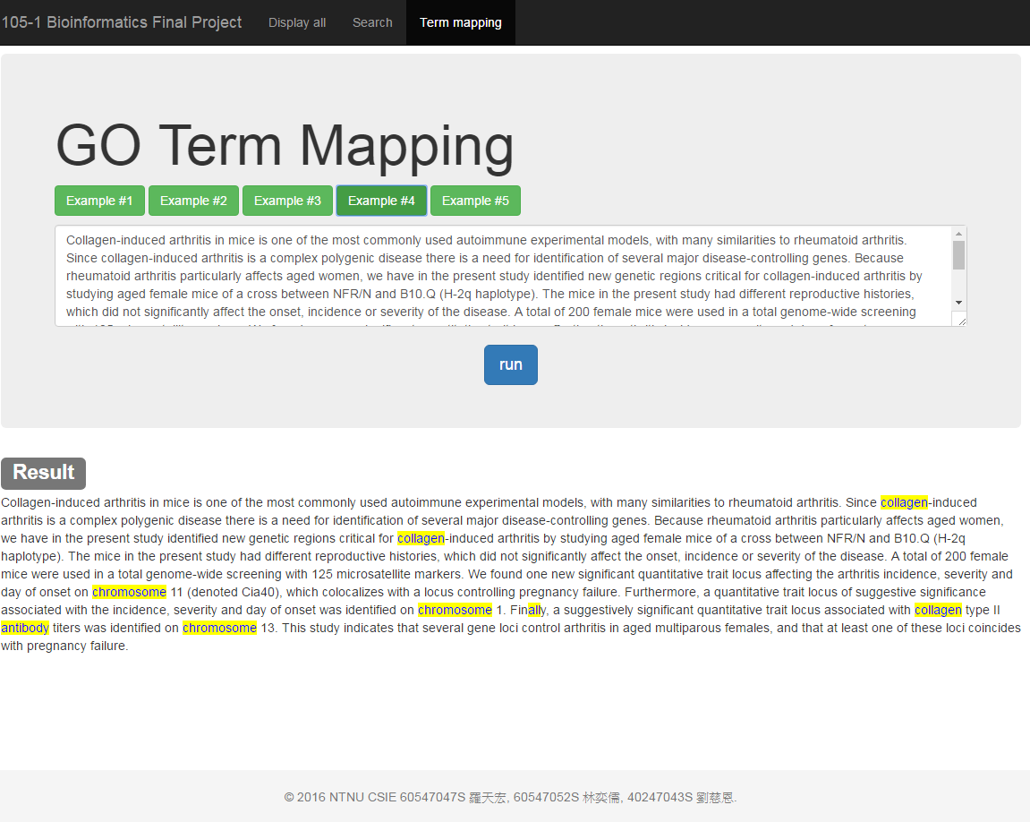
系統介紹

Slide 13
功能demo

