Slide 1
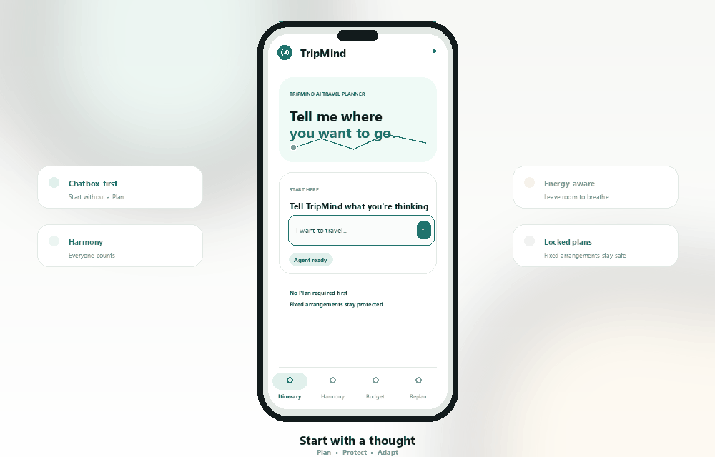
PRODUCT PRESENTATION
Travel planning
that works in
real life
A plan that works for everyone and keeps working when circumstances change.
Plan the trip. Protect the experience.
Rough idea to protected, explainable, approvable itinerary
Problem statement · Core features · Explainable workflow
TripMind · Problem to decision layer to protected itinerary
TRIPMIND
Notes:
TripMind turns a rough travel idea into an itinerary that a group can understand, adjust and approve. It keeps the plan usable as preferences, constraints and conditions change.
Source: README.md; visual asset: public/tripmind-product-flow.gif (first frame).

Slide 2
PROBLEM STATEMENT
02 / 05
Travel planning is scattered across tools
More information does not make a plan executable once people, time, budget and weather enter the picture.
01
Unclear starting point
The user may only know “I want to travel” and still not know what to answer next.
Context gets lost between tools
02
Group conflict
A group average can hide a member’s dietary or mobility constraint.
Destination search
Group chat
Budget sheet
Itinerary edits
Rebuild from scratch
Any change can ripple through the whole day.
03
Energy and budget stay hidden
Maps show distance, not whether a full day is comfortable or how much budget remains.
TripMind · The plan must survive real life
TRIPMIND
Notes:
Travel planning is split across research, group chat, budgets, maps and itinerary tools. Preferences get buried, average scores can hide dietary or mobility constraints, and distance alone does not show whether a day is too tiring.
When rain or delays happen, travelers often rebuild the plan manually. TripMind connects these decisions in one flow.
Source: README.md, sections “The Problem TripMind Solves” and “Who It Is For”.

Slide 3
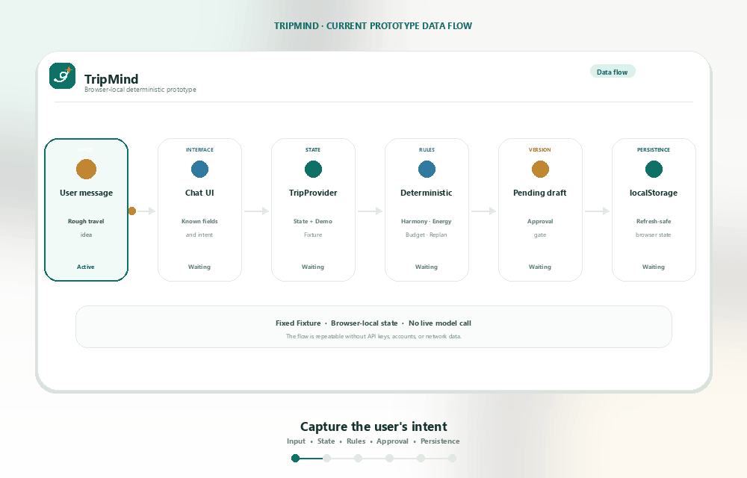
PRODUCT THESIS
03 / 05
TripMind is an explainable decision layer
AI handles intent and explanation. Deterministic logic validates. The user confirms before a change is written.
A one-off chat reply becomes a TripState that the traveler can keep editing.
Three responsibilities
A
Understand intent
The Agent extracts known details and asks only what blocks generation.
B
Validate constraints
The system checks time, distance, buffers, budget, opening hours and member limits.
C
Write with approval
A Pending draft shows the Experience Diff before approval creates the next version.
TripMind · Stateful workflow, not a one-time answer
TRIPMIND
Notes:
TripMind combines a conversational agent with planning rules. The agent understands natural language, organizes options and explains trade-offs. The rules check time, distance, transfers, budget, opening hours, fixed bookings and traveler constraints.
Every major change creates a Pending draft. Experience Diff shows the impact, and approval creates the next version. The current plan stays safe.
Source: README.md, sections “Product Overview”, “Explain before apply”, “Constraint-aware itinerary planning”, and “Agent Scope and Safety”; visual asset: public/tripmind-data-flow.gif (first frame).

Slide 4
CORE FEATURE 01
04 / 05
Start with one sentence, then confirm what matters
The Chatbox is the entry point. Requirement Clarifier and Itinerary Planner turn an idea into an executable itinerary.
The first two questions
01
Destination
For example: Penang
02
Date or trip length
For example: 3 days
Interests, travelers and pace can come later. The system labels defaults clearly.
Start with a thought
Rough idea to requirement review to structured itinerary
TripMind · Understand first, generate second
TRIPMIND
Notes:
Chatbox-first planning lets users begin with a sentence such as “I want to travel,” or provide a destination and trip length. TripMind extracts known information and asks only for the essentials that are still missing.
Requirement Clarifier makes the current requirements visible. It shows what the system knows, what needs confirmation and which values can use defaults. Itinerary Planner then turns the confirmed requirements into a structured plan with timing, movement, cost and buffers.
Source: README.md, sections “Chatbox-first planning”, “How to Use TripMind”, and “Complete Capability Map”; visual asset: public/tripmind-product-flow.gif (first frame).

Slide 5
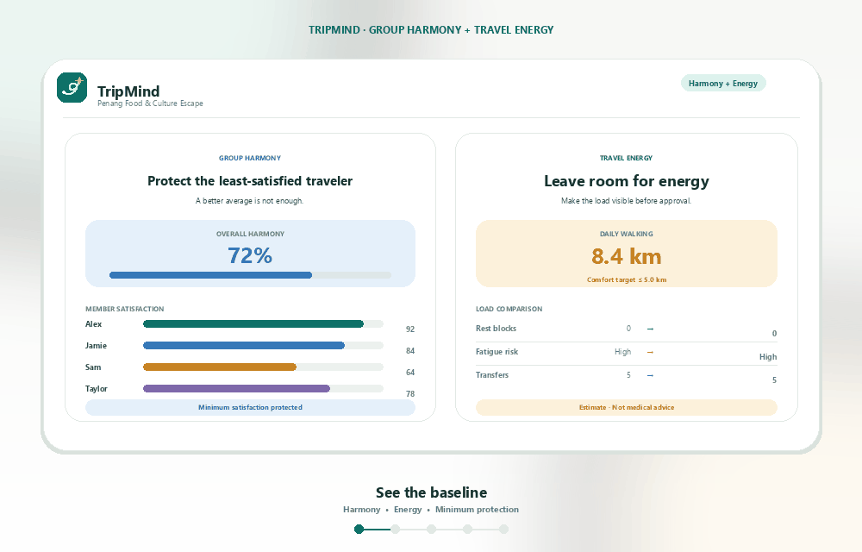
CORE FEATURES 02–03
05 / 05
Harmony and Energy make trade-offs visible
A strong average score is not enough. The plan must work for every traveler.
GROUP HARMONY
Protect the least-satisfied traveler
Harmony shows the overall score, satisfaction by traveler, unresolved conflicts and the reasons for each adjustment. It protects the least-satisfied traveler.
TRAVEL ENERGY
Make physical load part of the decision
Energy compares walking, activity density, transfers, rest blocks, early starts, late finishes and fatigue risk. These are planning estimates, not medical advice.
Baseline planning view
TripMind · Protect the outlier, leave room for energy
TRIPMIND
Notes:
Harmony makes group trade-offs visible. It shows the overall score, satisfaction by traveler, unresolved conflicts and the reasons behind each adjustment. A single average should not hide a constraint or leave one traveler consistently dissatisfied.
Energy makes physical load part of the planning decision. It compares walking, activity density, transfers, rest blocks, early starts, late finishes and fatigue risk. The group can see the cost of a more comfortable plan before choosing.
Source: README.md, sections “Group Harmony” and “Travel Energy”; visual asset: public/tripmind-harmony-energy.gif (first frame).

