Slide 1
Creare Grafici e Diagrammi
5

Slide 2
Excel Charts
5

Slide 3
Grafici (Charts)
Charts are visual representations of data used to make it more understandable.
Commonly used charts are:
Pie chart
Column chart
Line chart
Different charts are used for different types of data.

Slide 4
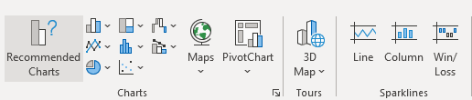
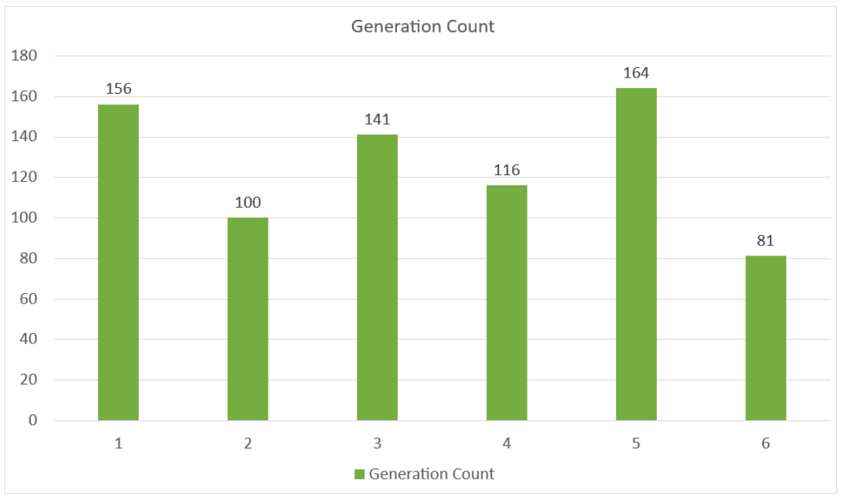
Grafici – Primi esempi
MENU: Insert > Charts

Slide 5
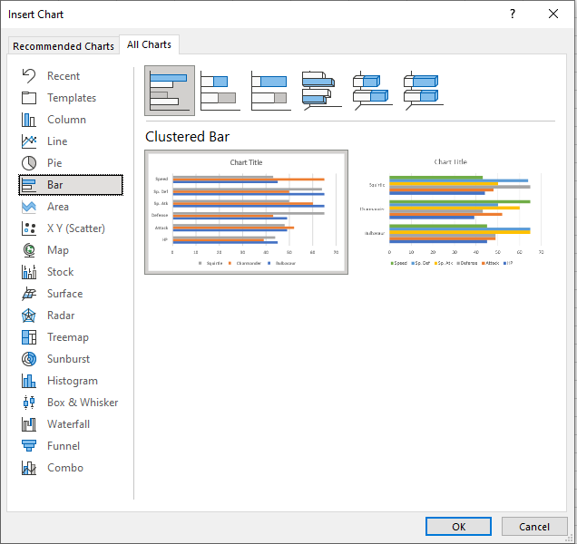



Clustered Bar Charts
There are three different type of bar charts:
Clustered bar( )
Stacked bar( )
100% Stacked bar( )

Slide 6
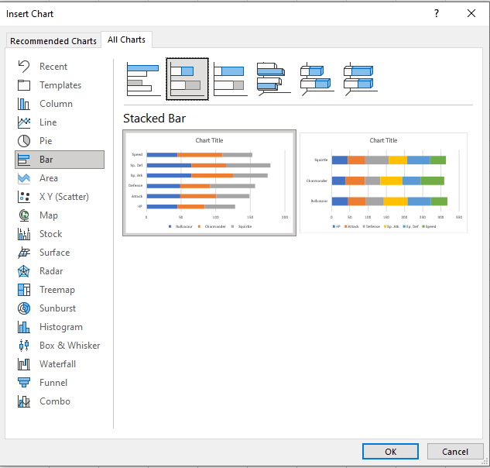
Stacked Bar Charts
Stacked bar charts are used to highlights the total amount of contribution for each category (absolute value).
This is done by stacking the bars at the end of each other.
The charts are used when you have more than one
data column.

Slide 7
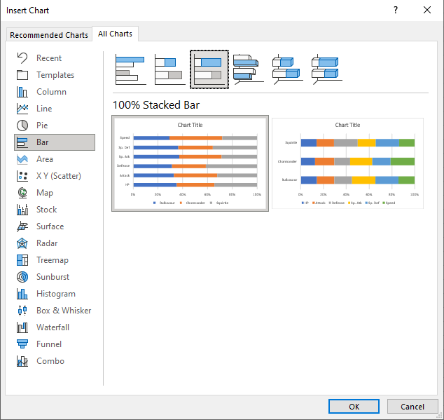
100% Stacked Bar Charts
Stacked bar charts are used to highlights the total amount of contribution for each category referred on 1-100% scale.
This is done by % stacking the bars referred to a total of 100
The charts are used when you have more than one
data column.

Slide 8
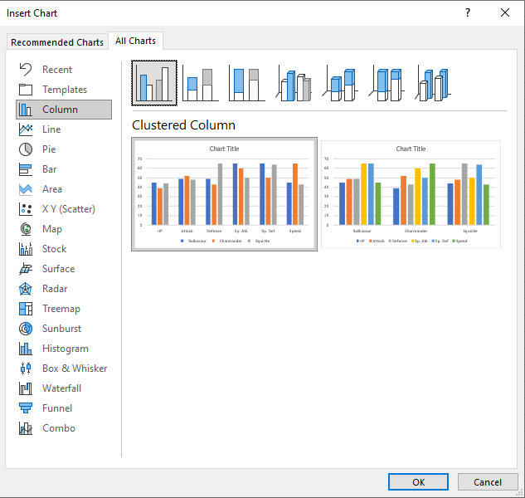



Clustered Column Chart
Column charts show the data as vertical bars.
Excel has three different types of column charts:
Clustered column( )
Stacked column( )
100% Stacked column( )

Slide 9
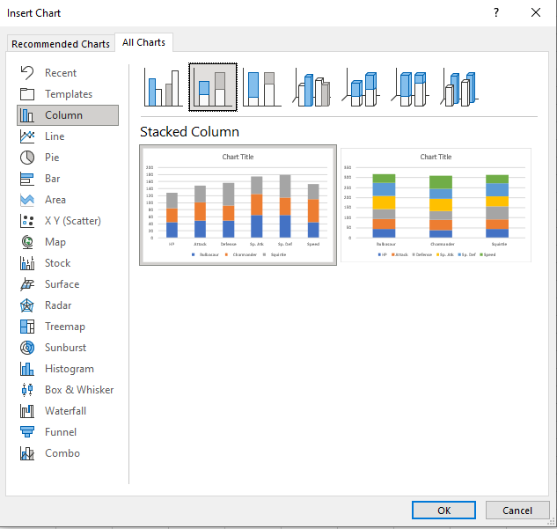
Stacked Column Chart
Stacked Column charts are used to highlights the total amount of contribution for each category.
This is done by stacking columns on top of each other.
The charts are used when you have more than one data column.

Slide 10
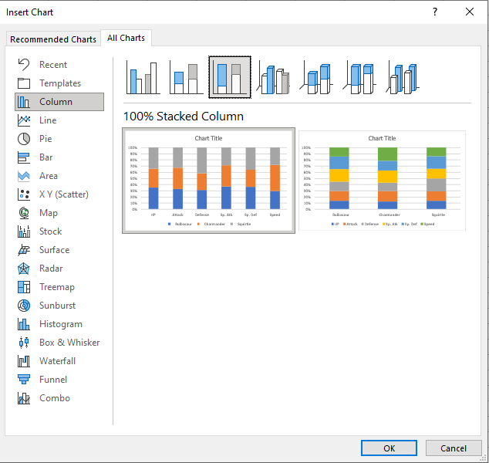
100% Stacked Column Chart
100% Stacked Column is used to highlights the proportion of contribution for each data column in a category.
This is done by scaling the total value of each category in a stacked column chart to 100.
The charts are used when you have more than one data column

Slide 11


Pie Chart
Pie charts arrange the data as slices in a circle.
Pie charts are used for representing values of qualitative (categorical) data.
Pie charts show the contribution of each category to the total.
Excel has two types of pie charts:
2-D pie ( )
Doughnut ( )

Slide 12
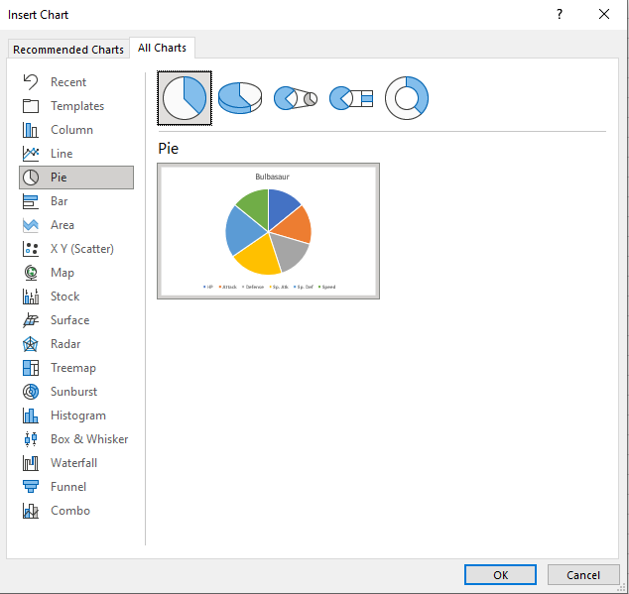
2D Pie Chart
Pie charts arrange the data as slices in a circle.
2-D pie charts are used when you only have one data column.

Slide 13
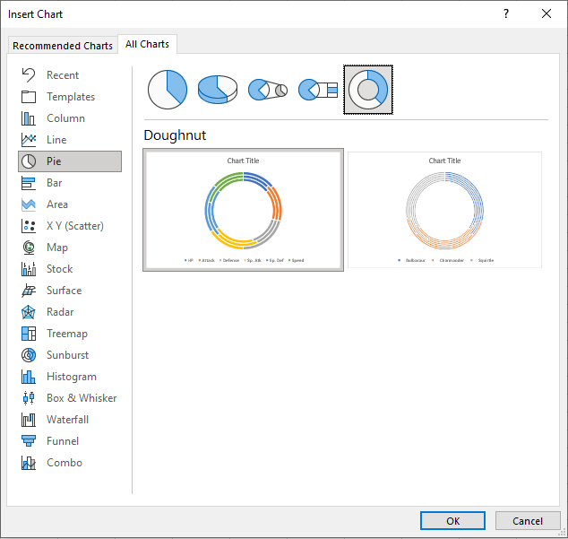
Doughnut Pie Chart
Doughnut charts arrange the data as slices in a circle with hollow center.
Doughnut charts are often used when you have more than one data column.

Slide 14
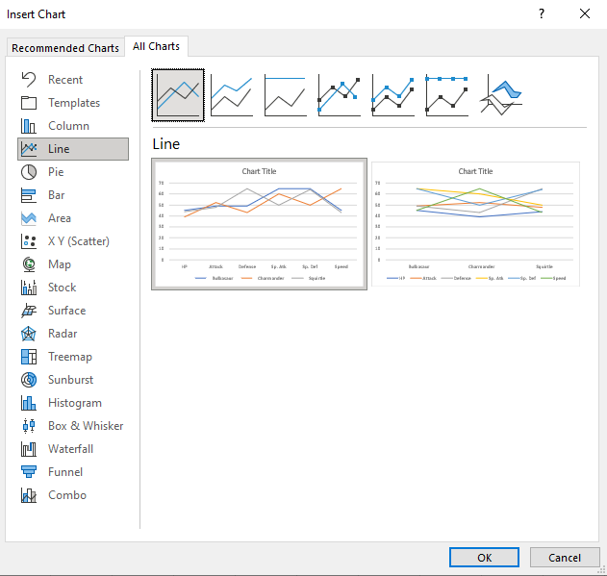
Line Charts
Line charts show the data as a continuous line.
Line charts are typically used for showing trends over time.
In Line charts, the horizontal axis typically represents time. Line charts are used with data which can be placed in an order, from low to high

Slide 15
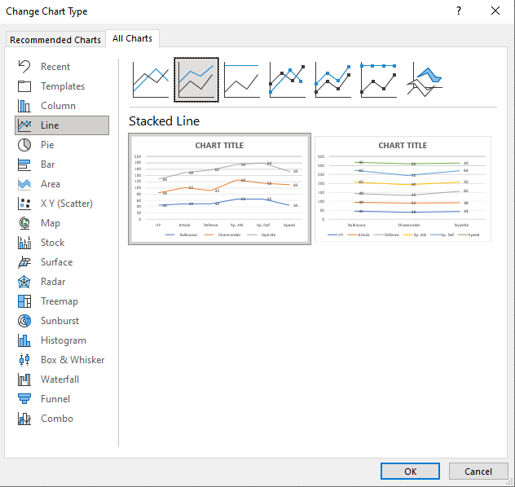
Stacked Line Charts
Stacked Line charts show the contribution to trends in the data.
This is done by stacking lines on top of each other.
Stacked Line charts are used with data which can be placed in an order, from low to high.
The charts are used when you have more than one data column which all add up to the total trend.

Slide 16
Esercizio 5-1
Esercizio sulle BarChart
document27\BarChart.xlsx
document27\BarChart2.xlsx

Slide 17
Esercizio 5-2
Esercizio sulle ColumnChart
document27\ColumnChart.xlsx

Slide 18
Esercizio 5-3
Esercizio sulle LineChart
document27\LineChart.xlsx

Slide 19
Esercizio 5-4
Esercizio sulle PieChart
document27\PieChart.xlsx

Slide 20
Esercizio 5-5
Altro esercizio sulle Charts
document27\Chart_Example.xlsx

