Slide 1


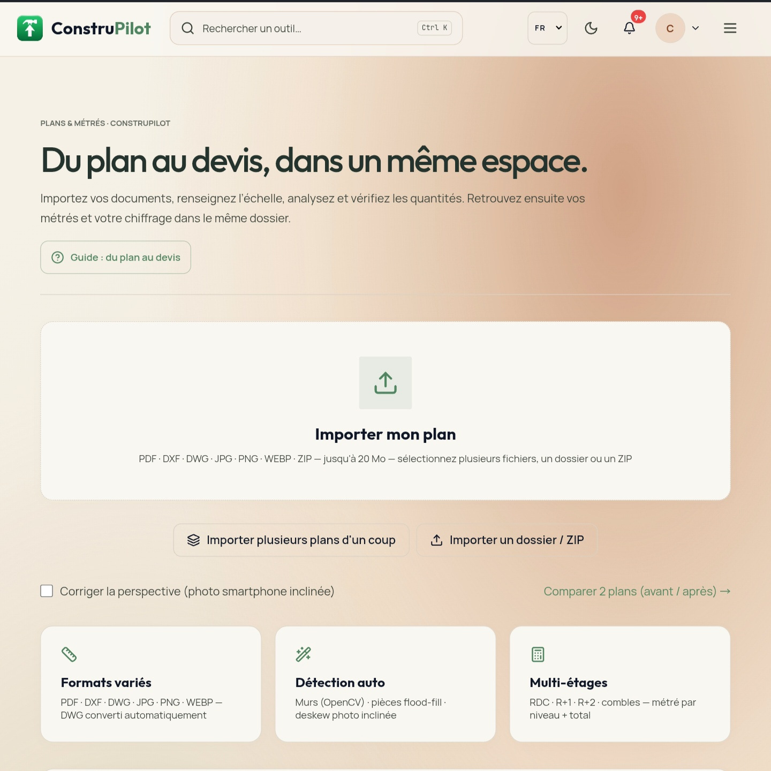
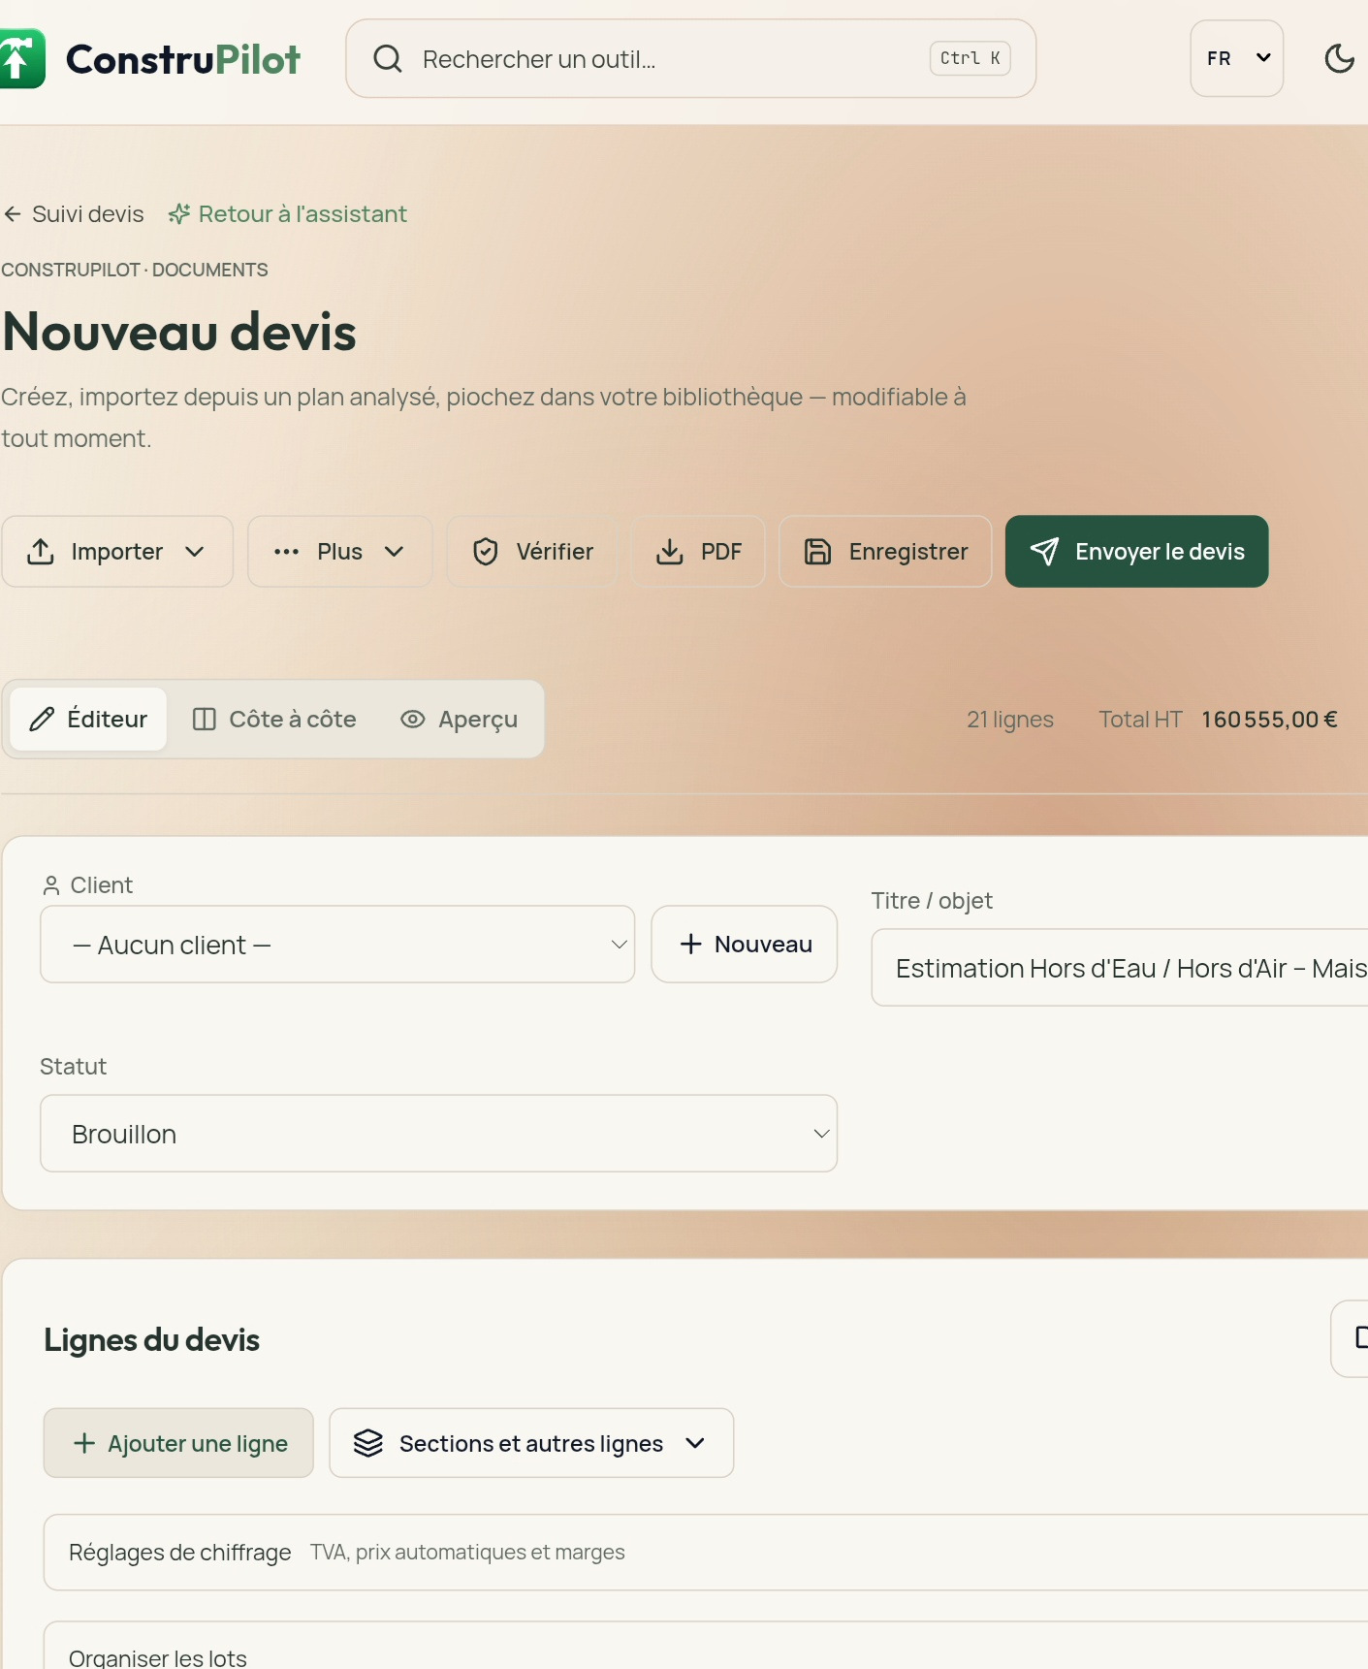
CONSTRUPILOT
From plan to project.
Faster, clearer.
For construction tradespeople and SMEs: plans, quantity take-offs, quotes.
For homeowners: help with building permit applications.
FRANCE · PORTUGAL
Investor presentation · 2026

Slide 2
THE PROBLEM
Tradespeople and SMEs lose time before the job even starts.
In France and Portugal, take-offs and quotes tie up teams; homeowners struggle with permit applications.
01
02
03
LOST DAYS
COSTLY ERRORS
PAPERWORK
Take-offs and quotes prepared by hand, one file at a time.
Quantities and omissions are hard to spot on plans.
Permit applications require gathering and preparing many documents.
Productive time diverted from the site and the client.
Fragile estimates undermine decisions and margins.
An administrative process that is hard for homeowners to follow.
The takeaway: essential, repetitive tasks that are still hard to standardise.
CONSTRUPILOT / PITCH DECK
02 / 12

Slide 3
THE SOLUTION
A digital copilot, from plan to deliverables.
For construction tradespeople and SMEs in France and Portugal, and for homeowners applying for permits.
01
02
03
PLAN
ANALYSIS
DELIVERABLES
Import
architect plans
Automatic reading
and extraction
Take-offs and
priced quotes
TECHNICAL STUDIES
FOR HOMEOWNERS
Structure · Electrical · Plumbing · Thermal
Permit
applications
Preparation support for tradespeople and SMEs — validated by qualified professionals.
A guided path to prepare the paperwork.
Patented technology (FR2611044)
CONSTRUPILOT / PITCH DECK
03 / 12

Slide 4
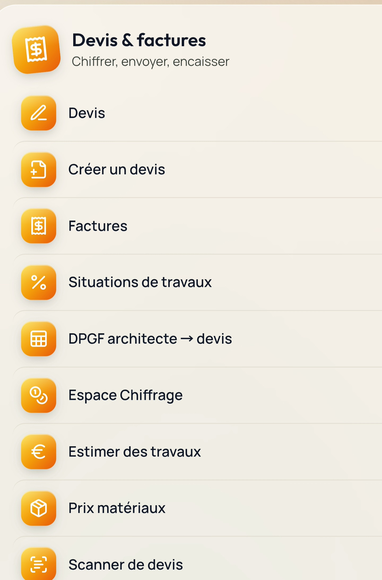
DEMO
The product journey, in three screens.
Real screenshots of the ConstruPilot interface.
1. Import the plan
2. Get the quote
3. A complete suite
CONSTRUPILOT / PITCH DECK
04 / 12

Slide 5
MARKET
An addressable market of construction SMEs.
France and Portugal: about 544,000 target companies; three-year penetration goal.
FR
PT
France
Portugal
€193bn
€39.1bn
BUILDING · 2025 · −6%
CONSTRUCTION TURNOVER · 2024 · +10.2%
€117bn maintenance & renovation · 61% of activity
73% building · 43.6% residential (+16%)
€31bn in energy renovation
Over 114,000 companies
450,000 companies · ~95% micro-businesses
460,000 workers · +7%
Micro-businesses generate nearly half of all activity.
A growing market with an addressable base of companies.
FRANCE · CONSTRUCTION MICRO-BUSINESSES / SMEs
PORTUGAL · CONSTRUCTION
~430,000 micro-businesses · ~95% of 450,000 · renovation / general contractors.
114,000 construction companies (INE 2024).
3-YEAR GOAL · 1% penetration ≈ 5,400 Pro customers out of ~544,000 target companies.
Sources: FFB, Le bâtiment en chiffres 2025 (ffbatiment.fr) · INE, Empresas de Construção 2024 (via Dinheiro Vivo).
CONSTRUPILOT / PITCH DECK
05 / 12

Slide 6
PRODUCT
An offer designed for every project stakeholder.
Four entry points into one shared base of plans, data and collaboration.
01
COMPANY
02
HOMEOWNER
Take-offs & quotes
Project & permits
Built for construction tradespeople and SMEs in France and Portugal.
Helps prepare a prior declaration (DP) or building permit (PC).
03
COLLABORATOR
04
API
Shared work
Integration
Discussions and project items accessible to the whole team.
Access to the product's capabilities for third-party integrations.
CONSTRUPILOT / PITCH DECK
06 / 12

Slide 7
BUSINESS MODEL
Usage-based plans, from homeowners to API.
Professional plans shown excl. VAT · no commitment · 7-day trial.
HOMEOWNERS
PROFESSIONALS · EXCL. VAT
API · PER MONTH
Free
€0
Pro
€149/month
or €1,570/year
Starter
€99
Project Pass
€50 one-off
Pro Business
€249/month
or €2,490/year
Business
€299
Premium
€19/month
or €190/year
Add-ons
Scale
€999
OPTIONS
Invoicing €5/month
3D render €5 · 3D video €10
Invoicing €5/month
3D render €5
3D video €10
Dedicated to integrations.
CONSTRUPILOT / PITCH DECK
07 / 12

Slide 8
TRACTION
A closed beta, already spread across two markets.
All users listed are currently in beta with free access.
55
FRANCE
PORTUGAL
27
28
users
users
USERS
3 professionals
2 Pro Business profiles
Closed beta · free for now
All in beta · free access
All in beta · free access
Next: activation, retention and conversion — metrics to be added once tracking is in place.
CONSTRUPILOT / PITCH DECK
08 / 12

Slide 9
COMPETITION
Established tools, still siloed workflows.
France / Portugal scan — indicative public prices.
FRANCE
PLAYERS / PRICE POINTS
PORTUGAL
PLAYERS / POSITIONING
Quotes /
invoicing
Obat €25–109/mo · Batappli 39–79 · EBP Bâtiment 29–69
Trustup Pro from 49 · BatiChiffrage ~37–42
CYPE
Arquimedes
Spanish desktop software, powerful but technical; the technical reference in Portugal, not aimed at tradespeople.
AI
estimating
Renalto 25–49 · quotes from voice / photo; draft needs review.
Presto
Take-off and budgeting software (RIB), aimed at engineering firms.
Site management
/ ERP
Alobees 40–190 · Vertuoza €2,400–5,000/yr.
General ERPs
Primavera / Cegid and PHC, with site modules.
Plan take-off
(direct)
Quoter Plan · Calculocad · Winbat (Fiducial)
Build2map · Esticom
AI offer
plan → quote
No modern Portuguese-language SaaS for tradespeople was found in our initial scan.
EDGE · Plan take-off + technical studies + deterministic pricing.
EDGE · A simple web and mobile offer versus CYPE.
Patented technology (FR2611044)
CONSTRUPILOT / PITCH DECK
09 / 12

Slide 10
GO-TO-MARKET
Earning trust where construction happens.
Recruit tradespeople and SMEs in France / Portugal, and homeowners for permits.
01
02
03
04
TRADE SHOWS
WEB SUMMIT
TRADE / SME NETWORKS
PARTNERSHIPS
Meet tradespeople and SMEs, demo the product and gather field feedback.
Present our approach to the tech ecosystem and build connections in Portugal.
Share use cases, recruit testers and drive referrals.
Explore construction channels and partners that help homeowners with permits.
Sequence: demo → recruit beta testers → measure usage → convert professionals.
CONSTRUPILOT / PITCH DECK
10 / 12

Slide 11
CONSTRUPILOT
Team
Three complementary profiles serving both target markets.
MA
ÂC
DA
Martinho Araujo
Ângelo Cunha
Diana Araujo
CO-FOUNDER · PRODUCT & TECH · FRANCE
CEO · CO-FOUNDER · PORTUGAL
MARKETING · CUSTOMER RELATIONS
Leads product and tech. Designed and built the platform (patent FR2611044).
Leads business and commercial development in Portugal.
User acquisition, onboarding and follow-up.
20+ years as site manager and works supervisor in construction.
Complementary profiles: product / tech, business and marketing. Trilingual team FR · PT · EN, based in both target markets.
KEY HIRES (FUNDRAISE)
Senior full-stack / AI developer
Construction field sales, France
Customer success, Portugal
CONSTRUPILOT / PITCH DECK
11 / 12

Slide 12
FUNDRAISING
Pre-seed: €200k to €500k.
Funding product development and a repeatable growth engine.
45%
Product & tech, 45%: €90k / €225k
(senior full-stack/AI developer, engine reliability, mobile apps)
TARGET
200–500
k€
25%
Acquisition, 25%: €50k / €125k
(trade shows, digital marketing, partnerships with trade federations)
20%
Pro conversion, 20%: €40k / €100k
(a field salesperson in France, a customer success hire in Portugal)
Pre-seed round
10%
Expansion, 10%: €20k / €50k
(FR/PT structuring via the holding, preparing a 3rd European market)
18–24 months of runway · 5–15% equity
Total 100% · 18-month milestones: 300 paying Pro customers, about €50k MRR, commercial launch in Portugal
Assumption: 300 customers × €167/month average basket ≈ €50k MRR
CONSTRUPILOT / PITCH DECK
12 / 12

