Slide 1

CONSTRUCTION SOFTWARE · FRANCE & PORTUGAL
From the architect's bill
of quantities to final account
Pricing, take-offs, quotes, site tracking and progress invoicing in one tool, built for tradespeople and construction SMEs.
Sales presentation · November 2026

Slide 2
WHY CONSTRUPILOT
Entered once, used all the way to final payment
Today
With ConstruPilot
Quotes typed at night in spreadsheets
Take-offs redone for every plan revision
Architect's bill of quantities priced line by line
Deposits lost when the progress claim is due
Reminders and retentions forgotten
A price library that grows with every job
Measurements taken directly on the PDF or DWG
Bill read, trades detected, prices proposed
Deposit actually received deducted automatically
7-day reminder, final account in one click

Slide 3






THE FULL CHAIN
Six steps, one single base
01
02
03
04
05
06
Price
Bills of quantities
Measure
PDF · DWG · DXF
Sign
Quote, QR, online
Track
Site, client
Invoice
Deposit, progress
Close
Final account
Web, Android and iOS · hosted in the European Union · patent no. FR2611044

Slide 4




1 · PRICING
Price the architect's bill of quantities
Several bills and specifications
Multi-sheet Excel bills and specifications in one study.
Your prices first, AI second
Trades detected; AI only fills unknown lines, with every source tracked.
Plain-language instructions
"Don't price the tiling, 12 % margin" plus alerts on missing items.
Subcontractors compared
Tender per trade, online reply without an account, best price in one click.
Real screenshot of the platform (French version)

Slide 5
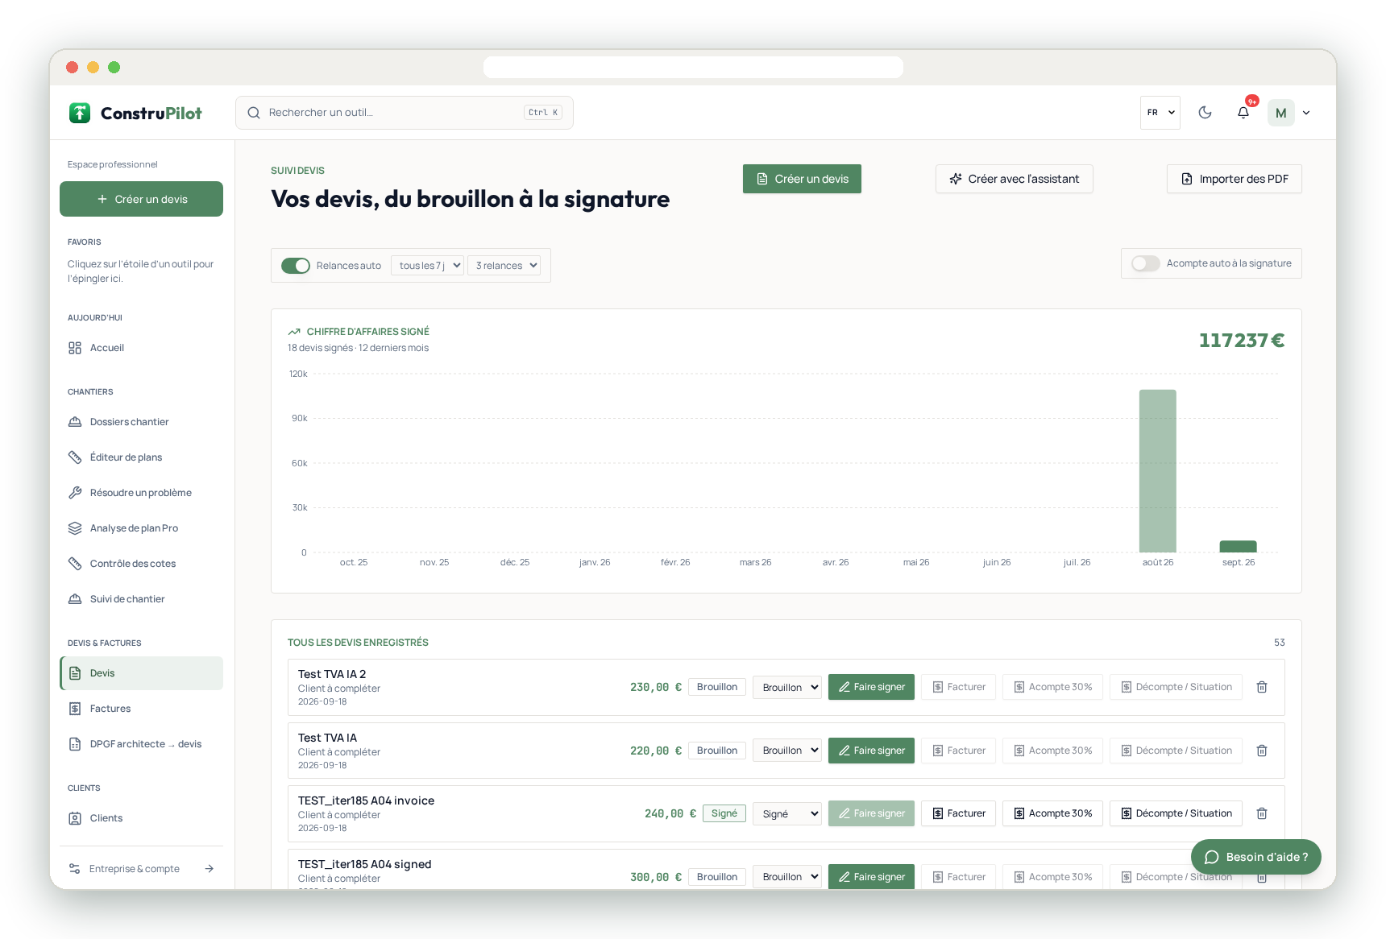

2 · TAKE-OFFS AND QUOTES
Measure on the plan, get signed fast
Take-offs on the plan
PDF or DWG import, scaling, lengths, areas, exportable quantities.
Quotes in your brand
3 layouts, your logo, detailed descriptions, all VAT rates.
Frictionless signature
QR code, online or on-site signature, automatic 7-day reminder.
Dictation from the site
Quotes, snags and messages dictated, even with busy hands.
Real screenshot of the platform (French version)

Slide 6
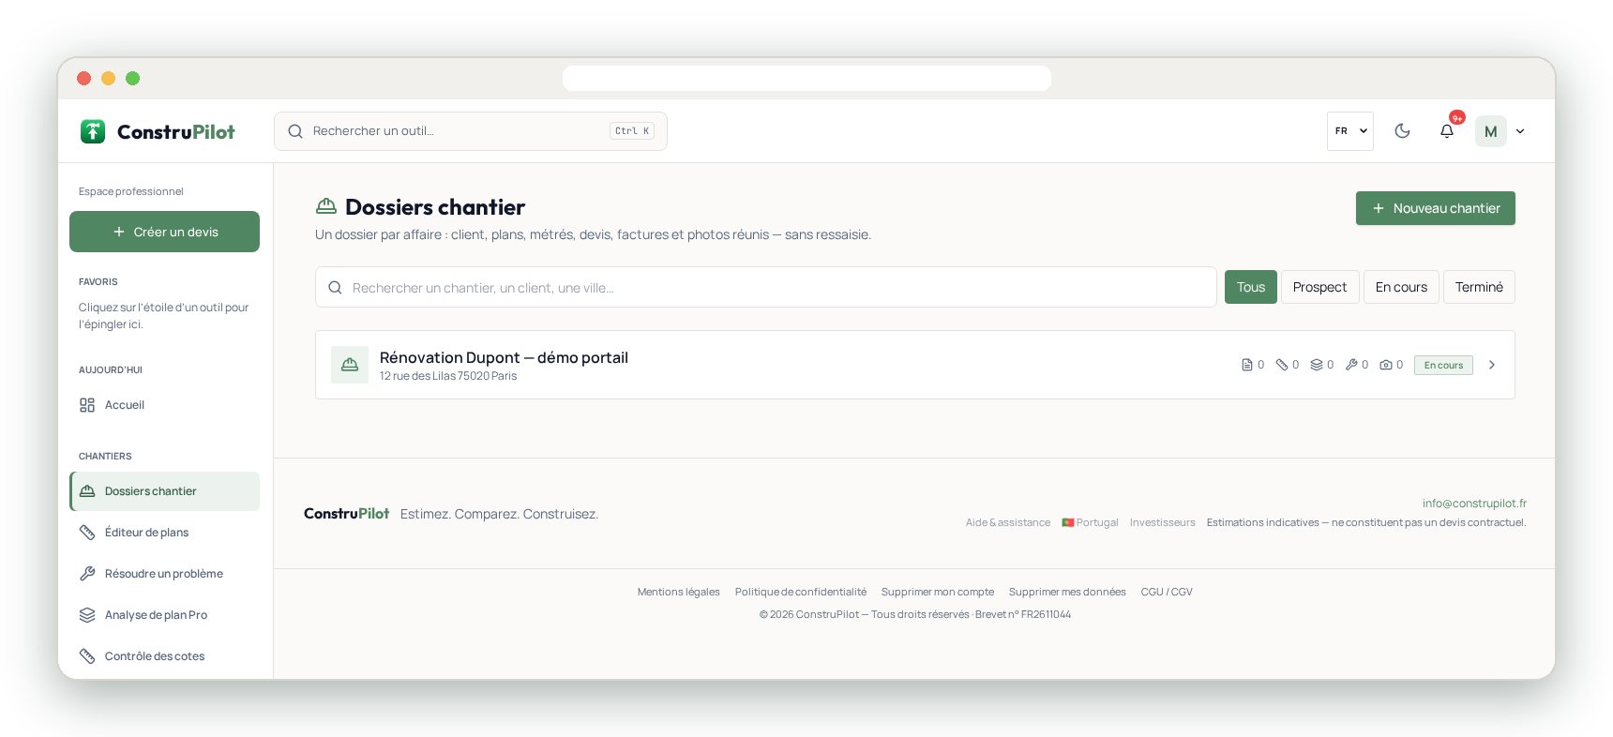

3 · SITE
Track the site and the client
Site file
Schedule, tasks, before / after photos, snags, reports.
Secure client portal
Progress, messages, documents; each client only sees their own job.
Subcontractors and suppliers
Records, tenders per trade, procurement, team time tracking.
Real screenshot of the platform (French version)

Slide 7


4 · INVOICING
Invoice without losing a cent
Deposit on signature
The deposit invoice is created as soon as the quote is signed.
Progress claims
Line-by-line progress, retention, payment certificate.
Received deposit deducted
Pro rata, in full or a chosen amount: no more allocation errors.
Final account
Balance, remaining deposit and retention release in one click.
Real screenshot of the platform (French version)
Invoicing option €5 / month, included in Pro Business.

Slide 8
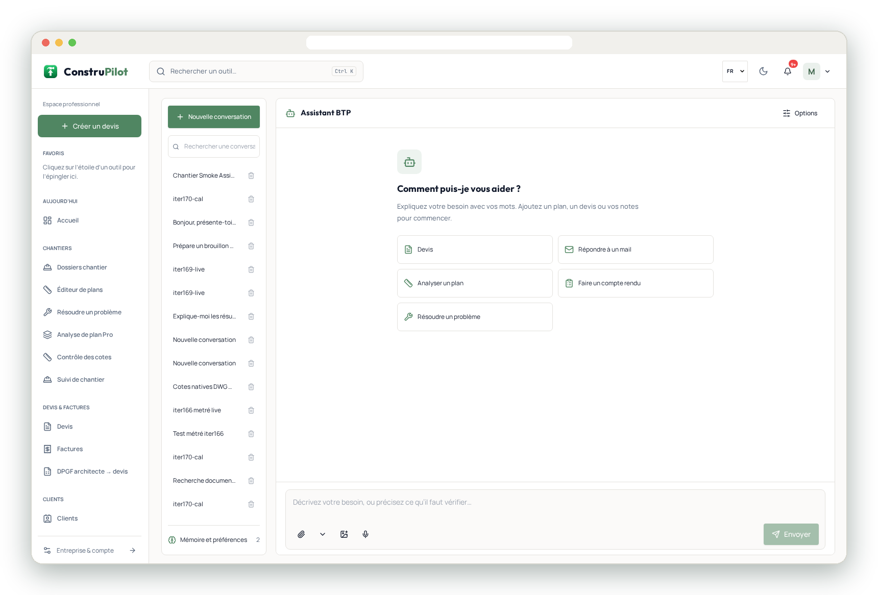



5 · ASSISTANT
An AI assistant that works with you
Technical answers
Standards, methods, mixes, with your own documents in context.
Assisted writing
Letters, reports and quote descriptions.
AI proposes, you decide
Every price stays editable and its source is tracked.
Real screenshot of the platform (French version)

Slide 9



MOBILE
Dedicated Android and iOS apps
Site
For the company: quotes, photos, snags, progress, on-site signature.
Team
For crews: today's tasks, time tracking, site notes and photos.
Homeowners
For the end client: estimate, job tracking, documents.
Notifications: quote signed, invoice overdue, subcontractor offer received. Self-service account deletion.

Slide 10


PRICING
A plan for every size of business
Most complete
Free
Homeowners
Premium
Homeowners with several projects
Pro
Tradespeople, sole traders, micro-firms
Pro Business
SMEs, general contractors, engineering offices
€0
€19 / month
€149 excl. VAT / month
€249 excl. VAT / month
2 active projects · 3 detailed estimates per month
or €190 / year · unlimited projects · quote scanner
or €1,570 excl. VAT / year · 1 user · quotes from a plan, specification, photo or voice
or €2,490 excl. VAT / year · 5 users · invoicing and e-invoicing included, HR, site tracking
Project Pass
€50 one-off · 1 full project, 90 days
Invoicing option
€5 / month (included in Pro Business)
AI renders
3D image €5 · 3D video €10
API
Starter €99 · Business €299 · Scale €999 / month
7-day free trial on paid plans, no commitment. Prices as of 1 Nov 2026; the pricing page on construpilot.fr prevails.

Slide 11


GET STARTED
Your data stays yours
Hosted in the European Union
Secure sign-in and strict data isolation between companies.
1
Create your account on construpilot.fr
No data resale
Your prices, clients and documents never leave your account.
2
Import your price library, or let it build itself
Self-service deletion
Account and data can be deleted at any time from the app.
3
Upload your first bill of quantities or create your first quote

Slide 12

Let's talk about your next job
7-day free trial · demo on request
contact@construpilot.fr · construpilot.fr · patent no. FR2611044

