Slide 1

DevOps Maturity Model

Slide 2
DevOps Maturity Model
A DevOps maturity model is a framework that organizations use to assess their level of maturity in adopting DevOps practices and processes. It typically consists of a set of criteria or characteristics across different dimensions of DevOps, such as Culture, Automation, Lean, Measurement, and Sharing (often referred to as the CALMS framework).

Slide 3
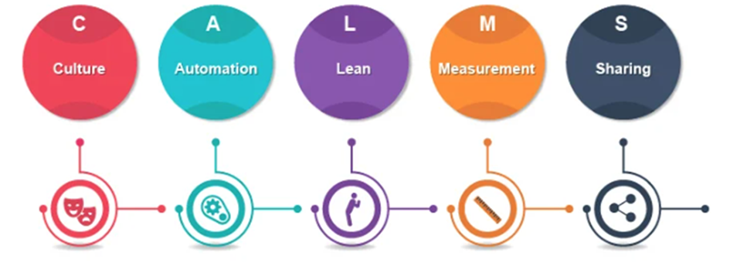
DevOps Maturity Model

Slide 4
DevOps Maturity Model
Culture: Culture is at the heart of DevOps. It involves encouraging collaboration, communication, and shared responsibility among development, operations, and other stakeholders. Building a culture of trust, transparency, and continuous improvement is essential for successful DevOps implementation.
Automation: Automation plays a crucial role in DevOps by reducing manual intervention, streamlining processes, and increasing efficiency. This includes automated testing, deployment, infrastructure provisioning, and monitoring. By automating repetitive tasks, teams can focus on delivering value and innovation more rapidly.

Slide 5
DevOps Maturity Model
Lean: Lean principles focus on eliminating waste and optimizing processes. In the context of DevOps, this means identifying and removing bottlenecks, reducing cycle times, and optimizing resource utilization. Lean practices help organizations deliver higher-quality software faster and with fewer resources.
Measurement: Measurement is essential for understanding the effectiveness of DevOps practices and identifying areas for improvement. This involves collecting data on key performance indicators (KPIs) such as deployment frequency, lead time, deployment success rate, and mean time to recovery. By measuring these metrics, teams can track progress, identify trends, and make data-driven decisions.

Slide 6
DevOps Maturity Model
Sharing: Sharing knowledge, experiences, and best practices is fundamental to the DevOps culture. This includes sharing code, documentation, tools, and insights across teams and departments. By fostering a culture of sharing, organizations can accelerate learning, promote collaboration, and drive continuous improvement.
By adopting the CALMS framework, organizations can create an environment beneficial to DevOps practices, enabling them to deliver software faster, more reliably, and with greater efficiency.

Slide 7
Key factors of DevOps Maturity Model
Culture and Leadership: This factor assesses the organization's culture and the extent to which leadership promotes collaboration, innovation, and continuous improvement.
Automation and Tooling: It evaluates the level of automation implemented across the software delivery pipeline and the effectiveness of tools used for development, testing, deployment, and monitoring.
Continuous Integration (CI) and Continuous Deployment (CD): This factor focuses on the frequency and efficiency of integrating code changes into a shared repository (CI) and automating the deployment process to production environments (CD).

Slide 8
Key factors of DevOps Maturity Model
Monitoring and Feedback Loops: It examines the organization's ability to monitor application and infrastructure performance, collect user feedback, and use this information to drive improvements.
Scalability and Infrastructure as Code (IaC): This factor assesses the scalability of the infrastructure and the extent to which infrastructure provisioning and management are automated using infrastructure as code principles.
Cross-functional collaboration: It evaluates how effectively different teams (e.g., development, operations, QA) collaborate and communicate to deliver value to customers efficiently.

Slide 9
Key factors of DevOps Maturity Model
Risk Management and Compliance: This factor considers how well the organization manages risks associated with changes to software and infrastructure and ensures compliance with regulatory requirements.
Continuous Learning and Improvement: It assesses the organization's commitment to learning and adapting to new technologies, processes, and market demands continuously.
Feedback and Metrics: This factor focuses on the collection and analysis of feedback and metrics to measure the effectiveness of DevOps practices and identify areas for improvement.

Slide 10
Key factors of DevOps Maturity Model
Customer-Centricity: It evaluates the organization's focus on delivering value to customers by prioritizing their needs and preferences in the software development and delivery process.
These factors provide a holistic view of an organization's DevOps maturity and help identify areas for improvement to achieve higher levels of maturity. DevOps maturity models typically define multiple maturity levels (e.g., beginner, intermediate, advanced) for each factor, allowing organizations to gauge their progress and set goals for improvement.

Slide 11
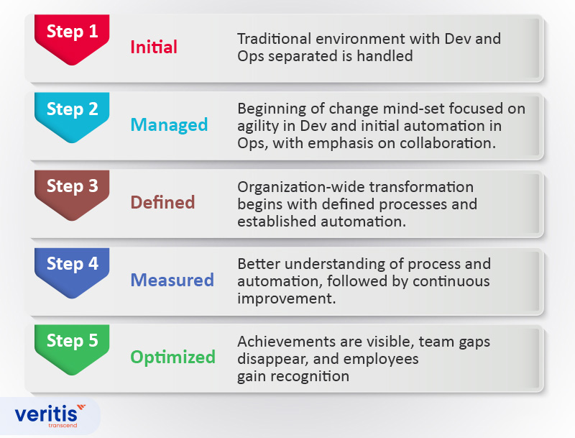
Stages of DevOps Maturity Model

Slide 12
Stages of DevOps Maturity Model
Initial Stage (Ad Hoc):
Teams work in silos with minimal collaboration between development, operations, and other stakeholders.
No formal DevOps practices.
Processes are mostly manual, leading to inefficiencies and delays.
There's little to no automation in place, and deployments are infrequent and error-prone.
The organization lacks a clear DevOps strategy or culture.

Slide 13
Stages of DevOps Maturity Model
Managed Stage (Repeatable):
Basic DevOps practices are introduced.
Some automation is implemented.
Teams start using version control and basic monitoring tools.
Processes are documented but may still be inconsistent.
Collaboration improves, but cultural resistance may exist.

Slide 14
Stages of DevOps Maturity Model
Defined Stage:
DevOps practices are well-defined and standardized across teams.
Continuous Integration (CI) and Continuous Delivery (CD) pipelines are established.
Infrastructure as Code (IaC) and configuration management tools are adopted.
Monitoring and logging are integrated into workflows.
Teams collaborate effectively, and cultural barriers are reduced.

Slide 15
Stages of DevOps Maturity Model
Measured Stage:
Metrics and KPIs are used to measure DevOps.
Continuous improvement is driven by data and feedback.
Advanced automation is implemented (e.g., self-healing systems, automated rollbacks).
Security is integrated into the DevOps pipeline (DevSecOps).
Teams are highly collaborative and aligned with business goals.

Slide 16
Stages of DevOps Maturity Model
Optimized Stage:
Fully mature DevOps practices.
Continuous experimentation and innovation.
Proactive identification and resolution of issues.
High levels of automation and self-service capabilities.
Strong alignment between DevOps practices and business objectives.
Culture of continuous learning and improvement.

Slide 17
What to Measure in a DevOps Maturity Model?
There are a set of parameters to be measured at every stage of the DevOps Maturity Model to confirm an organization’s level of DevOps maturity.
The number of completed projects and the release frequency should ideally be high resulting in ROI
Percentage of successful deployments should maintain an edge over unsuccessful ones
Mean Time To Recovery (MTTR) from an unexpected incident/failure from the time of occurrence, should be nil or as low as possible
Lead time, from development of code to deployment in production, should be satisfactory
Deployment frequency to determine the frequency of new code deployments

Slide 18
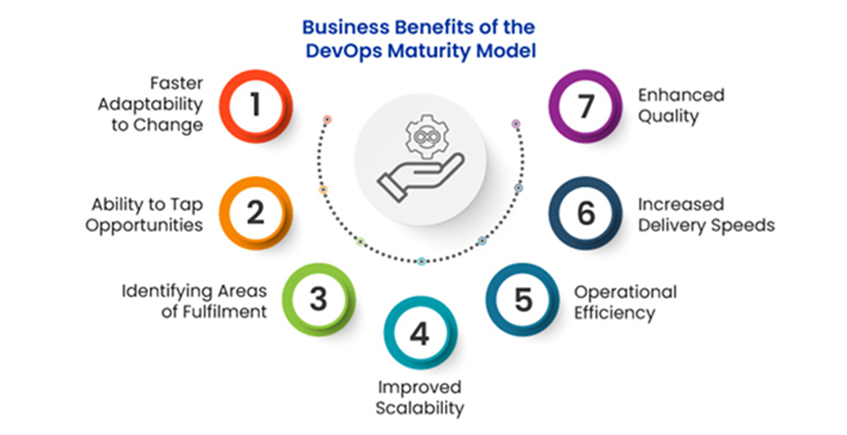
Business Benefits of DevOps Maturity Model

Slide 19
Business Benefits of DevOps Maturity Model
The DevOps maturity model presents a wide range of business benefits such as
Faster adaptability to change
Ability to tap opportunities
Identifying areas of fulfillment
Improved scalability
Operational efficiency
Increased delivery speeds
Enhanced quality

Slide 20
Business Benefits of DevOps Maturity Model
Faster adaptability to change:
In today's fast-paced business environment, agility is essential. The DevOps Maturity Model enables you to optimize your software delivery process, allowing for faster adaptation to evolving market demands and customer expectations.
By leveraging automation and continuous integration/delivery (CI/CD), you can efficiently roll out new features, address bugs, and stay ahead of industry trends, ensuring your business remains competitive.

Slide 21
Business Benefits of DevOps Maturity Model
Ability to Tap Opportunities:
The faster you can transform ideas into reality, the more opportunities you can capture. The DevOps Maturity Model enables you to achieve this by reducing development cycles and speeding up deployments, allowing you to stay ahead of the competition.

Slide 22
Business Benefits of DevOps Maturity Model
Identifying Areas of Fulfilment:
The DevOps Maturity Model helps organizations identify and address areas where their processes may be lacking. By continuously measuring and evaluating their practices, businesses can pinpoint inefficiencies and implement targeted improvements to enhance overall performance.

Slide 23
Business Benefits of DevOps Maturity Model
Improved Scalability:
Mature DevOps practices facilitate the seamless scaling of applications and infrastructure. Automated provisioning and management of resources through Infrastructure as Code (IaC) ensure that businesses can handle increased loads and expand their operations without significant manual intervention.

Slide 24
Business Benefits of DevOps Maturity Model
Operational Efficiency:
DevOps advocates automating repetitive tasks and breaking down barriers between development and operations teams. This leads to streamlined workflows, reduced manual errors, and more efficient resource use, ultimately lowering operational costs.

Slide 25
Business Benefits of DevOps Maturity Model
Increased Delivery Speeds:
Organizations can notably shorten the delivery time for new features and updates by implementing automated testing, integration, and deployment. Faster delivery speeds enhance customer satisfaction and allow businesses to stay competitive in fast-paced markets.

Slide 26
Business Benefits of DevOps Maturity Model
Enhanced Quality:
Continuous monitoring and feedback loops in mature DevOps practices ensure that issues are detected and resolved early in development. This leads to higher-quality software with fewer bugs and vulnerabilities, improving the overall user experience and reducing maintenance costs.

Slide 27
DevOps Maturity Assessment
A DevOps maturity assessment is a process used by organizations to evaluate their current level of maturity in adopting DevOps practices and identify areas for improvement. It helps identify strengths, weaknesses, and areas for improvement in the organization's DevOps journey. Here's an outline of how such an assessment might be conducted:

Slide 28
DevOps Maturity Assessment
Define Objectives: Clearly define the objectives of the assessment. Understand what the organization hopes to achieve by adopting DevOps practices and what specific outcomes it wants to improve, such as deployment frequency, lead time, mean time to recovery, etc.
Select Assessment Framework: Choose a suitable DevOps maturity model or framework to guide the assessment. Common frameworks include the CALMS model (Culture, Automation, Lean, Measurement, Sharing) or it could be a customized framework tailored to the organization's specific needs and goals.

Slide 29
DevOps Maturity Assessment
Gather Information: Collect data and information about the organization's current practices, processes, tools, and culture related to software development, deployment, and operations. This might involve surveys, interviews, workshops, and observation of current practices and workflows.
Assessment Criteria: Define the criteria and indicators for each dimension of the maturity model. These criteria should be measurable and aligned with the goals of the assessment. For example, criteria for the culture dimension might include the level of collaboration between teams and the frequency of knowledge sharing.

Slide 30
DevOps Maturity Assessment
Assessment Process/Scoring: Assign scores or ratings to each criterion based on the organization's current state. This could be done using a scale (e.g., 1-5) or descriptive levels (e.g., initial, repeatable, defined, managed, optimized).
Identify Gaps and Opportunities: Analyze the assessment results to identify gaps between the current state and the desired state of DevOps maturity. Identify areas of strength and weakness, as well as opportunities for improvement.

Slide 31
DevOps Maturity Assessment
Develop Improvement Plan: Based on the assessment findings, develop a roadmap or improvement plan that outlines specific actions and initiatives to enhance DevOps practices and advance maturity levels. Prioritize these actions based on their impact and feasibility.
Implement Changes: Implement the improvement plan, focusing on addressing the identified gaps and leveraging opportunities for improvement. This may involve changes to processes, tools, technologies, and culture, as well as investments in training and skill development.

Slide 32
DevOps Maturity Assessment
Monitor Progress: Continuously monitor and measure progress against the improvement plan. Use metrics and key performance indicators (KPIs) to track improvements in areas such as deployment frequency, lead time, quality, and customer satisfaction.
Iterate and Adapt: DevOps maturity is an ongoing journey, so it's essential to iterate and adapt the improvement plan based on feedback and changing organizational needs. Regularly revisit the assessment process to gauge progress and identify new areas for improvement.

