Slide 1
Implementation of Hardware monitoring using Ethernet LwIP.
By
Rithvik Ballal
Tejas Chavan

Slide 2
IN A NUTSHELL
Remotely monitoring a hardware through the network.
We will be using an Ethernet LwIP core to establish a point to point connection between the client and server.
Build an Ethernet based Hardware to create a server using the microblaze softcore.
Develop a QT based GUI application to create a client system that would ask for connection with the server in order to access a resource (Hardware)
This client server relationship is established using the LwIP stack which is a lighter implementation of the TCP/IP stack.
Once the connection is established packets can be transferred between the server and the client to monitor the hardware.

Slide 3
HARDWARE AND SOFTWARE USED:
Pmod-HB3 Motor driver – The motor is a computer fan running at 12V DC
Pmod-HYGRO – Temperature and Humidity sensor.
The temperature and humidity of the environment is sensed and sent to client
Ethernet cable
QT application GUI – The QT based application is used to create a GUI to act as a client.

Slide 4
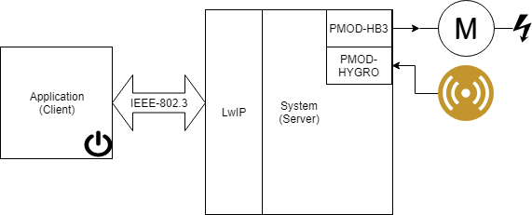
Block Diagram

Slide 5
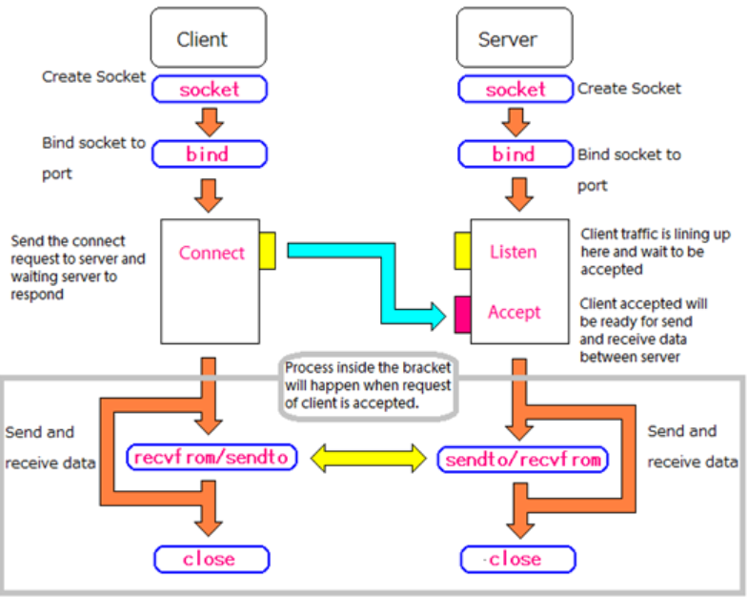
SOCKET PROGRAMMING
Socket: Create a new connection endpoint
Bind : Attach a local address to a socket
Listen : Announce willingness to accept a connection
Accept : Block caller until a connection request arrives.
Connect: Actively attempt to establish a connection.
Send: Send some data over the connection.
Receive : Receive some data.
Close: Release the connection.

Slide 6
SERVER
GENERALIZED PACKET FORMAT
CL
I
ENT
Ask_Temp_deg(16 bits)
0x05
0x00
give_Temp_deg(16 bits)
0x02 <data>
Ask_Temp_humid(16 bits)
0x03 0x00
give_Temp_humid(16 bits
0x04 <data>
send_duty_cycle(16 bits)
0x00 <data>

Slide 7
CHALLENGES FACED:
Getting started with the QT application builder.
Getting familiar with socket programming.
Data conversion between UNICODE to ASCII.
Synchronization when continuous packets are being transferred or received.

Slide 8
WORK DISTRIBUTION:
Rithvik : Building the Client side of the system.
Developing QT application GUI to interact with the server.
Tejas : Building the hardware using microblaze to get the ethernet up.
Performing Socket Programming to establish connections between the server and client.

Slide 9
APPLICATIONS:
Monitoring Machineries in industries from a remote location.
Home Automation.
*******************************************************

