Slide 1
Implementation of Hardware monitoring using Ethernet LwIP.
By
Rithvik Ballal
Tejas Chavan

Slide 2
IN A NUTSHELL
Remotely monitoring a hardware through the network.
We will be using an Ethernet LwIP core to establish a point to point connection between the client and server.
Build an Ethernet based Hardware to create a server using the microblaze softcore.
Develop a QT based GUI application to create a client system that would ask for connection with the server in order to access a resource (Hardware)
This client server relationship is established using the LwIP stack which is a lighter implementation of the TCP/IP stack.
Once the connection is established packets can be transferred between the server and the client to monitor the hardware.

Slide 3
CLIENT: (QT GUI application)
Basic application framework to communicate with the server.
Skeleton of GUI consisting of Speedometer, Temperature and Humidity display bar and scrollbar to vary the DC.
Packet transfer to the server
WHAT DO WE HAVE ?
SERVER (MICROBLAZE)
Hardware Setup to build the server side with IP address: 192.168.1.10
Working LwIP Echo Ping test using RAW API (Standalone)
Packet transfer with the client (QT Gui application).
Packet Structure created to decode the command and data.

Slide 4
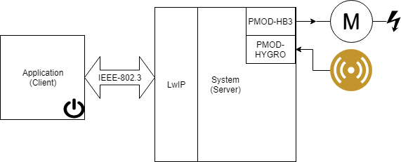
Block Diagram

Slide 5
LwIP PACKET FORMAT
COMMAND (1 BYTE) | DATA (1 BYTE)
COMMAND | NOTE | PATH | REQ/RESP | DATA
00 | Version number | C-S | Request | 00 (No data)
01 | ‘Version 1’ | S-C | Response | 0A
02 | new_Temp() | S-C | Response | ‘XX’ (Temp reading)
03 | new_DC() | S-C | Response | ‘XX’(Duty cycle reading)
04 | Give_DC() | C-S |  | ‘XX’(Feed Duty cycle )

Slide 6
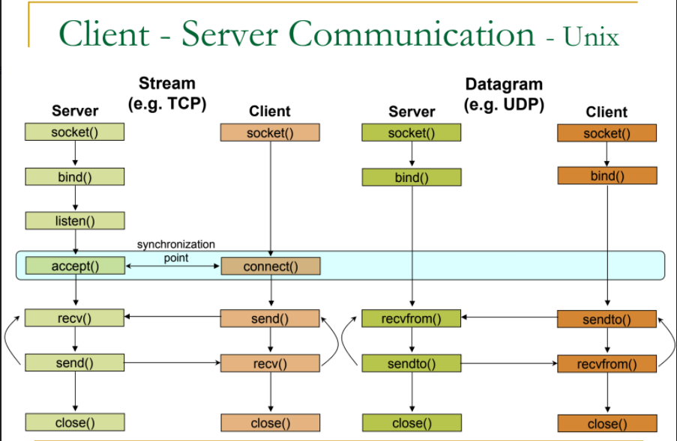
Socket: Create a new connection endpoint
Bind : Attach a local address to a socket
Listen : Announce willingness to accept a connection
Accept : Block caller until a connection request arrives.
Connect: Actively attempt to establish a connection.
Send: Send some data over the connection.
Receive : Receive some data.
Close: Release the connection.

Slide 7
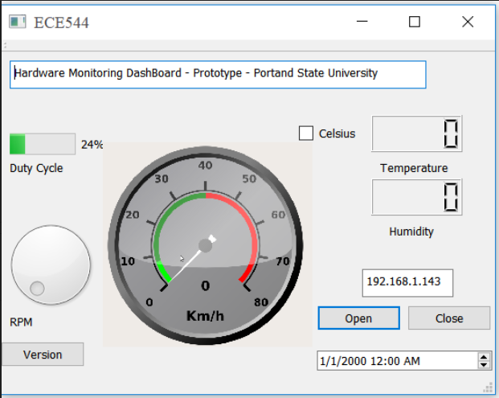
QT APPLICATION GUI

Slide 8
YET TO BE DONE
SERVER (Microblaze)
Converting the packet data into appropriate format and feeding it to the hardware.
Receiving readings from the temperature sensor and sending it to the client in the form of packets.
CLIENT (QT GUI)
Decoding the packets into a an appropriate format and displaying it on the GUI.
Building a speedometer that would display the current RPM of the motor.
Capturing various readings and connecting it to the GUI

Slide 9
APPLICATIONS:
Monitoring Machineries in industries from a remote location.
Home Automation.
*******************************************************

