Slide 1
Connect To Organic Salon
Presented By:
Tejas Sonawane 210943120103
Shrihari Awate 210943120019
Shreya Zade 210943120095
Sajjan Sorate 210943120105
Guided By:
Mrs. Harshita Maheshwari

Slide 2
Introduction
The need for hairdressing, grooming, facials, and related services will not decline as long as people live on this earth. In fact, in this age of fashion and corporate culture, people are more interested in grooming themselves than ever before. As we can see during this pandemic situation the zero contact policy is much more needed, there is no automated system for the people’s who prefer local salons for doing all the grooming and facial related things. Where we can have home service and salon service where people can book salon appointment with their respective local salon owners and can go with their given time slot where they have reserved seat for particular service also they can book home service for their little ones and old parents. So, we thought of project Connect To Organic Salon is best suited for people needs.

Slide 3
Modules
Our proposed system i.e. Connect To Organic salon consists of three modules listed as below.
1. Admin Module
2. Customer Module
3. Salon Owner Module

Slide 4
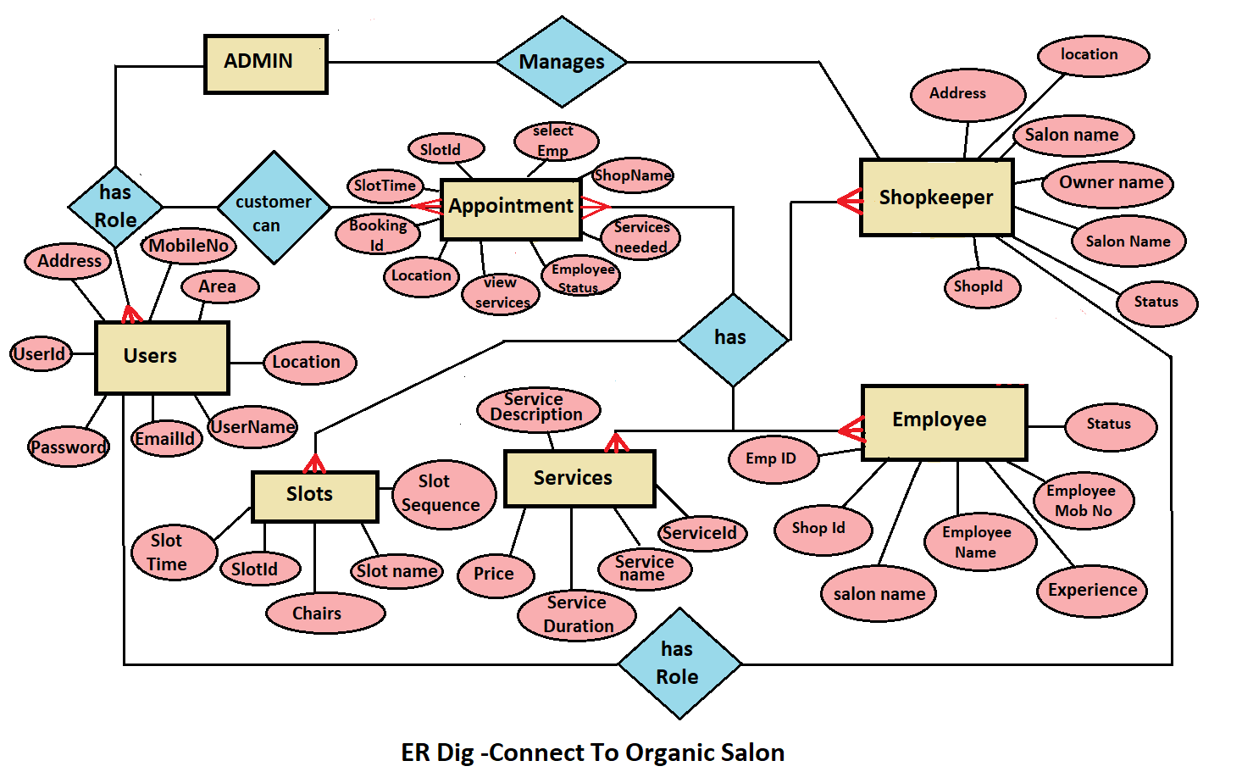
ER Diagram

Slide 5
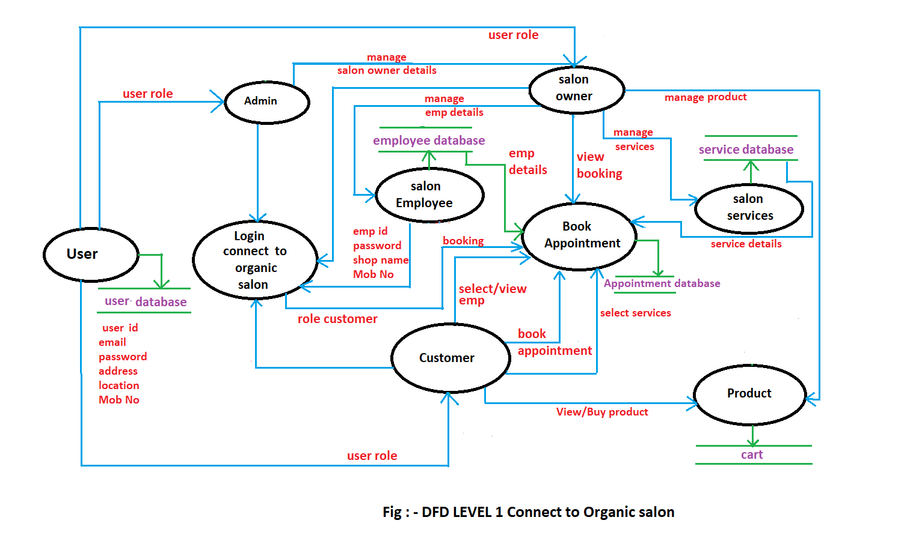
Sequence Diagram

Slide 6
Future Scope
This project can be enhanced further by adding other categories and Services. The software is flexible enough to be modified and implemented as per future requirements. Message and Email alerts for various happenings can be added to the system so that users do not miss the updates and happenings of the system.

Slide 7
Conclusion
Connect to Organic Salon system is responsible for providing best services, flexible time slot and daily services and time changes with the affordable prices on specified. This approach also offers an added advantage that customers can select a specified time slot of the day for the appointments of salon. The application provides facility to add/remove/slot and services items at salon. It also provides facility where customers can mention their queries/complaints in reviews. Application provides safety and reduces risk during the pandemic situation.

Slide 8
Thank You!

