Slide 1

CLOUD SERVICES
AzTecX

Slide 2
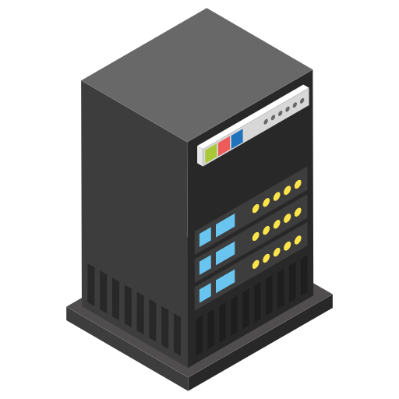
CLOUD SERVICES
Cloud refers to a network of remote servers that are hosted on the internet. These servers are used to store, manage, and process data, rather than relying on a local server or a personal computer.
Internet

Slide 3
CLOUD SERVICES
Then What do you mean by a server?
A server, refers to a computer or a system that is dedicated to managing network resources and providing services to other computers, known as clients.
Servers are designed to handle specific tasks, processes, or services and are often more powerful in terms of hardware and software capabilities compared to regular personal computers.

Slide 4
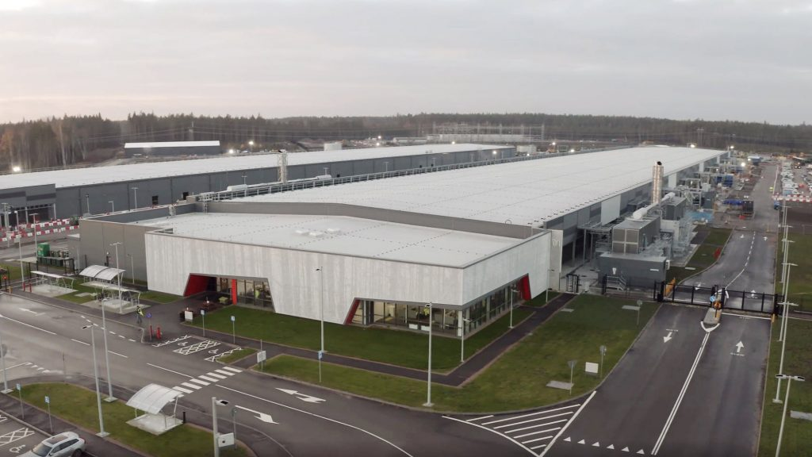

CLOUD SERVICES
Then Where Exactly these servers are Located?
A data center is a facility composed of networked computers and storage used to organize, process, store, and disseminate large amounts of data. Data centers provide the necessary infrastructure to support the reliable operation of servers.
Microsoft Azure Data Center Location in Sweden.
Inside View of a DC

Slide 5
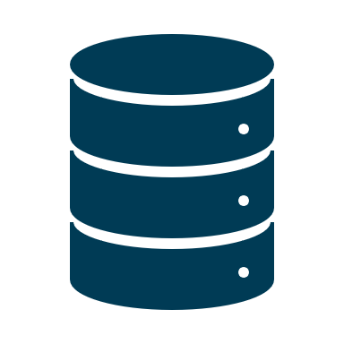
services typically refer to software or resources providers over a network, such as the internet (By Servers).
CLOUD SERVICES
applications
storage
processing power
Visualization

Slide 6

WHY CLOUD ?

Slide 7

Available Options?
User A
Wants to Host A Website
On Premise - purchase a server and host/install the app
Maintain the server for future Operating System level patches
Ensure security of the environment (setup a server room)
Setup local network (Local Area Network - LAN)
Ensure 24*7 Uninterrupted Power Supply (UPS)
Setup backup procedures for application and database.
Setup a team to manage servers, networks, databases etc.
Manage contracts with hardware companies like IBM, HP etc.

Slide 8
Key Features of the Cloud

Slide 9
Ability to scale server health parameters (RAM, CPU, Disk, Network) on demand basis.
Add more processors if app requires lot of computation
Add more RAM if app requires lot of data to be available in memory
Add more disk space for database with huge data to be stored
Scalability

Slide 10
Ability to scale up, scale down or scale out or scale in the resource dynamically.
Demand driven scalability strategy for unpredictable loads.
Elasticity

Slide 11
Application should be up and running 24*7 365 days.
There should not be any downtime, due to planned maintenance ог any network/server issue (called fault).
Systems should be "Highly Available" and "Fault Tolerant"
Availability

Slide 12
Ability to move faster and easily. Cloud is Agile in terms of
Ability to quickly recover from internal or external threats like faults, bug fixes, patches, cyber attacks or natural disasters
Achieved via automated code deployments called Continuous Integration - Continuous Deployment (CI-CD)
Agility helps in faster time to market, hence helps business in going live early, adapting to business change faster i.e. being relevant in dynamic business environment
Agility

Slide 13
Pay as you go

Slide 14



The Platform that Provide these Services over a network are called as “Cloud Service Providers”.
Amazon Web Services
Microsoft Azure
Google Cloud Platform

Slide 15
MICROSOFT AZURE
Azure is a Cloud Platform Provided by Microsoft
it is basically an online portal used to access and manage resources and services provided by Microsoft on cloud.

Slide 16


User
Internet
Azure Portal
User
Resources

Slide 17

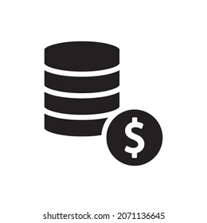



February 1st
2010
Pay as you go
Support Multiple Languages

Slide 18
Azure Portal
portal.azure.com

Slide 19
Where the Cloud is Used?

Slide 20
THANKS!

