Slide 1



MUTUAL FUND ANALYTICS PLATFORM
Bluestock Data Science Internship Capstone Project
Prepared By: Tejashwini.B
Tools Used:
Python
SQLite
Power BI
GitHub

Slide 2
PROBLEM STATEMENT
Problem:
Investors face difficulties in:
Comparing mutual funds
Understanding risk and return
Tracking SIP trends
Evaluating portfolio diversification
Objective:
Build an end-to-end analytics platform for mutual fund analysis and decision support.

Slide 3
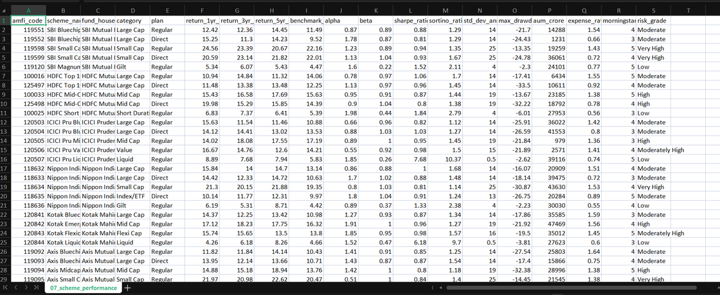
DATA SOURCES
Datasets Used
Fund Master
NAV History
AUM Data
SIP Inflows
Category Inflows
Folio Count
Scheme Performance
Investor Transactions
Portfolio Holdings
Benchmark Indices

Slide 4
PROJECT ARCHITECTURE
Raw Data
↓
ETL Pipeline
↓
SQLite Database
↓
EDA
↓
Performance Analytics
↓
Advanced Analytics
↓
Power BI Dashboard
↓
Reporting

Slide 5
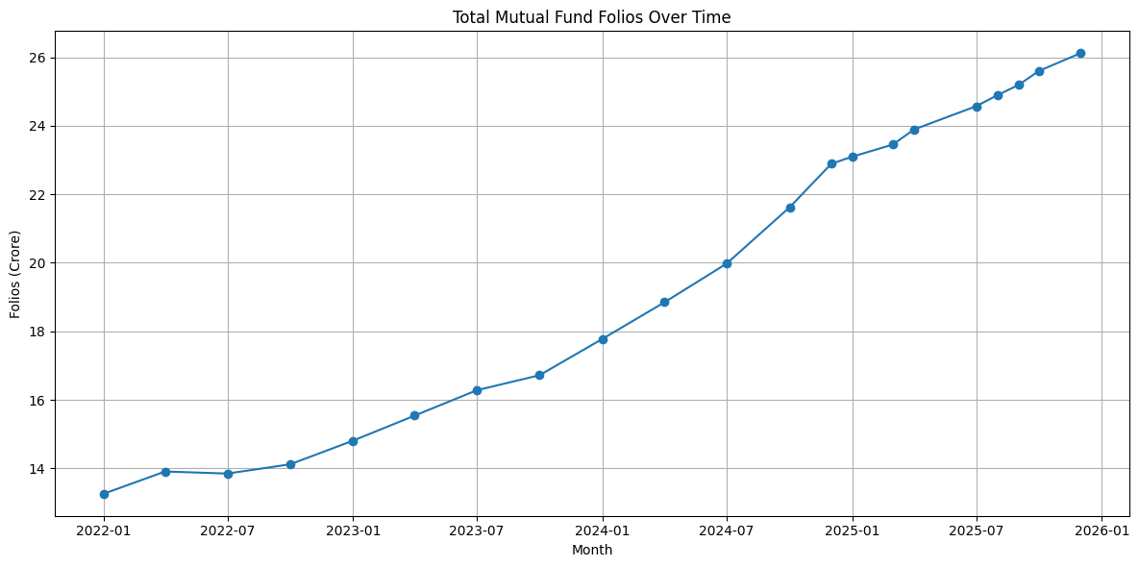
EDA HIGHLIGHT 1: MUTUAL FUND FOLIO GROWTH

Slide 6
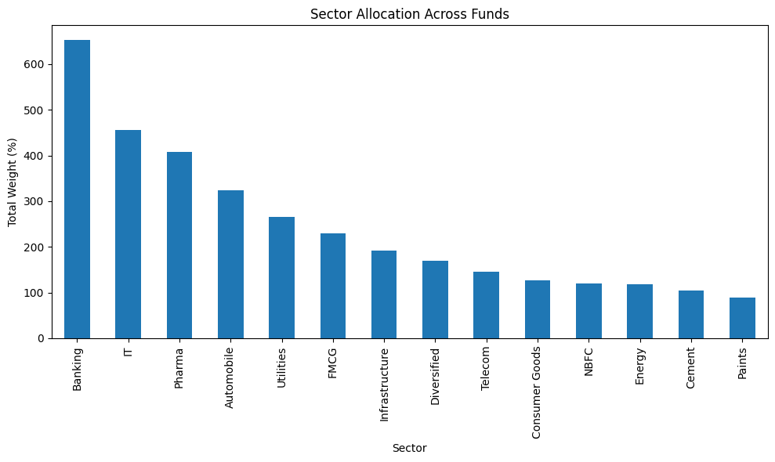
EDA HIGHLIGHT 2: SECTOR ALLOCATION ACROSS FUNDS

Slide 7
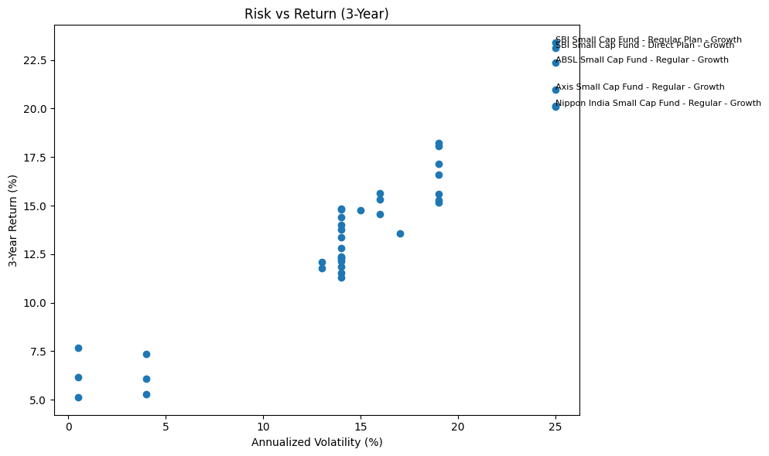
PERFORMANCE METRICS 1

Slide 8
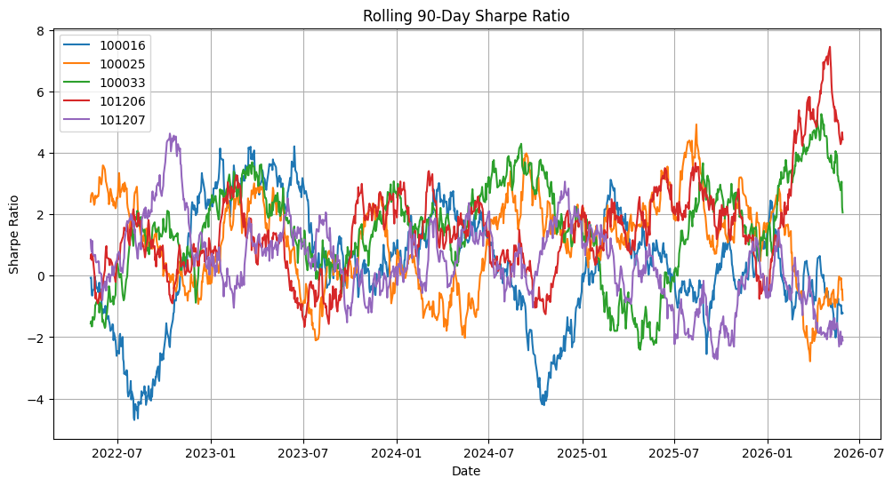
PERFORMANCE METRICS 2

Slide 9
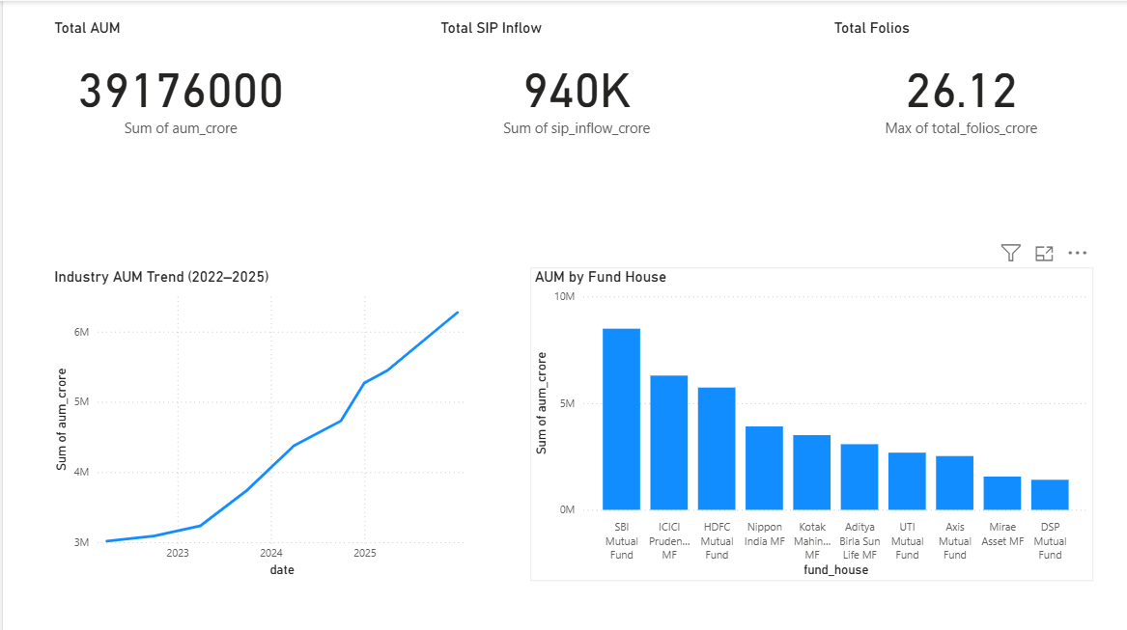
DASHBOARD 1

Slide 10
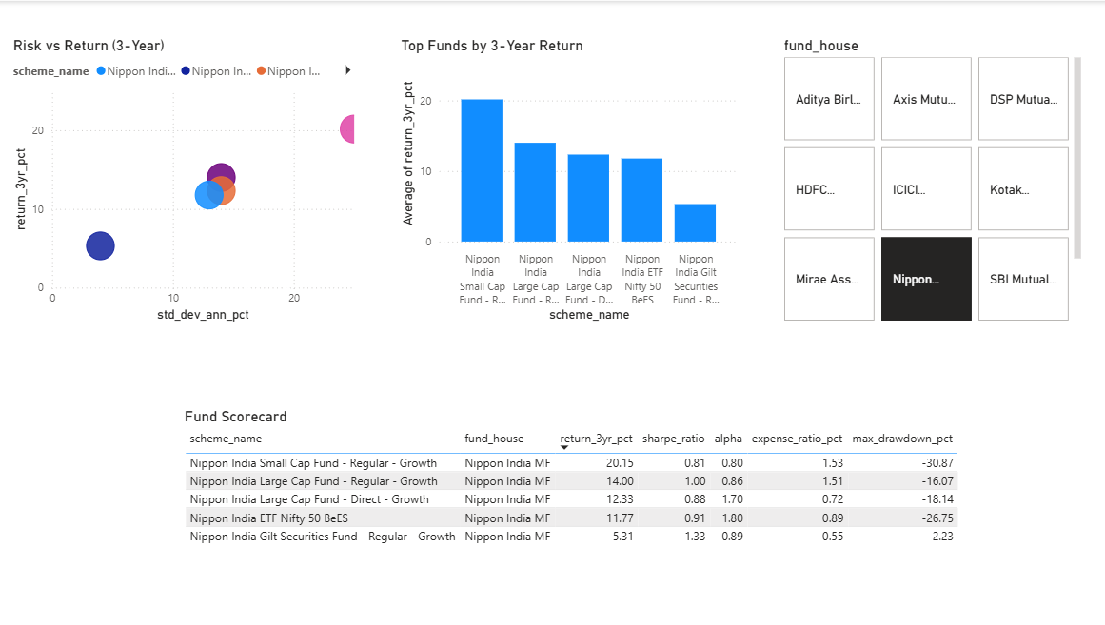
DASHBOARD 2

Slide 11
KEY FINDINGS
Major Insights
Mutual fund participation increased significantly.
SIP investments grew consistently.
Risk-adjusted returns varied across schemes.
Investor behavior differed by demographics.
Portfolio concentration varied among funds.

Slide 12
THANK YOU
TEJASHWINI.B
BLUESTOCK INTERNSHIP

