Slide 1
Chaos Game Representation (CGR) Based DNA Sequence Visualization
24AIM144 Introduction to Data Compression
Guided by
Dr. Soman sir

Slide 2

What is CGR?
CGR is a way to convert DNA into fractals.
It helps in visualizing long DNA sequences.
Each base (A, T, G, C) maps to a corner in a square → repeated midpoint plotting.

Slide 3
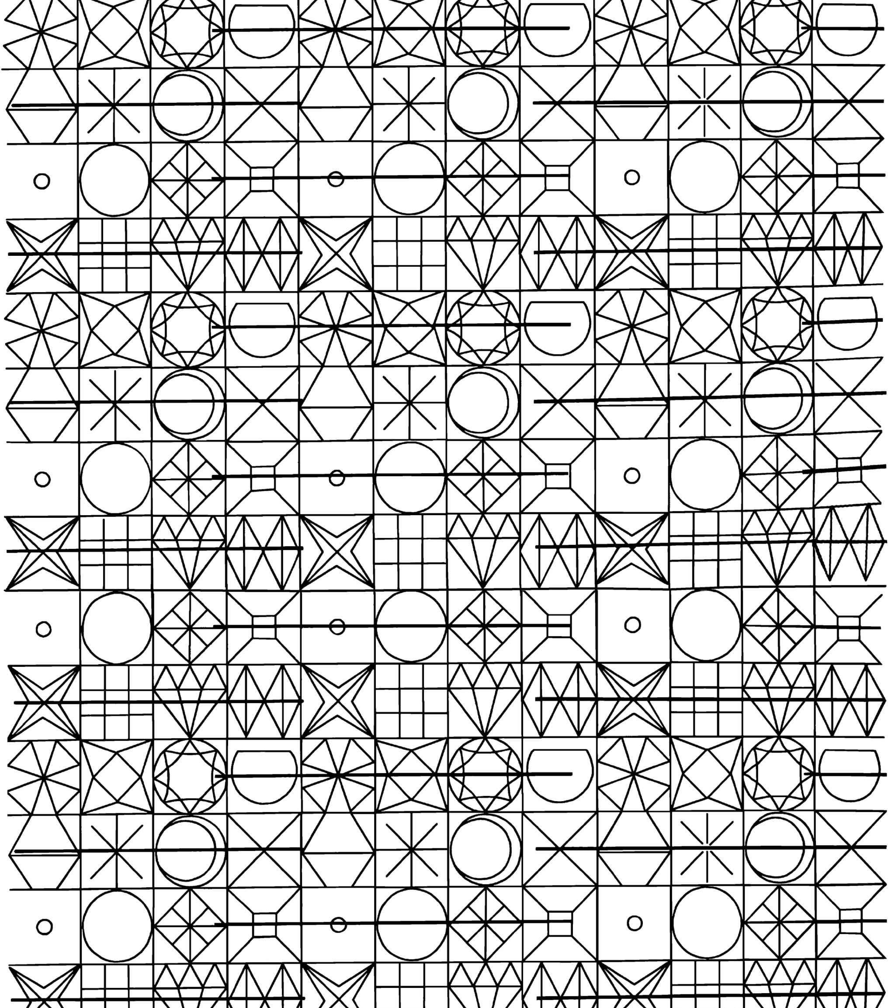
Why Use CGR?
Traditional methods can’t visualize patterns.
CGR reveals motifs, repetitions, and sequence complexity visually.

Slide 4
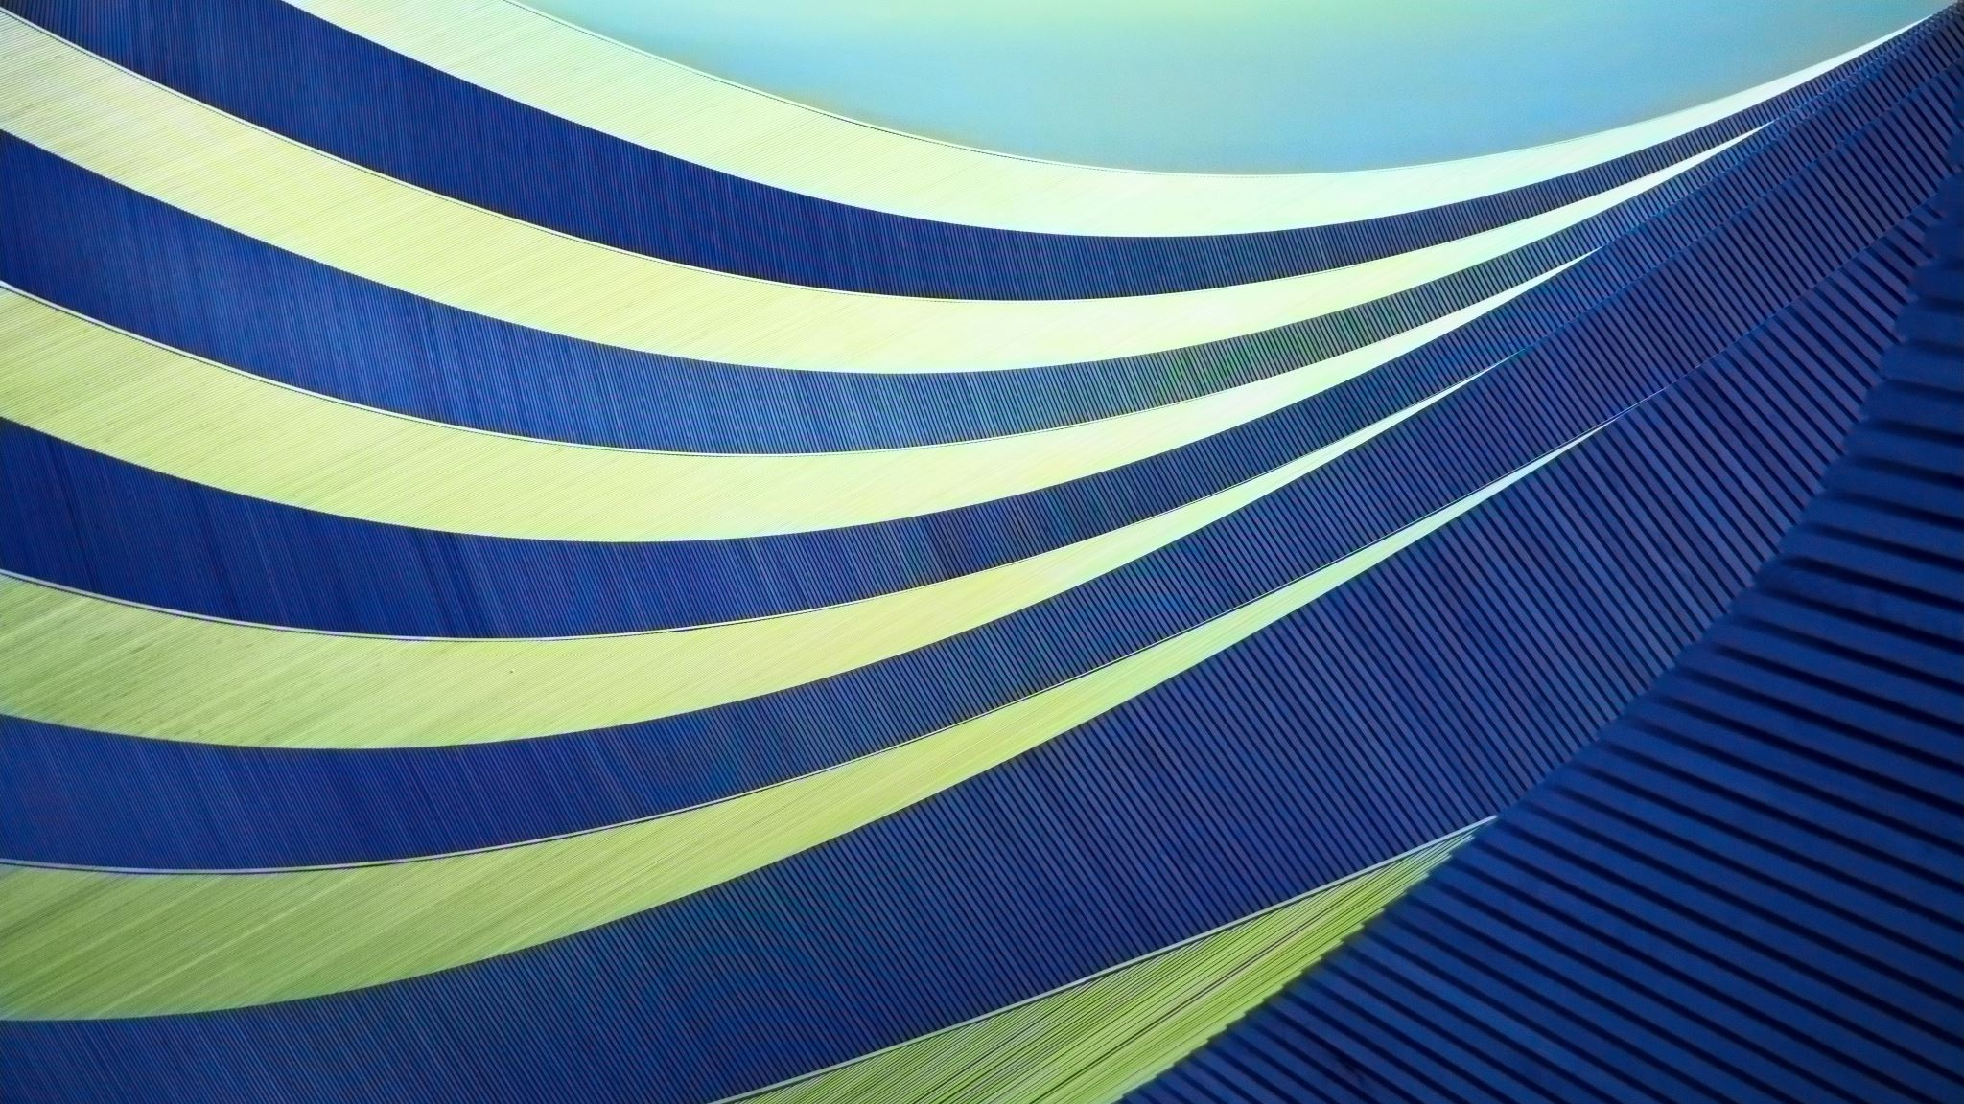
How It Works
Each base is assigned a corner.
Start at the center and keep plotting halfway points.
End result = a fractal image unique to the sequence.

Slide 5
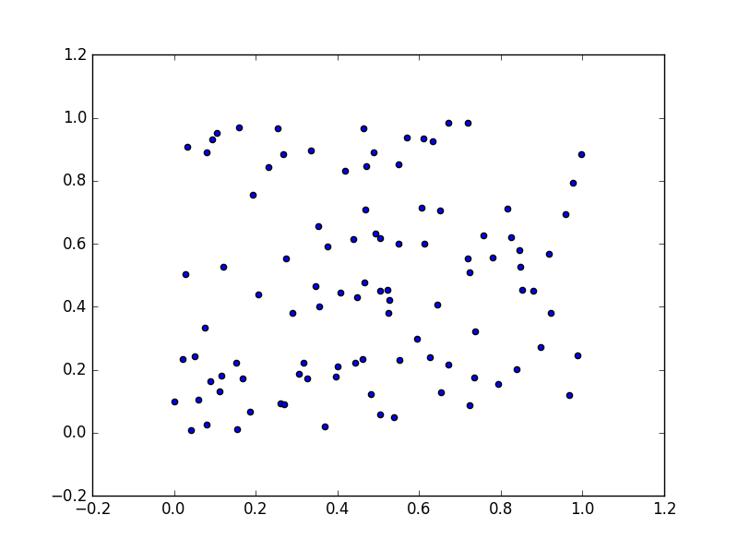


Technology Used
Python
Matplotlib / NumPy for plotting
Gradio for web interface

Slide 6
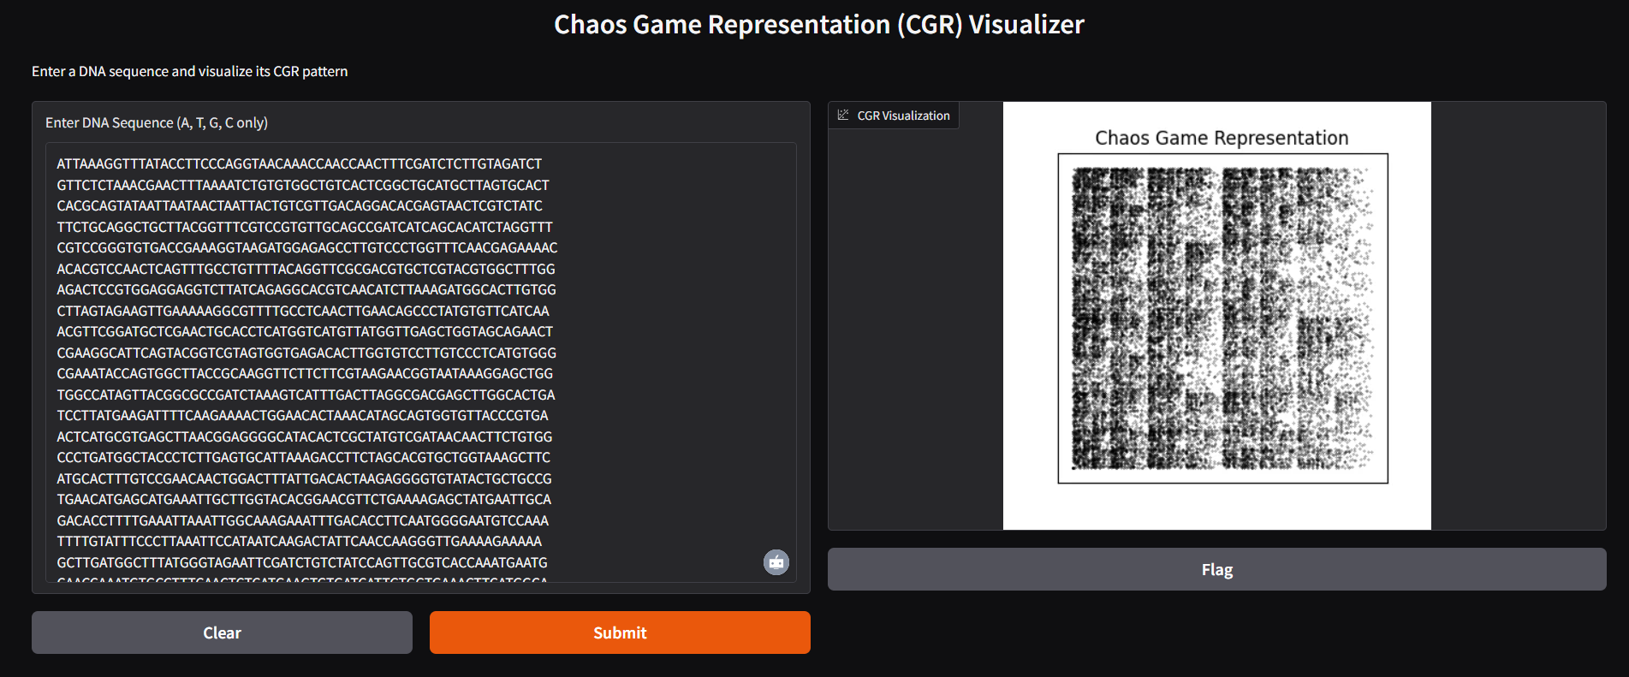
Our Interface
Input: DNA sequence
Output: CGR fractal image

Slide 7
Applications
DNA pattern analysis
Biological fingerprinting
Can be extended to virus vs human DNA classification
Educational tool for bioinformatics

Slide 8
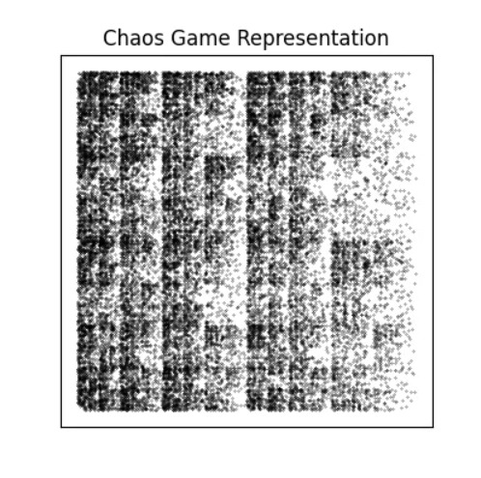
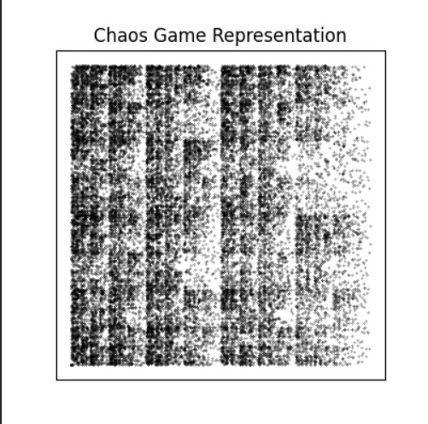
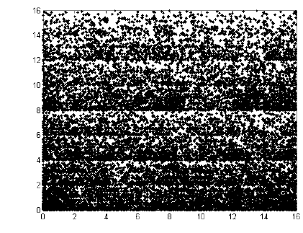
Our Work on some dna sequences
Fig-1:Schizosaccharomyces Pombe (Eukaryote)
Fig-3:PA564804.1 DNA representation
Fig-2:Covid OM798486.1 DNA representation

Slide 9
Conclusion
Simple yet powerful visualization method
Interactive tool using CGR and Gradio
Great potential for education and research

Slide 10
Thank you sir

