Slide 1

SMART INDIA HACKATHON 2026
Problem Statement ID – 26133
Problem Statement Title- Accessibility and quality of public healthcare services, particularly in rural and underserved areas
Theme- MedTech /BioTech / HealthTech
PS Category- Software
Team ID- SIH26-A0H-T392
Team Name - ChatGPTers

Slide 2
ChatGPTers
RURAL HEALTHCARE SYSTEM AND CO-ORDINATION SYSTEM
Challenge We're Solving
The Last-Mile Barrier: Rural areas suffer from acute specialist shortages, high travel costs, and delayed emergency triage.
Operational Friction: Primary Health Centres (PHCs) rely on fragmented manual records, causing high drop-offs between initial screening and specialist care.
Addressing the Core Problem!
Specialist Access: Connects rural patients directly to specialists via remote teleconsultation, cutting travel.
Drop-Off Prevention: Live tracking and automated SMS alerts ensure patients complete hospital visits.
Offline Resilience: Secure local caching allows smooth operation in low-connectivity areas.
Govt. Compliance: Fully aligned with ABDM standards for secure health records.
What Makes Us Different
Holistic Coordination: Unifies triage, routing, teleconsultation, and tracking into a single platform instead of isolated tools.
Ecosystem Synergy: Native interoperability with national frameworks like ABDM and eSanjeevani.
Automated Escalation: Risk algorithms instantly flag and escalate critical cases to administrators.
Role-Based Design: Tailored interfaces for Health Workers, Patients, Specialists, and Admins.
Our Revolutionary Solution
End-to-End Care Platform: A unified ecosystem streamlining the patient journey from grassroots data capture to specialist follow-up.
Core Workflow Integration:
Smart Data Capture: Digital logging of symptoms, vitals, and documents by health workers.
AI/Rule-Based Triage: Instant risk stratification to identify and prioritize critical cases.
Smart Referral Engine: Automated facility matching based on clinical need and real-time availability.
Teleconsultation & Tracking: Integration with eSanjeevani and live lifecycle tracking (Created ---> Visited -----> Treated ----->Follow-up).
Beyond Problem Statement
Epidemiological Insights: District-level dashboards track disease patterns and resource bottlenecks in real time.
Empowering Workers: Cuts administrative paperwork for ASHA and ANM workers by up to 70%.
Cost Reduction: Minimizes out-of-pocket health and travel expenditures for rural families.

Slide 3
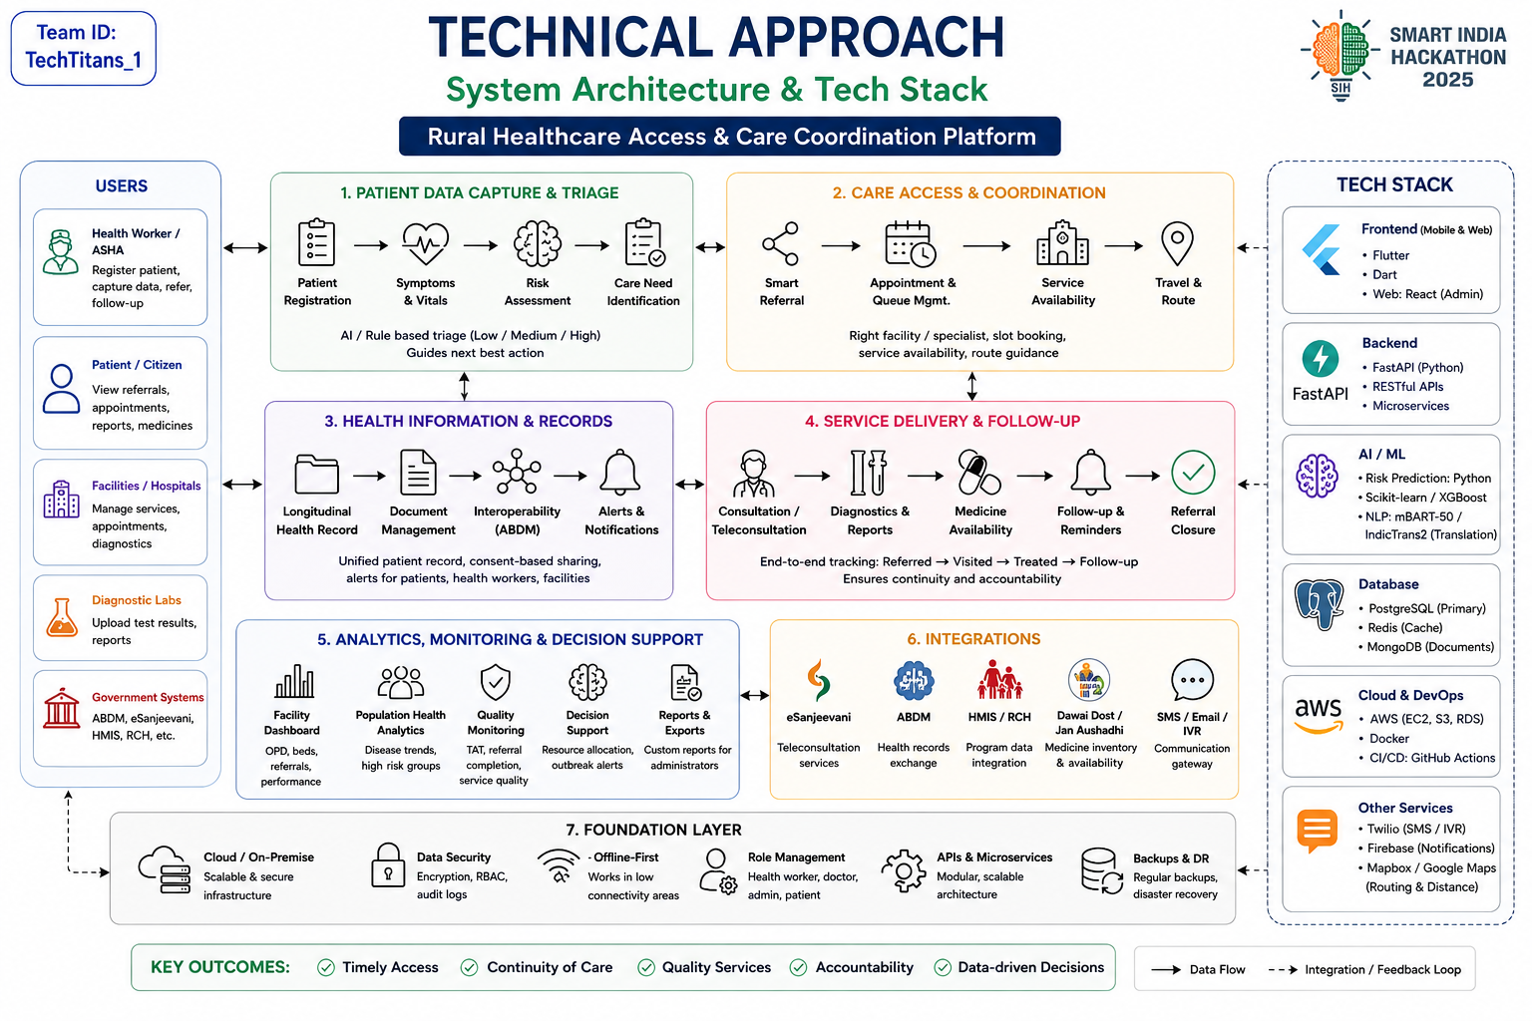
TECHNICAL APPROACH
ChatGPTers

Slide 4
FEASIBILITY AND VIABILITY
ChatGPTers
Technical Feasibility
Scalable Architecture: Modular web and mobile framework ensures robust performance and seamless handling of concurrent users across district networks.
Low-Bandwidth Optimization: Designed to function efficiently in remote regions with high data-compression and responsive layouts.
Offline Resilience: Local data caching architecture enables continuous grassroots operation even during total internet blackouts.
Challenges & Solutions
Challenge 1: Referral Drop-Offs
Patients frequently fail to visit higher-facility hospitals after initial screening, leading to critical health complications going untreated.
Solution: Lifecycle Tracking & Alerts
Deploys an automated end-to-end lifecycle tracking system (Created --> Visited --> Treated --> Follow-up).
Automated SMS and reminder alerts notify both patients and health workers to ensure successful hospital visits.
Challenge 2: Connectivity Constraints
Unreliable internet infrastructure in remote rural areas disrupts cloud-dependent health platforms and live coordination.
Solution: Offline-First Caching Architecture
Local data caching allows health workers to capture vitals and sync records automatically once network connectivity is restored.
Challenge 3: Digital Literacy Barriers
Frontline ASHA and ANM workers may struggle with complex UI/UX designs during rapid field data entry.
Solution: Intuitive & Multilingual Design
Streamlined, role-based interfaces with regional language support and minimal typing requirements tailored for grassroots users.
Economic & Business Feasibility
Operational Cost Reduction: Achieves up to 70% savings in administrative paperwork and manual coordination overhead for health workers.
Resource Optimization: Eliminates redundant travel and maximizes the utilization of available specialists and facility beds.
Public-Sector Scalability: High economic viability for state and central deployment with minimal hardware infrastructure costs.
Regulatory & Legal Feasibility
ABDM Alignment: Fully aligned with the Ayushman Bharat Digital Mission standards for secure health records exchange.
Data Privacy: Role-based access control and end-to-end encryption ensure total patient data confidentiality.
Standard Compliant: Adheres to national public health governance and digital health interoperability protocols.

Slide 5
IMPACT AND BENEFITS
ChatGPTers
Target Audience Impact Analysis
3. Government & District Administration
Epidemiological Insights: Empowers health authorities with real-time dashboards to track disease patterns, facility loads, and resource bottlenecks.
System Optimization: Seamlessly integrates grassroots operations with national initiatives like ABDM and eSanjeevani.
1. Rural Patients & Communities
Direct Access: Grants transparent, reliable access to specialists, eliminating travel uncertainty and out-of-pocket transit expenses.
Proactive Care: Ensures timely emergency interventions and continuous health tracking for critical conditions.
2. Frontline Health Workers (ASHA / ANM)
Workflow Efficiency: Streamlines field-level data capture, symptom logging, and risk stratification right at the doorstep.
Reduced Burden: Cuts down manual paperwork by up to 70%, allowing workers to cover more households effectively.
^{Benefit Analysis}
3. Digital-First Approach
Paperless Coordination: Eliminates the need for physical paper registers and fragmented record-keeping.
Interoperable Records: Secure digital health records ensure seamless information exchange across different tiers of healthcare facilities.
Disaster Resilience: Cloud-backed digital backups protect critical patient records against physical damage or local disasters.
Sustainable Access: Unlimited digital care coordination and tracking vs. limited, bottlenecked physical visits.
1. Social & Public Health Benefits
Mortality Reduction: Drastically lowers maternal, infant, and critical illness mortality through automated high-risk escalation.
Healthcare Equity: Bridges the urban-rural divide by bringing specialist medical advice to underserved populations.
Preventive Care: Encourages early diagnosis and proactive follow-ups through automated reminder alerts.
2. Economic Benefits
Cost Savings: Minimizes catastrophic out-of-pocket health and travel expenditures for rural households.
Operational Efficiency: Optimizes the utilization of public hospital beds, medical staff, and diagnostic resources.
Scalable Public Model: High economic viability for district and state-wide deployment with minimal hardware overhead.

Slide 6
RESEARCH AND REFERENCES
ChatGPTers
Government & National Health Policies
National Health Policy - Ministry of Health and Family Welfare, Government of India
Ayushman Bharat Digital Mission (ABDM) - Standards & Guidelines
National Health Authority (NHA) Strategic Document & Frameworks
Telehealth & Care Coordination Frameworks
eSanjeevani - National Telemedicine Service Operational Guidelines
Digital India Initiative: Transforming Public Health Delivery via eSanjeevani
Digital Health Interventions & System Strengthening
WHO Guidelines on Digital Interventions for Health System Strengthening
World Health Organization (WHO) - Recommendations on Mobile & Electronic Health Technologies
Interoperability & Data Standards
HL7 FHIR R4 Standards for Interoperable Electronic Health Records (EHR)
Guidelines on Electronic Health Record (EHR) Standards for India - MoHFW

