Slide 1
MOBILE SHOPPY
V.KRISHNA TEJA
43111205

Slide 2
ABSTARCT
MobileShop is a full-stack eCommerce web application designed for an online mobile shop. Users can browse, search, and purchase mobile devices online. The project features a robust backend developed with Spring Boot (Java) and a modern, user-friendly frontend using React.js, providing all the essential eCommerce functionalities such as product management, shopping cart, order placement, and user authentication

Slide 3
EXISTING SYSTEM
Most mobile shops operate through physical stores or outdated web portals that lack real-time product management, digital-first shopping cart systems, intuitive user interfaces, and flexible order management. Customers often face challenges such as limited accessibility, manual billing, and inadequate product information.

Slide 4
PROPOSED SYSTEM
The proposed MobileShop application offers a seamless online shopping experience. It enables:
User registration and authentication
Browsing and searching for mobiles by name
Viewing detailed product descriptions and images
Adding/removing items from a shopping cart
Placing orders with automated stock updates
Admin product management (add, update, delete)
All business processes are digitized and automated, reducing human effort and making the shopping process faster and easier.

Slide 5
ADVANTAGES
24/7 Accessibility: Shop anytime, anywhere
User-Friendly Interface: Built using React.js for a modern look and feel
Data Accuracy: Automated inventory and order management with Spring Boot and MySQL
Scalable Architecture: Easily expandable with new features or product categories
Secure: Role-based access and proper error handling

Slide 6
DISADVANTAGES
Initial setup and configuration require technical knowledge
Requires a stable internet connection
Limited to selling only mobile devices (current version)
Does not include a payment gateway integration (as per open repo details)

Slide 7
HARDWARE REQUIREMENTS
Processor: Intel Core i3 or above
RAM: 4 GB minimum (8 GB recommended)
Hard Disk: 100 MB for source code and project files
Internet Connection: Required for online hosting or cloud deployment

Slide 8
SOFTWARE REQUIREMENTS
Operating System: Windows, Linux, or MacOS
Backend: Java 17+, Spring Boot, Maven
Database: MySQL
Frontend: React.js, npm/yarn
IDE: VS Code
Browser: Google Chrome

Slide 9
MODULES
User Authentication – Handles user sign-up, login, and role management
Product Management – Enables CRUD operations for mobile products (for admin)
Product Catalog – Users can browse/search mobile phones with images & details
Shopping Cart – Add/remove products, update quantity, and view total
Order Management – Place orders, view order history, cancel orders (user/admin)
Admin Dashboard – Manage inventory, track sales, and update product listings

Slide 10
MODULE DESCRIPTION
User Authentication: Uses JWT or session-based login to restrict access, with separate admin and user roles.
Product Management: Admins can add new mobiles, edit details, upload images, and remove outdated items.
Product Catalog: Displays products with filters and search features; fetches data from backend REST APIs.
Shopping Cart: Maintains selected items, manages quantities, and calculates real-time totals for checkouts.
Order Management: Enables users to finalize purchases, view past orders, and handle cancellations. Admins can update shipping status.
Admin Dashboard: Provides analytics and full control over the product lifecycle and order pipeline.

Slide 11
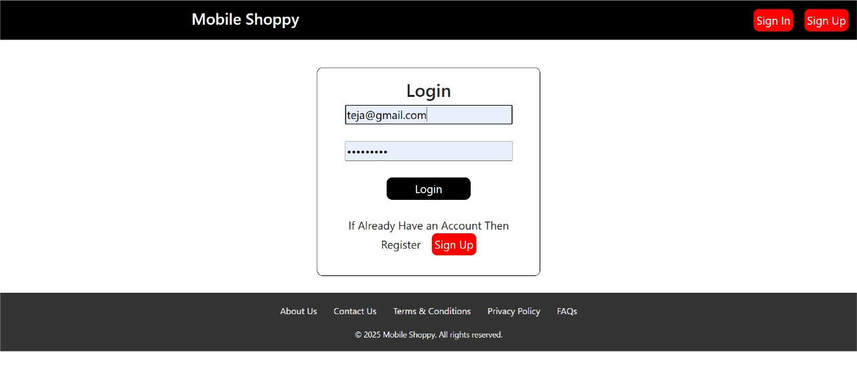
SAMPLE OUTPUT

Slide 12
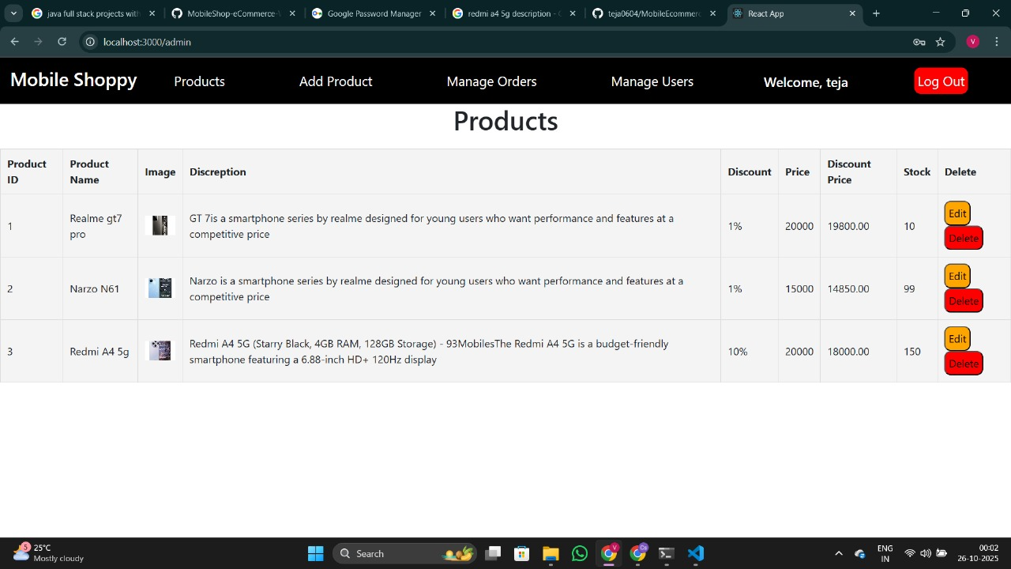
SAMPLE OUTPUT

Slide 13
CONCLUSION
The MobileShop eCommerce application demonstrates how modern technologies like Spring Boot and React.js can create a scalable, feature-rich online store. The project digitizes the mobile shopping experience for both customers and administrators, offering streamlined management, instant access to products, and an intuitive interface. Future improvements could include payment gateway integration, advanced analytics, and multi-category product support

