Slide 2
DataOps

Slide 3
Session focuses on:
1)What is DataOps?
2)Why it is there?
3)Who started?
4)Where to implement?
5)How to implement to organization?

Slide 4
DataOps was first introduced by Lenny Liebmann, Contributing Editor, InformationWeek, in a blog post on the IBM Big Data & Analytics Hub titled "3 reasons why DataOps is essential for big data success" on June 19, 2014. The term DataOps was later popularized by Andy Palmer at Tamr.
DataOps applies Agile software development, DevOps and the statistical process control used in lean manufacturing, to data analytics.

Slide 5
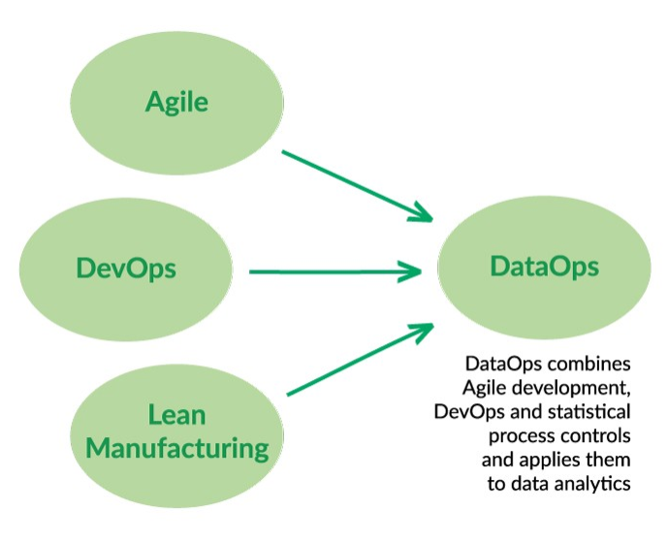
Figure 1: The intellectual heritage of DataOps.

Slide 6
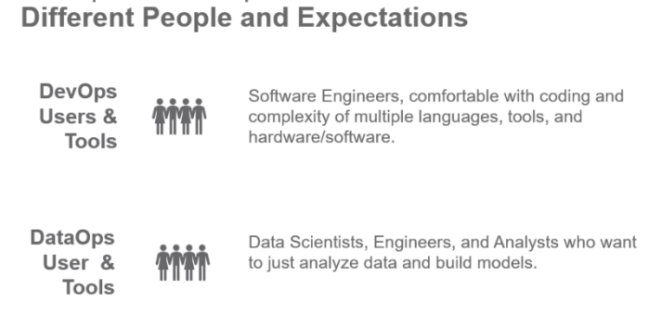
Figure 2: DataOps and DevOps users have different mindsets

Slide 7
The DataOps lifecycle — the Value and Innovation Pipelines
The data factory takes raw data sources as input and through a series of orchestrated steps produces analytic insights that create “value” for the organization. We call this the “Value Pipeline.” DataOps automates orchestration and, using SPC, monitors the quality of data flowing through the Value Pipeline.
The “Innovation Pipeline” is the process by which new analytic ideas are introduced into the Value Pipeline.

Slide 8
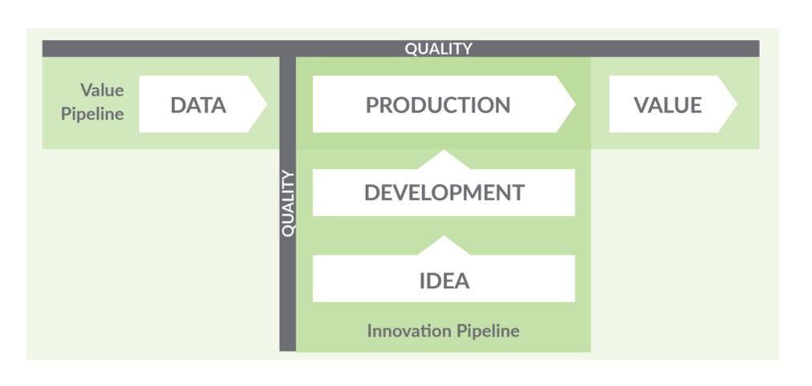
Figure 3: The DataOps lifecycle — the Value and Innovation Pipelines

Slide 9
Comparing the DataOps and DevOps processes
DevOps is an approach to software development that accelerates the build lifecycle (formerly known as release engineering) using automation.
DevOps focuses on continuous integration and continuous delivery of software by leveraging on-demand IT resources (infrastructure as code) and by automating integration, test and deployment of code.
DataOps seeks to reduce the end-to-end cycle time of data analytics, from the origin of ideas to the literal creation of charts, graphs and models that create value.
The data lifecycle relies upon people in addition to tools. For DataOps to be effective, it must manage collaboration and innovation.

Slide 10
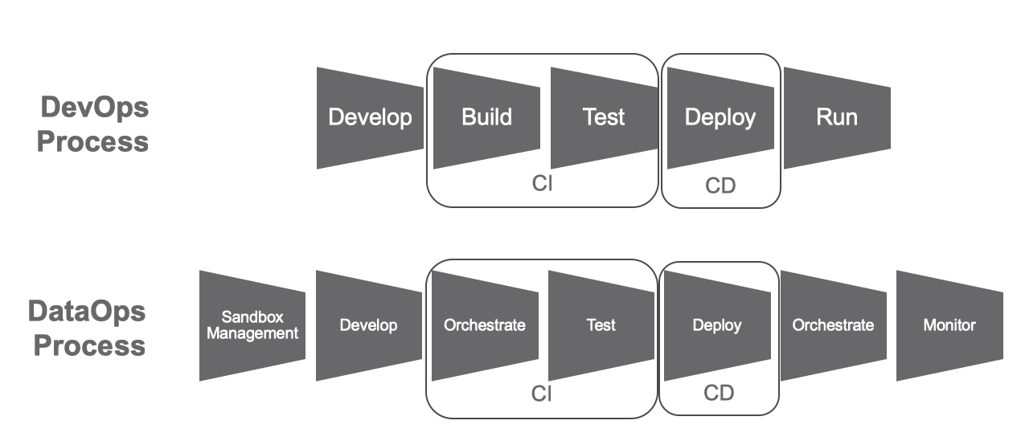
Figure 4: Comparing the DataOps and DevOps processes

