Slide 1
DataOps orchestrates the data factory
The data factory consists of a pipeline process with many steps. Imagine a complex directed acyclic graph (DAG). The “orchestrator” could be a software entity which controls the execution of the steps, traverses the DAG, and handles exceptions.
For example, the orchestrator might create containers, invoke runtime processes with context-sensitive parameters, transfer data from stage to stage, and “monitor” pipeline execution. Orchestration of the data factory is the second “orchestration” in the DataOps process in Figure 5.

Slide 2
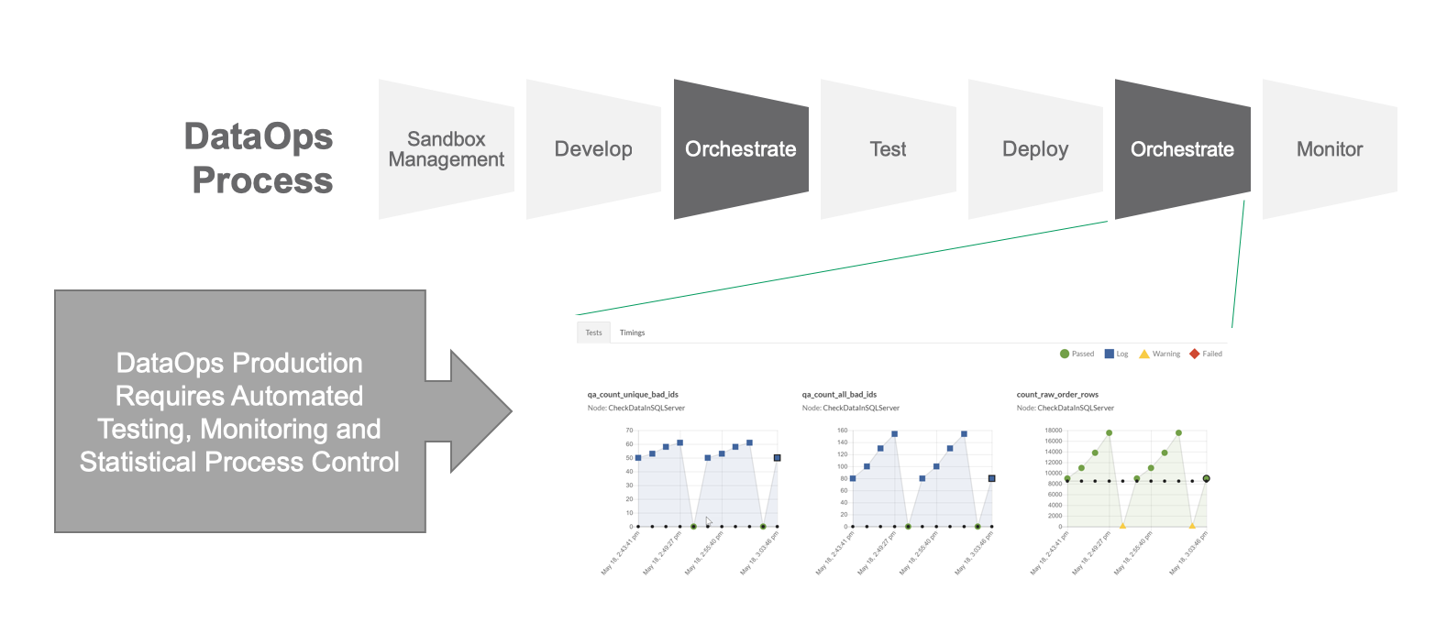
Figure 5: DataOps orchestrates the data factory.

Slide 3
DataOps orchestration
The Innovation Pipeline has a representative copy of the data pipeline which is used to test and verify new analytics before deployment into production. This is the orchestration that occurs in conjunction with “testing” and prior to “deployment” of new analytics — as shown in Figure 6.
Orchestration occurs in both the Value and Innovation Pipelines. Similarly, testing fulfills a dual role in DataOps.

Slide 4
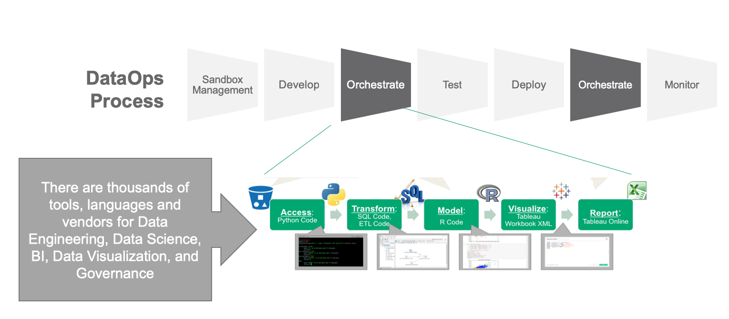
Figure 6: DataOps orchestration controls the numerous tools that access, transform, model, visualize and report data.

Slide 5
DataOps Complexity — Test Data Management
In order to create a dev environment for analytics, you have to create a copy of the data factory. This requires the data professional to replicate data which may have security, governance or licensing restrictions. It may be impractical or expensive to copy the entire data, set so some thought and care is required to construct a representative data set.
Once a multi-terabyte data set is sampled or filtered, it may have to be cleaned or redacted (have sensitive information removed). The data also requires infrastructure which may not be easy to replicate due to technical obstacles or license restrictions.

Slide 6
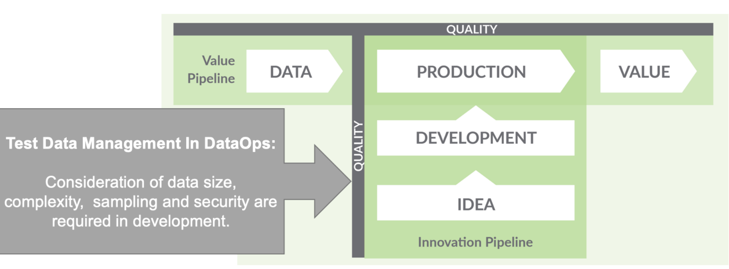
Test Data Management in DataOps
Figure 7: The concept of test data management is a first order problem in DataOps

Slide 7
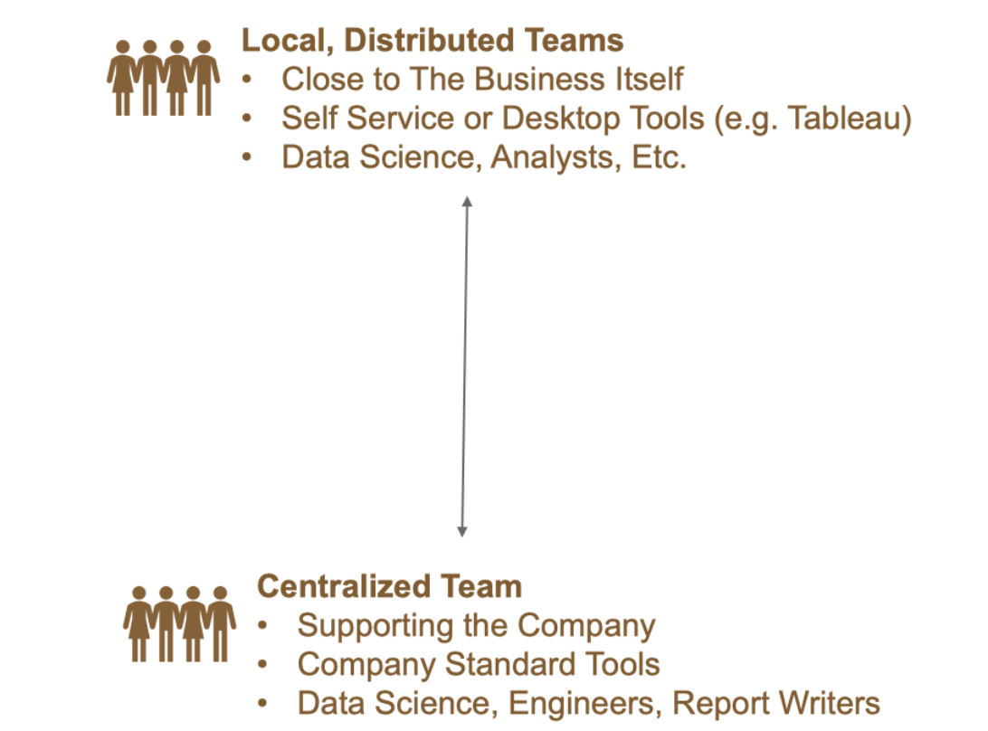
DataOps brings together centralized and distributed development

Slide 8
Data Analytics Lifecycle Complexity
Analytics are first created and developed by an individual and then merged into a team project. After completing unit acceptance testing (UAT), analytics move into production.
The goal of DataOps is to create analytics in the individual development environment, advance into production, receive feedback from users and then continuously improve through further iterations.

Slide 9
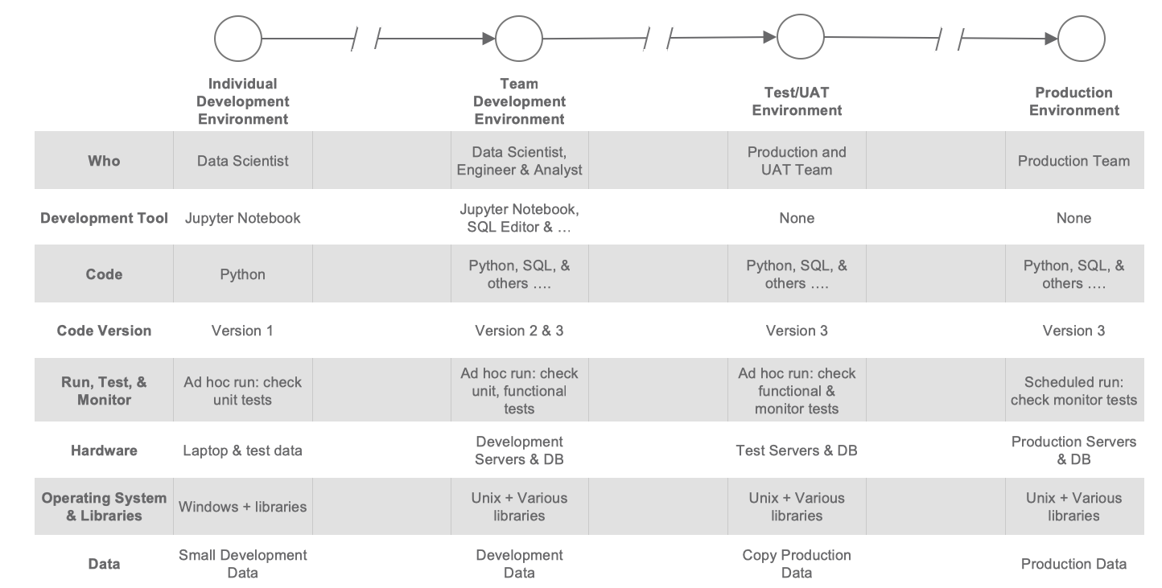
Figure 8: Data Analytics Development Lifecycle Complexities

Slide 10
Thank You

