Slide 1
Technical use cases
Denodo – Data Virtualization Tool

Slide 2

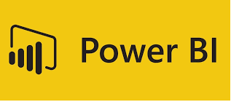
Denodo – Data Virtualization
Data Virtualization
SAP BW
SAP ECC
Web Scraping
(Walmart)
Scheduling
& Monitoring
1
2
3
5
6
4
Use Cases
#1 - SAP BW
#2 – SAP ECC
#3 – Web Scraping
#4 – Denodo Publish API
Dashboard
Apps
#5 – Self Service
#6 – Data Lake
Dashboard
SELF SERVICE
DATA LAKE
API
DASHBOARD
APPS
DASHBOARD

Slide 3
DevOps - Automation
Alerts & Notifications
Source Control
Quality Gates
Testing
Deploy & Configure
01
Developer Commits the code into the Source Control which triggers the build with automatic versioning
02
Unit Testing & Code Metrics are run Automatically and updating the Ticketing system with issues
03
Functional, Integration and other regression Tests are run on the new Build and issues updated into Ticketing system
04
Automatic Deployment & Configuration of the new Build into Test, Pre-Prod and Production servers with configurations

Slide 4
DevOps - Continuous Integration
Build & Version
Source Control
Code Quality & Metrics
Test
Unit Test
CI
Continuous Integration doesn’t get rid of bugs, but it does make them dramatically easier to find and remove

Slide 5
DevOps – Integrated Tools
Manage
JIRA
Store
Redmine
GITLAB
TFS
Build
Ant
Maven
Gradle
Continuous Integration
Jenkins
Bamboo
Hudson
Continuous Deployment
SonarQube
Chef
Puppet
SALT
BitBucket
TFS
MS Build
Continuous Testing
Selenium
SoapUI
Appium
JUnit
NUnit
SVN
Nexus
Ansible

Slide 6
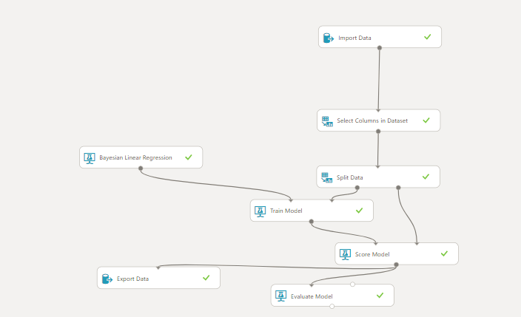
Machine Learning – Regression Model

Slide 7
Technical use cases
Machine Learning Framework

