Slide 1
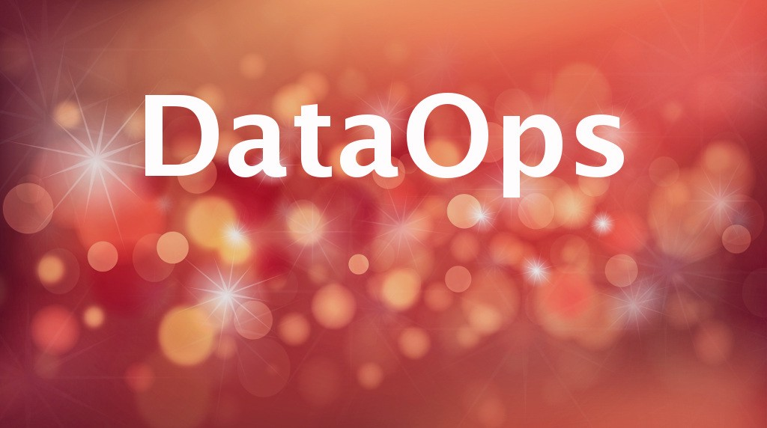

Slide 2
Key Motivation:
1)What is DataOps?
2)why it is there?
3) who started?
4) where to implement?
5) How to implement to organization?

Slide 3
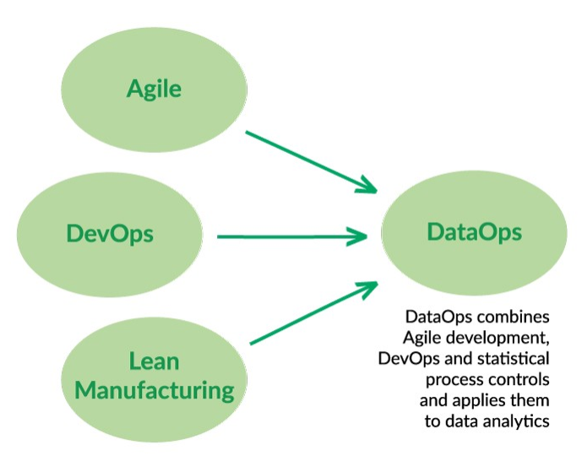
Figure 1: The intellectual heritage of DataOps.

Slide 4
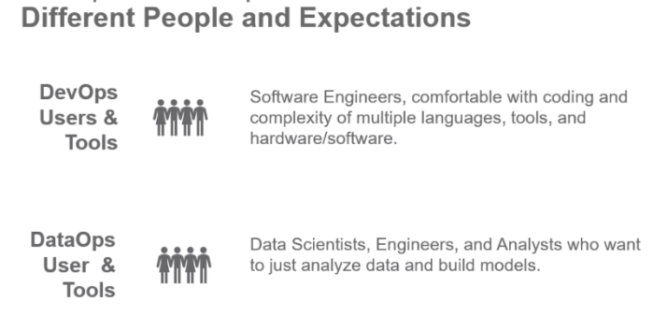
Figure 2: DataOps and DevOps users have different mindsets

Slide 5
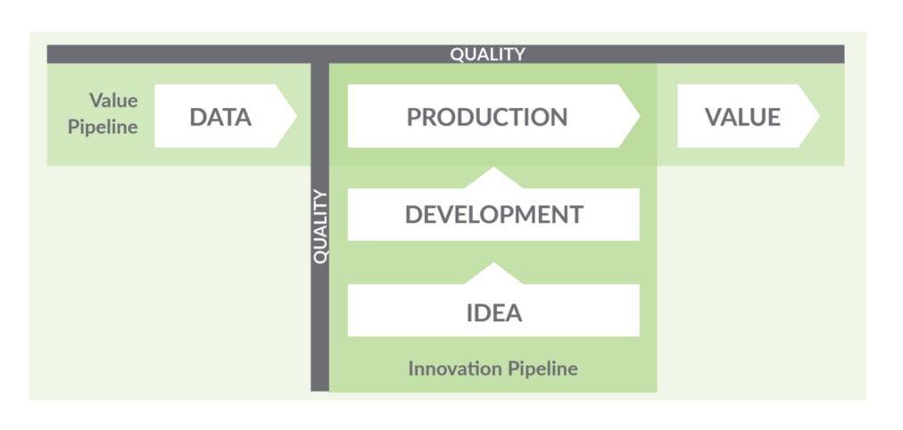
Figure 3: The DataOps lifecycle — the Value and Innovation Pipelines

Slide 6
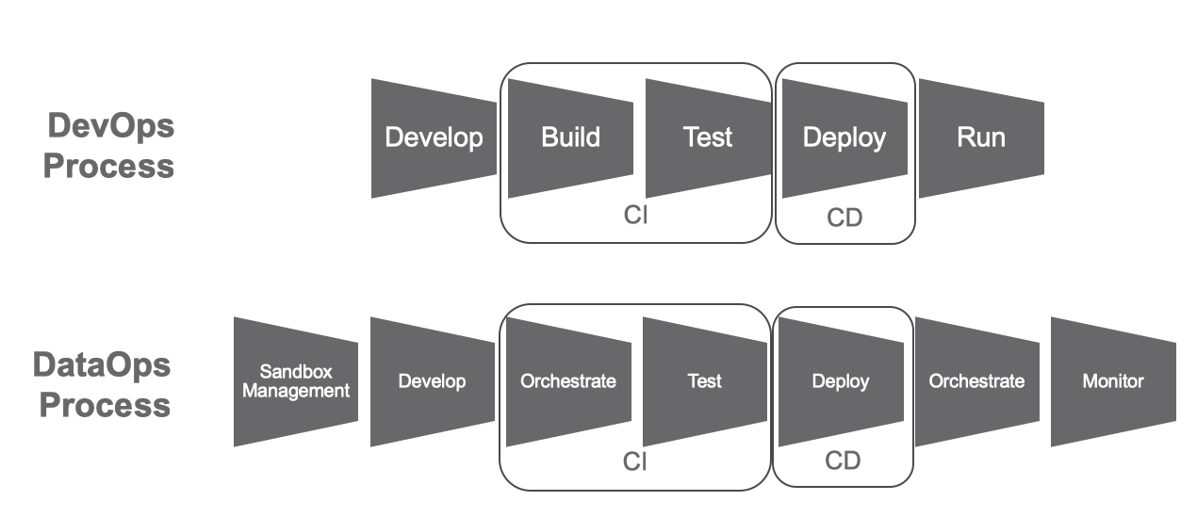
Figure 4: Comparing the DataOps and DevOps processes

Slide 7
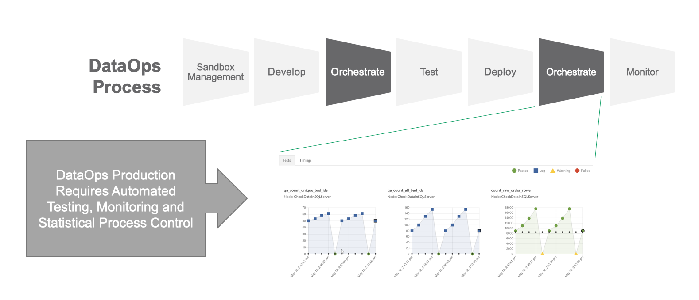
Figure 5: DataOps orchestrates the data factory.

Slide 8
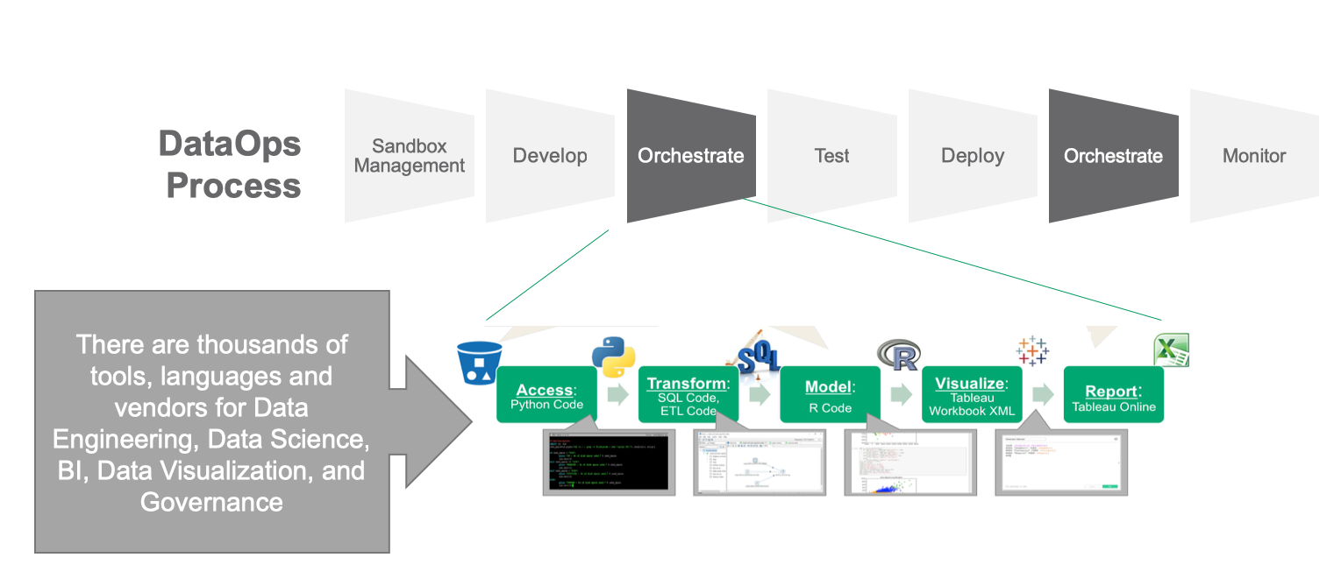
Figure 6: DataOps orchestration controls the numerous tools that access, transform, model, visualize and report data.

Slide 9
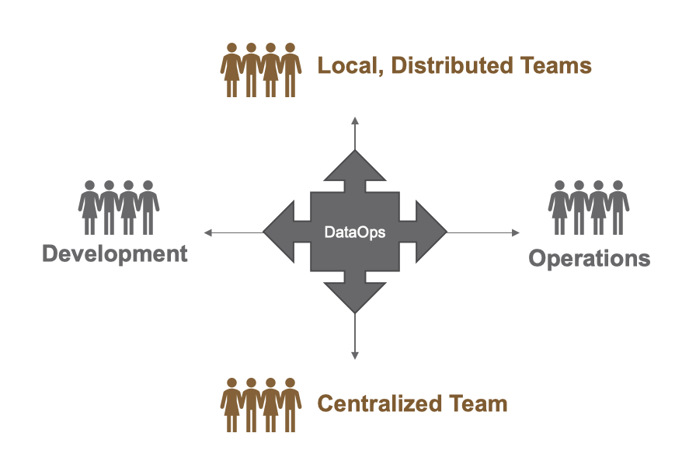
Figure 7: DataOps brings teams together across two dimensions — development/operations
as well as distributed/centralized development.

Slide 10
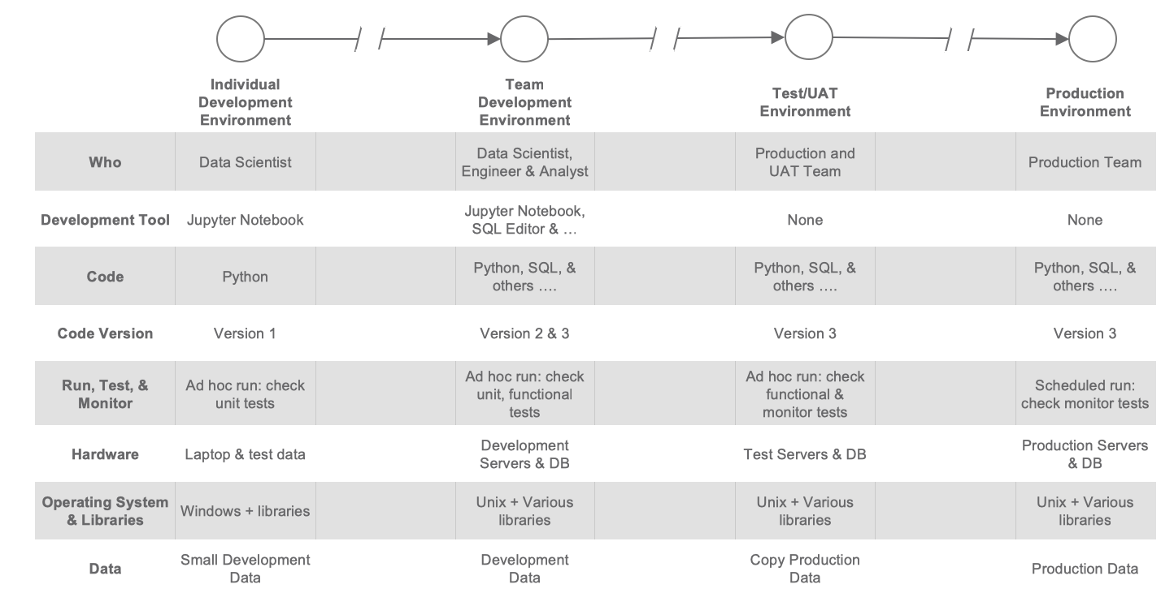
Figure 8: Data Analytics Development Lifecycle Complexities

Slide 11

Thanks & Regards
Bala Venkata Teja

