Slide 1

Customer Analysis
Data Analyst Project — [Student Name] · [College Name]
PYTHON
POSTGRESQL
PANDAS
POWER BI

Slide 2

Understanding Customer Analysis
Customer analysis is the systematic process of examining customer data to uncover purchasing patterns, preferences, and behaviors. In today's competitive market, businesses that understand their customers gain a decisive advantage.
Why It Matters
Business Impact
Reveals who buys, what they buy, and when — enabling targeted strategies.
Drives personalized marketing, improves retention, and boosts revenue.
Core Goal
Transform raw transaction data into actionable business intelligence.

Slide 3


Problem Statement & Objectives
The Challenge
Businesses struggle to interpret raw customer data, making it difficult to identify high-value customers, understand sales trends, and measure the true impact of discounts on purchasing behavior.
Project Objectives
Analyze customer purchasing behavior across demographics
Identify top-performing customers and product categories
Measure the impact of discounts on sales volume
Generate actionable, data-driven business insights

Slide 4
Dataset & Technologies
Dataset: customer-behaviour.csv
Technology Stack
A structured dataset capturing real-world purchasing transactions across seven key dimensions:
Python & Pandas
Data cleaning, transformation, and exploratory analysis
Customer ID
Gender & Age
Purchase Amount
Category
Discount Applied
Payment Method
PostgreSQL & SQL
Relational storage and complex analytical queries
Power BI & Matplotlib
Data preprocessing ensured quality before loading into PostgreSQL.
Interactive visualizations and reporting dashboards

Slide 5
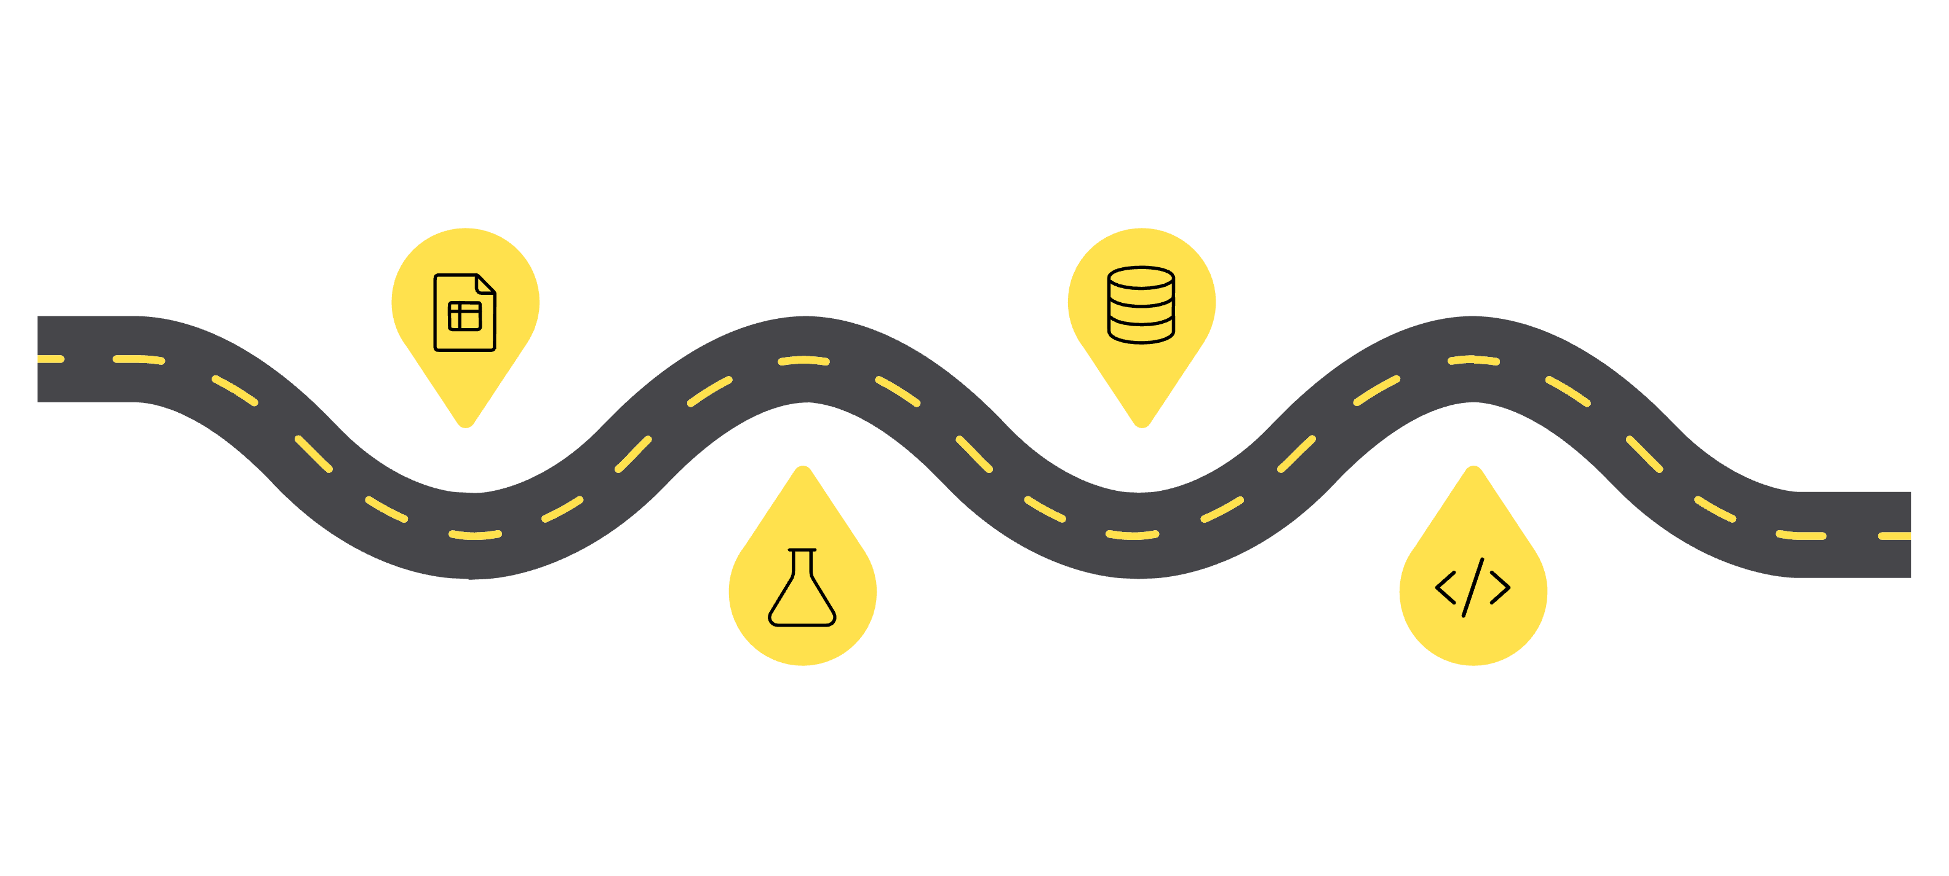
System Architecture
Data Import
Storage
Raw CSV dataset ingested
Load into PostgreSQL database
Cleaning
Analytics
Python scripts ensure data quality
SQL queries prepare datasets
The end-to-end pipeline transforms raw CSV data into a polished analytics dashboard — ensuring data quality at every stage before insights reach decision-makers.

Slide 6

Data Cleaning & Preprocessing
Preprocessing Steps
Null Value Removal
Rows with missing critical fields were identified and removed to ensure data integrity.
Column Standardization
Columns were renamed for consistency and readability across the analysis.
Duplicate Handling
Duplicate records were detected and eliminated to prevent skewed results.
Data Type Conversion
Numeric and categorical fields were cast to appropriate types before PostgreSQL upload.

Slide 7
SQL Queries & Analysis
Key analytical queries executed in PostgreSQL to extract meaningful business insights from the cleaned dataset.
Average Purchase Amount
Gender-Wise Revenue
Computed mean spend per customer segment to gauge purchasing power.
Aggregated total revenue by gender to identify spending patterns.
Discount Impact
Top Categories
Compared purchase volumes with and without discounts applied.
Ranked product categories by total revenue to spotlight top performers.

Slide 8
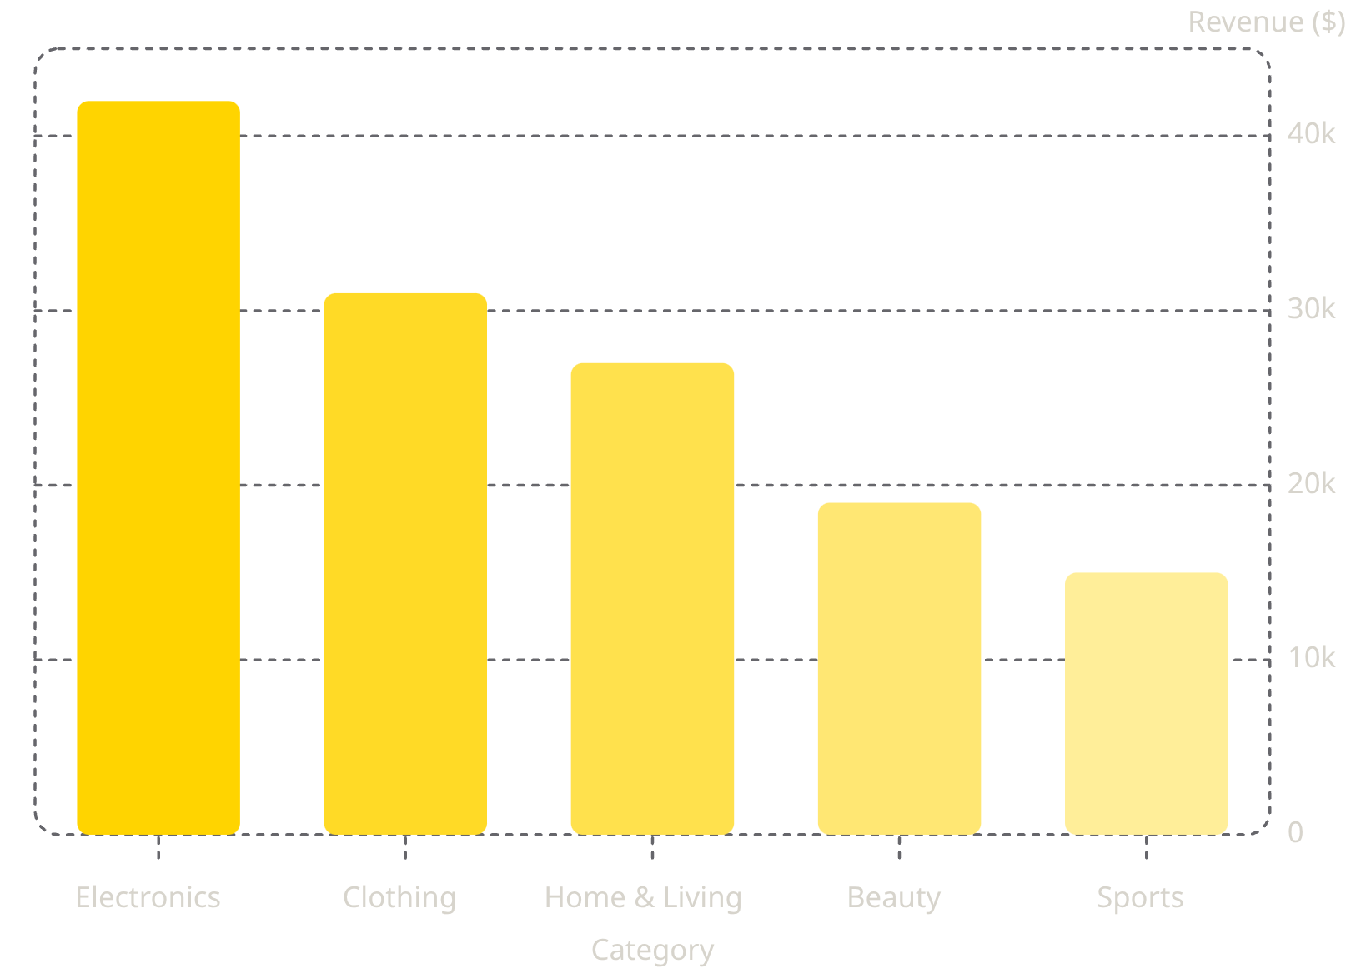
Data Analysis & Insights
Key Findings
Electronics Leads Revenue
Discount Sensitivity
Highest-grossing category, driving over 30% of total sales.
Discounted transactions showed 18% higher purchase frequency.
Gender Spending Gap
Female customers contributed ~55% of total revenue on average.

Slide 9


Results & Business Advantages
Project Outcomes
1
Customer Behavior Mapped
Clear segmentation of customers by age, gender, and spending habits.
2
Top Categories Identified
Electronics and Clothing emerged as the highest-revenue segments.
3
Discount Strategy Validated
Confirmed discounts drive volume — enabling smarter promotional planning.
Key Advantage: Data-driven decisions replace guesswork, improving marketing ROI and revenue growth.

Slide 10
Future Scope & Conclusion
What's Next
Conclusion
01
This project demonstrates the full power of a modern data analytics pipeline — from raw CSV data to actionable business intelligence. By combining Python, PostgreSQL, and Power BI, we transformed customer transaction data into clear, strategic insights.
Data analytics is not just a tool — it's a competitive advantage.
Machine Learning Predictions
Build models to forecast customer lifetime value and churn risk.
02
Recommendation Engine
Personalized product recommendations based on purchase history.
Thank You
Questions & Discussion Welcome
03
Real-Time Dashboard
Live Power BI integration for instant business monitoring.

