Slide 1
Adaptive Hybrid Quantum–Classical Optimization Framework for Distributed Order Management Using QAOA
WISER × Nestlé Quantum Challenge 2026
Prepared by:
Kadiyam Nava Kasturi Teja
Computer Science and Engineering
(Data Science)
R.V.R. & J.C. College of Engineering

Slide 2
Distributed Order Management (DOM)
Business Challenge
When the default Distribution Center (DC) cannot fulfill an order due to operational constraints, an alternative DC must be selected while satisfying business requirements.
Constraints
Inventory Availability
Throughput Capacity
Dock Capacity
Shipping Cost
Revenue
Penalty Cost
Objective
Assign every order to at most one distribution center while maximizing business value and minimizing operational cost.

Slide 3
Proposed Hybrid Quantum–Classical Framework
Key Components
Data Preprocessing
Candidate Generation
Adaptive Priority Score
Candidate Reduction
QUBO Formulation
QAOA Optimization
Business Repair
Final Business Solution

Slide 4
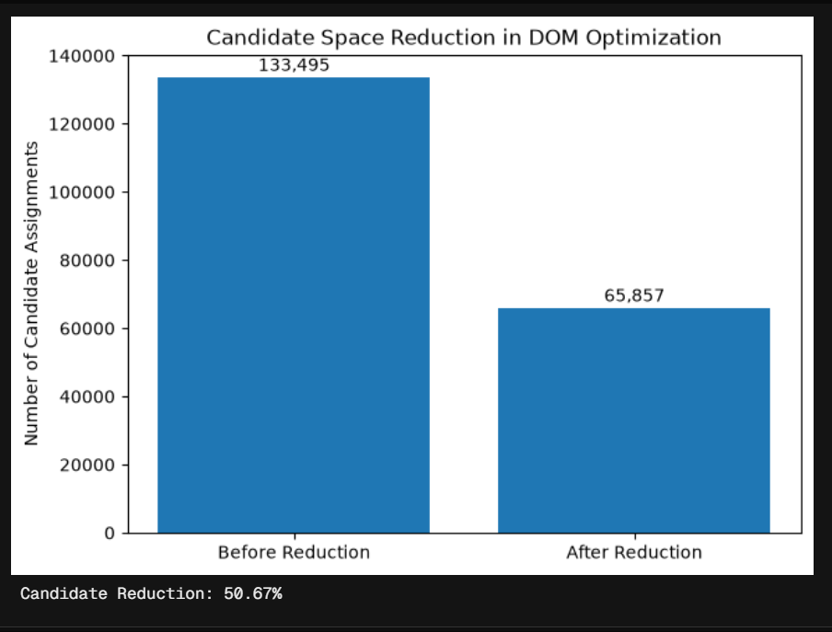
Optimization Results:
Candidate Reduction:
Benchmark Comparison
Benchmark Comparison:
Stage | Number of Candidates
Initial feasible candidates | 133,495
Reduced optimization candidates | 65,857
Reduction achieved | 50.67%
Method | Revenue | Shipping | Penalty
Greedy | 76,691,433 | 32,027,721 | 461.746
Exact QUBO | 4,744,085 | 22,405 | 0.000
QAOA | 2,490,693 | 12,477 | 0.040

Slide 5
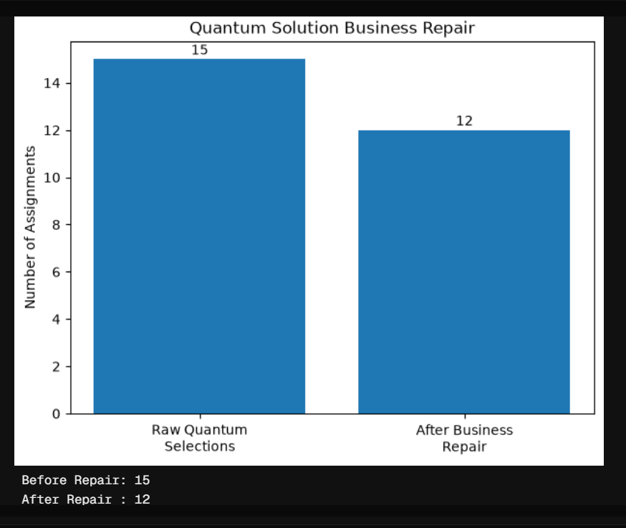
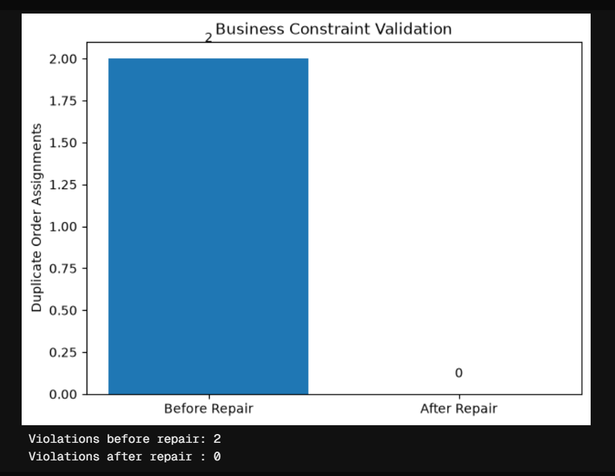
Business Validation and Feasibility Repair
Business Repair Process Constraint Validation
Raw quantum solution selected 15 assignments.
Duplicate order assignments were identified.
A business repair layer removed duplicate assignments.
Final feasible solution contained 12 valid assignments.
Key Result::The repair layer successfully eliminated all duplicate order assignments, ensuring that every order was assigned to at most one distribution center while satisfying business constraints.
Outcome: The business repair layer transformed the raw quantum output into a fully feasible business solution with zero constraint violations.
Metric | Value
Violations Before Repair | 2
Violations After Repair | 0

Slide 6
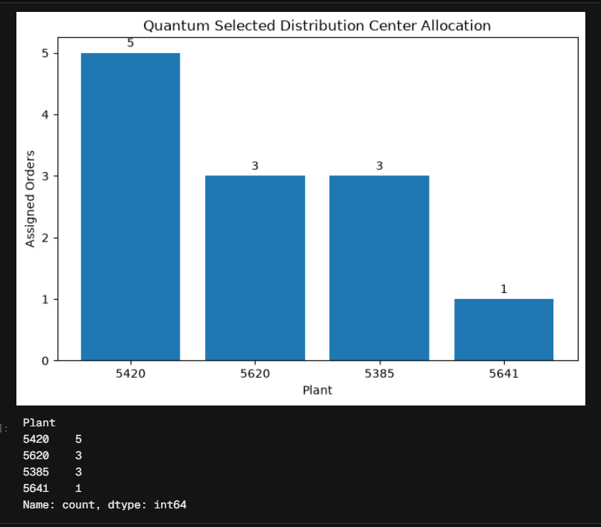
Distribution Center Allocation and Scalability Analysis
Distribution Center Allocation
Final Distribution Center Allocation
Key Observation
Orders were assigned across four feasible distribution centers.
Plant 5420 handled the highest number of optimized assignments.
The final allocation satisfied all operational constraints after business repair.
Scalability Analysis
Current Limitations
Large number of candidate assignments
Exponential growth in optimization variables
Limited qubit availability
QAOA execution restricted to small problem instances
Increased runtime for larger optimization models
Scalability Improvements
✅ Adaptive Candidate Reduction (50.67%)
✅ Classical preprocessing
✅ Problem decomposition
✅ Batch optimization
✅ Future execution on larger quantum hardware
Distribution Center | Orders Assigned
5420 | 5
5620 | 3
5385 | 3
5641 | 1

Slide 7
Thank You

Slide 8
Conclusion and Future Work
Project Contributions
✅ Developed a Hybrid Quantum–Classical Optimization Framework for Distributed Order Management.
✅ Formulated the business problem as a Quadratic Unconstrained Binary Optimization (QUBO) model.
✅ Implemented Adaptive Priority Scoring and Candidate Reduction, reducing the optimization search space by 50.67%.
✅ Solved the optimization problem using both the Exact QUBO Solver and the Quantum Approximate Optimization Algorithm (QAOA).
✅ Introduced a Business Repair Layer to ensure feasible order assignments and eliminate duplicate distribution center allocations.
Key Achievements
Future Work
Scale the framework to larger Distributed Order Management datasets.
Evaluate the approach on future quantum hardware with more qubits.
Investigate advanced QAOA parameter optimization and circuit designs.
Develop multi-objective optimization models incorporating sustainability and delivery time.
Integrate real-time inventory updates and dynamic demand forecasting.
Compare the framework with additional optimization techniques such as MILP, Genetic Algorithms, and Simulated Annealing.
Closing Statement
The proposed hybrid quantum–classical framework demonstrates that adaptive preprocessing, QUBO modeling, quantum optimization, and business validation can effectively address complex Distributed Order Management problems while providing a scalable foundation for future quantum-assisted supply chain optimization.
Metric | Result
Candidate Reduction | 50.67%
Constraint Violations After Repair | 0
Final Business Assignments | 12
Hybrid Quantum–Classical Workflow | Successfully Implemented

