Slide 1

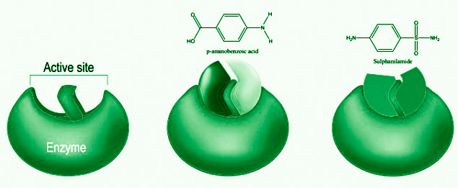
BIOINFORMATICS
Machine Learning Models for Predicting Drug-Target Interactions
BY-D09
PRESENTED
Teja deep (CB.SC.U4AIE23328)
Kalyan (CB.SC.U4AIE23318)
Devi Aakash (CB.SC.U4AIE23311)
Sikar (CB.SC.U4AIE23355)
School of Artificial Intelligence
Amrita Vishwa Vidyapeetham Coimbatore - 641112

Slide 2
PROBLEM STATEMENT
The goal of this project is to develop a predictive model using Random Forest to identify potential interactions between drug molecules and target proteins. Accurately predicting drug-target interactions (DTI) is critical in drug discovery, as it helps in identifying candidate compounds that may have therapeutic effects, thereby accelerating the drug development process. The model will be trained on a dataset of known drug-target interactions and tested for its ability to predict interactions for novel compounds or targets.

Slide 3
PROJECT OVERVIEW
Objective
Goal: Predict interactions between drugs and biological targets (e.g., proteins) using a machine learning approach. This can help in drug discovery and repurposing by identifying potential new uses for existing drugs or discovering new drug candidates.
Aim: Develop a random forest-based model to classify whether a given drug will interact with a specific target based on various features.

Slide 4
Background
Drug-Target Interactions:
Drug target interactions are the connections between drugs and the parts of the body they act on, like proteins. Understanding these interactions helps us figure out how a drug works and how to design new medicines.
Use: Figuring out these interactions traditionally takes a lot of time and money because it involves lots of experiments and tests.
Machine Learning in DTI:
Machine learning is a way of teaching computers to recognize patterns and make predictions based on data.
How It Helps:
Instead of doing all the experiments manually, machine learning can quickly analyze data to predict which drugs might work on which targets. This speeds up the process and can uncover useful information that might be missed using traditional methods

Slide 5
LITERATURE REVIEW
S.No | Authors and Year | Title of the paper | observation
1 | Zeng et al. (2020) | Network-based prediction of drug-target interactions using random forest | Applied Random Forests to predict DTIs by leveraging network-based features, demonstrating the effectiveness of ensemble methods in DTI prediction.
2 | Wen et al. (2017) | Deep-learning-based drug-target interaction prediction | Applied deep learning techniques to DTI prediction, achieving better performance compared to traditional methods. Highlighted deep learning’s potential
3 | Mei et al. (2013) | Drug-target interaction prediction by learning from local information and neighbors | Focused on local information and neighbor-based learning for predicting DTIs, showing the importance of local structure in DTI networks.
4 | Rifat et al. (2021) | Prediction of drug-target interactions using machine learning methods and ensemble learning | Compared multiple machine learning models, including Random Forest, showing that ensemble learning approaches generally perform better for DTI prediction.
5 | Chen et al. (2016) | WNN-DTI: Weighted Nearest Neighbor Profiles for Drug-Target Interaction Prediction | Developed WNN-DTI, a weighted nearest neighbor method, which outperformed several traditional machine learning models in predicting DTIs
6 | Öztürk et al. (2018) | DeepDTA: deep drug-target binding affinity prediction | Focused on predicting binding affinity, introducing a novel approach for continuous DTI prediction rather than binary classification

Slide 6
CONCLUSION
Our machine learning model effectively predicted drug-target interactions using a small synthetic dataset. The model identified key features influencing interactions and demonstrated potential for accelerating drug discovery. For better results, expanding the dataset and exploring advanced methods are recommended

