Slide 1
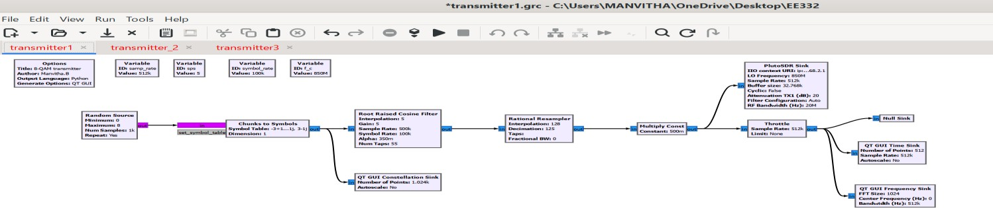
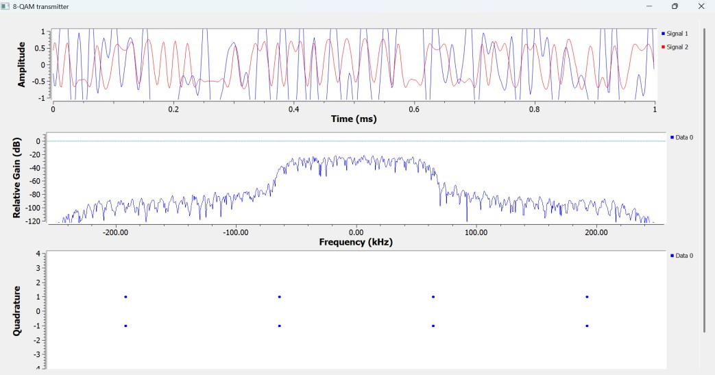
TRANSMITTER DESIGN
EE 332 COURSE PROJECT
Question-1 : Design a transmitter in GNU Radio Companion (GRC) that is capable of transmitting a 8QAM modulated signal using an ADALM-Pluto SDR with specifications.
FLOWGRAPH :
Procedure :
Random Source generates integers 0–7 for 8-QAM
Chunks to Symbols →Maps integers to 8-QAM IQ points
RRC Filter → Pulse shaping and interpolation (symbol rate = 100kHz, sps = 5.12)
Rational Resampler →The sps of 5.12 is not an integer, so you use sps=5 in the RRC filter and compensate with the to get the true 512k sample rate.
Multiply Const →to keep the IQ samples within the range of PlutoSDR driver
PlutoSDR Sink→This is the RF output block, it sends IQ samples to the physical ADALM-Pluto hardware.
RESULTS and ANALYSIS :
Constellation sink : 8-QAM constellation at symbol rate and we get 8 distinct IQ points.
Fequency sink :Baseband signal with bandwidth = symbol_rate × (1 + alpha) = 135 kHz.

Slide 2
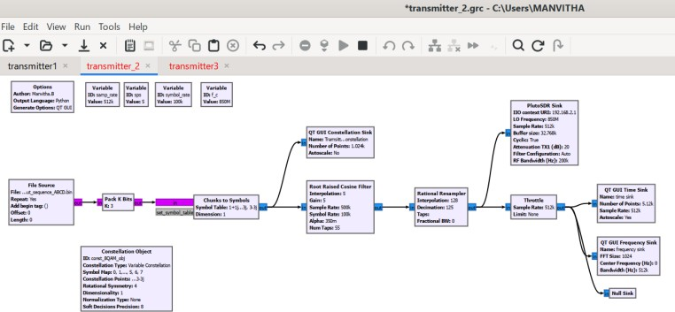
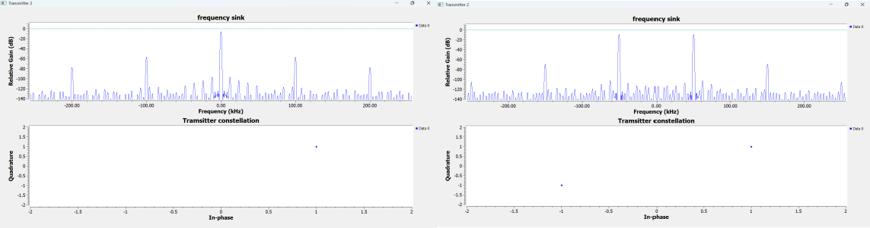
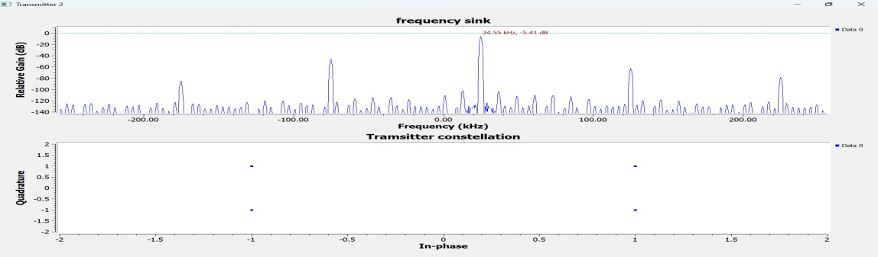
Question2 : Design a transmitter using a binary file source as the input, where the source contains sequences of bit streams corresponding to a modulated signal(A→B→C→D)
Flow graph :
Procedure :
a File Source block with binary sequence input file(generated by python code)
Remaining all blocks are similar to question -1.
Results and Analysis :
ForA→B→C→D,constellation sink is only four points like corners of square of side 2. And frequency sink is peak at 25kHz and 100KHz apart frequencies with decreasing gain on either side (100/4 = 25)
For A→C→A→C, constellation sink in only 2 points diagonal to each other. Frequency sink is peaks at 50kHz and-50KHz and others at harmonics(100/2 = 50)
For A→A→A→A, constellation sink in only 1 point.Frequency sink is peak at 0 Hz .

Slide 3
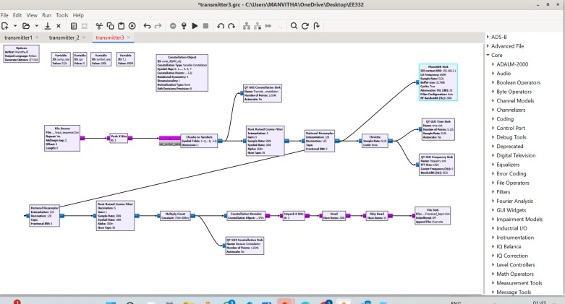
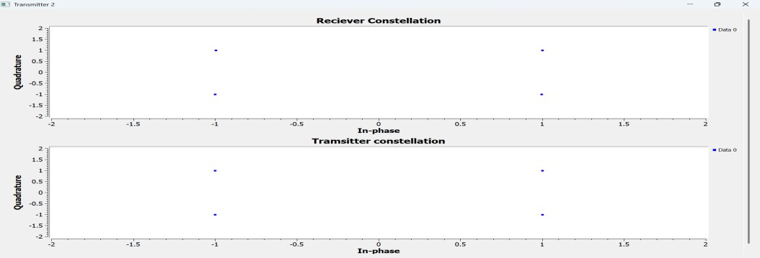
Question-3 : Using the transmitter flowgraph designed in part 2, implement a receiver under ideal loopback conditions by feeding the transmitted signal directly to the receiver input.
Flowgraph :
Procedure :
The transmitted baseband signal is fed directly back into the receiver without going through any real RF channel — no noise, no frequency offset, no timing error, no phase error. The receiver reverses every step the transmitter did to recover the original bitstream and save it to a file.
Resampler and root raised cosine are exactly used again.
Multiply Const (0.734 − 0.698j). corrects the overall complex amplitude scaling
introduced by the transmitter.
Constellation Decoder: Maps received samples to nearest 8-QAM symbol.
Unpack K Bits:Converts symbol indices back to raw bits.Head Limits output to fixed number of bits, Skip HeadRemoves filter delay transients.
File Sink :saves the recovered bitstream to a binary file
RESULTS and ANALYSIS :
Matched constellation at receiver and transmitter
Input binary file generated by python code
Decode file recovered and both the binary files are compared with the help python code.

Slide 4
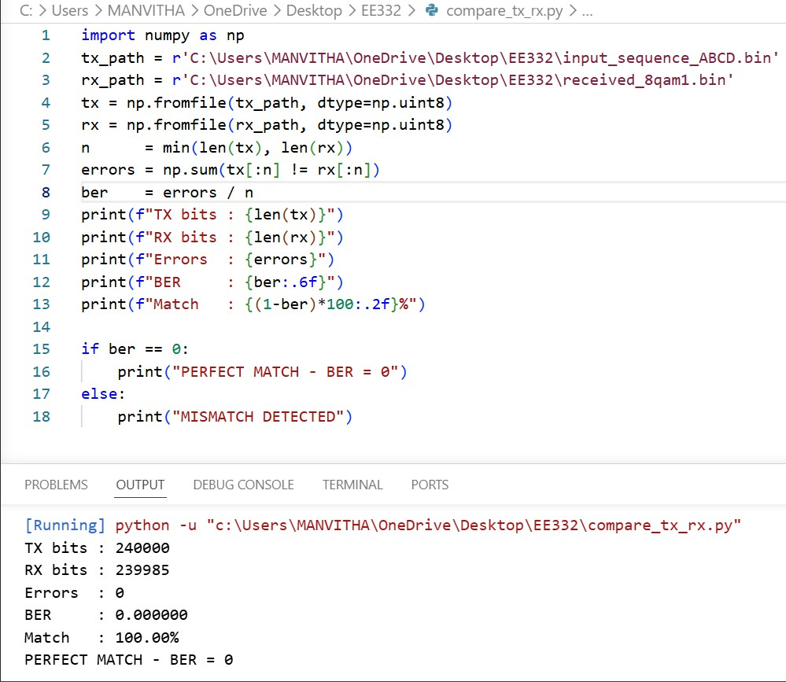
4. We got 100% matched with zero bit error rate .

