Slide 1

STREAMLINING JOB SEARCH
DOMAIN: JOB SEARCH AND RECRUITMENT OPTIMIZATION
TEJAAS MUKUNDA REDDY
886702844

Slide 2
AGENDA
INTRODUCTION
PROBLEM STATEMENT
CURRENT SITUATION
APPROACH
ACCOMPLISHMENTS
APPLICATION ARCHITECTURE
DATABASE
FUTURE SCOPE
CONCLUSION
DEMO

Slide 3
INTRODUCTION
People in the IT industry and graduating computer science students are confronted with various problems when seeking jobs opportunities as the software and IT industry dedicated to recruiting is evolving at an accelerated rate. Job hunting requires numerous hours of commitment, including cases of fraudulent job posts and misaligned skills.
The context of these issues clearly shows that these gaps need to be closed to improve hiring for both recruiters and job seekers.

Slide 4
PROBLEM STATEMENT
The current recruitment process takes significant time and is stressful for candidates
Only 36% of candidates are satisfied with the hiring process, according to Indeed
A survey conducted my Indeed reveals that graduating students typically spend 10-20 hours per week searching for employment
The IT industry is the most targeted industry for job scams, according to the Federal Trade Commission
Only 23% of US adults have the basic digital skills needed for most jobs in today's economy, according to the National Skills Coalition
These statistics show that many candidates are not satisfied with the current hiring process. They also show that the IT industry is in high demand for skilled workers, but that there is a shortage of tech-literate candidates.

Slide 5



CURRENT SITUATION
Job boards provide a platform for employers to advertise job openings and for job seekers to search and apply for positions.
However,
Candidates often need to search through numerous job listings to identify the skills companies are seeking
The key issues mentioned in the problem statement like time consumed for each application & job scams persist in job boards.
Job boards sometimes display job listings that are no longer available when you visit the company's website
Currently, there is no established website that offers real-time information on trending technologies for users.
My approach prioritizes candidates and students to work on enhancing their skills, while recruiters focus on finding and hiring suitable candidates.

Slide 6
APPROACH
The home page of the website will display the current trending technologies based on the data fetched from Job Boards
The user/candidate will allow them to perform the following operations
Upload resume
Express interest in companies
Upload Certifications
The recruiter will have a separate page where they can perform the following operations
Filter Candidates Based On Ranking and Company Interest
Specify The Domain In Which The Recruiter Is Seeking Candidates
Reach out to candidates
Candidates do not need to actively apply for jobs, recruiters will directly contact them if they believe the candidate is a suitable fit for their role.

Slide 7
ACCOMPLISHMENTS
Closing the Skills Gap
Global ranking system guides candidates, fostering continuous skill enhancement.
Enhancing Efficiency and Transparency
Streamlined recruitment process reduces manual applications and direct connections minimize fraud risks
Empowering Recruiters
Advanced algorithms enable recruiters to target candidates with precise skill sets, optimizing hiring strategy.
Innovative Technological Architecture
Integration of Angular, Flask, Hadoop, Apache Spark, Apache Kafka, and neural network models for robust architecture.
User-Centric Design
User-friendly design ensures seamless navigation for both candidates and recruiters.

Slide 8
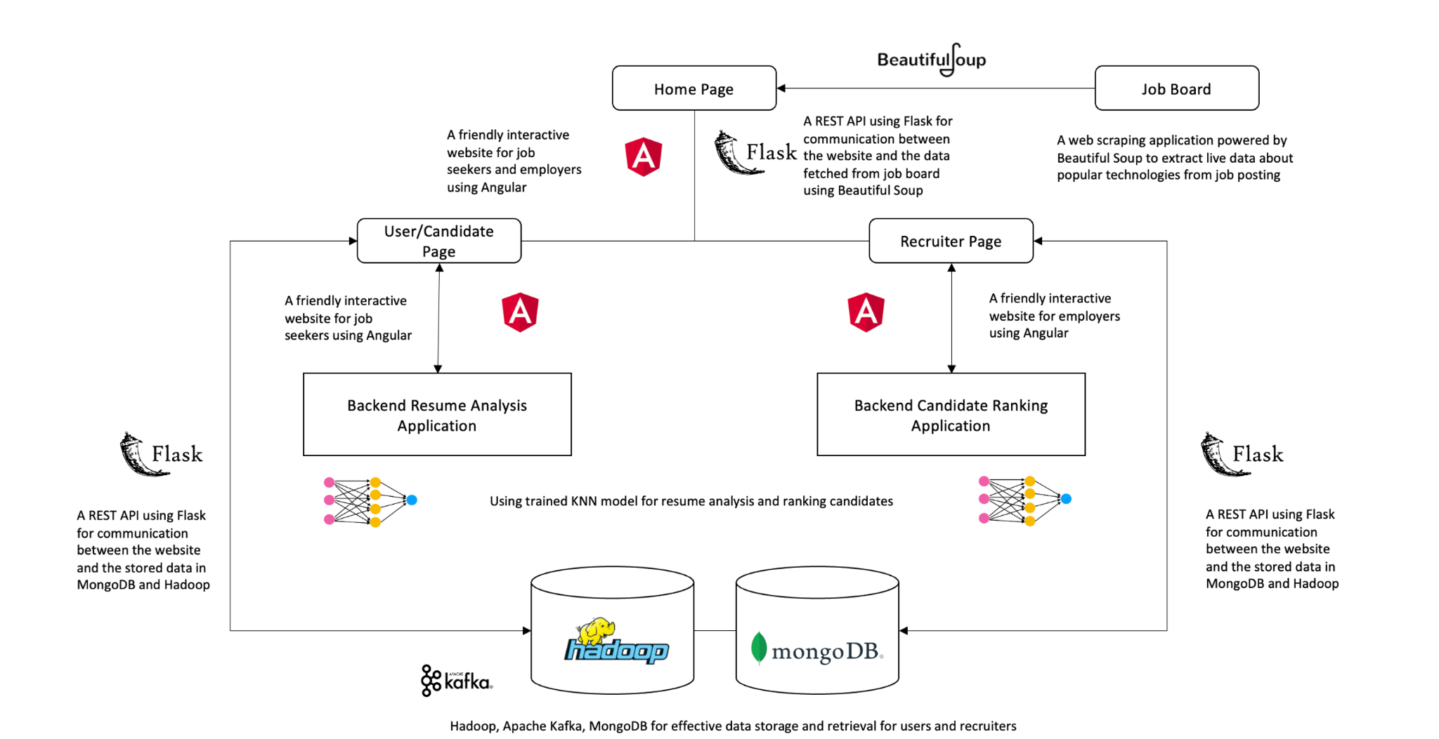
APPLICATION ARCHITECTURE
Homepage displays trending technologies from Job Board
Homepage: Links for users and recruiters
Users can upload resumes
Recruiters can filter candidates based on ranks and domain
Data is stored in Hadoop and MongoDB database
Frontend built with Angular
Backend linked through REST API using Flask.

Slide 9
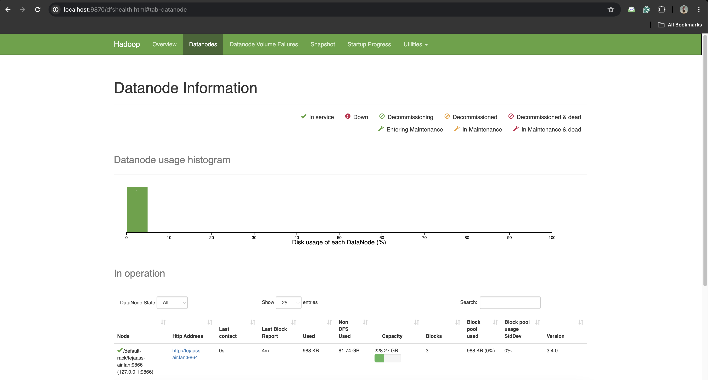
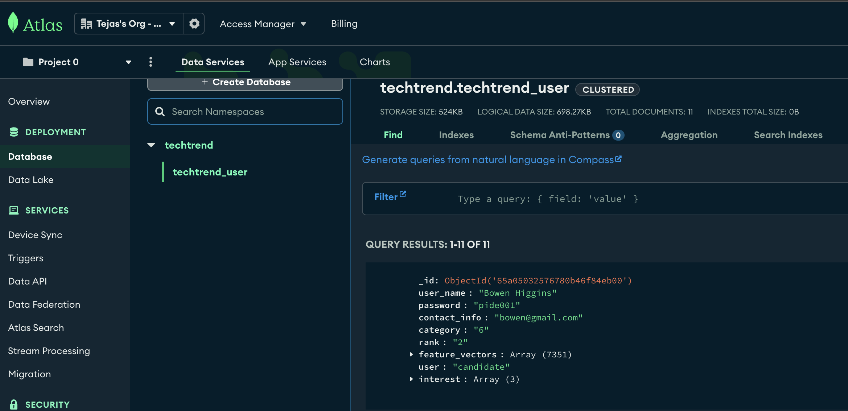
DATABASE
Hadoop
MongoDB

Slide 10
FUTURE SCOPE
EXPAND
IMPROVEMENT
DIRECT CONNECT
Enhance the existing project by integrating with additional job boards and broaden its scope to include posting job listings, reducing reliance on external boards for data retrieval
Enhance Resume Review Technology with Advanced Algorithms
Implement Enhanced Data Security and Verification Measures
Connect directly with companies and recruiters to post job listings on our website, eliminating the need to fetch data from job boards.

Slide 11
CONCLUSION
Proposed project is designed with a twofold purpose,
To empower students with the skills that employers are seeking and to shield them from potential job posting scams by facilitating direct connections with recruiters while streamlining the traditional job application process
Additionally, this platform offers recruiters a more efficient means of candidate selection. My project is dedicated to simplifying and enhancing the job search and recruitment process, ultimately promoting efficiency for both job seekers and recruiters

Slide 12
DEMO

Slide 13

THANK YOU!

