Slide 1
EfficientFormer: Vision Transformers at MobileNet Speed
IE643 Course Project
Team Karasuno
200050020 Teja Bale
200050160 Yash Mailapalli

Slide 2
Outline
Description of Problem Statement
Work Done until Mid Term Review
Comments Received at Mid Term review
Addressing the Comments
Work done after Midterm Review
Latency Comparison
Deployment
Conclusion
Possible Future Directions
References

Slide 3
Problem Statement
Vision Transformers have lower inference speed compared to CNN’s and are unsuitable for real time applications on resource-constrained hardware.
The major factors contributing to latency issues:
Inefficient operations in ViT architectures
Suboptimal patch embedding strategies
Feature dimension inconsistencies
Non-optimized nonlinearity choices
Solving these limitations help us in unlocking the potential of transformers in edge and mobile devices achieving a balance between latency and accuracy.

Slide 4
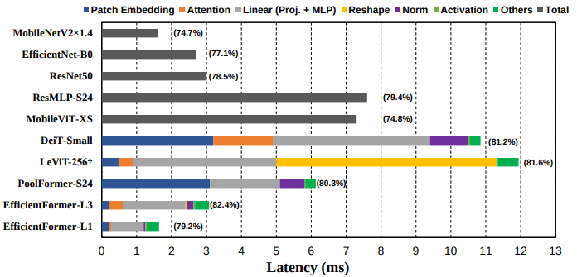
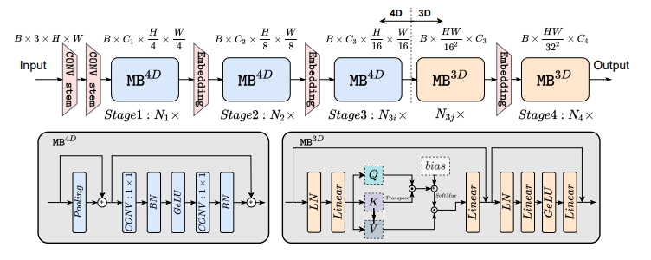
Work done before Mid Term
We learnt about Transformers, attention mechanism and how they work.
We also understood the necessity of vision transformers.
We’ve completed reading and understanding the whole paper and how they’ve implemented it.
We identified the areas where the efficientformer has improved upon as compared to the ordinary vision transformers.

Slide 5
Comments during Mid term Review
Instructor Comments:
Overall presentation was ok.
Status of work: read source code and understand the implementation of model.
For final review:
Team should implement the code and get it working on a small subset of imagenet or some other image dataset
The team should show results on latency comparison with at least a couple of existing models
After the code implementation is done, the team can try some tweaks on their own for the final presentation
TAs Comments:
Presentation was ok, understanding of paper was also decent. Team did not run any experiments that could have been done using some smaller version of Imagenet or CIFAR.

Slide 6
Addressed the comments given
Reading the Source Code and Understanding the code implementation.
Implementation of Code on a smaller subset of the dataset(ImageNet).
Met with TA’s regarding the difficulties faced during implementation of code.
Latency Comparison with the following Models on 5000 images:
MobileNetV2 - CNN Model
PoolFormer-S12 - Vision Transformer
Levit-256 - Vision Transformer
Tested the trained model with random images from the internet, not part of the ImageNet Dataset.
Tried to deploy our model on Iphone(using Xcode), to test latency and accuracy in real time scenarios.

Slide 7
Work Done after Mid Term
Initially, we attempted to train the model on the complete dataset, but faced challenges due to prolonged training times and limitations of Colab's GPU.
Although Kaggle offered additional computational power with a dual GPU setup, the original code wasn't optimized for parallel execution on two GPUs.
Following advice from the TAs, we opted to continue using Colab due to its compatibility and resource availability.

Slide 8
Work Done after Mid Term
Narrowed focus to 10 classes to alleviate training complexities.
Despite efforts, training for 100 epochs took over 3 hours with only 50% accuracy.
Noticed continuous improvement in accuracy, indicating potential with extended training.
But practical limitations emerged, making it impractical to train effectively even for the reduced set of 10 classes.

Slide 9
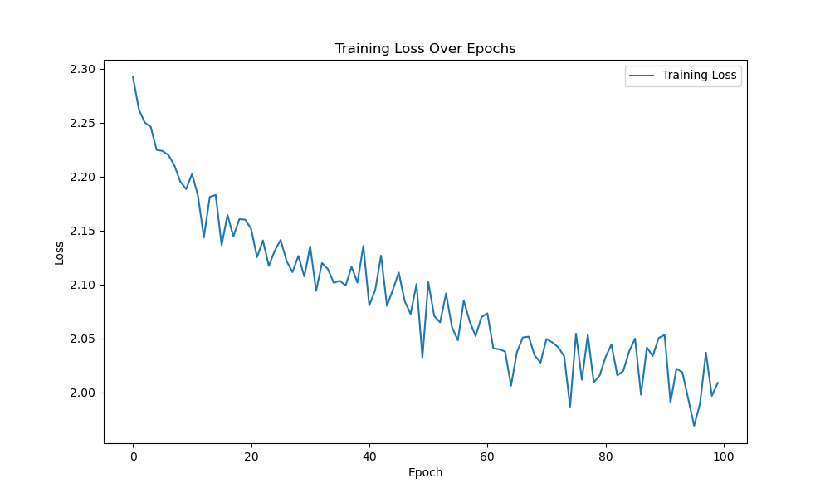
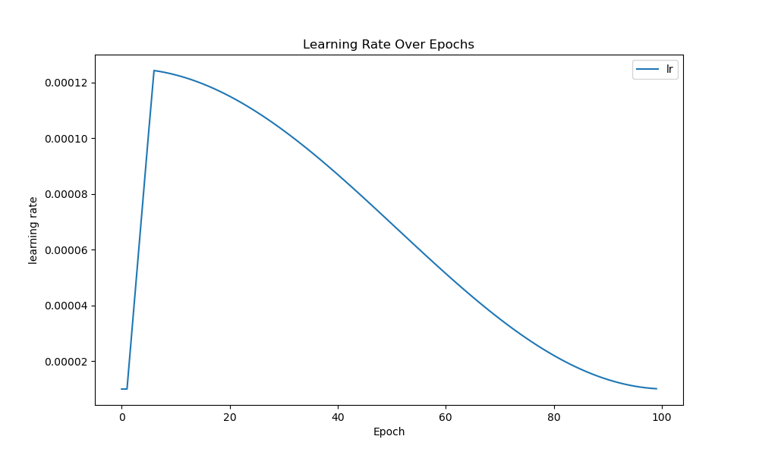
Graphs Generated during Training

Slide 10
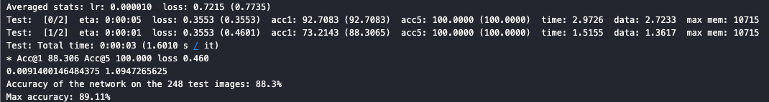
Work Done after Mid Term
Explored training on a subset of 3 classes (Fish, Salamander, Frog) from the complete dataset.
Despite focusing on a smaller set, training 300 epochs persisted for 3 hours.
Achieved an accuracy of 88%, aligning with the results reported in the paper.

Slide 11
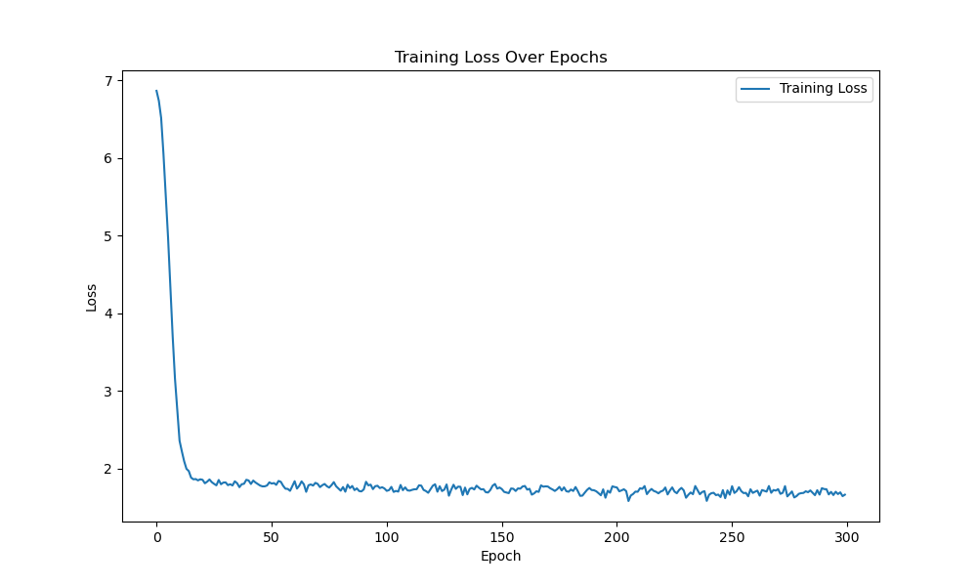
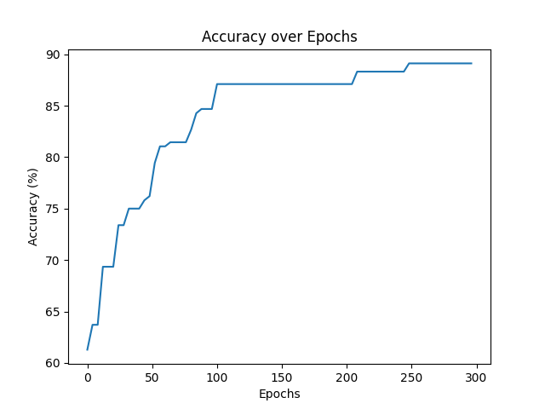
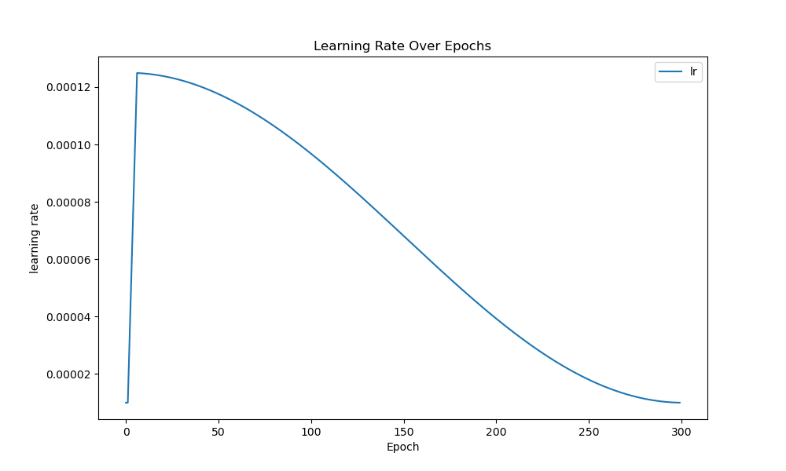

Slide 12
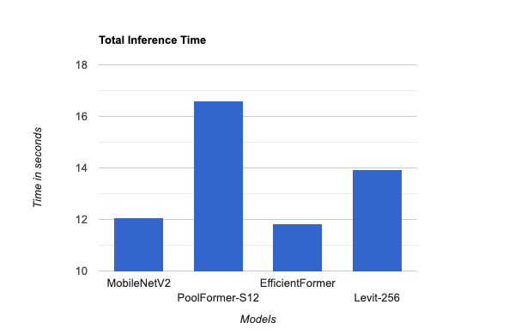
Latency Comparison
We have run the following 3 other models on a test set of 5000 images and compared the total inference time
MobileNetV2 - CNN Model
PoolFormer-S12 - Vision Transformer
Levit-256 - Vision Transformer

Slide 13
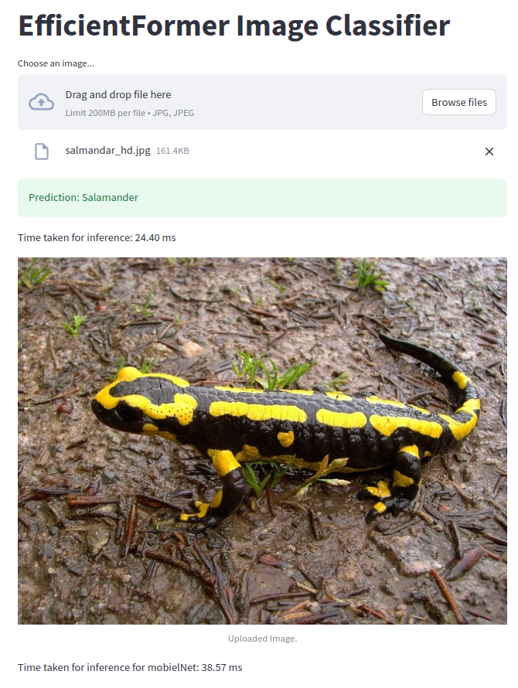
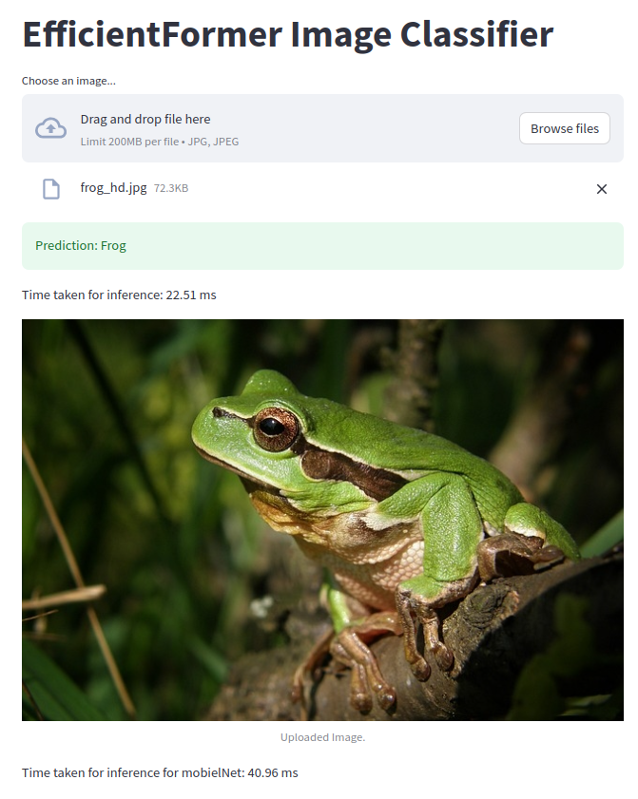
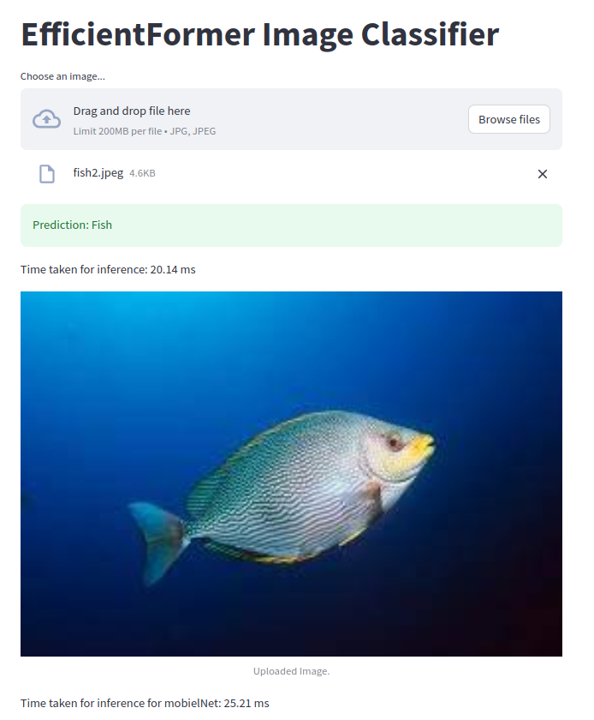
Deployment on a website

Slide 14
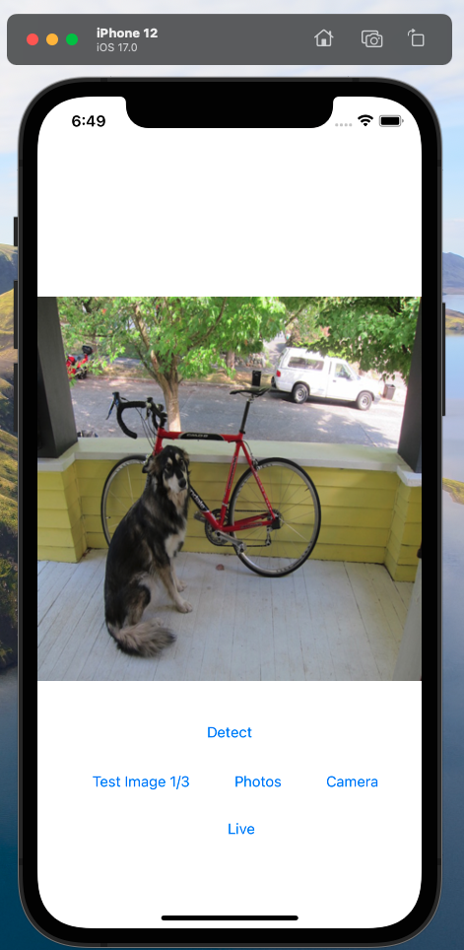
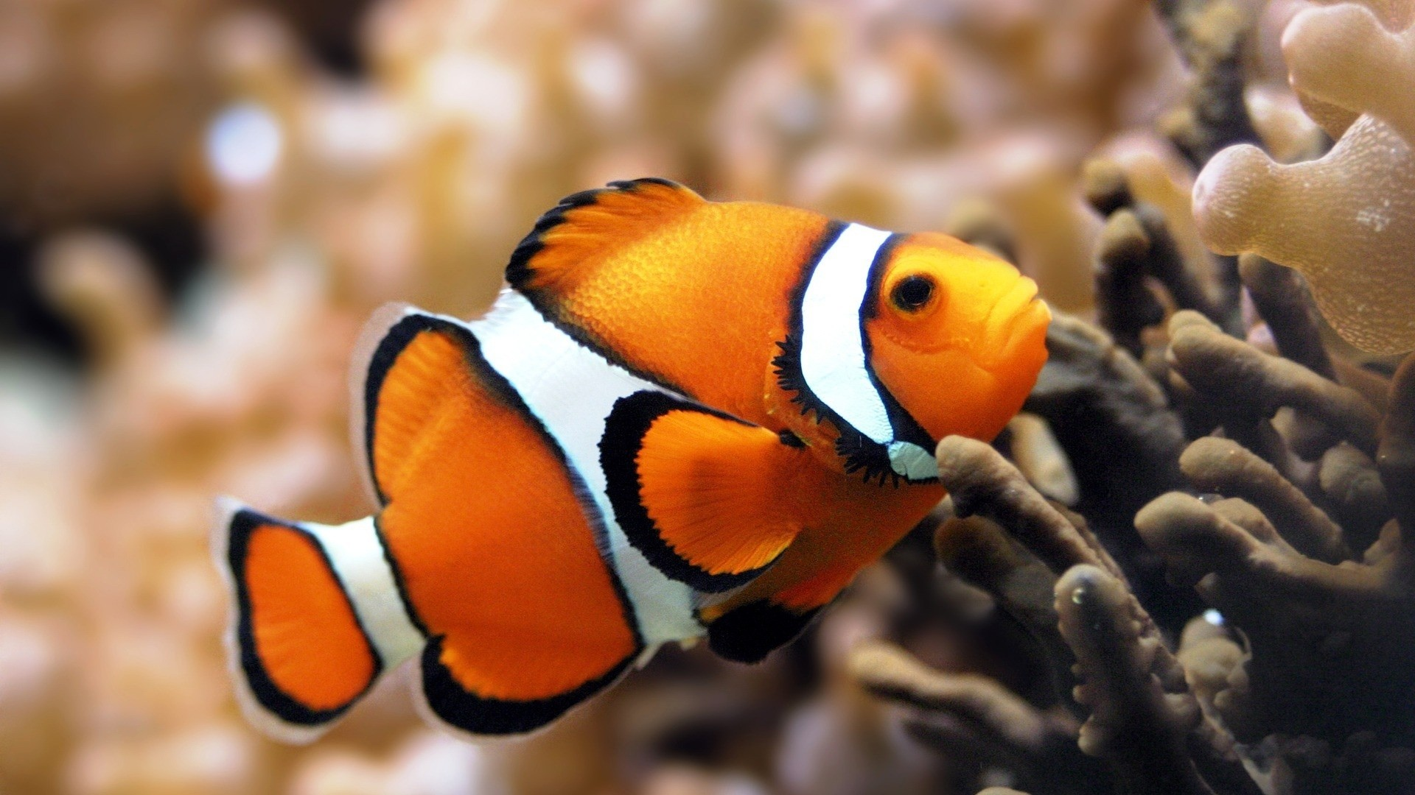
Deployment on Mobile
We also tried deploying the model on mobile for real time scenarios but we were unsuccessful.

Slide 15
Possible Future Directions
Adaptive Model Architecture Optimization:
This on-the-fly adaptation could leverage real-time performance metrics, allowing EfficientFormer to adjust its architecture dynamically based on the computational resources available and the specific requirements of the input data.
Fine grained Latency Analysis:
Employing a meticulous examination of latency at a granular level to pinpoint and address specific bottlenecks in the inference process.
Adaptive batch embedding:
Implementing a dynamic batch embedding strategy that adapts in real-time, optimizing the embedding process based on the characteristics of the input data and available computational resources.

Slide 16
Conclusions
EfficientFormer exhibits superior performance in terms of both accuracy and latency compared to existing models.
EfficientFormer bridges the gap between transformer accuracy and CNN-like latency, making transformers more practical for real-time applications.
Offers a competitive alternative to existing transformer and hybrid models in terms of both accuracy and speed.

Slide 17
References
EfficientFormer: Vision Transformers at MobileNet Speed; Yanyu Li, Geng Yuan, Yang Wen, Ju Hu, Georgios Evangelidis, Sergey Tulyakov, Yanzhi Wang, Jian Ren; arXiv:2206.01191v5 [cs.CV], 2022
https://github.com/snap-research/EfficientFormer
https://huggingface.co/snap-research/efficientformer-l1-300#direct-use
https://huggingface.co/docs/transformers/model_doc/efficientformer#transformers.EfficientFormerImageProcessor
https://towardsdatascience.com/using-transformers-for-computer-vision-6f764c5a078b

Slide 18
References[CONTD.]
https://towardsdatascience.com/transformers-141e32e69591
https://towardsdatascience.com/illustrated-guide-to-transformers-step-by-step-explanation-f74876522bc0
https://jalammar.github.io/illustrated-transformer/
https://www.analyticsvidhya.com/blog/2021/03/an-image-is-worth-16x16-words-transformers-for-image-recognition-at-scale-vision-transformers/
https://www.analyticsvidhya.com/blog/2023/06/vision-transformers-vit-revolutionizing-computer-vision/
https://theaisummer.com/vision-transformer/

