Slide 1
Things to cover
Then the main problem considered in the paper needs to be introduced, with a background of the problem, motivations for the problem (e.g. applications or theoretical contributions) and some details about at least two past works done on the problem (if the problem is new altogether, some past motivations can be provided). Overall this can span 4 to 5 slides.
Then the details of the problem considered in the paper need to be provided along with the solution approaches proposed. It would be useful to provide concise, crisp and concrete descriptions (figures, equations, and other illustrations need to be provided aptly) about the problem and methods considered. This can span about 4 to 5 slides.
The details of experiments in the paper can be described next. All details about the experiments related to the data sets, data pre-processing, computational framework considered, programming language considered, etc. should be listed. Details of competing methods should also be provided briefly. Importance of the results established in the paper need to be discussed. This can span 2 or 3 slides.
The status of work done by the team in replicating the results in the paper (e.g. details of initial experiment setup, status of experiments, results, etc.) should be provided. This can be presented in 2 to 3 slides. The contributions of each team member towards the project should be listed carefully when discussing the work done by the team.
The team must provide at least one modification to the work done in the paper which the team will investigate for the final review. This can span around a couple of slides.

Slide 2
EfficientFormer: Vision Transformers at MobileNet Speed
IE643 Course Project
Team Karasuno
200050020 Teja Bale
200050160 Yash Mailapalli

Slide 3
Outline
Problem Background and Motivation
Related Works
Problem Details
Proposed Solution
EfficientFormer's Design Paradigm
Experimental Results
References

Slide 4
Problem Background and Motivation
Vision Transformers (ViT) are effective in computer vision tasks but are computationally intensive.
ViT models, due to the massive number of parameters and self-attention mechanisms, are slower than lightweight convolutional networks.
Deploying ViT for real-time applications on mobile devices is challenging, especially on resource-constrained hardware such as mobile devices.
Previous attempts have tried to reduce computation complexity of ViT but with limited success
Can transformers achieve MobileNet-like speed on mobile devices while maintaining high performance?

Slide 5
Past works
Transformers were initially developed for handling long sequences in NLP tasks
Dosovitskiy and Carion adapted the transformer architecture to computer vision for classification and detection tasks.
These early works demonstrated competitive performance against CNN counterparts through stronger training techniques and larger-scale datasets.

Slide 6
Past works
Various approaches were introduced to accelerate ViT models, involving different methodologies:
New architectures or modules
Re-thinking self-attention and sparse-attention mechanisms
Utilizing search algorithms similar to those used in CNNs to find smaller and faster ViT models
MobileViT presented a hybrid architecture combining MobileNet blocks and MHSA blocks to reduce computation
In contrast to previous works, EfficientFormer aims to push the latency-performance boundary of pure vision transformers without relying on hybrid designs.
The paper directly optimizes for mobile latency through a new design paradigm and architecture search.

Slide 7
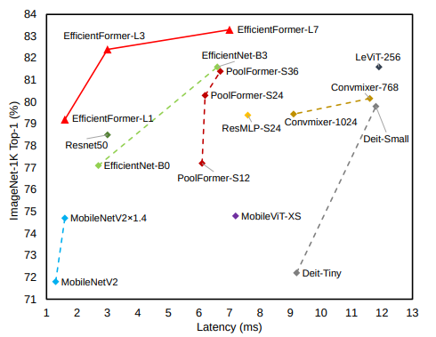
Inference Speed vs. Accuracy
Compared to CNNs, EfficientFormer-L1 runs 40% faster than EfficientNet-B0, while achieves 2.1% higher accuracy

Slide 8
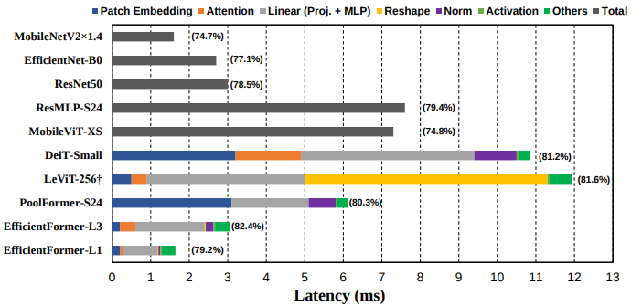
Latency Analysis

Slide 9
Identifying inefficient designs in ViT-based models
Observation 1: Patch embedding with large kernel and stride is a speed bottleneck on mobile devices.
Traditional belief: Patch embedding in transformers is computationally negligible.
Contrary finding: The paper's comparison shows that large-kernel patch embedding can be a speed bottleneck on mobile devices.
Challenge: Large-kernel convolutions are not well-supported and can't be efficiently accelerated.
Proposed Solution: Suggests replacing non-overlapping patch embedding with a convolution stem using efficient 3 × 3 convolutions.
Observation 2: Consistent feature dimension is important for the choice of token mixer. MHSA is not necessarily a speed bottleneck.
We explore the efficiency of token mixers, including pooling and Multi-Head Self-Attention.
The Reshape operation in models like LeViT-256 can be a bottleneck, hindering real-time performance.

Slide 10
Identifying inefficient designs in ViT-based models
Observation 3: CONV-BN is more latency-favorable than LN (GN)-Linear and the accuracy drawback is generally acceptable.
BN can be folded into the preceding convolution for inference speedup, while dynamic normalizations, such as LN and GN, still collects running statistics at the inference phase, thus contributing to latency
Observation 4: The latency of nonlinearity is hardware and compiler dependent.
They examined various activation functions, including GeLU, ReLU, and HardSwish.
Previous work suggests GeLU is not efficient on hardware and slows down inference.
observed GeLU is well supported by iPhone 12 and hardly slower than its counterpart, ReLU. On the contrary, HardSwish is surprisingly slow in our experiments and may not be well supported by the compiler

Slide 11
Proposed Solution
EfficientFormer: In response to the challenges posed by existing Vision Transformers (ViTs), Introduced "EfficientFormer."
Informed by Latency Analysis: The foundation of EfficientFormer is built upon a comprehensive latency analysis. Examined the bottlenecks and inefficiencies in existing transformer-based architectures to identify areas for improvement.
Elimination of Inefficient Operations: One of the key tenets of EfficientFormer is the elimination of inefficient operations. Redesigned the architecture to mitigate unnecessary overheads and streamline the model, ensuring that it operates with optimal efficiency.

Slide 12
EfficientFormer's Design Paradigm
Dimension-Consistent Design
Principles and Rationale: The dimension-consistent design paradigm divides the architecture into two partitions, 4D and 3D, to address the dimension mismatch issue. This approach starts with a 4D partition and transitions to a 3D partition as the model progresses. The motivation behind this paradigm is to enable efficient processing of low-level features in the initial stages while taking full advantage of the global modeling power of Multi-Head Self-Attention (MHSA) in later stages.
Divergence from Existing Designs: EfficientFormer's dimension-consistent design distinguishes it from existing architectures. While prior models often rely solely on 3D partitions, EfficientFormer's hybrid approach, combining 4D and 3D, is tailored for enhanced efficiency without compromising global modeling capabilities.
EfficientFormer's unique design paradigm allows it to strike the ideal balance between computational efficiency and performance, setting it apart as a pioneering solution for real-time computer vision.

Slide 13
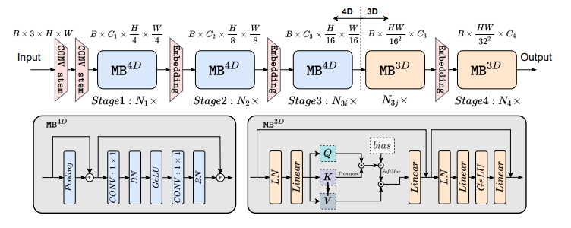
EfficientFormer: Overall Architecture
Based on the observations, EfficientFormer is designed.

Slide 14



About Architecture
From the results of the latency, the PatchEmbed is two Conv stem 3 x 3 convolution with stride 2
MB consists of unspecified token mixer (TokenMixer) followed by a MLP block
The network starts with 4D partition, while 3D partition is applied in the last stages.
After processing all the MB4D blocks, we perform a one-time reshaping to transform the features size and enter 3D partition. MB3D follows conventional ViT structure
MHSA to the last Stages aligns with the intuition that early stages in the networks capture low-level features, while late layers learn long-term dependencies.
Notes:
[Slide Title: Design of EfficientFormer]
EfficientFormer Design Overview: The EfficientFormer architecture is the outcome of a meticulous design process driven by the insights gained from extensive latency analysis.
Components of EfficientFormer:
Patch Embedding: EfficientFormer begins with a Patch Embedding process that efficiently converts input images into tokenized representations.
Meta Transformer Blocks (MB): These constitute the core of the network. MBs are a stack of blocks that handle features of the same spatial size, ensuring efficient processing.
Dimension-Consistent Design: A central tenet of EfficientFormer is the dimension-consistent design approach. This design strategy partitions the network into a 4D segment and a 3D segment. The 4D partition uses ConvNet-style operations (MB4D), while the 3D partition integrates linear projections and self-attention mechanisms (MHSA) in a 3D tensor.
Benefits of Dimension-Consistent Design: The dimension-consistent design of EfficientFormer successfully addresses dimension mismatch issues, thus facilitating optimal hardware utilization. It ensures that low-level features are processed efficiently at the beginning, while the model gains access to the global modeling power of MHSA in later stages. This innovative approach distinguishes EfficientFormer from conventional models and is key to its success in real-time applications.

Slide 15
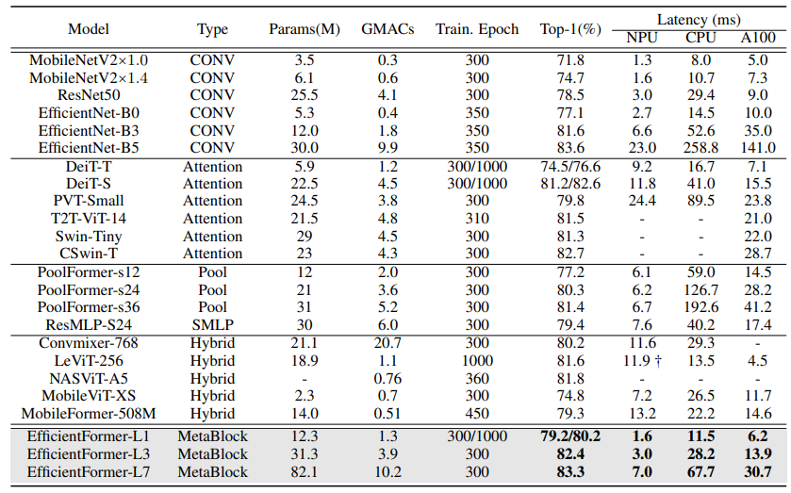
Image Classification
Training on ImageNet-1K: EfficientFormer is rigorously trained on the ImageNet-1K dataset, a standard benchmark for image classification tasks.
Training Parameters: Employed the AdamW optimizer, warm-up training for 5 epochs, and a cosine annealing learning rate schedule. The initial learning rate is set to 1e-3, and the minimum learning rate is 1e-5.

Slide 16
Experiment Details
Comparison to CNNs
EfficientFormer demonstrates a better trade-off between accuracy and latency when compared to CNN-based MobileNet
EfficientFormer-L1 matches the speed of MobileNetV2 1.4 on mobile, while achieving a 4.5% higher top-1 accuracy. On desktop GPUs, EfficientFormer-L1 runs 38% faster than EfficientNet-B0 with a 2.1% higher top-1 accuracy.
Comparison to ViTs
Compared to traditional ViTs such as DeiT-Tiny, EfficientFormer showcases a notable reduction in latency while maintaining competitive accuracy levels.
Comparison to Hybrid Designs
In contrast to hybrid designs like LeViT and MobileViT, EfficientFormer stands out by maintaining high performance and achieving ultra-fast inference speeds.
The results solidify the notion that EfficientFormer excels in delivering the accuracy of ViTs without compromising the latency, putting it at the forefront of transformer-based models.

Slide 17
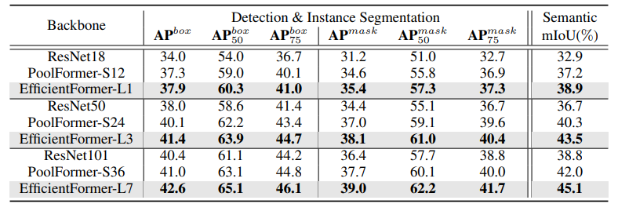
Object Detection and segmentation
EfficientFormer extends beyond image classification. It serves as a powerful backbone in various vision tasks.
The consistent performance across different tasks highlights the robustness and versatility of EfficientFormer as a backbone.
When integrated into object detection and instance segmentation tasks using the COCO-2017 dataset, EfficientFormer consistently outperforms both CNN (ResNet) and transformer (PoolFormer) backbones.
For instance, EfficientFormer-L3 surpasses ResNet50 by 3.4 box AP and 3.7 mask AP.

Slide 18
Status of work
Read source code and understand the implementation of the model class EfficientFormer.
The original model was trained on ImageNet-1K (of size around 160 GB)
But we are not able to run the code locally and the code is having outdated functions and to run the code in kaggle is difficult to run because of the is given in multiple files to run
So we used the pretrained model to experiment with model by giving different images as input.

Slide 19
Experiment Details
Semantic Segmentation
Empowering Semantic Segmentation: EfficientFormer takes the lead in semantic segmentation using the challenging ADE20K dataset, encompassing 150 class categories.
Remarkable Results: Across different backbones, EfficientFormer outperforms both CNN- and transformer-based counterparts by a significant margin. For example, EfficientFormer-L3 surpasses PoolFormer-S24 by 3.2 mIoU.
Global Attention Benefits: The incorporation of global attention in EfficientFormer plays a crucial role in capturing long-term dependencies, enhancing its performance in dense prediction tasks.

Slide 20
Proposed Modification(s)

Slide 21
References
EfficientFormer: Vision Transformers at MobileNet Speed; Yanyu Li, Geng Yuan, Yang Wen, Ju Hu, Georgios Evangelidis, Sergey Tulyakov, Yanzhi Wang, Jian Ren; arXiv:2206.01191v5 [cs.CV]
https://github.com/snap-research/EfficientFormer
https://huggingface.co/snap-research/efficientformer-l1-300#direct-use
https://huggingface.co/docs/transformers/model_doc/efficientformer#transformers.EfficientFormerImageProcessor

