Slide 1
EfficientFormer: Vision Transformers at MobileNet Speed
IE643 Course Project
Team Karasuno
200050020 Teja Bale
200050160 Yash Mailapalli

Slide 2
Outline
Introduction to Vision Transformers
Traditional Computer Vision vs. Vision Transformers
What are Transformers?
Transformer Architecture
Adaptation for Vision: Vision Transformers (ViTs)
Components of Vision Transformers
Benefits of Vision Transformers
Applications of Vision Transformers
Challenges and Limitations
Conclusion
References

Slide 3
Introduction to Vision Transformers
Vision Transformers (ViTs) are a type of artificial neural network that uses self-attention to learn the relationships between different parts of an image.
They are inspired by the transformer architecture, which was originally developed for natural language processing tasks.
ViTs have had a major impact on computer vision, achieving state-of-the-art results on a variety of tasks, including image classification, object detection, and segmentation.
ViTs are also more efficient than traditional convolutional neural networks (CNNs), making them well-suited for mobile and edge devices.

Slide 4
Traditional Computer Vision vs. Vision Transformers
Traditional computer vision methods use hand-crafted features to extract information from images.
These features are then used to train a classifier or regressor to perform a desired task.
CNNs are a type of neural network that is specifically designed for computer vision tasks. CNNs use convolution operations to extract features from images.
ViTs are a newer type of neural network that is inspired by the transformer architecture. Transformers use self-attention to learn the relationships between different parts of an image. ViTs have been shown to be more effective than CNNs for some computer vision tasks, such as image classification and object detection.

Slide 5
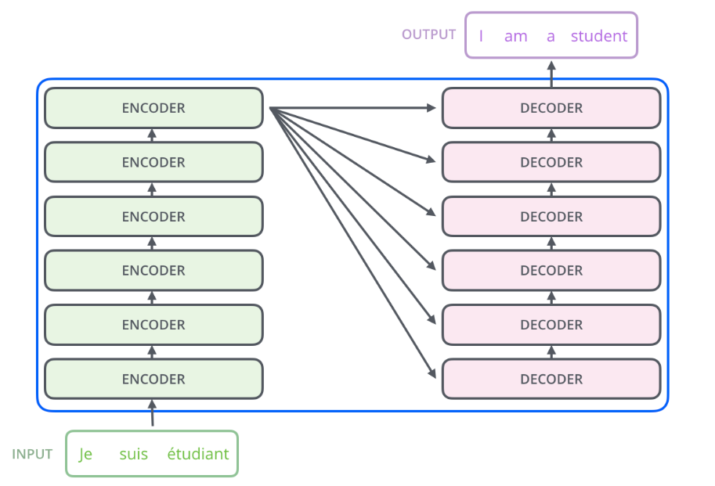
What are Transformers?
Transformers are a type of neural network that is based on the attention mechanism.
The attention mechanism allows the model to learn the relationships between different parts of the input sequence.
Transformers were originally developed for natural language processing tasks, but they have been adapted for use in computer vision.

Slide 6
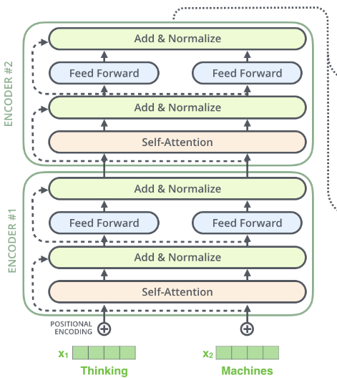
Transformer Architecture
The core components of a transformer are:
Self-attention mechanism
Multi-head attention
Positional encoding
Feed-forward networks
Layer normalization
The self-attention mechanism is used to learn the relationships between different parts of the input sequence.
The multi-head attention mechanism allows the model to learn multiple relationships between the input sequence.
The positional encoding is used to encode the order of the input sequence.
The feed-forward networks are used to learn non-linear transformations of the input seq.
Layer normalization is used to normalize the input and output of each layer.

Slide 7
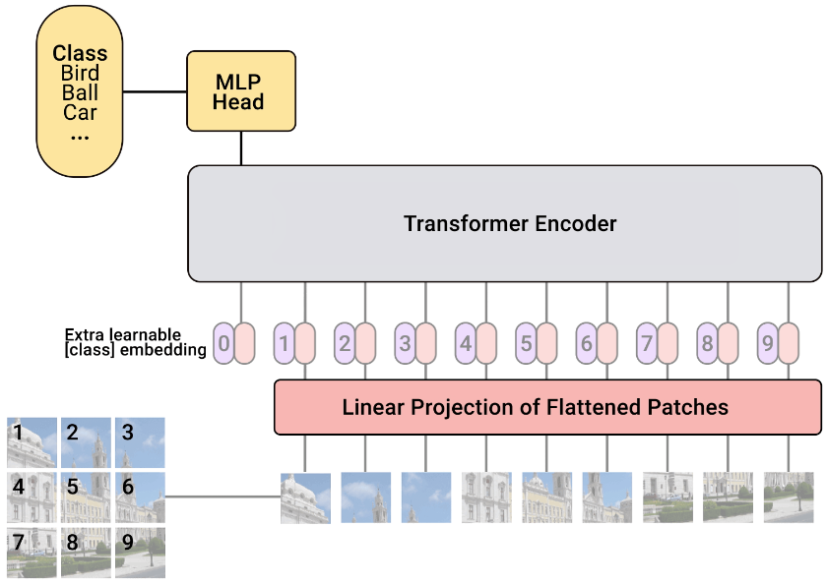
Adaptation for Vision: Vision Transformers (ViTs)
Vision Transformers (ViTs) are a type of transformer that is specifically designed for computer vision tasks.
ViTs adapt the transformer architecture to images by first splitting the image into patches.
The patches are then fed into the transformer as the input sequence.
The transformer learns the relationships between the patches, which allows it to identify objects and other features in the image.

Slide 8
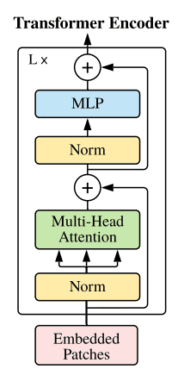
Components of Vision Transformers
The key components specific to Vision Transformers are:
Patch embeddings
Positional encodings (2D grid)
Multi-head self-attention
Feed-forward layers
Patch embeddings are used to represent the patches in the image.
Positional encodings are used to encode the 2D grid structure of the image.
Multi-head self-attention is used to learn the relationships between the patches.
Feed-forward layers are used to learn non-linear transformations of the patches.

Slide 9
Benefits of Vision Transformers
Vision Transformers have several advantages over traditional CNNs:
They can capture long-range dependencies in images.
They are more scalable, meaning that they can be trained on larger datasets.
They are more parallelizable, meaning that they can be trained on multiple GPUs or TPUs.
They have achieved state-of-the-art results on a variety of computer vision tasks.

Slide 10
Applications of Vision Transformers
Vision Transformers have been applied to a variety of computer vision tasks, including:
Image classification
Object detection
Semantic segmentation
Image generation
Video classification
Visual question answering

Slide 11
Challenges and Limitations
Vision Transformers still have some challenges and limitations:
They are computationally expensive to train and deploy.
They require large amounts of data to train.
They are not as good at capturing local features as CNNs.
They are not as well-suited for tasks that require spatial reasoning, such as object detection.

Slide 12
Conclusion
Vision Transformers are a promising new approach to computer vision.
They have the potential to outperform traditional methods on a variety of tasks.
However, they still have some challenges and limitations that need to be addressed.
Future research on Vision Transformers is likely to lead to further improvements in their performance and capabilities.

Slide 13
References
https://towardsdatascience.com/using-transformers-for-computer-vision-6f764c5a078b
https://www.analyticsvidhya.com/blog/2023/06/vision-transformers-vit-revolutionizing-computer-vision/
https://towardsdatascience.com/transformers-141e32e69591
https://towardsdatascience.com/illustrated-guide-to-transformers-step-by-step-explanation-f74876522bc0
https://jalammar.github.io/illustrated-transformer/
https://www.analyticsvidhya.com/blog/2021/03/an-image-is-worth-16x16-words-transformers-for-image-recognition-at-scale-vision-transformers/
https://www.analyticsvidhya.com/blog/2023/06/vision-transformers-vit-revolutionizing-computer-vision/
https://theaisummer.com/vision-transformer/

