Slide 1
GNR602
Course Project
Classify a remote sensing image using a kernel PCA based classifier.
Team Members:
Teja Bale(200050020)
Krishna Kamal(200050142)
Yash Mailpalli(200050160)

Slide 2
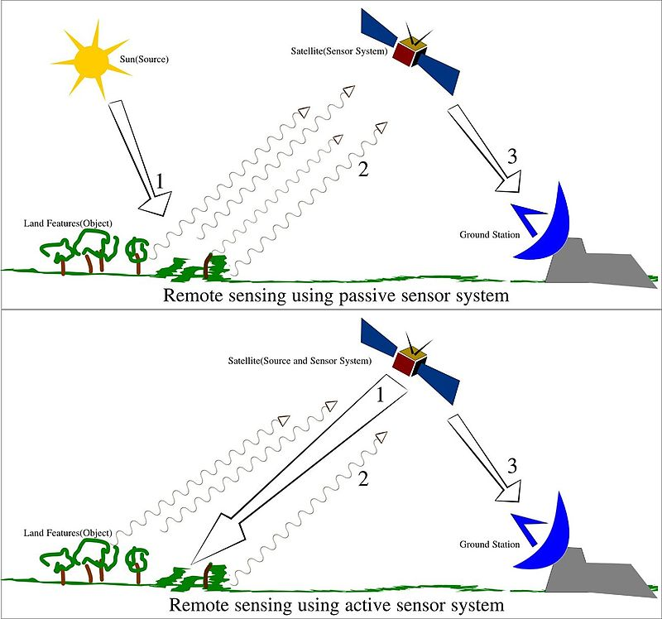
Remote Sensing
Remote sensing is the acquisition of information about an object or phenomenon without making physical contact with the object.
Used in geography, land surveying, military, intelligence and planning

Slide 3
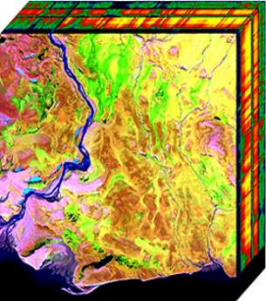
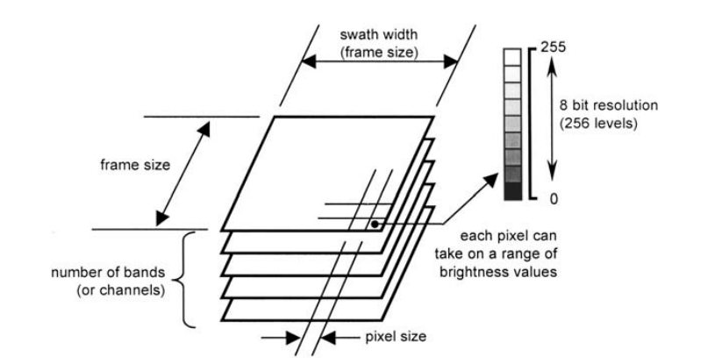
Hyperspectral Images
The goal of hyperspectral imaging is to obtain the spectrum for each pixel in the image of a scene, with the purpose of finding objects, identifying materials, or detecting processes.

Slide 4
Challenges with Hyperspectral Images
Hyperspectral image having huge numbers of narrow and contiguous bands involves high computation complexity in processing and analysing the image
All the feature are not equally important
So we will do dimensionality reduction
The aim of dimensionality reduction is to eliminate redundant information and simplify the subsequent processes of classification and the search of information.

Slide 5
Kernel PCA
Kernel PCA is a non-linear extension of principal component analysis. It is used to reduce high-dimensional datasets to a lower dimension while preserving non-linear structures.
Using kernal methods we can project the data into higher dimension where the data is linearly saperable
Extracting only relevant features
Improving classification accuracy
We have used polynomial as kernel for Kernal PCA

Slide 6
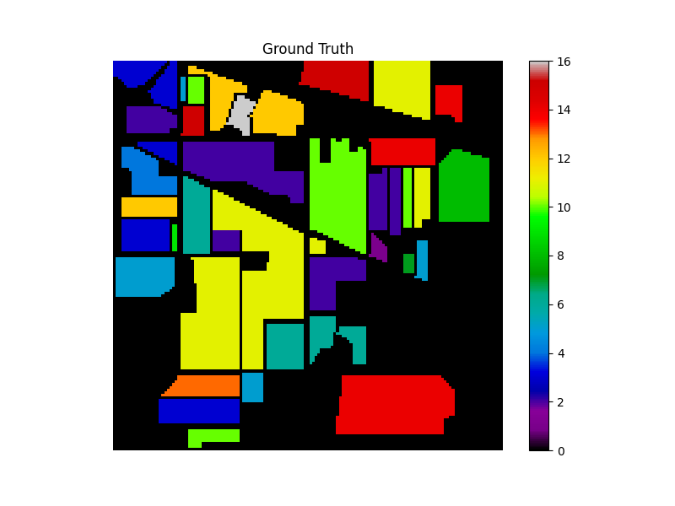
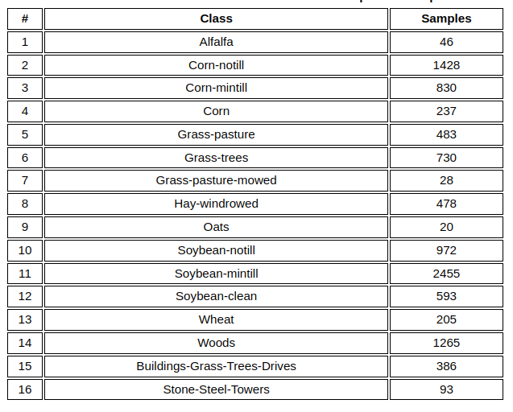
Indian pines Dataset
Spatial Resolution: 145 x 145 px
Total 16 classes

Slide 7
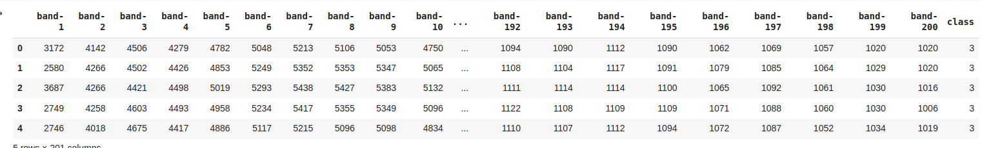
Dataset

Slide 8
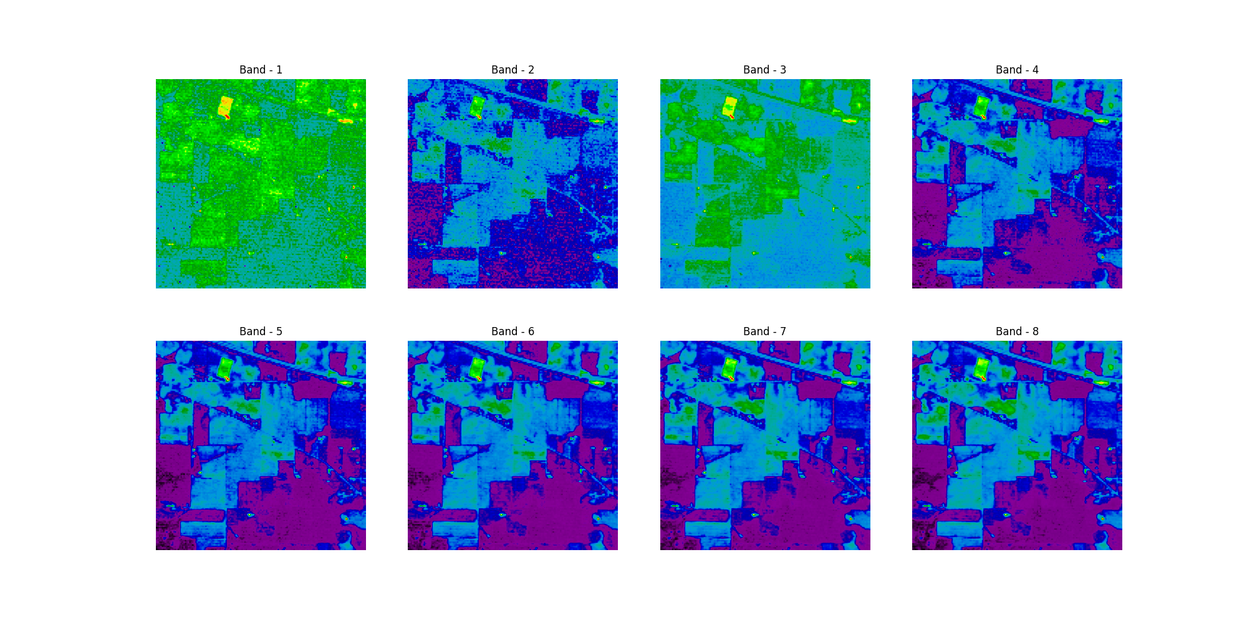
Intial Bands

Slide 9
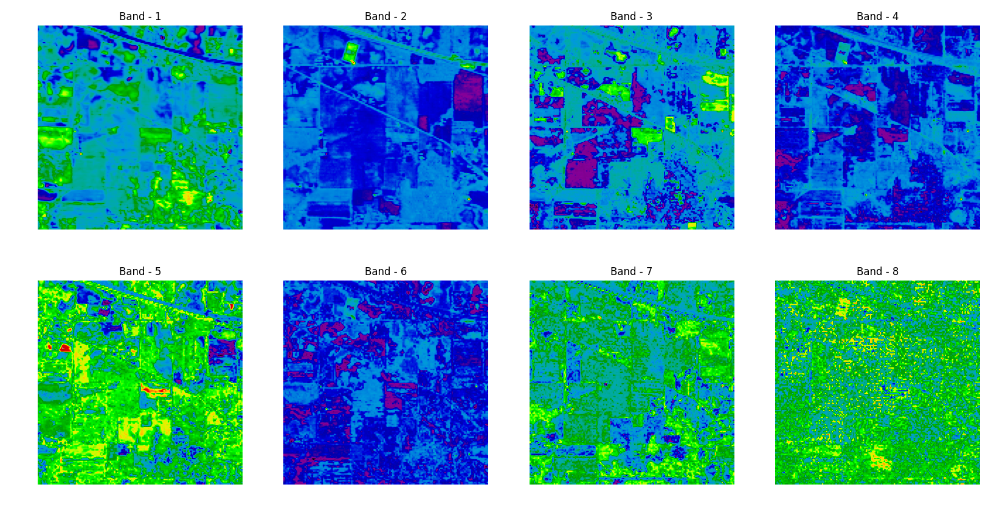
After Kernal PCA ( Reduced to 40 components)

Slide 10
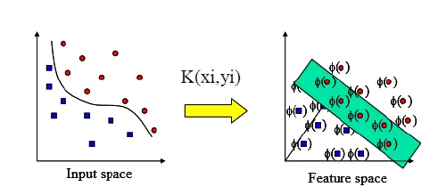
Kernel SVM
Radial Basis Function Kernel (RBF):
K(x,xi) = exp(-gamma * sum((x – xi^2))

Slide 11
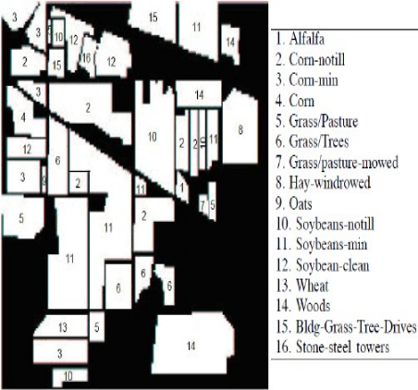
SVM Classification
So we have used the SVM classification to classify this 16 classes.
Kernel used in the SVM is rbf
Divided the data into two sets training data and test data.
Test data is 20% of total data
Calculate the gamma for which high accuracy is achieved for rbf kernel svm
Accuracy achieved 80.23781212841855%
Around 70 percent accuracy is attained when reduced to 100 instead of 40

Slide 12
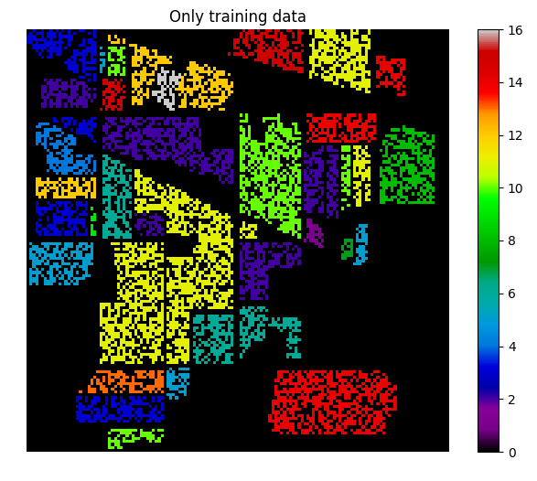


Slide 13
THANK YOU

