Slide 1
Stock Market Prediction
200050020 Teja Bale
200050044 Guduru Manoj
200050112 Janaki Ram
200050125 Vavilapalli Sainath

Slide 2
Project Description
The goal of this project is to perform stock price prediction using deep learning techniques. A stock price is a sequential data and thus a simple feed-forward network may not be appropriate for this task. We will need to use models that operate with input data that acts as a sequence. Eg, Recurrent networks, Transformers etc.

Slide 3
Data Extraction
We used yfinance for data extraction
To extract data of Indian stocks, we should add .NS at the end of the scrip along with the start and end date
Reshaped the data to (200,1) to feed the data into the model
We trained the model on BTC-USD’s stock data because it being crypto, has lot of volatility and lot of patterns to generalize for other stocks as well

Slide 4
Models & their Architectures
We used CNN, Transformer, LSTM, GRU to learn and forecast the market
LSTM and GRU have comprise of same architectures so that their comparison will be more precise and accurate
CNN consists of Conv1D layers followed by MaxPooling1D layers each, then a couple of dense layers
LSTM and GRU comprise of four hidden layers and a couple of dense layers
Transformer model consists of an Encoder layer followed by a Linear layer and a ReLU Layer. We used Multihead Attention in the Encoder layer
We trained the each of the models for 100 epochs

Slide 5
CNN
None x 200 x 1
None x 193 x 32
None x 96 x 32
None x 93 x 16
Conv1D
MaxPooling1D
Conv1D
MaxPooling1D
INPUT
None x 46 x 16
Flatten
None x 736
Dense
None x 1
None x 16
OUTPUT
Dense

Slide 6
LSTM
None x 200 x 1
None x 200 x 100
None x 200 x 33
None x 200 x 12
None x 8
LSTM
LSTM
LSTM
LSTM
Dense
INPUT
None x 1
OUTPUT
GRU
None x 200 x 1
None x 200 x 100
None x 200 x 33
None x 200 x 12
None x 8
GRU
GRU
GRU
GRU
Dense
INPUT
None x 1
OUTPUT

Slide 7
Metrics
We used MSE (Mean Squared Error) as our metric to evaluate (On training data)
CNN: 3.7451e-04
LSTM: 1.9480e-04
GRU: 2.2890e-04
Transformer:3.8875e-05

Slide 8
Testing
We tested the models on three other stocks which are completely different. The stocks are Google, Apple and Tesla. Losses came out to be as follows. Note that the loss mentioned for transformers is over the entire dataset
Stocks | CNN | LSTM | GRU | Transformer
Apple | 6.8796 | 0.5471 | 0.2523 | 0.086
Google | 5.1853 | 0.5898 | 0.2968 | 0.0558
Tesla | 5.6628 | 0.5161 | 0.3935 | 0.8141

Slide 9
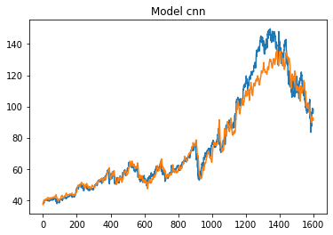
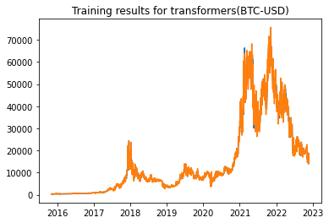
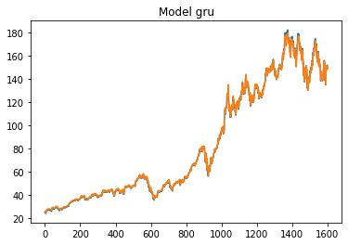
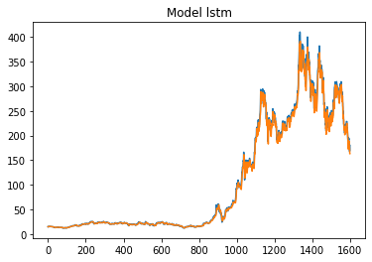
Few Plots on train and test stocks
Transformer
BTC-USD
CNN
Google
GRU
Apple
LSTM
Tesla

Slide 10
Inferences
Among the models, LSTM and GRU generalised the learning well for other stocks as well compared to CNN
It is due to the fact that LSTM and GRU have memory property because of which they can remember the old patterns and dependencies
In all the cases, CNN picked the trend correctly but it failed to generalize the trend for other stocks in as the time steps got increased
Among LSTM and GRU, GRU seems to generalize well even though it is relatively less complex because LSTM could’ve been learning more about the training data because of it’s complexity resulting in it’s relative failure in generalising the data

Slide 11
Transformer is an attention-based model which uses positional encoding whose values represent the importance of the different input features in each time step, i.e which features that the model should pay more attention to. This along with multihead scaled dot product layers with residual connections and feed-forward linear bottleneck creates the transformer encoder.
Transformer was able to perform better compared better to other models as it uses a self-attention mechanism, allowing the model to focus on the relevant parts of the time-series to improve prediction quality.

Slide 12
References
https://www.sciencedirect.com/science/article/pii/S1877050918307828
https://youtu.be/H6du_pfuznE
https://github.com/olof98johansson/StockPrediction

