Slide 1
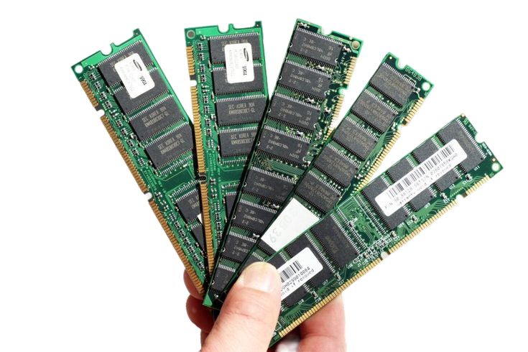
MEMORY HIERARCHY
Organization of Memory in Computer Systems
Digital Logic and Computer Organization (DLCO) | Unit IV
JNTUK R23 Regulation | Department of CSE
Presented by (Team of 5 Members):
• Member 1: Karthikeya (Intro & Hierarchy Structure)
• Member 2: Nikhil (Semiconductor RAM & ROM)
• Member 3: Teja (Cache Memory & Performance)
• Member 4: Srinivas (Virtual Memory & Management)
• Member 5: Manohar (Secondary Storage & Summary)

Slide 2
Introduction to Memory Organization
Presented by: Member 1 (Karthikeya) | Basic Concepts & Trade-offs
Role of Memory in Systems
Memory stores programs, instructions, operational data, and computation results.
Crucial subsystem directly determining processor utilization and throughput.
CPU executes instructions at nanosecond clock speeds requiring rapid data access.
A single memory technology cannot satisfy both maximum speed and maximum capacity.
The Core Trade-offs & Hierarchy
Speed vs. Cost: Faster memory technologies are substantially more expensive per bit.
Capacity vs. Speed: Larger capacity memories exhibit longer physical access latencies.
Hierarchy Strategy: Combines multiple memory technologies in a tiered structure.
Goal: Delivers nearly the speed of the fastest memory with the capacity and cost of the cheapest.

Slide 3
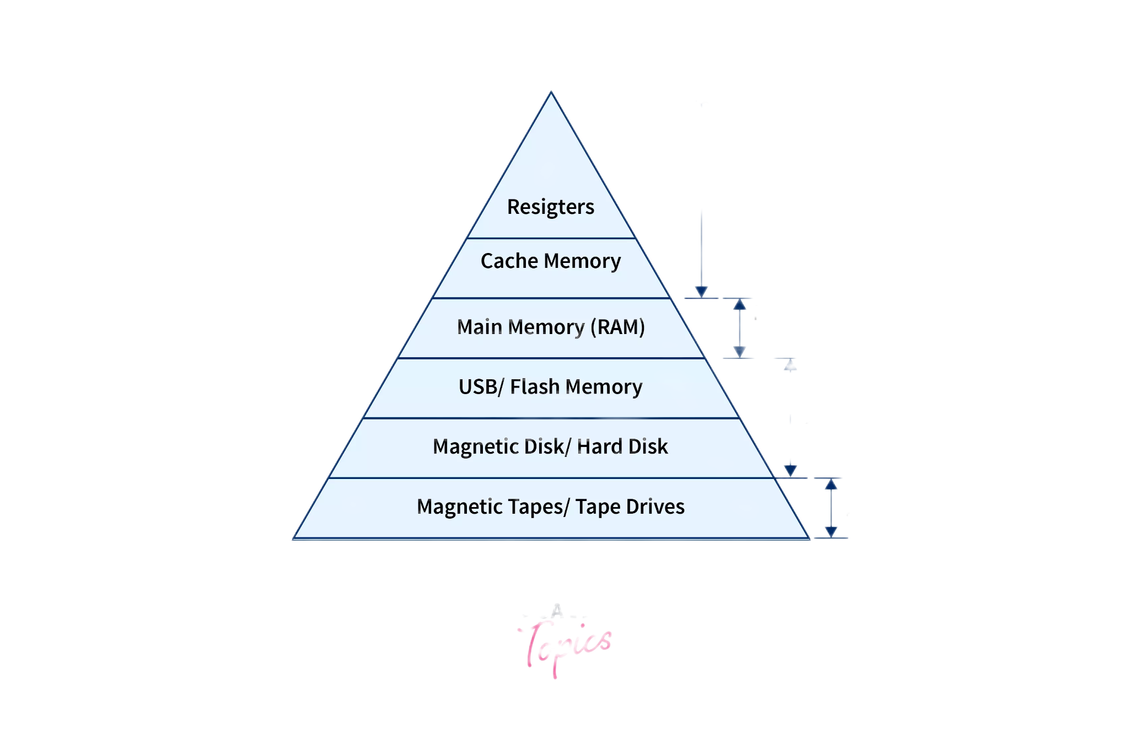
Structure of Memory Hierarchy
Presented by: Member 1 (Karthikeya) | The Memory Pyramid
Key Hierarchy Trends
Top (Registers): Inside CPU, fastest access (< 1 ns), smallest capacity, highest cost/bit.
Cache Memory: Fast SRAM (L1, L2, L3) bridging processor and main memory speeds.
Main Memory (DRAM): System RAM holding active applications and working datasets.
Secondary Storage: Magnetic disk & flash SSD; large capacity, non-volatile, lowest cost.
Downward trend: Increasing access time, increasing capacity, decreasing cost per bit.

Slide 4
Semiconductor RAM Memories
Presented by: Member 2 (Nikhil) | Random Access Memory (SRAM & DRAM)
Static RAM (SRAM)
Storage Mechanism: Built using bistable flip-flop logic circuits (4 to 6 transistors per cell).
Speed: Very fast access times (sub-nanosecond to few nanoseconds).
Refreshing: Does NOT require dynamic periodic refreshing while power is maintained.
Density & Cost: Lower packing density, complex circuitry, and higher cost per bit.
Primary Application: Used exclusively for CPU internal and external Cache memory.
Dynamic RAM (DRAM)
Storage Mechanism: Stores bits as electrical charges in tiny capacitor-transistor pairs.
Periodic Refresh: Charge leaks away continuously; requires periodic refreshing cycles.
Speed: Slower access latency compared to SRAM due to cycle precharge & refresh overhead.
Density & Cost: Extremely high bit density, simple cell layout, and very low cost per bit.
Primary Application: Standard choice for computer Main Memory (System RAM).

Slide 5
Read-Only Memory (ROM)
Presented by: Member 2 (Nikhil) | Non-Volatile Semiconductor Storage
ROM Characteristics & Role
Non-Volatile: Retains program code permanently even when electrical power is disconnected.
System Bootstrap: Holds initialization programs (BIOS / UEFI) and system startup routines.
Embedded Firmware: Stores dedicated control routines in microcontrollers and appliances.
Read Operations: Standard CPU operation is read-only during normal computing execution.
Evolution & Types of ROM
Mask ROM: Hardwired during fabrication; cannot be modified or updated.
PROM (Programmable ROM): Shipped blank and electrically programmed once using fuse links.
EPROM: Erasable Programmable ROM; erased by exposing chip die to ultraviolet (UV) light.
EEPROM: Electrically Erasable PROM; erased in-circuit via electrical signals byte-by-byte.
Flash Memory: High-density EEPROM variation erasable in large sector blocks.

Slide 6
Cache Memory Architecture
Presented by: Member 3 (Teja) | High-Speed Buffer & Multi-Level Cache
Principles of Cache Operation
Buffer Role: Small, ultra-fast memory placed directly between CPU execution units and Main RAM.
Locality of Reference:
• Temporal Locality: Recently accessed items are likely to be accessed again soon.
• Spatial Locality: Items stored near recently accessed items are likely to be accessed soon.
Transparency: Operates automatically in hardware without requiring manual programmer management.
Multi-Level Cache Organization
L1 Cache (Primary): Integrated inside CPU core; smallest (32–64 KB), fastest (sub-nanosecond).
L2 Cache (Secondary): Dedicated per-core buffer; larger (256 KB–1 MB), slightly slower access.
L3 Cache (System-Level): Shared across all processor cores; high capacity (8–64 MB).
Access Flow: CPU first checks L1 -> then L2 -> then L3 -> falls back to DRAM only on miss.

Slide 7
Cache Performance Considerations
Presented by: Member 3 (Teja) | Metrics & Access Time Analysis
Key Performance Metrics
Cache Hit: Requested memory word is found directly within cache buffer.
Cache Miss: Requested word is not present, requiring retrieval from main memory.
Hit Ratio (h): Fraction of total memory references satisfied by the cache:
• Hit Ratio = (Cache Hits) / (Total Memory Accesses)
Miss Ratio: Complement of hit ratio, equal to (1 - Hit Ratio).
Miss Penalty: Extra latency required to fetch the required block from DRAM into cache.
Typical Performance Example
90% - 95%
Typical Hit Ratio: 90 hits out of 100 accesses drastically lowers effective memory latency.
Average Memory Access Time (AMAT)
Formula: AMAT = Hit Time + (Miss Rate × Miss Penalty)
High hit rates ensure the CPU rarely experiences the full DRAM access delay.
Performance optimization balances cache capacity, line size, and associativity.

Slide 8
Virtual Memory Architecture
Presented by: Member 4 (Srinivas) | Address Translation & Paging
Concept & Hardware Support
Logical Address Space: Grants programs an illusion of large, contiguous memory.
Overcoming Physical RAM Limits: Programs can run even if they exceed physical RAM size.
Memory Management Unit (MMU): Hardware component performing fast address translation.
Separation: Decouples user logical addresses from actual physical memory locations.
Paging & Page Fault Mechanism
Pages & Frames: Virtual memory is divided into fixed pages; physical RAM into page frames.
Page Table: Maps process virtual pages to corresponding physical RAM frames.
Page Fault: Triggered when an active instruction references a page not currently in RAM.
Demand Paging: OS retrieves required page from secondary storage into free RAM frame.
Replacement Policy: Replaces inactive pages (using LRU or FIFO) when memory is full.

Slide 9
Memory Management Requirements
Presented by: Member 4 (Srinivas) | Core Operating System Functions
Relocation & Protection
Relocation:
• Translates logical program addresses dynamically.
• Allows programs to be loaded anywhere in RAM upon execution.
Protection:
• Prevents processes from unauthorized access to other memory areas.
• Enforced by hardware base/limit registers.
Sharing & Modularity
Sharing:
• Allows multiple cooperating processes to access common code safely.
• Shared system libraries (DLLs) save valuable physical RAM space.
Logical Organization:
• Structures memory into logical modules, procedures, and data arrays.
Physical Organization
Two-Tier Flow:
• Coordinates transparent data flow between volatile RAM and secondary storage.
System Responsibility:
• Managed by OS kernel and hardware without burdening application programmer.
Maximizes multitasking throughput and stability.

Slide 10
Secondary Storage Systems
Presented by: Member 5 (Manohar) | Non-Volatile Mass Storage
Role in Memory Hierarchy
Permanent Data Repository: Non-volatile storage for OS kernel, applications, and user files.
Massive Capacity: Provides hundreds of gigabytes to several terabytes of storage volume.
Lowest Cost per Bit: Highly economical compared to semiconductor SRAM and DRAM.
Virtual Memory Backing: Serves as swap space holding inactive pages displaced from RAM.
Storage Media Technologies
Solid State Drives (SSD):
• Uses NAND flash memory; no moving parts, high IOPS, fast random access.
Hard Disk Drives (HDD):
• Magnetic platters with mechanical read/write arms; high capacity, cost-effective.
Optical Discs (CD/DVD/Blu-ray):
• Laser-based optical tracks; used for archival media distribution.
Removable USB Flash Drives: Portable storage using flash memory.

Slide 11
Comparison of Memory Levels
Presented by: Member 5 (Manohar) | Quantitative Summary Across Hierarchy
Memory Level | Typical Technology | Access Speed | Typical Capacity | Cost per Bit
CPU Registers | Flip-Flops (CMOS) | Fastest (< 1 ns) | Bytes to Kilobytes | Highest
Cache Memory | Static RAM (SRAM) | Very Fast (1-10 ns) | Kilobytes to Megabytes | Very High
Main Memory | Dynamic RAM (DRAM) | Moderate (50-100 ns) | Gigabytes (8-64 GB) | Moderate
Secondary Storage | SSD Flash / HDD Magnetic | Slower (Micro to Milliseconds) | Terabytes (512 GB - 4 TB) | Lowest
Key Takeaway on Memory Trade-offs
As we move downward: Access time increases by orders of magnitude, capacity expands dramatically, and cost per bit plummets.
The hierarchy ensures that high-speed execution is sustained without incurring prohibitive semiconductor manufacturing costs.

Slide 12
Summary & Conclusion
Presented by: Member 5 (Manohar) | Key Insights & Wrap-up
Seminar Synthesis
Unified Hierarchy: Bridges the growing processor-memory performance gap.
Complementary Roles: Fast SRAM caches mask DRAM latencies, while virtual memory pages leverage secondary storage capacity.
Cost-Effective Performance: Delivers near-cache access speed at main memory capacity and budget.
System Stability: OS memory management ensures isolation, protection, and efficient hardware relocation.
THANK YOU!
Seminar Presentation Team (CAI 2-1)
Team Members: Karthikeya (M1) • Nikhil (M2) • Teja (M3) • Srinivas (M4) • Manohar (M5)
Subject: Digital Logic and Computer Organization (DLCO) | Department of Computer Science & Engineering

