Slide 1


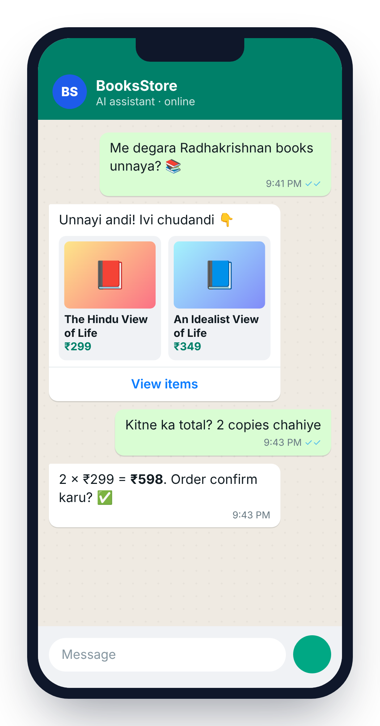
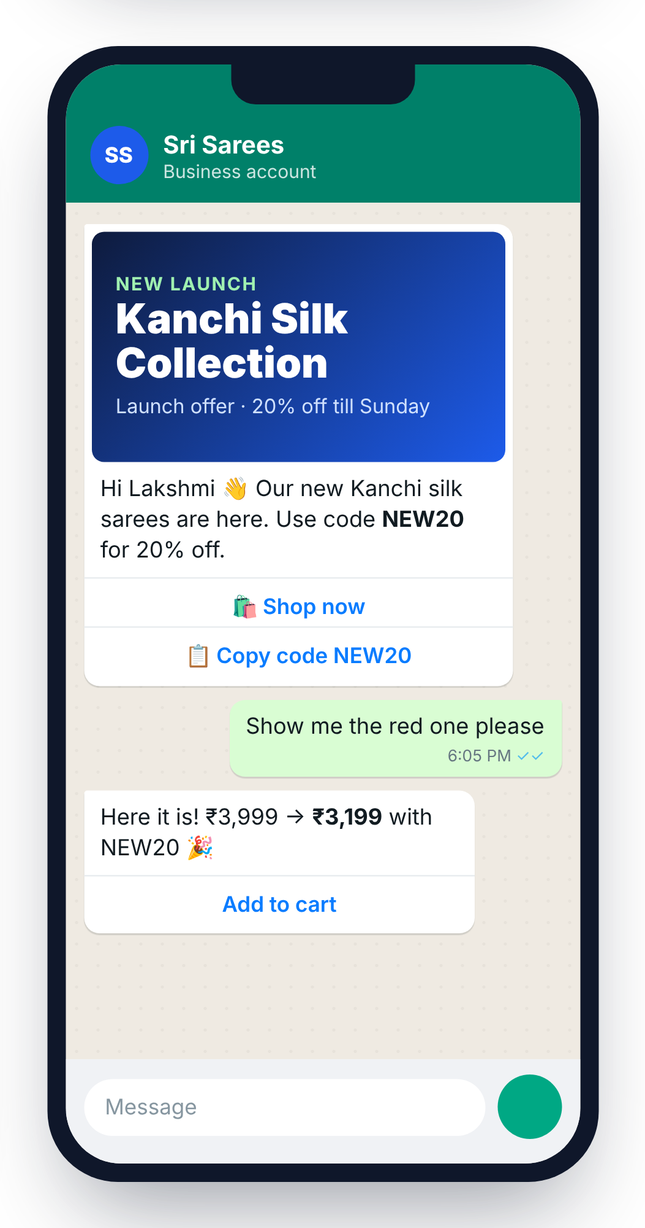

Turn WhatsApp chats into sales
AI replies · Launches and offers · Shop in chat · Support
Official Meta Tech Provider
by Magnetora AI Solutions
Notes:
Namaste! WAMA CRM turns WhatsApp chats into sales: AI replies, product launches and offers to all your customers, a shop inside WhatsApp, and support. Built by Magnetora AI Solutions, an official Meta Tech Provider.

Slide 2
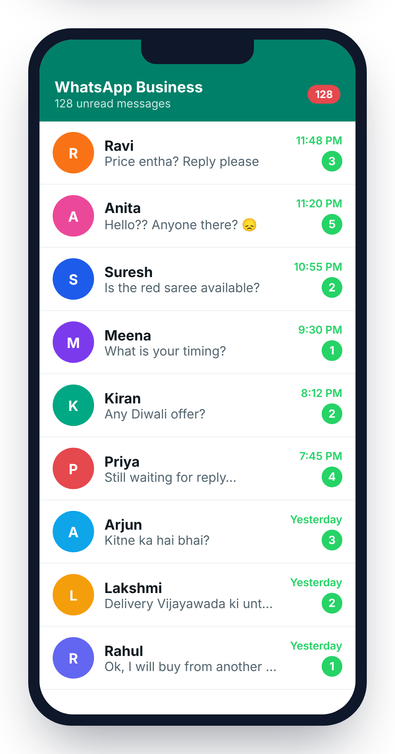






Where businesses lose customers
Late replies
Leads lost
They buy from someone else
Chats stuck in staff phones
No follow-up
Same questions
Interested buyers forgotten
“Price? Timing? Address?”
Launches missed
Offers unseen
Customers never find out
Posts and SMS get ignored
Notes:
This is what most business WhatsApp numbers look like: 128 unread messages, customers asking price and timing late at night, and one saying they will buy from another shop. Ask: does your WhatsApp look like this? The last two problems are about growth: new launches and offers never reach existing customers.

Slide 3




Magnetora AI Solutions
We make AI simple for Indian businesses
AI chatbots
WhatsApp CRM
Custom AI tools
Official Meta Tech Provider
Notes:
Magnetora AI Solutions builds AI products for Indian businesses. We are an official Meta Tech Provider, so we connect you to WhatsApp the official way.

Slide 4
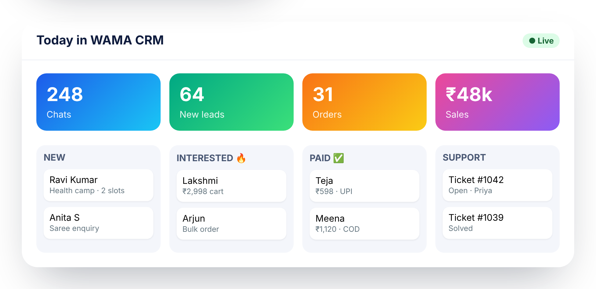



One app for every WhatsApp customer
Reply
Launch
Sell
Support
Notes:
WAMA CRM does four jobs in one app: replying, launching products and offers, selling and support. Your whole team works from one WhatsApp number.

Slide 5


AI replies in seconds, in their language
English
తెలుగు
हिंदी
Tenglish
Hinglish
24 × 7
Even at 2 AM
Knows your business
Products, prices, FAQs
Hands over
Hot leads to your team
Notes:
The AI understands how Indians really type, including Telugu and Hindi in English letters, and answers from your own product list and FAQs.

Slide 6




New launch? Tell every customer in one click
All your customers, one list
From every chat, order and Excel sheet
Pick who gets it
Past buyers, city, interest, tags
Photo, offer code, Shop button
They can buy straight from the message
See who read and bought
Delivered, read, replied, ordered
Notes:
This answers the launch problem. Every customer who ever messaged or bought is already in WAMA CRM. Pick a group, add a photo and an offer code, and send. Customers can tap Shop now and buy in the chat.

Slide 7
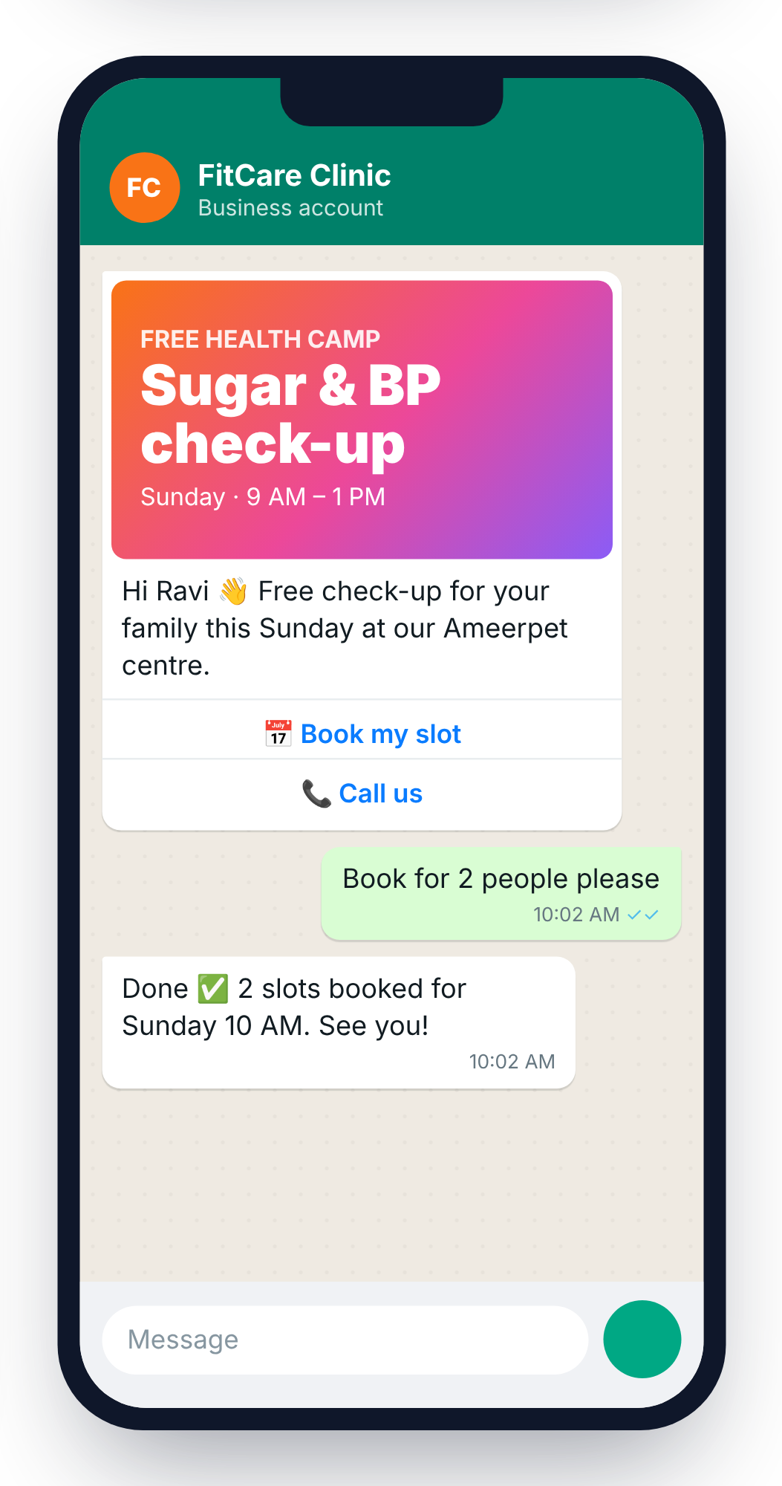




Offers that bring customers back
Customer list
Choose group
Send offer
Orders come in
Festival offers
Reminders
Diwali, Sankranti, Ugadi
Appointments, renewals, stock back
Schedule once
Meta approved
Sends at the right time
Your number stays safe
Notes:
Most businesses post offers on Instagram or send SMS, and most customers never see them. On WhatsApp, the offer reaches the customer’s chat list with a button to book or buy.

Slide 8
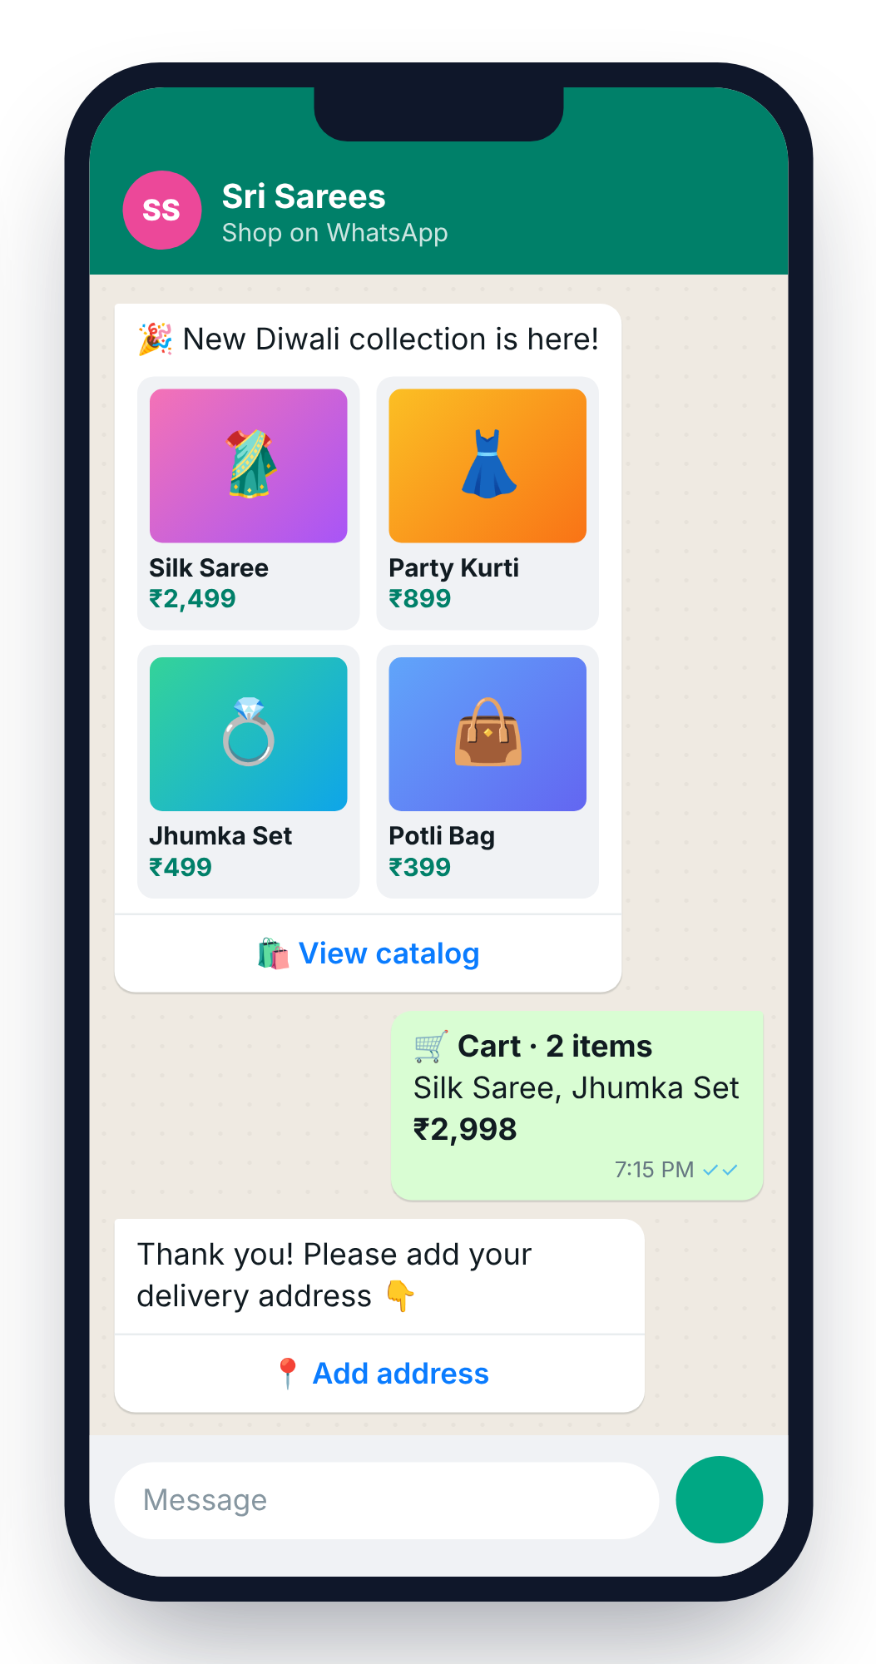
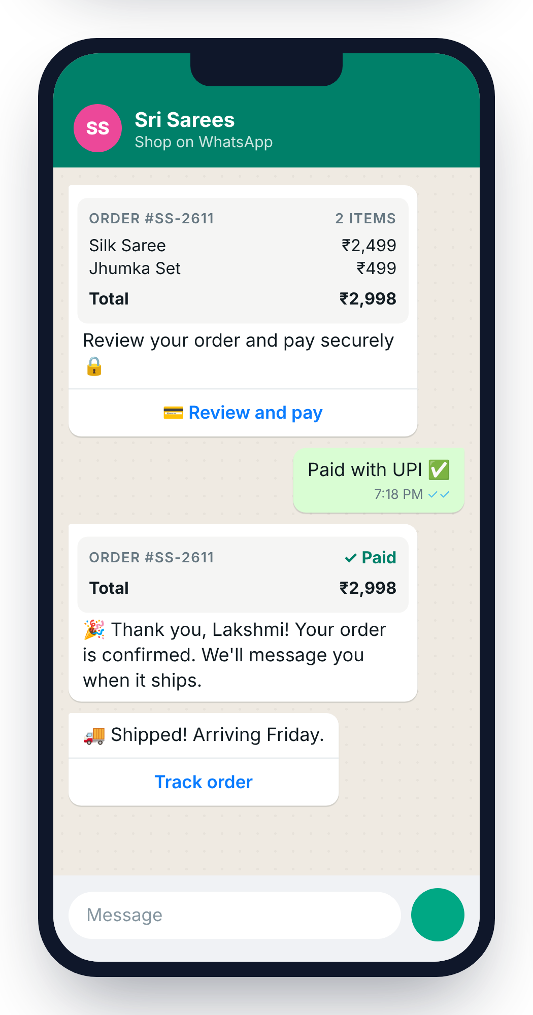



Your shop, inside WhatsApp
NEW · WhatsApp Commerce
No website. No app. Customers browse, order and pay in the chat.
Catalog
Cart
Address
Pay
Delivery
Notes:
For shops and brands: customers see your catalog, add to cart, give their address and pay, without leaving WhatsApp.

Slide 9


Everything a WhatsApp shop needs
Catalog sync
UPI · Cards · COD
AI shop assistant
With your Meta catalog
WhatsApp Pay built in
“Where is my order?”
Auto order updates
Orders in CRM
Repeat sales
Paid, packed, shipped
Every order, one screen
Thank-you and offers
Notes:
Stress UPI and Cash on Delivery, and that every order lands in the CRM.

Slide 10
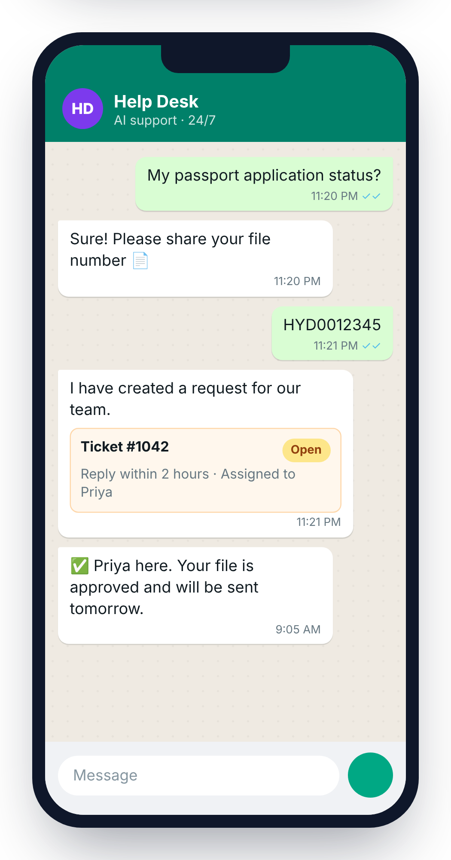


Support that never sleeps
AI answers first
24 × 7, instantly
A ticket for every request
Nothing gets lost
Smooth hand-over
To the right person
Reply time limits
Alerts before delays
Notes:
AI answers first. When a person is needed, a ticket is created and assigned with a reply time limit.

Slide 11


Before vs. after WAMA CRM
Before
With WAMA CRM
Reply next day
Reply in seconds
Leads in staff phones
Every lead in CRM
Launches reach a few people
Launches reach every customer
Customers call to order
Order and pay in chat
Guess what works
Live reports
Notes:
Read the left side, then the right. Ask which change matters most to them.

Slide 12


Trusted by organisations that serve people
Consular Helpdesk
Passport · OCI · PCC
Health screening campaigns
AI chat support + tickets
WhatsApp campaigns for health camps, and support for people who reach out
AI answers questions 24 × 7 and every request becomes a tracked ticket
deepindia.org
consularhelpdesk.com
Notes:
DEEP Trust (Disease Eradication through Education and Prevention) uses WAMA CRM for health screening campaigns and support. Consular Helpdesk uses it for AI chat support with tickets for passport, OCI and PCC help.

Slide 13



Why WAMA CRM
Official
0% markup
Made for India
Live in minutes
Meta Tech Provider
Pay Meta’s rates directly
Languages, UPI, COD
No coding needed
Notes:
Four reasons: official Meta connection, no markup on Meta charges, built for India, and quick to start.

Slide 14


Let’s grow your business on WhatsApp
Free demo
1
Connect WhatsApp
2
14-day free trial · wamacrm.magnetora.in
Go live
3
Thank you · ధన్యవాదాలు · धन्यवाद
Notes:
Book the demo date before you leave the meeting. Offer to connect their WhatsApp number together on a call.

