Slide 1
Amazon Data Set Batch: DS3AD
Language: MYSQL IDE: VSCode.

Slide 2
Product Analysis:
The dataset includes six unique product lines: Health and beauty, Electronic accessories, Home and lifestyle, Sports and travel, Food and beverages, and Fashion accessories.
The Health and beauty line had the highest sales and incurred the highest VAT, while Food and beverages generated the maximum revenue.
The sales status for Health and beauty and Sports and travel was "Good," indicating above-average performance, while the remaining four product lines had a "Bad" sales status.

Slide 3
Sales Analysis:
The dataset spans three months: January, February, and March, with January witnessing the highest purchases.
Wednesday afternoons recorded the highest sales, while Thursday evenings saw the lowest sales (excluding weekends).
Branch A performed exceptionally well, having sold the highest quantity of 1859 units.

Slide 4
Customer Analysis:
Males showed a greater interest in purchasing Health and beauty products, contrary to the stereotype that men are not inclined towards such products.
Females were more interested in Fashion accessories, with Food and beverages being the second most popular line among them.
Customers with memberships contributed significantly to the revenue, indicating the success of the company's membership concept. Notably, all membership holders were female.
Branch B received the highest customer ratings on Wednesday afternoons, coinciding with the day and time of highest sales

Slide 5

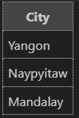
What is the count of distinct cities in the dataset?

Slide 6

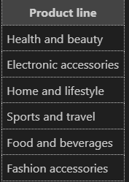
For each branch, what is the corresponding city?

Slide 7
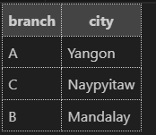
For each branch, what is the corresponding city?

Slide 8
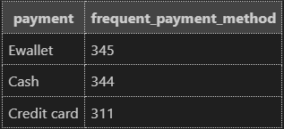
Which payment method occurs most frequently?

Slide 9

Which product line has the highest sales?

Slide 10
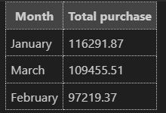
How much revenue is generated each month?

Slide 11

Which product line generated the highest revenue?

Slide 12

In which month did the cost of goods sold reach its peak?

Slide 13

In which city was the highest revenue recorded?

Slide 14

Which product line incurred the highest Value Added Tax?

Slide 15
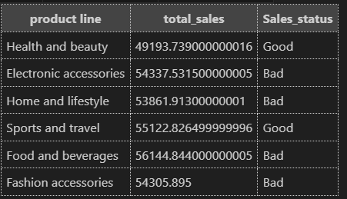
For each product line, add a column indicating "Good" if its sales are above average, otherwise "Bad."

Slide 16

Identify the branch that exceeded the average number of products sold.

Slide 17
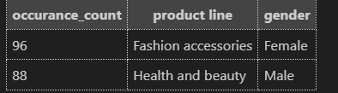
Which product line is most frequently associated with each gender

Slide 18
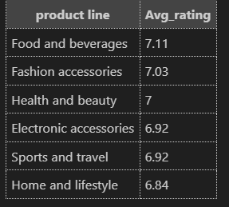
Calculate the average rating for each product line.

Slide 19
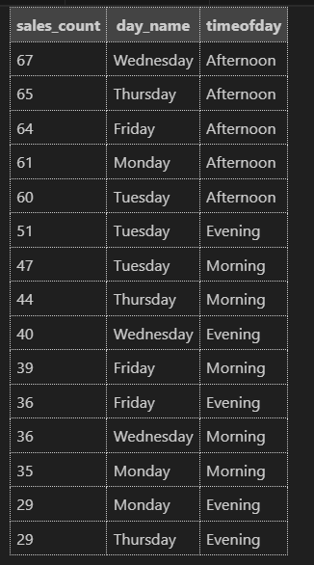
Count the sales occurrences for each time of day on every weekday.

Slide 20
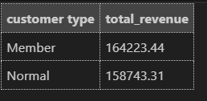
Identify the customer type contributing the highest revenue.

Slide 21

Determine the city with the highest VAT percentage.

Slide 22

Identify the customer type with the highest VAT payments.

Slide 23

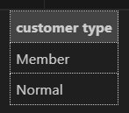
What is the count of distinct customer types in the dataset?

Slide 24
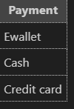

What is the count of distinct payment methods in the dataset?

Slide 25

Which customer type occurs most frequently?

Slide 26
Identify the customer type with the highest purchase frequency.

Slide 27
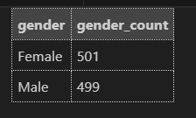
Determine the predominant gender among customers.

Slide 28
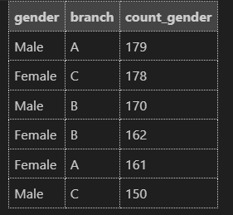
Examine the distribution of genders within each branch.

Slide 29

Identify the time of day when customers provide the most ratings.

Slide 30
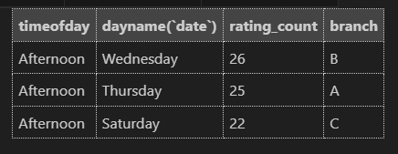
Determine the time of day with the highest customer ratings for each branch.

Slide 31

Identify the day of the week with the highest average ratings.

Slide 32

Determine the day of the week with the highest average ratings for each branch.

Slide 33
Suggestions to our client:
Focus on expanding and enhancing the Health and beauty product line, as it has shown exceptional performance in terms of sales and VAT generation.
Implement targeted marketing campaigns and promotional offers during January, as it appears to be the peak month for purchases.
Identify the successful strategies employed by Branch A and replicate them across other branches to improve overall performance.

