Slide 1
ONLINE TEST DRIVE AND SERVICE BOOKING SYSTEM

Slide 2
EXISTING SYSTEM
ROYAL BAJAJ , ADIMALY is a Bajaj showroom owned and run by ROYAL DEALERS , KOTTAYAM .
DMS (Dealers Management System) is the software used in the showroom
DMS keeps the records of
. transactions
. sales and service
. customer details

Slide 3
PROBLEM STATMENT
Existing system , DMS is controlled by the head office at Kottayam .
Showroom does not provide a platform for booking test drive and service for desired Bajaj bikes

Slide 4
MODULES
1. REGISTRATION
2.PRODUCT
3.BOOKING
3.1 TEST DRIVE BOOKING
3.2 SERVICE BOOKING

Slide 5
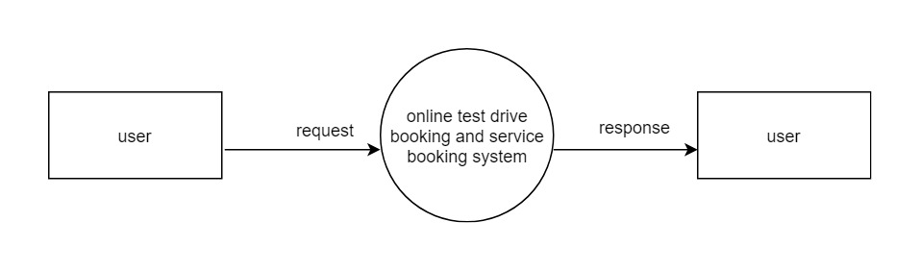
CONTEXT LEVEL DFD

Slide 6
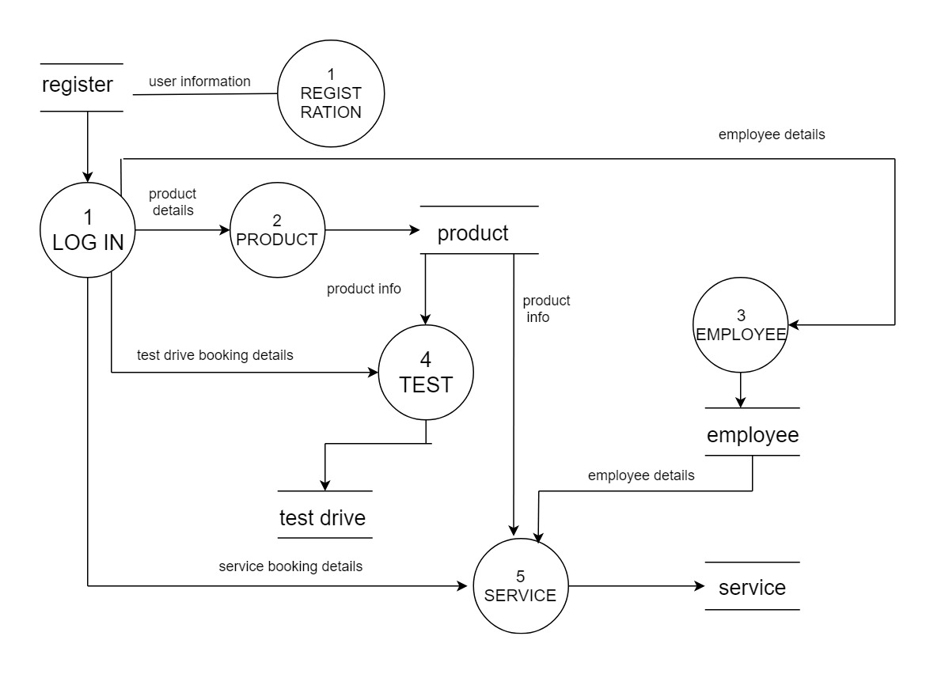
LEVEL 1DFD

Slide 7
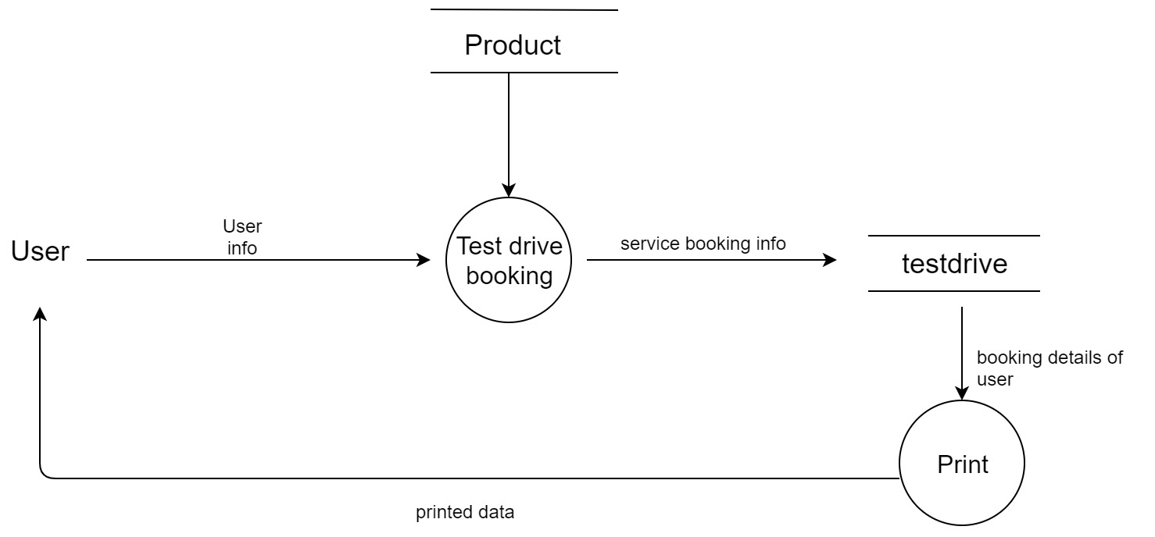
LEVEL 2 DFD
TEST DRIVE BOOKING

Slide 8
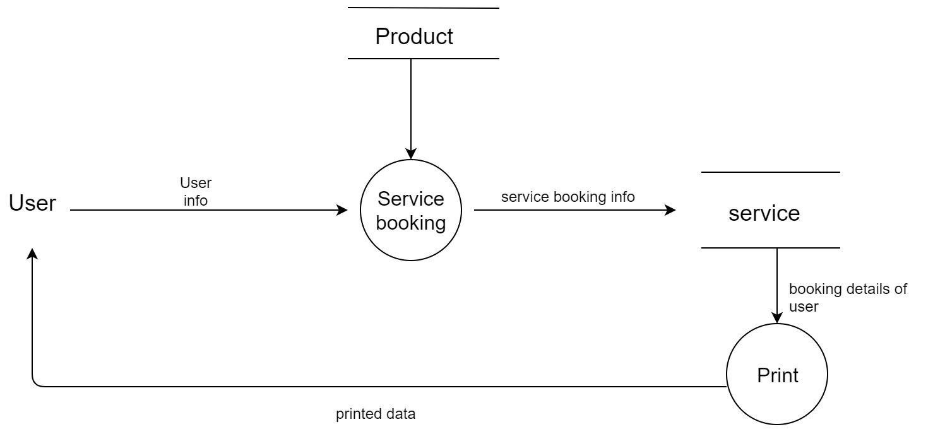
SERVICE BOOKING

Slide 9
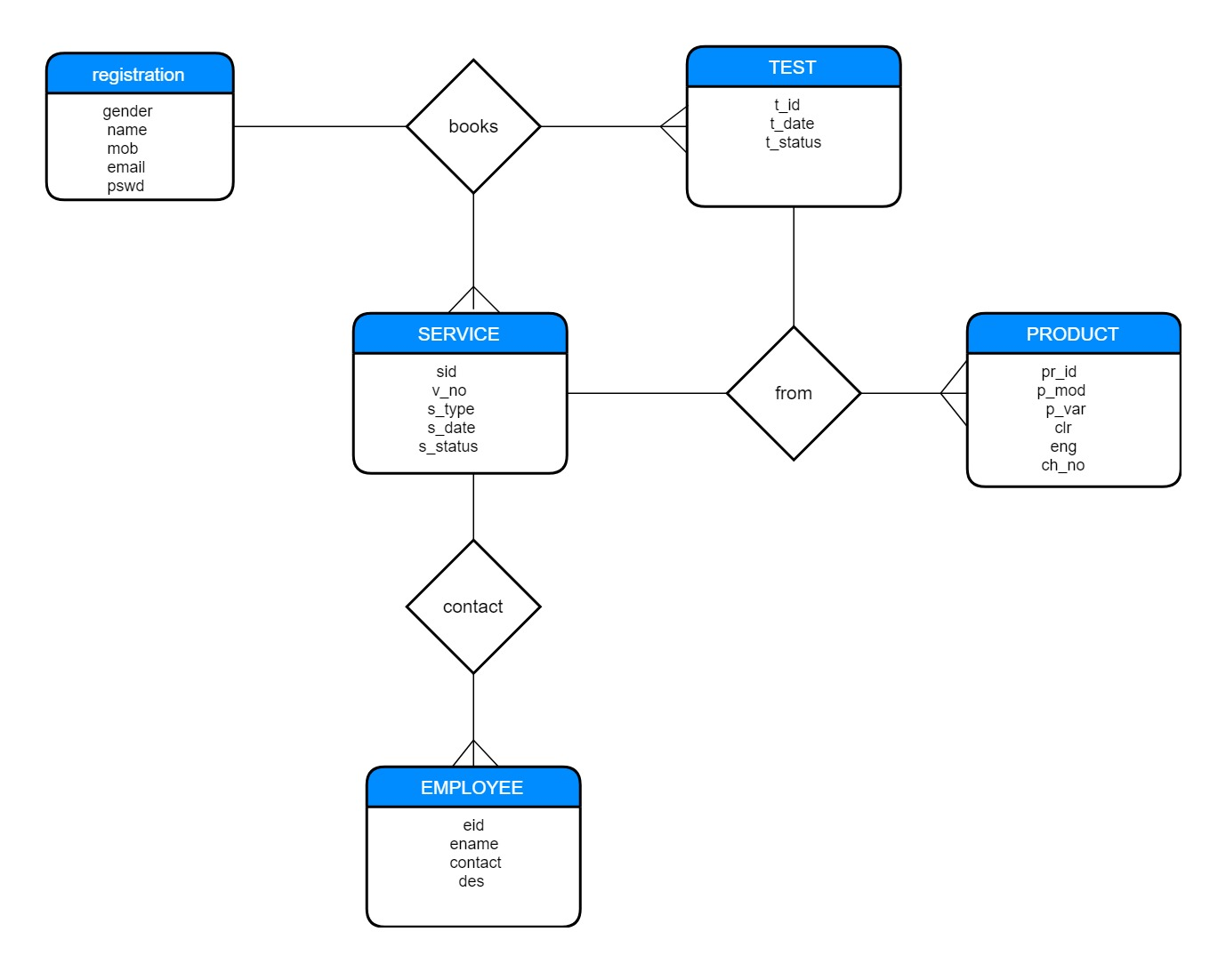
ER DIAGRAM

Slide 10
REGISTRATION TABLE
FEILDS | DATATYPE (SIZE) | CONSTRAINT | DESCRIPTION
fname | varchar(30) | not null | First name
lname | varchar(30) | not null | Last name
age | int | Not null | Age
l_no | varchar(15) | Not null | License number of user
email | varchar(50) | not null | email
contact | bigint10) | notnull | Contact number of user
uname | var char(10) | primary key | User name
pswd | varchar(20) | not null | password
utype | Int(1) | Not null | Usertype(admin/user)

Slide 11
EMPLOYEE TABLE
FEILDS | DATA TYPE (SIZE) | CONSTRAIN | DESCRIPTION
E_id | int(5) | Auto Increment | employee number
ename | varchar(30) | Primary key | Employee name
edes | Varchar(30) | Not null | Designation of employee
econtact | Bigint(10) | Not null | Contact number of employee

Slide 12
PRODUCT TABLE
FEILDS | DATA TYPE (SIZE) | CONSTRAIN | DESCRIPTION
pr_id | varchar(5) | primary key | Product id
pimg | Text(50) | Not null | Image of product
p_mod | varchar(20) | not null | model name
p_var | varchar(20) | not null | variant name
clr | varchar(20) | not null | Color
disp | Varchar(10) | not null | Displacement of product
t_speed | Varchar(8) | Not null | Top speed of product
wght | Varchar(5) | Not null | Weight of the product
description | Varchar(200) | Not null | Description about product

Slide 13
TEST DRIVE BOOKING TABLE
FEILDS | DATA TYPE (SIZE) | CONSTRAINT | DESCRIPTION
t_id | var char(5) | primary key | test id
uname | var char(10) | foreign key | username
pr_id | var char(5) | foreign key | product id
t_date | date | not null | date for test drive
t_status | var char (12) | notnull | Approved/not approved

Slide 14
SERVICE BOOKING TABLE
FIELD NAME | DATA TYPE (SIZE) | CONSTRAINT | DESCRIPTION
s_id | var char(5) | primary key | service id
pr_id | var char(5) | foreign key | product id
uname | var char(10) | foreign key | User name
s_type | var char(4) | not null | service type (free/paid)
vno | varchar2(5) | Not null | Vehicle number
s_date | date | not null | service date
s_status | var char(3) | Not null | Approved/not approved

