Slide 1

PROFESSIONAL INTRODUCTION
Tejal Mugul
Market Research Professional | Competitive Intelligence | Strategic Insights
USD 400K+ Consulting Impact • Fortune 500 Client Trust • Cross-Sector Market Intelligence
Pune, Maharashtra, India (Open to All Locations)
tejal10mugul@gmail.com
linkedin.com/in/tejal10mugul
+91 8698741555
tejal10mugulgif.github.io/tejal-portfolio
substack.com/@tejmugul
TEJAL MUGUL | MARKET RESEARCH & COMPETITIVE INTELLIGENCE
01

Slide 2
About This Portfolio
WHAT THIS IS
Consultant Profile
Report at a Glance
Three years of Competitive Intelligence and Strategy Consulting experience delivering market entry strategy, pricing intelligence, and business analysis for Fortune 500 clients across five sectors and five global regions.
SCOPE
Work Sample
Market sizing, competitive landscape, regional analysis, and a 2025–2036 forecast
A complete, client-grade market intelligence report — Global Functional Beverage Market — reproduced in full to demonstrate the standard of analysis and delivery.
METHODOLOGY
Primary and secondary research, applying TAM/SAM/SOM, SWOT, PESTLE, and Porter's Five Forces
WHY IT'S HERE
STANDARD
Most portfolios describe a track record. This one demonstrates it — the same structure, rigor, and depth delivered to clients including ABB, Honda, IBM, Siemens, and BASF.
What follows is not a summary. It is the work itself.
Structured, client-ready, and built to the standard used for Fortune 500 engagements
TEJAL MUGUL | MARKET RESEARCH & COMPETITIVE INTELLIGENCE
02

Slide 3
Professional Snapshot
Transforming market intelligence into strategic, revenue-driving decisions.
3
400+
20+
Years in Market Research &
Competitive Intelligence
Company Intelligence Profiles &
Benchmarking Reports Authored
Repeat Client
Engagements Built
Who I Am
I am a Competitive Intelligence and Strategy Consulting professional with 3 years of experience delivering market intelligence, market entry strategy, pricing intelligence, and business analysis for Fortune 500 clients across Automotive, FMCG, ICT, Chemicals, and Industrial sectors — spanning North America, Europe, Asia-Pacific, Latin America, and the Middle East & Africa.
My work applies structured frameworks — SWOT, PESTLE, Porter's Five Forces, and TAM/SAM/SOM market sizing — backed by Power BI and SQL, to build dashboards tracking pricing intelligence, M&A activity, and supply chain signals. I've mentored junior analysts and delivered 100% on-time across concurrent client engagements in distributed Agile teams.
TEJAL MUGUL | MARKET RESEARCH & COMPETITIVE INTELLIGENCE
03

Slide 4
Work Experience
A track record of turning research into revenue-driving decisions.
Consultant – Market Research & Strategy
Research Nester Analytics · Oct 2023 - Nov 2025
Frameworks
Promoted from Senior Research Associate to Consultant. Ranked top 3 of 10 consultants for proposal-to-engagement conversion; authored 400+ company intelligence profiles for clients including ABB, Honda, IBM, Siemens, and BASF; led 20+ RFPs worth ~USD 400K for clients including IKEA and Adani Wilmar.
SWOT • PESTLE • Porter's Five Forces
TAM / SAM / SOM • Competitive Benchmarking
Senior Research Associate
Prudour Pvt. Ltd., Pune · Nov 2022 - Aug 2023
Tools & Databases
Compiled 30+ market research reports across ICT, Consumer Goods, Industrial Manufacturing, and Food & Beverage sectors, applying SWOT, PESTLE, and Porter's Five Forces to identify whitespace opportunities and shape client strategy.
Power BI • SQL • Advanced Excel (VBA)
Factiva • Statista • GlobalData • MarketLine
TEJAL MUGUL | MARKET RESEARCH & COMPETITIVE INTELLIGENCE
04

Slide 5
Sector Coverage (1/2)
Delivering research across technology, manufacturing, mobility, and advanced materials.
ICT
Semiconductors & Electronics
Industrial Automation & Manufacturing
Global Data Centre Market
Japan Data Centre Cooling Market
NA & Japan Data Centre Infrastructure Management Market
Others
Global In-Vehicle USB-C Market
Global Photosensitive Polyimide Market
Global Electrostatic Discharge (ESD) Packaging Market
Others
Global Building Management System Market
Global Plant Factory Market
Global Vacuum Insulated Pipe Market
Others
Global Vehicle Dynamic Control System Market
Global Automotive Polycarbonate Glass Market
Others
Global Ammonia Market
Global Friction Material Market
Global Nickel Alloys Market
Others
Automotive & Mobility
Chemical & Advanced Materials
TEJAL MUGUL | MARKET RESEARCH & COMPETITIVE INTELLIGENCE
05

Slide 6
Sector Coverage (2/2)
Expanding expertise across healthcare, infrastructure, energy, and consumer markets.
Healthcare & Life Sciences
Energy, Utilities & Sustainability
Construction & Infrastructure
Global Non-Invasive Prenatal Testing (NIPT) Market
Global mAbs Contract Manufacturing Market
Global Medical Rubber Stoppers Market
Others
Global Smart Water Meter Market
Global Smart Water Metering Market
Global Water Heater Market
Others
Asia Pacific Building Information Modelling (BIM) Market
Global Concrete Paving Equipment Market
Global Windows & Doors Market
Others
Global Access Control Market
Crowd Management & Event Security Market
Others
Food Packaging Market
Matcha Market
Coffee Market
Others
Security & Safety
Chemical & Advanced Materials
TEJAL MUGUL | MARKET RESEARCH & COMPETITIVE INTELLIGENCE
06

Slide 7
Experience & Expertise
Building data-driven strategies through research, analysis, and business intelligence.
Research Associate
Research Nester Analytics · Nov 2023 - Oct 2025
Frameworks
Delivered market intelligence reports and competitive positioning studies for global clients including 3M, ABB, Honda, IBM, Siemens, and BASF. Led PESTEL, SWOT, and M&A tracking across ICT, chemicals, and industrial markets.
SWOT • PESTLE • Porter's Five Forces
TAM / SAM / SOM • Competitive Benchmarking
Research Associate
Prudour Pvt. Ltd. · Dec 2022 - Aug 2023
Tools & Databases
Conducted SWOT, PESTLE, and Porter's Five Forces analysis to assess competitive landscapes, identify risks and opportunities, and produce client-ready research reports.
Advanced Excel • Power BI (basic proficiency)
Factiva • Statista • GlobalData
TEJAL MUGUL | MARKET RESEARCH & COMPETITIVE INTELLIGENCE
07

Slide 8
Education & Let's Connect
EDUCATION
PGDM, Marketing
Get In Touch
Dr. D. Y. Patil B-School, Pune · 2020 - 2022
EMAIL
BMS, E-Commerce
tejal10mugul@gmail.com
M.D. Palesha Commerce College, Dhule · 2017 - 2020
LINKEDIN
linkedin.com/in/tejal10mugul
CERTIFICATIONS
LOCATION
Market Research: Qualitative • Conducting a SWOT Analysis
Excel for Business Analysts • Preparing Data for Analysis with Microsoft Excel
Pune, Maharashtra, India (Open to All Locations)
TEJAL MUGUL | MARKET RESEARCH & COMPETITIVE INTELLIGENCE
08

Slide 9
MARKET INTELLIGENCE REPORT
Global Functional Beverage Market
Size, Share, Competitive Landscape, Regional Analysis & Forecast
2025 – 2036
By Product Type • Ingredient • Packaging • Distribution Channel • End User • Region

Slide 10
Table of Contents
Report structure — Part 01 of 02
Research Methodology
Definition of Market and Segmentation
Executive Summary
Market at a Glance
Global Market Size & Forecast, 2025–2036
Part 1 (Market Dynamics)
Market Growth Drivers
Market Restraints
Market Opportunities
Market Trends
Part 2 (Industry & Structural Analysis)
PESTEL Analysis
Regulatory & Standards Landscape
Industry Value Chain Analysis
Porter's Five Forces Analysis
Industry Risk Analysis
Trade Analysis
Raw Material Analysis
Ingredient Innovation Analysis
Manufacturing Analysis
Technology Analysis
Supply Chain Analysis
Pricing Analysis
Regional Demand Analysis
Distribution Channel Analysis
Consumer Behavior Analysis
Consumer Preference Analysis
Packaging Analysis
Competitive Positioning Matrix
SWOT Analysis
Recent Strategic Developments
Brand Positioning Analysis
AI Impact Analysis
Sustainability & Clean-Label Trends
GLOBAL FUNCTIONAL BEVERAGE MARKET | 2025 – 2036

Slide 11
Table of Contents
Report structure — Part 02 of 02
Part 3 (Market Segmentation)
Product Type Analysis
Ingredient Type Analysis
Packaging Type Analysis
Distribution Channel Analysis
End User Analysis
Part 4 (Regional & Country Analysis)
Global Functional Beverage Market Overview
North America Functional Beverage Market Overview
Europe Functional Beverage Market Overview
Asia-Pacific Functional Beverage Market Overview
Latin America Functional Beverage Market Overview
Middle East and Africa Functional Beverage Market Overview
Part 5 (Competitive Landscape)
Competitive Landscape Market Share, 2025
Key Players
PepsiCo, Inc.
The Coca-Cola Company
Red Bull GmbH
Danone S.A.
Nestle S.A.
Suntory Holdings
Monster Beverage Corp.
Celsius Holdings, Inc.
GT's Living Foods
Others
Part 6 (Market Size & Forecast Analysis)
Part 7 (Outlook & Recommendations)
Investment & Funding Landscape
Impact of Inflation & Economic Slowdown
Future Outlook to 2036
Analyst Recommendations for Stakeholders
Conclusion
GLOBAL FUNCTIONAL BEVERAGE MARKET | 2025 – 2036

Slide 12
Research Methodology
A blended top-down and bottom-up approach validated through primary and secondary research
1
2
3
4
Secondary Research
Primary Research
Data Modeling
Expert Validation
Company reports, trade journals, government & industry association databases, paid statistical databases.
Structured interviews with manufacturers, distributors, retailers, and category experts across regions.
Top-down and bottom-up triangulation to size the market by segment, region, and country.
Findings validated with C-level executives and subject-matter experts before publication.
GLOBAL FUNCTIONAL BEVERAGE MARKET | 2025 – 2036

Slide 13
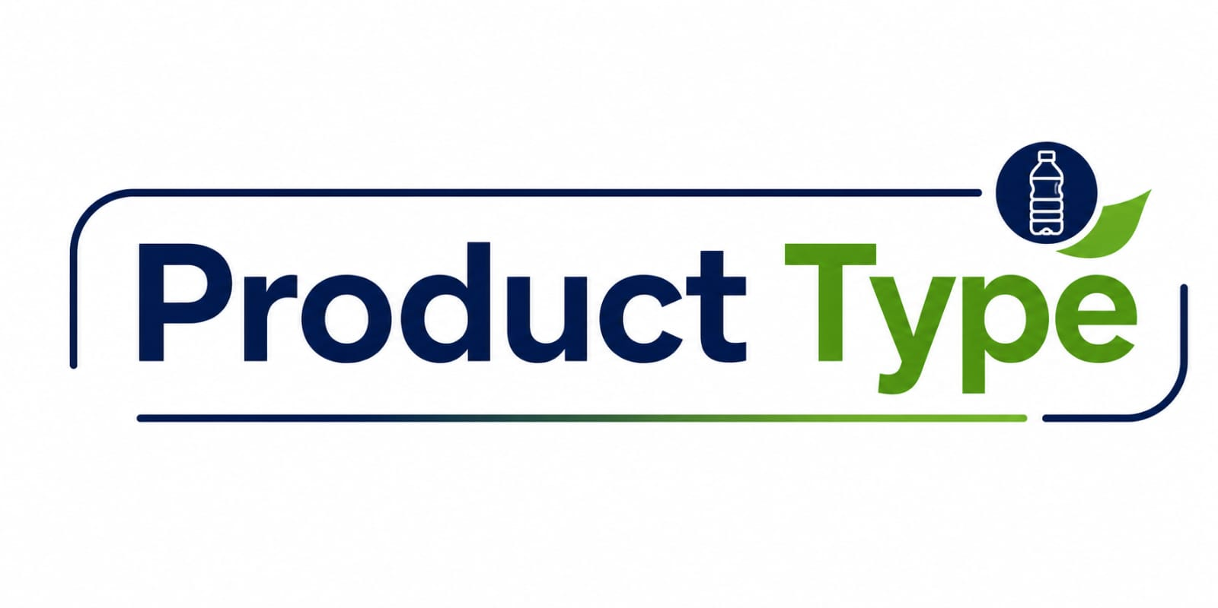
Definition of Market and Segmentation
Segmentation detail — Part 01 of 03
The Global Functional Beverages Market comprises beverages fortified with bioactive ingredients that deliver health benefits beyond basic nutrition and hydration. These products are formulated to support specific health outcomes, including energy enhancement, digestive health, immunity, cognitive performance, hydration, and overall wellness.
The market encompasses categories such as energy drinks, sports and performance drinks, functional waters, fortified juices, probiotic beverages, and other nutritionally enhanced beverages. Market growth is driven by rising health consciousness, increasing demand for preventive nutrition, continuous product innovation, and expanding availability through both retail and e-commerce distribution channels.
Product Type
Energy Drinks
Sports & Performance Drinks
Fortified Juices
Functional Water
Others
GLOBAL FUNCTIONAL BEVERAGE MARKET | 2025 – 2036

Slide 14
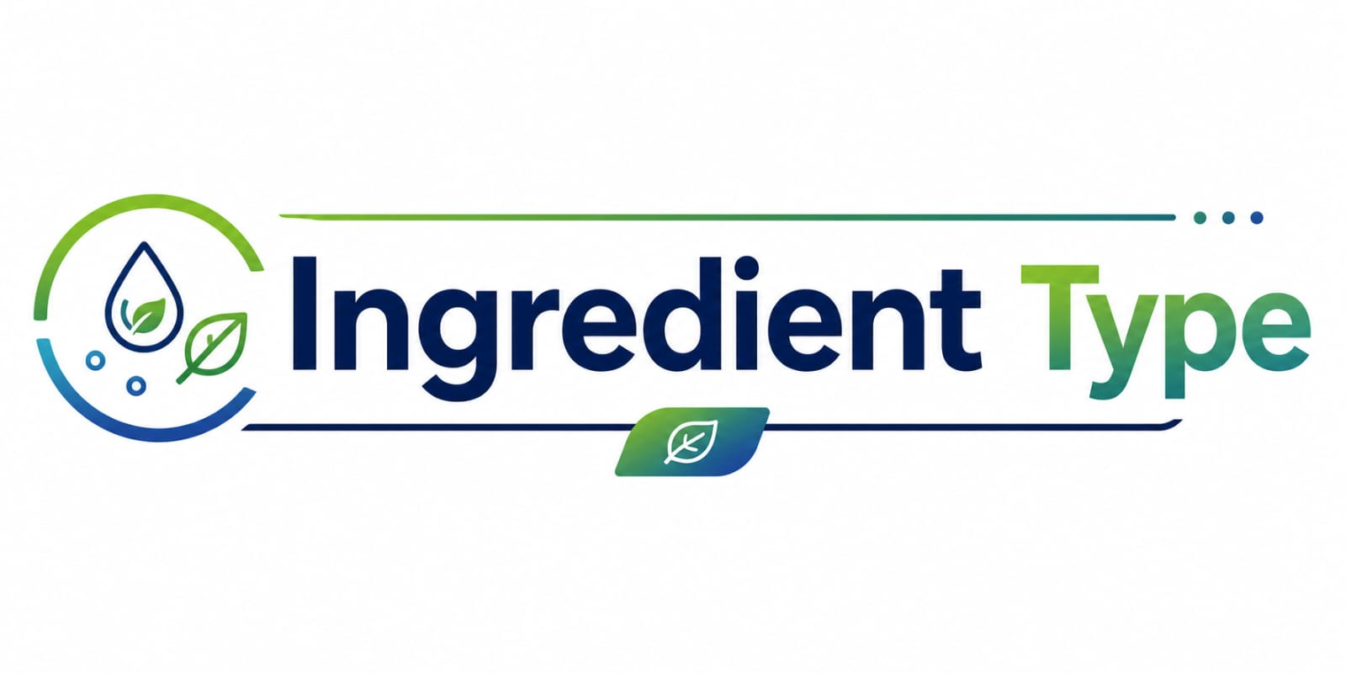
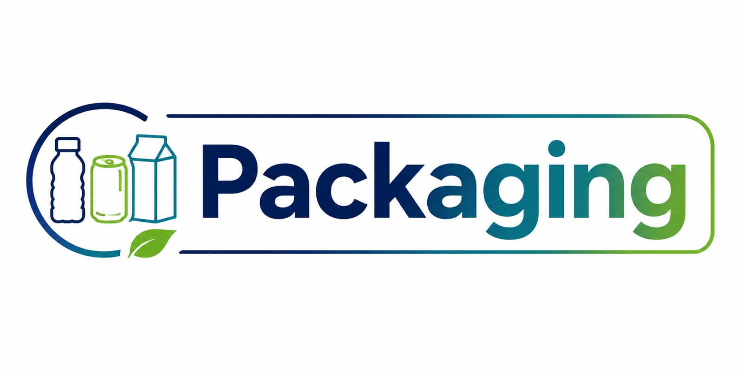

Definition of Market and Segmentation
Segmentation detail — Part 02 of 03
Ingredient Type
Vitamins & Minerals
Probiotics & Prebiotics
Amino Acids & Protein
Caffeine & Botanicals
Adaptogens & Nootropics
Packaging
PET Bottles
Cans
Cartons
Pouches
Distribution Channel
Supermarkets/Hypermarkets
Convenience Stores
Online/E-commerce
Specialty & Health Stores
GLOBAL FUNCTIONAL BEVERAGE MARKET | 2025 – 2036

Slide 15

Definition of Market and Segmentation
Segmentation detail — Part 03 of 03
End User
Gen Z
Millennials
Athletes & Fitness Enthusiasts
Aging Population
GLOBAL FUNCTIONAL BEVERAGE MARKET | 2025 – 2036

Slide 16
Executive Summary
The global functional beverage market is witnessing strong growth, driven by health-conscious consumers, scientific innovation, clean-label formulations, and increasing demand for preventive nutrition and wellness solutions.
The global functional beverage market is projected to grow from USD 182.47 billion in 2025 to USD 483.66 billion by 2036, registering a CAGR of 9.27%, driven by increasing demand for preventive healthcare, immunity, hydration, and wellness-focused beverages.
Rising consumer preference for clean-label, reduced-sugar, plant-based, probiotic, and protein-enriched beverages is accelerating product innovation, while AI, personalized nutrition, and advanced formulation technologies continue to reshape the industry.
Asia Pacific is expected to remain the largest and fastest-growing regional market, supported by rapid urbanization, rising disposable incomes, and increasing health awareness, while North America and Europe continue to lead in premiumization and innovation.
Stringent regulations from organizations such as WHO, FDA, EFSA, FAO, and Codex Alimentarius are encouraging healthier formulations, transparent labelling, and scientifically substantiated health claims, driving industry-wide compliance and innovation.
Leading companies including PepsiCo, The Coca-Cola Company, Danone, Nestlé, Red Bull, and Monster Beverage are strengthening their market position through strategic acquisitions, product innovation, sustainability initiatives, and expansion into emerging functional beverage categories.
9.27%
Projected CAGR, 2026–2036
45+
Countries covered in this study
12+
Companies profiled or referenced
GLOBAL FUNCTIONAL BEVERAGE MARKET | 2025 – 2036

Slide 17
Market at a Glance
Key headline figures for the global functional beverage industry
$182.47B
$483.66B
9.27%
Estimated market value, 2025
Forecast market value, 2036
CAGR, 2026–2036
APAC
53.0%
29.0%
Fastest-growing region
Share held by top 10 players
Online channel share by 2036
GLOBAL FUNCTIONAL BEVERAGE MARKET | 2025 – 2036

Slide 18
Global Market Size & Forecast, 2025–2036
The global functional beverage market is projected to grow steadily through 2036, driven by rising health awareness, premiumization, and continuous product innovation.
GLOBAL FUNCTIONAL BEVERAGE MARKET | 2025 – 2036

Slide 19
PART 01
Market Dynamics
Forces shaping demand, supply, and innovation across the functional beverage industry
GLOBAL FUNCTIONAL BEVERAGE MARKET | 2025 – 2036

Slide 20
Market Growth Drivers
Key structural and policy-driven factors accelerating the adoption of functional beverages worldwide.
Rising Preventive Healthcare: Increasing focus on preventive healthcare is driving demand for functional beverages fortified with vitamins, minerals, probiotics, and other beneficial ingredients, as consumers seek products that support overall health and wellness.
WHO – Healthy Diet Fact Sheet, 26 January 2026: WHO recommends nutrient-rich diets and reduced free sugar intake to help prevent obesity, diabetes, cardiovascular diseases, and other NCDs.
Advancements in Nutrition Research Supporting Innovation: Continuous advances in microbiome and nutrition research are driving innovation in functional beverages with probiotics, prebiotics, and other bioactive ingredients, supporting digestive health, immunity, and overall wellness.
NIH – Precision Nutrition Research Program (Ongoing since 2022): NIH continues funding research on personalized nutrition, microbiome science, and diet–health interactions.
Expansion of National Fortification Programs Driving Innovation: National micronutrient fortification programs are driving innovation in fortified beverages, including juices, dairy drinks, and functional waters, to address vitamin and mineral deficiencies.
WHO & FAO – What are Healthy Diets? (24 October 2024): The publication supports food fortification to improve micronutrient intake.
Sugar Reduction Initiatives: Government-led sugar reduction initiatives are driving demand for low-sugar functional beverages with added nutritional benefits. Public health campaigns are encouraging manufacturers to expand reduced-sugar and nutrient-enriched product offerings.
WHO – Healthy Diet Fact Sheet (26 January 2026): WHO recommends limiting free sugar intake to less than 10% of total daily energy intake to support better health.
GLOBAL FUNCTIONAL BEVERAGE MARKET | 2025 – 2036

Slide 21
Market Restraints
Critical regulatory, formulation, and commercialization challenges influencing market growth.
High Product Reformulation Costs
Evidence-Based Claim Requirements
Continuous product reformulation increases R&D costs as manufacturers adapt to evolving nutrition guidelines and regulations. Reducing sugar and improving nutrient profiles while maintaining taste and functionality requires ongoing investment in innovation.
WHO – Healthy Diet Fact Sheet, 2026): WHO recommends reducing sugar, sodium, saturated fat, and trans fat through product reformulation.
Scientific substantiation requirements delay the commercialization of novel functional ingredients. Manufacturers must provide robust scientific evidence before making health-related claims, extending product development timelines.
U.S. FDA – Final Rule for "Healthy" Nutrient Content Claim (19 December 2024): Strengthens evidence-based requirements for nutrition claims on food and beverage products.
Ingredient Stability Challenges
Complex Global Regulatory Frameworks
Maintaining the stability of probiotics, vitamins, botanical extracts, and other functional ingredients increases production costs. Specialized formulation, packaging, and storage technologies are required to preserve product efficacy and shelf life.
Codex Alimentarius – General Principles of Food Hygiene (2022–2024): Emphasizes ingredient stability, food safety, and quality management throughout food production and distribution.
Diverse international regulations increase compliance complexity. Varying ingredient approvals, labeling standards, and health claim requirements extend product approval timelines and raise regulatory costs.
Codex Alimentarius (2024–2025), U.S. FDA, and EFSA: Continue enforcing stringent requirements for food safety, ingredient approvals, and nutrition claims.
GLOBAL FUNCTIONAL BEVERAGE MARKET | 2025 – 2036

Slide 22
Market Opportunities
Emerging growth avenues creating long-term value across the functional beverage ecosystem.
Personalized Nutrition:
Advances in precision nutrition, nutrigenomics, microbiome research, and wearable health technologies are creating opportunities for personalized functional beverages.
Manufacturers can develop targeted products tailored to individual health goals, age groups, and lifestyle needs, enabling greater product differentiation and consumer engagement.
Healthy Aging
The growing global aging population is increasing demand for functional beverages that support hydration, muscle health, bone health, immunity, and cognitive function.
This demographic shift presents significant opportunities for manufacturers to develop nutrition-focused products for healthy aging.
Plant-Based Nutrition
Rising adoption of plant-based diets is driving innovation in functional beverages formulated with plant proteins, oats, soy, almonds, and botanical ingredients.
This trend supports the development of sustainable and nutrient-rich beverage offerings.
NIH – Precision Nutrition Research Program (Ongoing since 2022): NIH continues advancing personalized nutrition research to improve dietary interventions and health outcomes.
WHO – Decade of Healthy Ageing (2021–2030): WHO promotes nutrition-focused interventions to improve health and functional ability among older adults.
WHO & FAO – "What are Healthy Diets?" (Published: 24 October 2024): The joint publication encourages diversified dietary patterns with greater consumption of plant-based foods.
GLOBAL FUNCTIONAL BEVERAGE MARKET | 2025 – 2036

Slide 23




Market Trends
Emerging innovation, formulation, and consumer trends reshaping the functional beverage industry.
Multi-functional formulations lead product development
OFFICIAL SOURCE
PRODUCT INNOVATION
U.S. FDA — Final Rule, “Healthy” Nutrient Claim (Dec 19, 2024)
Manufacturers increasingly combine hydration, immunity, digestive health, vitamins, electrolytes, and botanicals within a single product to meet multiple wellness needs.
Updated nutrient criteria encourage development of foods and beverages with more balanced nutritional profiles.
Clean-label & ingredient transparency shape formulation
OFFICIAL SOURCE
LABELING & TRANSPARENCY
U.S. FDA — Final Rule, “Healthy” Nutrient Claim (Dec 19, 2024)
Brands prioritize recognizable ingredients, natural flavors, and reduced sugar to meet evolving regulatory expectations and consumer demand.
Reinforces clearer nutrition labeling and encourages healthier product formulations.
Life-stage-specific nutrition is expanding
OFFICIAL SOURCE
LIFE-STAGE NUTRITION
WHO — Healthy Diet Fact Sheet (Updated Jan 26, 2026)
Companies are developing beverages tailored for children, athletes, working professionals, and older adults, backed by evolving nutrition science.
WHO emphasizes healthy nutrition across the life course to support long-term health outcomes.
GLOBAL FUNCTIONAL BEVERAGE MARKET | 2025 – 2036

Slide 24
PART 02
Industry & Structural Analysis
Frameworks assessing competitive intensity, macro forces, and category strengths
GLOBAL FUNCTIONAL BEVERAGE MARKET | 2025 – 2036

Slide 25
PESTEL Analysis
Government nutrition policies, evolving food safety regulations, consumer health awareness, technological advancements, and sustainability initiatives are collectively driving innovation while shaping compliance, operational strategies, and long-term growth in the global functional beverage market.
Factor | Impact on the Functional Beverage Market
Political | Government nutrition policies promoting healthier diets encourage manufacturers to develop functional beverages with improved nutritional profiles. Harmonized food safety standards (e.g., Codex Alimentarius) facilitate international trade while requiring compliance with national regulations.
Economic | Rising production costs for high-quality functional ingredients and regulatory compliance increase manufacturing expenses.
Social | Growing consumer awareness of healthy lifestyles, immunity, digestive health, and hydration increases demand for functional beverages. Consumers increasingly prefer clean-label products with transparent ingredient information and scientifically supported health benefits.
Technological | Advances in food processing, fermentation, encapsulation, and ingredient stabilization improve product quality and shelf life. Digital traceability and quality management systems strengthen food safety and supply chain transparency.
Environmental | Content
Legal | Content
GLOBAL FUNCTIONAL BEVERAGE MARKET | 2025 – 2036

Slide 26
Regulatory & Standards Landscape
Global functional beverage manufacturers operate within evolving food safety, labeling, and health claim regulations, making scientific substantiation, regulatory compliance, and transparent consumer communication essential for sustainable market success.
Codex Alimentarius – General Standard for the Labelling of Prepackaged Foods (CODEX STAN 1-1985)
Developed by the FAO and WHO to harmonize international food standards and facilitate fair trade.
Establishes requirements for food labeling, ingredient declarations, nutrition information, allergen labeling, and consumer information.
U.S. FDA – Food Safety Modernization Act (FSMA)
Shifts food safety from reactive measures to preventive controls across the food supply chain.
Requires manufacturers to implement hazard analysis, preventive controls, supplier verification, and risk-based food safety plans.
European Union – Regulation (EC) No. 1924/2006 on Nutrition and Health Claims
Regulates nutrition and health claims made on foods and beverages marketed in the European Union.
Requires all health claims to be scientifically substantiated and authorized before use.
GLOBAL FUNCTIONAL BEVERAGE MARKET | 2025 – 2036

Slide 27
Industry Value Chain Analysis
The functional beverage value chain integrates quality sourcing, scientific formulation, compliant manufacturing, efficient distribution, and consumer-focused innovation to deliver safe, effective, and nutritionally beneficial products.
1
2
3
4
5
Ingredient Sourcing
Formulation & R&D
Manufacturing & Fill
Distribution
Consumer Purchase
Source vitamins, minerals, probiotics, botanicals, proteins, and other functional ingredients from qualified suppliers.
Verify ingredient identity, purity, safety, and traceability through quality testing and supplier audits.
Develop scientifically supported formulations that deliver targeted health and nutritional benefits.
Optimize taste, stability, bioavailability, and shelf life while maintaining product quality.
Produce beverages under GMP and HACCP-based quality management systems.
Content
Content
Content
GLOBAL FUNCTIONAL BEVERAGE MARKET | 2025 – 2036

Slide 28
Porter's Five Forces Analysis
The functional beverage market is characterized by intense competition, strong buyer influence, moderate supplier and substitution pressures, and evolving entry barriers, encouraging continuous innovation, product differentiation, and regulatory compliance to sustain competitive advantage.
Moderate
High
Moderate
Threat of new entrants
Bargaining power of buyers
Bargaining power of suppliers
Contract manufacturing and e-commerce lower market entry barriers for emerging brands.
Consumers have extensive product choices and can easily switch between competing brands.
Dependence on specialized ingredients (probiotics, botanicals, proteins) increases supplier influence.
Moderate
High
Threat of substitutes
Competitive rivalry
Conventional beverages, bottled water, dairy products, and dietary supplements provide readily available alternatives.
Intense competition exists among multinational beverage companies, regional manufacturers, and emerging wellness brands.
GLOBAL FUNCTIONAL BEVERAGE MARKET | 2025 – 2036

Slide 29
Industry Risk Analysis
Assessing key operational, regulatory, and market uncertainties influencing profitability, resilience, and long-term growth across the global functional beverage industry.
Raw material price volatility
Seasonal demand swings
Rising competition
Private-label expansion
Regulatory & health-claim changes
High
Consumer preference shifts
Supply chain disruptions
Packaging cost inflation
Ingredient safety recalls
Medium
Probability of Occurrence
Currency fluctuations
Trade policy changes
Sugar-tax / regulatory bans
Low
Low
Medium
High
Impact of Risk
GLOBAL FUNCTIONAL BEVERAGE MARKET | 2025 – 2036

Slide 30



Trade Analysis
Evaluating global trade dynamics, tariff frameworks, import-export patterns, and regional agreements shaping functional beverage supply and market accessibility.
Export Trends
Import Trends
Tariff & Trade Policy
Regional Trade Agreements
Established manufacturing hubs continue expanding exports of concentrates and finished goods.
Export growth concentrates among manufacturers with strong regulatory compliance infrastructure.
Content
Emerging markets increase imports of premium functional beverages as demand outpaces local capacity.
Import reliance is most pronounced in categories needing specialized cold-chain logistics.
Content
Ingredient and finished-product tariffs vary by region, influencing sourcing decisions.
Policy shifts can materially affect landed-cost competitiveness across trading blocs.
Content
Agreements across North America, Europe, and Asia Pacific ease cross-border movement of compliant products.
Harmonized labeling standards reduce reformulation costs for exporters.
Content
GLOBAL FUNCTIONAL BEVERAGE MARKET | 2025 – 2036

Slide 31




Raw Material Analysis
Analyzing critical ingredient categories, sourcing considerations, quality requirements, and supply trends driving formulation and production efficiency.
Functional Ingredients
Botanical Extracts & Adaptogens
Probiotics & Prebiotics
Proteins & Amino Acids
Vitamins, minerals, and electrolytes form the nutritional backbone of fortified and hydration-focused beverages.
Sourcing emphasizes bioavailability and stability across shelf life and formulation pH.
Content
Ashwagandha, ginseng, and green tea extract are increasingly used for stress-support and energy positioning.
Supply is shifting toward standardized, traceable extracts to meet quality and potency requirements.
Content
Live cultures and fiber-based prebiotics anchor the fast-growing gut-health and kombucha segments.
Cold-chain-compatible and heat-stable strains are both in active development.
Content
Whey, plant, and collagen proteins supply the sports-nutrition and recovery-beverage categories.
Blended amino-acid profiles are optimized to match dairy-equivalent nutritional completeness.
Content
GLOBAL FUNCTIONAL BEVERAGE MARKET | 2025 – 2036

Slide 32




Ingredient Innovation Analysis
Exploring next-generation functional ingredients, scientific advancements, and formulation innovations enabling product differentiation and premium consumer positioning.
Novel Botanicals & Adaptogens
Postbiotics & Next-Gen Probiotics
Plant-Based Protein Blends
Functional Mushrooms & Nootropics
Functional mushrooms, L-theanine, and ashwagandha enter stress-relief and focus formulations.
Clinical-style dosing transparency is becoming a competitive differentiator.
Content
Heat-stable postbiotic strains offer shelf-stable alternatives to live-culture probiotics.
Broaden distribution beyond cold-chain-dependent retail channels.
Content
Pea, rice, and algae protein combinations close the amino-acid gap versus dairy proteins.
Blends improve solubility and reduce characteristic plant-protein off-notes.
Content
Lion's mane and reishi extracts gain traction in cognitive-wellness and energy beverages.
Nootropic blends pair botanicals with amino acids for compounded focus benefits.
Content
GLOBAL FUNCTIONAL BEVERAGE MARKET | 2025 – 2036

Slide 33
Manufacturing Analysis
Examining end-to-end production processes, quality assurance practices, packaging technologies, and operational efficiencies supporting scalable beverage manufacturing.
1
2
3
4
5
Formulation Design
Batching & Blending
Filling & Packaging
Quality Control & Testing
Distribution Readiness
• Blend functional ingredients to targeted health-benefit and sensory specifications.
• Validate nutrient stability and interaction effects prior to scale-up.
• Confirm regulatory compliance before production commitment.
• Precisely dose vitamins, botanicals, and proteins using automated metering.
• Maintain temperature and pH control to protect sensitive bioactives.
• Conduct in-process quality checks to verify batch consistency.
• Apply cold-fill, hot-fill, or aseptic processing per ingredient sensitivity.
• Seal products under controlled conditions to preserve shelf life.
• Integrate tamper-evident and traceability packaging features.
• Test for nutrient potency, microbial safety, and label accuracy.
• Conduct shelf-life and stability studies across storage conditions.
• Document compliance with GMP and HACCP-based systems.
• Palletize and prepare products for warehousing and cold-chain logistics.
• Align production schedules with distribution partner demand forecasts.
• Finalize labeling and documentation for regional requirements.
GLOBAL FUNCTIONAL BEVERAGE MARKET | 2025 – 2036

Slide 34




Technology Analysis
Assessing emerging processing, formulation, and digital technologies improving product quality, manufacturing efficiency, innovation speed, and competitive differentiation.
High-Pressure Processing (HPP)
Microencapsulation
Fermentation Technology
AI-Enabled Formulation
Preserves nutrients and live cultures without heat, extending shelf life for cold-pressed and probiotic drinks.
Enables clean-label preservation, replacing thermal pasteurization in premium lines.
Content
Protects sensitive bioactives such as probiotics and omega-3s from degradation and off-flavors.
Improves controlled release and taste-masking for reactive functional ingredients.
Content
Precision fermentation enables scalable, consistent production of postbiotics and novel compounds.
Reduces reliance on traditional agricultural inputs for select ingredients.
Content
Machine-learning platforms accelerate ingredient-combination testing and shorten development cycles.
Predictive modeling helps optimize taste, stability, and cost simultaneously.
Content
GLOBAL FUNCTIONAL BEVERAGE MARKET | 2025 – 2036

Slide 35
Supply Chain Analysis
Evaluating sourcing strategies, production networks, logistics capabilities, and inventory resilience supporting reliable functional beverage manufacturing and distribution.
1
2
3
4
5
Sourcing & Supplier Risk
Inventory & Demand Planning
Manufacturing & Co-Packing
Logistics & Cold Chain
Retail Fulfillment
Diversify supplier base across regions to mitigate single-source dependency.
Conduct supplier audits for quality, ethics, and continuity assurance.
Monitor agricultural and geopolitical risk affecting key raw materials.
Align raw-material inventory with seasonal and promotional demand forecasts.
Use safety-stock buffers for ingredients with volatile pricing or lead times.
Coordinate cross-functionally across procurement, production, and sales.
Balance in-house capacity with co-packing partnerships for flexibility.
Maintain redundant production sites to reduce facility-disruption risk.
Standardize quality across all manufacturing and co-packing partners.
Manage temperature-controlled logistics for probiotic and perishable products.
Optimize distribution routing to reduce lead times and transport costs.
Deploy tracking systems for real-time shipment visibility.
Content
Content
Content
GLOBAL FUNCTIONAL BEVERAGE MARKET | 2025 – 2036

Slide 36


Pricing Analysis
Comparing product pricing, premium positioning, package formats, and value propositions influencing purchasing decisions across key beverage categories.
Product Type
Typical Format
Relative Price Positioning
Energy Drinks
250 ml can
$2.10 – $2.80
Sports & Performance Drinks
500 ml bottle
$1.60 – $2.30
Fortified Juices
330 ml bottle
$2.20 – $3.10
Functional Water
500 ml bottle
$1.80 – $2.60
Probiotic & Kombucha Drinks
355 ml bottle
$3.00 – $4.50
Plant-Based & Dairy Beverages
330 ml bottle/carton
$2.50 – $3.80
GLOBAL FUNCTIONAL BEVERAGE MARKET | 2025 – 2036

Slide 37
Regional Demand Analysis
Analyzing regional demand patterns, adoption levels, growth drivers, and competitive dynamics shaping future market expansion across major geographies.
Region | Key Players & Demand Drivers | Adoption Rate | Future Outlook
North America | Key players: PepsiCo, Coca-Cola, Monster Beverage, Chobani Demand led by sports nutrition and fortified-water formats |  | Personalization and app-linked nutrition tracking to shape next-gen launches.
Europe | Key players: Danone, Nestlé, Suntory, Innocent Drinks Clean-label expectations push evidence-backed, low-sugar formulations |  | EU regulatory harmonization may streamline cross-border product launches.
Asia Pacific | Key players: Suntory, Otsuka Pharmaceutical, Nongfu Spring, Danone Urbanization and rising health awareness fuel fortified/probiotic uptake |  | Continued premiumization and local-flavor innovation to sustain growth lead.
Latin America | Content | Content | Content
Middle East and Africa | Content | Content | Content
High
High
Very High
GLOBAL FUNCTIONAL BEVERAGE MARKET | 2025 – 2036

Slide 38
Distribution Channel Analysis
Examining channel performance, sales contribution, consumer accessibility, and retail trends influencing product availability and market penetration globally.
Channel | Description | Share of Sales | Outlook
Supermarkets & Hypermarkets | Dominant channel, offering broad assortment and in-store sampling for new launches. |  | Steady growth; share gradually ceded to e-commerce.
Convenience Stores | Favored for impulse and on-the-go purchases of single-serve beverages. |  | Stable demand tied to urban commuter traffic.
Online E-commerce | Fastest-growing channel, enabling subscriptions and direct brand relationships. |  | Expected to post the strongest channel growth through 2032.
Specialty & Health Stores | Content | Content | Content
~45%
~20%
~25%
GLOBAL FUNCTIONAL BEVERAGE MARKET | 2025 – 2036

Slide 39




Consumer Behavior Analysis
Understanding evolving purchase motivations, consumption habits, wellness priorities, and digital influences shaping functional beverage demand across diverse consumer segments.
Preventive Health Mindset
On-the-Go Consumption
Digital & Social Discovery
Value-Conscious Premiumization
Consumers increasingly choose beverages to proactively support immunity, digestion, and wellness.
Purchase decisions shift from symptom relief toward everyday preventive nutrition.
Content
Busy lifestyles drive demand for portable, ready-to-drink formats fitting daily routines.
Single-serve, travel-friendly packaging is now a baseline expectation.
Content
Social media and influencer content increasingly shape awareness and trial of new brands.
Short-form video reviews influence purchase decisions among younger consumers.
Content
Shoppers pay a premium for evidence-backed benefits but stay price-sensitive in downturns.
Mid-tier ‘accessible functional’ products are emerging between mass and premium tiers.
Content
GLOBAL FUNCTIONAL BEVERAGE MARKET | 2025 – 2036

Slide 40



Consumer Preference Analysis
Evaluating product attributes, ingredient transparency, taste expectations, and sustainability factors influencing purchasing decisions and long-term brand loyalty.
Clean-Label & Natural Ingredients
Low / No-Sugar Formulations
Flavor & Format Variety
Sustainability-Linked Choices
Recognizable, minimally processed ingredient lists remain a top purchase driver.
Short ingredient panels are increasingly used as a proxy for healthfulness.
Content
Reduced-sugar and sugar-free options are increasingly preferred, per public-health guidance.
Natural sweetener systems are replacing artificial alternatives in premium lines.
Content
Consumers seek diverse flavors and formats, from single-serve bottles to powdered sachets.
Limited-edition and seasonal flavors support repeat engagement and sharing.
Content
Recyclable packaging and responsible sourcing are becoming meaningful purchase factors.
Transparent sourcing claims increasingly influence brand trust and loyalty.
Content
GLOBAL FUNCTIONAL BEVERAGE MARKET | 2025 – 2036

Slide 41



Packaging Analysis
Assessing packaging innovations, material choices, sustainability initiatives, and convenience features enhancing product protection, consumer engagement, and operational efficiency.
Recyclable & Lightweight PET
Aseptic Cartons
Reusable & Refillable Formats
Smart & QR-Enabled Packaging
Widely adopted for single-serve formats, balancing cost efficiency with improving recyclability.
Lightweighting reduces material use without compromising structural integrity.
Content
Support ambient-stable distribution of fortified juices and dairy-based beverages.
Enable longer shelf life while reducing cold-chain logistics costs.
Content
Emerging in premium and DTC channels as brands respond to plastic-reduction commitments.
Subscription-based refill models are being piloted by wellness challenger brands.
Content
Interactive labels provide sourcing transparency and nutrition info at the point of purchase.
QR-linked content supports traceability claims and deeper engagement.
Content
GLOBAL FUNCTIONAL BEVERAGE MARKET | 2025 – 2036

Slide 42
Competitive Positioning Matrix
Comparing leading market participants based on innovation capabilities, portfolio differentiation, and distribution strength to evaluate competitive positioning and market leadership.
HIGH INNOVATION
Red Bull
Monster
Coca-Cola
LOW SCALE
PepsiCo
HIGH SCALE
Danone
Celsius
GT's Living Foods
LOW INNOVATION
GLOBAL FUNCTIONAL BEVERAGE MARKET | 2025 – 2036

Slide 43


SWOT Analysis
Identifying key strengths, weaknesses, opportunities, and threats influencing competitive advantage, innovation potential, and sustainable growth within the functional beverage market.
STRENGTHS
WEAKNESSES
Preventive-nutrition alignment — supports WHO/health-agency goals for diet, hydration, and nutrient intake.
Bioactive ingredient innovation — vitamins, probiotics, amino acids, and botanicals drive continuous product development.
Broad wellness applications — hydration, sports nutrition, digestive health, cognition, and healthy aging.
Strict claim substantiation — scientific evidence requirements raise R&D cost and development timelines.
Complex, fragmented regulation — ingredient, labeling, and claim rules vary widely by country.
High formulation complexity — balancing stability, bioavailability, taste, and shelf life is demanding.
OPPORTUNITIES
THREATS
Personalized nutrition — AI, wearables, and precision health enable tailored formulations.
Healthy-aging demand — rising life expectancy drives need for bone, immunity, and cognitive support.
Clean-label innovation — demand for recognizable ingredients, less sugar, and minimal processing.
Rising claim scrutiny — regulators closely monitor disease-risk and structure/function claims.
Frequent regulatory change — new food-safety and novel-ingredient rules can delay product launches.
Supply chain disruption — climate, agricultural, and geopolitical risks affect input availability.
GLOBAL FUNCTIONAL BEVERAGE MARKET | 2025 – 2036

Slide 44
Recent Strategic Developments
Highlighting recent acquisitions, partnerships, product launches, and expansion initiatives reshaping competitive dynamics and accelerating innovation across the functional beverage market.
Type | Development
Acquisition | Leading beverage manufacturers are actively pursuing strategic acquisitions of high-growth functional beverage brands to strengthen their portfolios, accelerate innovation, and expand their presence across health and wellness categories. Recent examples include PepsiCo (Siete Foods), Celsius Holdings (Alani Nutrition), and Keurig Dr Pepper (GHOST Lifestyle).
Product Launch | Product innovation remains focused on low- and no-sugar formulations, functional hydration, and clean-label ingredients. Major beverage companies continue expanding zero-sugar sports drinks, functional waters, and nutrient-enriched beverage portfolios to align with evolving consumer preferences and regulatory trends.
Partnership | Beverage manufacturers are increasingly collaborating with ingredient suppliers and biotechnology companies to develop next-generation formulations incorporating probiotics, postbiotics, adaptogens, botanicals, and clinically supported functional ingredients, accelerating product differentiation and commercialization.
Capacity Expansion | Content
Retail Expansion | Content
GLOBAL FUNCTIONAL BEVERAGE MARKET | 2025 – 2036

Slide 45
Brand Positioning Analysis
Evaluating brand positioning across price, functional benefits, and consumer perception to identify differentiation strategies and competitive market positioning.
PERFORMANCE-LED
CLINICAL PREMIUM
Everyday Wellness
Accessible pricing paired with simple, functional benefit messaging for daily routine use.
Performance & Sports Nutrition
Electrolyte and protein science targeting active consumers, backed by performance research.
Focus: Everyday Wellness → Clinical / Performance
MASS EVERYDAY
NATURAL PREMIUM
Premium Clinical Functional
Clinically studied ingredients and precise dosing transparency at the highest price tier.
Clean-Label Natural
Premium-priced, minimally processed ingredients with transparency-led everyday positioning.
Price Positioning: Value → Premium
GLOBAL FUNCTIONAL BEVERAGE MARKET | 2025 – 2036

Slide 46


AI Impact Analysis
Examining artificial intelligence applications transforming product innovation, demand forecasting, personalized nutrition, operational efficiency, and consumer engagement across the value chain.
Personalized Nutrition
AI-Driven Formulation & R&D
Demand Forecasting & Inventory
AI-Powered Marketing & Insights
AI-driven platforms analyze individual health data to recommend tailored beverage formulations.
Wearable integration enables real-time hydration and nutrient-intake recommendations.
Content
Machine-learning models accelerate ingredient screening and optimize taste, stability, and cost.
Simulation tools reduce the number of physical prototype iterations before launch.
Content
Predictive analytics improve production planning and reduce stockouts across seasonal shifts.
AI-supported inventory systems help minimize spoilage for perishable formats.
Content
Consumer-sentiment analysis helps brands identify emerging functional-benefit trends.
Generative content tools accelerate creative testing across digital marketing channels.
Content
GLOBAL FUNCTIONAL BEVERAGE MARKET | 2025 – 2036

Slide 47
Sustainability & Clean-Label Trends
Assessing sustainability initiatives, clean-label innovation, responsible sourcing, and environmental practices driving regulatory compliance, consumer trust, and long-term market growth.
Water Stewardship
Sustainable Packaging
Beverage manufacturers are increasing the use of recyclable aluminum cans, recyclable PET (rPET), and paper-based packaging to reduce packaging waste.
Packaging designs increasingly support circular economy principles through improved recyclability and recycled content.
Clean-Label Formulations
Consumers increasingly prefer beverages with recognizable ingredients and shorter ingredient lists.
Manufacturers are reducing artificial colors, flavors, preservatives, and added sugars while incorporating naturally derived ingredients.
Responsible Ingredient Sourcing
Companies are strengthening supplier traceability to ensure ingredient authenticity, quality, and food safety.
Sustainable agricultural practices are increasingly adopted for botanical ingredients, fruits, and plant-based raw materials.
Beverage manufacturers are improving water-use efficiency throughout production processes.
Water risk assessments are becoming increasingly important in water-stressed regions.
Carbon & Climate Initiatives
Manufacturers are setting greenhouse gas reduction targets aligned with corporate sustainability commitments.
Renewable energy adoption and energy-efficient manufacturing are expanding across production facilities.
GLOBAL FUNCTIONAL BEVERAGE MARKET | 2025 – 2036

Slide 48
PART 03
Market Segmentation
Breaking down the market by product type, ingredient, packaging, channel, and end user
GLOBAL FUNCTIONAL BEVERAGE MARKET | 2025 – 2036

Slide 49
Market Segmentation Overview
The functional beverage market is analyzed across five key dimensions
Segment | Key Categories
By Product Type | Energy Drinks Sports & Performance Drinks Fortified Juices Functional Water Others
By Ingredient Type | Vitamins & Minerals Probiotics & Prebiotics Amino Acids & Protein Caffeine & Botanicals Adaptogens & Nootropics
By Packaging | PET Bottles Cans Cartons Pouches
By Distribution Channel | Supermarkets/Hypermarkets Convenience Stores Online/E-commerce Specialty & Health Stores
By End User | Gen Z Millennials Athletes & Fitness Enthusiasts Aging Population
GLOBAL FUNCTIONAL BEVERAGE MARKET | 2025 – 2036

Slide 50
Product Type Analysis
Detailed explanation of major product categories, including Energy Drinks, Sports & Performance Drinks, Fortified Juices, Functional Water, and Other Functional Beverages, emphasizing their composition, functional benefits, intended purpose, and consumer applications across different health and lifestyle needs.
GLOBAL FUNCTIONAL BEVERAGE MARKET | 2025 – 2036

Slide 51
Market Value by Product Type, 2025 vs. 2036
Energy drinks are expected to maintain market leadership through 2036, while functional water and sports beverages record strong long-term growth.
GLOBAL FUNCTIONAL BEVERAGE MARKET | 2025 – 2036

Slide 52
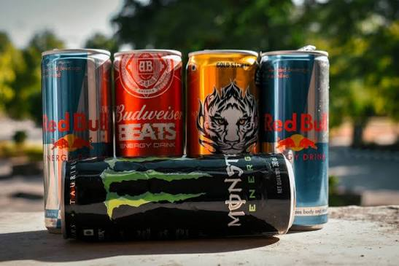
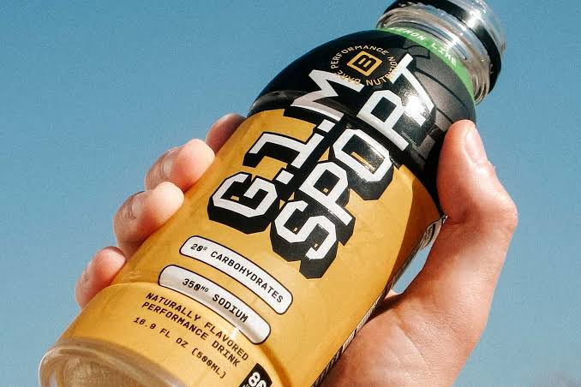
Product Type Analysis (1/3)
Performance-focused beverages continue to evolve through cleaner formulations, functional ingredients, and regulatory-compliant innovation that supports energy, hydration, and active lifestyles.
Energy Drinks
Energy drinks are formulated with ingredients such as caffeine, vitamins, amino acids (e.g., taurine), and other approved functional ingredients to help improve alertness and reduce fatigue. Their composition and labeling must comply with applicable food safety and ingredient regulations.
Manufacturers are increasingly reformulating products with reduced sugar, natural caffeine sources, and transparent ingredient labeling to align with evolving nutrition guidelines and consumer preferences.
Sports & Performance Drinks
Sports and performance drinks are designed to replace fluids, electrolytes, and carbohydrates lost during prolonged physical activity, supporting hydration and exercise performance.
Product development increasingly emphasizes balanced electrolyte formulations, reduced added sugars, and functional ingredients that support active lifestyles while meeting regulatory nutrition standards.
GLOBAL FUNCTIONAL BEVERAGE MARKET | 2025 – 2036

Slide 53
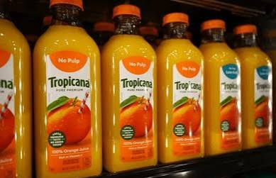
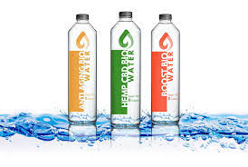
Product Type Analysis (2/3)
Health-oriented beverage categories are expanding with nutrient fortification, enhanced hydration, and clean-label formulations that address evolving consumer wellness preferences.
Fortified Juices
Fortified juices contain added vitamins, minerals, or other permitted nutrients to enhance nutritional value while complying with food fortification and labeling regulations.
Manufacturers are expanding offerings with vitamin C, vitamin D, calcium, and other essential micronutrients to support balanced dietary intake.
Functional Water
Functional water combines hydration with added electrolytes, vitamins, minerals, or other approved functional ingredients to provide nutritional benefits beyond basic hydration.
Manufacturers emphasize low-calorie, sugar-free, and clean-label formulations that align with healthy dietary recommendations.
Innovation is focused on enhanced hydration, ingredient transparency, and environmentally sustainable packaging to address evolving consumer expectations.
GLOBAL FUNCTIONAL BEVERAGE MARKET | 2025 – 2036

Slide 54
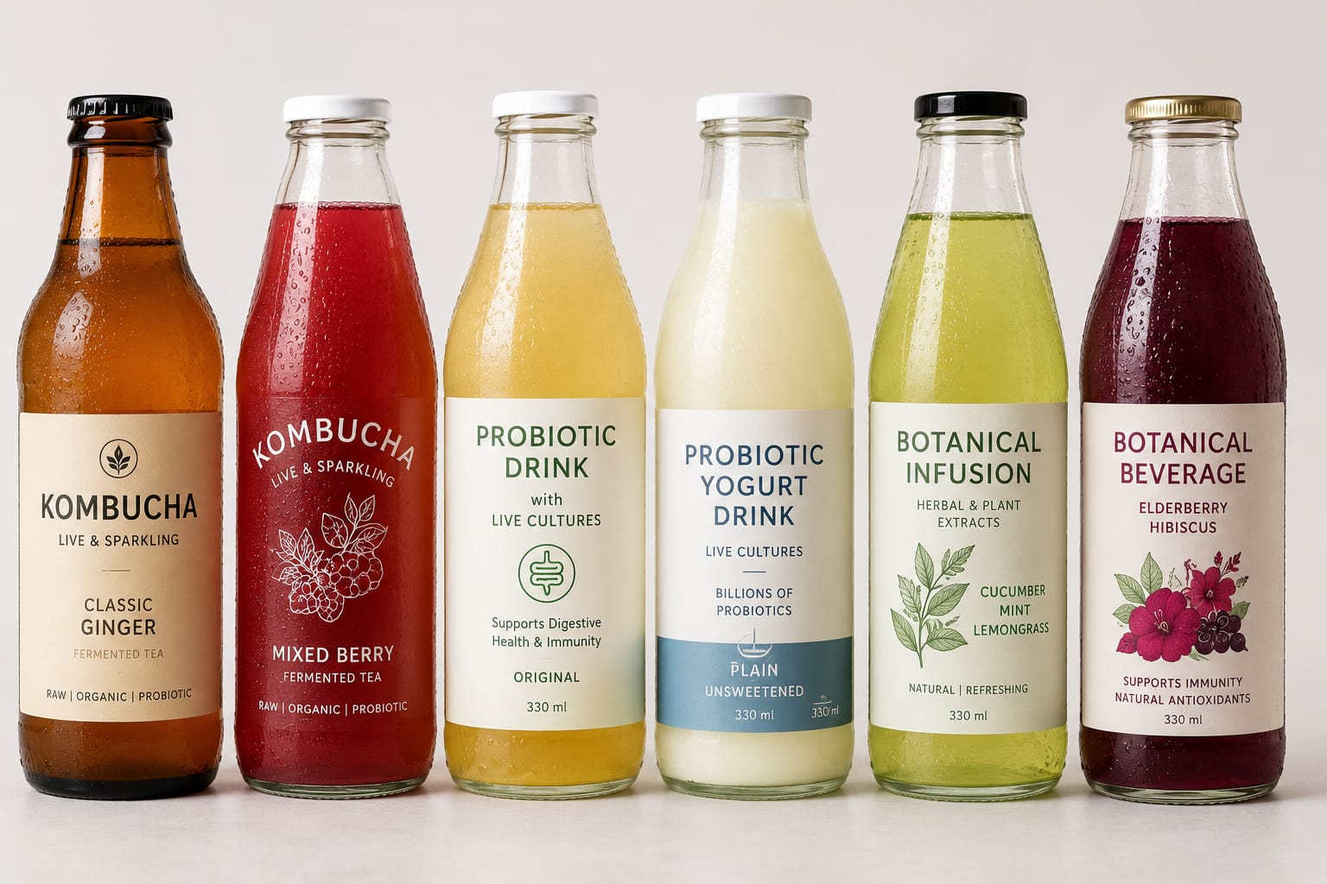
Product Type Analysis (3/3)
Emerging functional beverages are driving category diversification through scientifically supported ingredients, personalized nutrition, and continuous product innovation.
Others
This segment includes beverages formulated with probiotics, botanical extracts, plant proteins, fermented ingredients, and other scientifically supported functional components.
Manufacturers continue investing in research-driven product innovation, clean-label ingredients, and personalized nutrition solutions across emerging beverage categories.
Regulatory compliance for novel ingredients, food safety, nutrition labeling, and health claims remains essential for successful commercialization.
GLOBAL FUNCTIONAL BEVERAGE MARKET | 2025 – 2036

Slide 55
Ingredient Type Analysis
Comprehensive analysis of key ingredient categories, including Vitamins & Minerals, Probiotics & Prebiotics, Amino Acids & Protein, Caffeine & Botanicals, and Adaptogens & Nootropics, highlighting their nutritional properties, health functions, formulation role, and contribution to product differentiation.
GLOBAL FUNCTIONAL BEVERAGE MARKET | 2025 – 2036

Slide 56
Market Share by Ingredient Type, 2025
Consumer demand for preventive health and wellness continues to fuel the adoption of nutrient-rich ingredients, with vitamins, probiotics, and botanicals leading market growth.
Vitamins & Minerals dominate the ingredient landscape, accounting for 40% of the market, driven by increasing consumer demand for immunity, energy, and overall wellness products.
Probiotics & Prebiotics hold a significant 20% share, reflecting the growing focus on gut health, digestive wellness, and microbiome-based nutrition.
Caffeine & Botanicals (18%) and Amino Acids & Protein (15%) continue to gain traction, supported by rising consumption of energy drinks, sports nutrition, and performance-enhancing beverages.
Adaptogens & Nootropics represent 7% of the market, but the segment is witnessing strong growth as consumers increasingly seek beverages that support stress management, cognitive health, and mental well-being.
Content
GLOBAL FUNCTIONAL BEVERAGE MARKET | 2025 – 2036

Slide 57
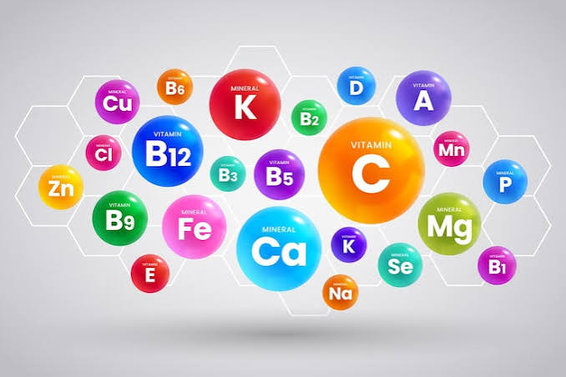
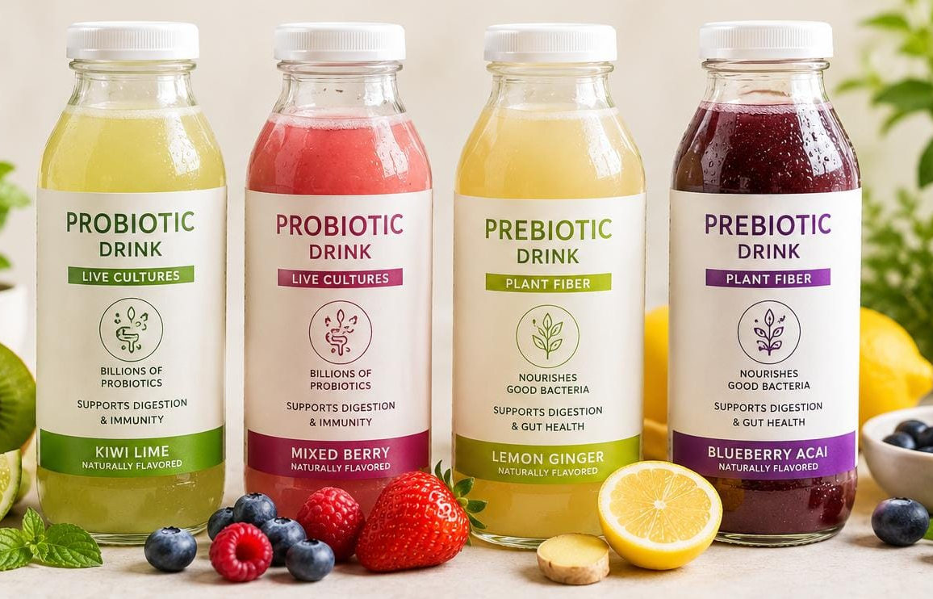
Ingredient Type Analysis (1/3)
Performance-focused beverages continue to evolve through cleaner formulations, functional ingredients, and regulatory-compliant innovation that supports energy, hydration, and active lifestyles.
Vitamins & Minerals
Vitamins and minerals are added to functional beverages to help address nutritional needs and support normal physiological functions, such as immune function, bone health, and energy metabolism, in accordance with established dietary recommendations.
Commonly used nutrients include vitamins C, D, B-complex, calcium, magnesium, iron, and zinc, with permitted fortification levels determined by national food regulations.
Probiotics & Prebiotics
Probiotics are live microorganisms that, when administered in adequate amounts, may provide health benefits, while prebiotics are non-digestible food components that support the growth of beneficial intestinal microorganisms.
Functional beverages containing probiotics and prebiotics require careful formulation to maintain microbial viability, product stability, and food safety throughout shelf life.
Manufacturers continue investing in scientifically supported strains and fermentation technologies while complying with regulations governing health claims and labeling.
GLOBAL FUNCTIONAL BEVERAGE MARKET | 2025 – 2036

Slide 58

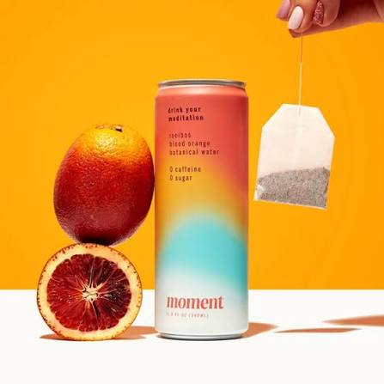
Ingredient Type Analysis (2/3)
Health-oriented beverage categories are expanding with nutrient fortification, enhanced hydration, and clean-label formulations that address evolving consumer wellness preferences.
Amino Acids & Protein
Amino acids and proteins are incorporated into functional beverages to support muscle maintenance, recovery, and normal protein nutrition, particularly for physically active consumers.
Common ingredients include whey protein, plant-based proteins, branched-chain amino acids (BCAAs), and essential amino acids, formulated to meet nutritional and quality standards.
Caffeine & Botanicals
Caffeine is widely used in functional beverages to help improve alertness and reduce fatigue, while botanical ingredients are incorporated for their traditional or nutritional properties were permitted by regulation.
Common botanical ingredients include green tea extract, guarana, ginseng, ginger, turmeric, and herbal extracts, subject to food safety and ingredient approval requirements.
GLOBAL FUNCTIONAL BEVERAGE MARKET | 2025 – 2036

Slide 59
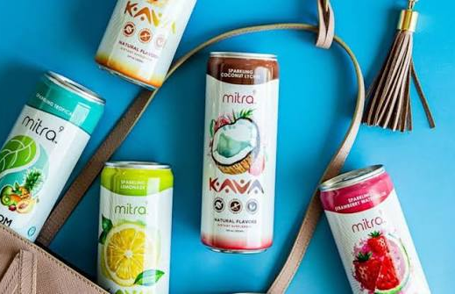
Ingredient Type Analysis (3/3)
Health-oriented beverage categories are expanding with nutrient fortification, enhanced hydration, and clean-label formulations that address evolving consumer wellness preferences.
Adaptogens & Nootropics
Adaptogens and nootropic ingredients are increasingly incorporated into functional beverages designed for cognitive wellness, stress management, and mental performance, subject to local regulatory approval.
Ingredients such as ashwagandha, rhodiola, L-theanine, and selected botanical extracts are formulated in accordance with applicable food safety and labeling regulations.
Manufacturers invest in scientific research, ingredient standardization, and evidence-based product development to support innovation and regulatory compliance.
GLOBAL FUNCTIONAL BEVERAGE MARKET | 2025 – 2036

Slide 60
Packaging Type Analysis
Detailed assessment of major packaging formats, including PET Bottles, Cans, Cartons, and Pouches, focusing on material characteristics, product protection, portability, sustainability considerations, consumer convenience, and suitability for different beverage applications.
GLOBAL FUNCTIONAL BEVERAGE MARKET | 2025 – 2036

Slide 61
Market Value by Packaging Type, 2025–2036
PET bottles and cans are projected to remain the preferred packaging formats through 2036, driven by convenience, portability, and expanding retail distribution.
GLOBAL FUNCTIONAL BEVERAGE MARKET | 2025 – 2036

Slide 62
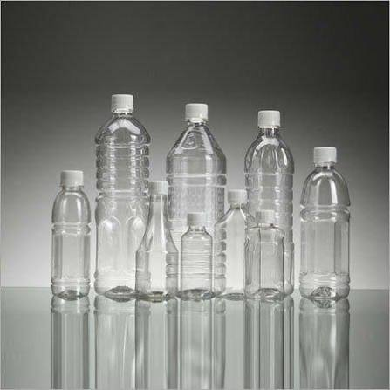
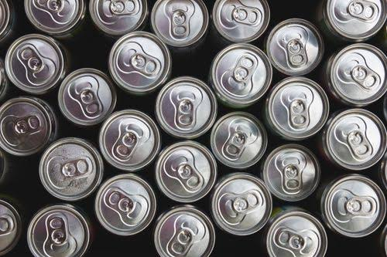
Packaging Type Analysis (1/2)
Performance-focused beverages continue to evolve through cleaner formulations, functional ingredients, and regulatory-compliant innovation that supports energy, hydration, and active lifestyles.
PET Bottles
PET bottles are widely used for functional beverages due to their lightweight design, durability, and product protection, making them suitable for both still and ready-to-drink beverages.
Manufacturers are increasingly incorporating recycled PET (rPET) and designing bottles for improved recyclability to support circular economy and sustainability objectives.
Cans
Aluminum cans provide an effective barrier against light, oxygen, and moisture, helping preserve beverage quality and extend shelf life.
Cans are widely used for energy drinks, functional sparkling beverages, and ready-to-drink products due to their portability and rapid cooling properties.
Aluminum is highly recyclable, supporting resource efficiency and sustainable packaging initiatives across the beverage industry.
GLOBAL FUNCTIONAL BEVERAGE MARKET | 2025 – 2036

Slide 63
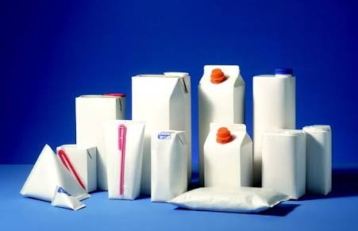
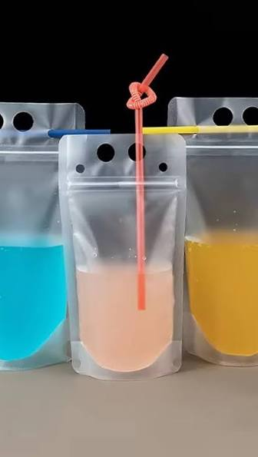
Packaging Type Analysis (2/2)
Health-oriented beverage categories are expanding with nutrient fortification, enhanced hydration, and clean-label formulations that address evolving consumer wellness preferences.
Cartons
Cartons are commonly used for fortified juices, plant-based beverages, and dairy-based functional drinks, offering protection against light and environmental exposure.
Multi-layer carton packaging helps maintain product quality, nutritional stability, and extended shelf life for shelf-stable beverages.
Manufacturers increasingly source carton materials from responsibly managed forests and improve recyclability to support environmental sustainability.
Pouches
Flexible pouches offer lightweight packaging, efficient transportation, and reduced material usage, contributing to lower packaging waste.
Pouches are increasingly adopted for functional beverage concentrates, wellness shots, powdered drink mixes, and single-serve products.
Manufacturers continue improving pouch materials to enhance product protection, food safety, and recyclability while meeting regulatory requirements.
GLOBAL FUNCTIONAL BEVERAGE MARKET | 2025 – 2036

Slide 64
Distribution Channel Analysis
Comprehensive evaluation of primary distribution channels, including Supermarkets/Hypermarkets, Convenience Stores, Online/E-commerce, and Specialty & Health Stores, emphasizing purchasing behavior, retail accessibility, channel-specific advantages, and their role in expanding market reach.
GLOBAL FUNCTIONAL BEVERAGE MARKET | 2025 – 2036

Slide 65
Market Share by Distribution Channel, 2025
Supermarkets and hypermarkets continue to dominate functional beverage sales, while online channels gain traction through expanding digital retail adoption.
Supermarkets & Hypermarkets account for the largest share (42%), driven by extensive product availability, strong brand visibility, and high consumer footfall.
Convenience Stores represent 28% of the market, benefiting from increasing demand for on-the-go functional beverages and impulse purchases.
Online/E-commerce (18%) and Specialty & Health Stores (12%) continue to expand as consumers increasingly seek convenient shopping experiences, wider product selections, and health-focused beverage offerings.
Content
GLOBAL FUNCTIONAL BEVERAGE MARKET | 2025 – 2036

Slide 66

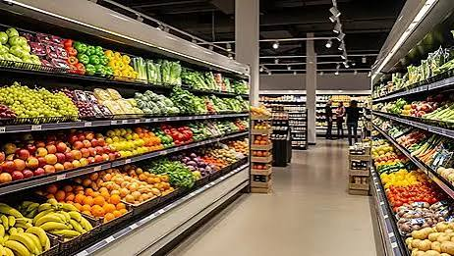
Distribution Channel Analysis (1/2)
Performance-focused beverages continue to evolve through cleaner formulations, functional ingredients, and regulatory-compliant innovation that supports energy, hydration, and active lifestyles.
Supermarkets/Hypermarkets
Supermarkets and hypermarkets provide broad product availability, enabling consumers to compare multiple functional beverage brands, formulations, and package sizes in one location.
These retail formats support the sale of ready-to-drink beverages, fortified juices, functional water, and sports drinks through dedicated beverage and health food sections.
Convenience Stores
Convenience stores offer quick and easy access to single-serve functional beverages, particularly energy drinks, sports drinks, and functional water.
Strategic placement near checkout counters and refrigerated displays encourages impulse purchases and on-the-go consumption.
Extended operating hours and urban accessibility make convenience stores an important retail channel for ready-to-drink beverages.
GLOBAL FUNCTIONAL BEVERAGE MARKET | 2025 – 2036

Slide 67

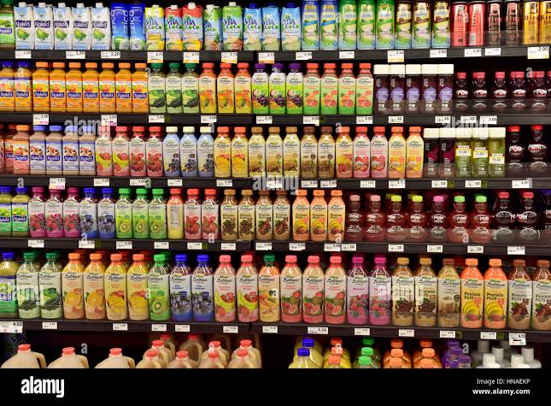
Distribution Channel Analysis (2/2)
Health-oriented beverage categories are expanding with nutrient fortification, enhanced hydration, and clean-label formulations that address evolving consumer wellness preferences.
Online/E-commerce
Online platforms provide consumers with easy access to a wide range of functional beverages, including niche and specialty products that may have limited retail availability.
E-commerce enables manufacturers to offer direct-to-consumer purchasing, subscription services, and detailed product information, including ingredient lists and nutrition labeling.
Specialty & Health Stores
Specialty and health stores focus on premium functional beverages, including probiotic drinks, plant-based beverages, botanical formulations, and clean-label products.
These retailers often provide product guidance and health-focused assortments, helping consumers make informed purchasing decisions.
Manufacturers use this channel to introduce innovative formulations and scientifically supported wellness products targeting health-conscious consumers.
GLOBAL FUNCTIONAL BEVERAGE MARKET | 2025 – 2036

Slide 68
End User Analysis
Detailed analysis of key consumer groups, including Gen Z, Millennials, Athletes & Fitness Enthusiasts, and the Aging Population, highlighting consumption patterns, health priorities, lifestyle preferences, purchasing motivations, and demand drivers influencing functional beverage adoption.
GLOBAL FUNCTIONAL BEVERAGE MARKET | 2025 – 2036

Slide 69
Market Value by End User, 2025–2036
Millennials and Gen Z are expected to remain the primary consumers of functional beverages, driven by increasing health consciousness and active lifestyles.
GLOBAL FUNCTIONAL BEVERAGE MARKET | 2025 – 2036

Slide 70


End User Analysis (1/2)
Performance-focused beverages continue to evolve through cleaner formulations, functional ingredients, and regulatory-compliant innovation that supports energy, hydration, and active lifestyles.
Gen Z
Gen Z represents a digitally connected consumer group that rapidly adopts new beverage formats through social media, influencer marketing, and online product discovery.
Preference for plant-based ingredients, low-sugar beverages, and environmentally responsible packaging is encouraging brands to accelerate clean-label innovation.
Millennials
Millennials view functional beverages as part of a broader preventive wellness and balanced lifestyle, integrating them into daily routines such as work, travel, and fitness.
This segment places greater emphasis on ingredient quality, product transparency, and scientifically supported nutrition information before making purchasing decisions.
Subscription services, online purchasing, and premium beverage offerings continue to improve accessibility and consumer engagement.
GLOBAL FUNCTIONAL BEVERAGE MARKET | 2025 – 2036

Slide 71


End User Analysis (2/2)
Health-oriented beverage categories are expanding with nutrient fortification, enhanced hydration, and clean-label formulations that address evolving consumer wellness preferences.
Athletes & Fitness Enthusiasts
Functional beverages are consumed before, during, and after physical activity to support hydration, electrolyte replenishment, and nutritional recovery.
Product selection is increasingly influenced by protein quality, electrolyte composition, carbohydrate content, and scientifically supported sports nutrition recommendations.
Innovation continues toward sugar reduction, improved hydration technologies, and plant-based performance nutrition.
Aging Population
Healthy aging initiatives encourage greater attention to adequate nutrient intake, hydration, and maintaining muscle and bone health throughout later life.
Older consumers increasingly prefer beverages that are easy to consume, fortified with essential nutrients, and suitable for daily nutritional support.
Product development emphasizes digestibility, nutrient bioavailability, and convenient ready-to-drink formulations to address changing dietary requirements.
GLOBAL FUNCTIONAL BEVERAGE MARKET | 2025 – 2036

Slide 72
PART 04
Regional & Country Analysis
Regional demand patterns, growth rates, and country-level breakdowns
GLOBAL FUNCTIONAL BEVERAGE MARKET | 2025 – 2036

Slide 73
Global Functional Beverage Market Overview
The global functional beverage market is expanding rapidly as consumers prioritize health, immunity, and wellness. Innovation in clean-label, plant-based, and science-backed formulations, supported by evolving regulations and strategic investments from leading beverage companies, continues to accelerate long-term market growth.
Growth Statistics
Trend Analysis
The global functional beverage market is growing steadily, driven by rising health awareness and increasing demand for beverages enriched with vitamins, probiotics, plant proteins, and botanical extracts.
Government initiatives promoting healthier diets and FDA regulations supporting evidence-based claims are further encouraging innovation and long-term market growth.
The functional beverage industry is shifting toward clean-label, plant-based, and science-backed products, with growing investments in probiotics, adaptogens, protein fortification, and personalized nutrition solutions.
Danone (2025) expanded its high-protein nutrition portfolio through new Oikos Protein product launches, reflecting growing global demand for protein-enriched functional beverages and dairy nutrition.
Growth Drivers
Rising demand for functional beverages supporting immunity, digestion, cognition, and sports nutrition, along with innovation in clean-label and reduced-sugar products, is driving market growth.
PepsiCo (FY2025): Expanded its portfolio with Pepsi Prebiotic Cola and acquired poppi to strengthen its presence in the prebiotic beverage market.
Key Players
PepsiCo
The Coca-Cola Company
Danone
Nestlé
Yakult Honsha Co., Ltd.
Red Bull GmbH
Monster Beverage Corporation
Others
Challenges
Stringent regulations on ingredient safety, health claims, and nutrition labeling, along with growing pressure to reduce sugar content, increase compliance costs and product reformulation efforts.
WHO (2025) reported that 64 countries had implemented sugar-sweetened beverage taxes by 2024, increasing reformulation efforts and compliance costs for beverage manufacturers while encouraging the development of healthier, lower-sugar products.
GLOBAL FUNCTIONAL BEVERAGE MARKET | 2025 – 2036

Slide 74
Regional Market Value, 2025 vs. 2036
Asia Pacific is projected to remain the largest and fastest-growing regional market, supported by rapid urbanization, rising disposable incomes, and increasing health awareness.
GLOBAL FUNCTIONAL BEVERAGE MARKET | 2025 – 2036

Slide 75
North America Functional Beverage Market Overview
The global functional beverage market is expanding rapidly as consumers prioritize health, immunity, and wellness. Innovation in clean-label, plant-based, and science-backed formulations, supported by evolving regulations and strategic investments from leading beverage companies, continues to accelerate long-term market growth.
Growth Statistics
Trend Analysis
North America is one of the most mature functional beverage markets, driven by strong consumer demand for protein drinks, electrolyte beverages, functional waters, kombucha, and prebiotic products.
The U.S. FDA, USDA, and Health Canada continue strengthening nutrition labeling and evidence-based health claim regulations, supporting innovation and increasing consumer confidence.
The North American functional beverage market is witnessing growing demand for high-protein beverages, clean-label products, functional hydration, probiotics, and reduced-sugar formulations.
Celsius Holdings (2025) introduced CELSIUS HYDRATION Zero-Sugar Powder Sticks, highlighting continued innovation in sugar-free electrolyte hydration solutions.
Growth Drivers
Rising consumer demand for beverages supporting hydration, immunity, gut health, sports nutrition, and healthy aging continues to accelerate the North American functional beverage market.
The Coca-Cola Company (2025) strengthened its North American functional beverage portfolio through continued growth of fairlife, Powerade, and BODYARMOR.
Key Players
Challenges
PepsiCo, Inc.
The Coca-Cola Company
Monster Beverage Corporation
Keurig Dr Pepper Inc.
Celsius Holdings, Inc.
Others
Manufacturers face increasingly stringent regulatory requirements regarding nutrition labeling, ingredient safety, sugar reduction, and substantiation of functional health claims under U.S. FDA and Health Canada regulations, increasing reformulation costs and product development timelines.
The FDA, together with USDA and HHS, has intensified initiatives addressing ultra-processed foods and nutrition transparency, encouraging manufacturers to reformulate products with cleaner ingredients while meeting evolving consumer expectations.
GLOBAL FUNCTIONAL BEVERAGE MARKET | 2025 – 2036

Slide 76
North America Market Size & Forecast, 2025–2036
North America is projected to witness steady market growth through 2036, supported by strong consumer demand for health, wellness, and premium functional beverages.
10.67%
Regional CAGR, 2026–2036
US
Largest country market in the region
GLOBAL FUNCTIONAL BEVERAGE MARKET | 2025 – 2036

Slide 77
North America Country-Level Breakdown
The United States remains the dominant market in North America, while Canada and Mexico are expected to record stronger growth through 2036.
Country | 2025 Value | 2036 Value | CAGR (2025-2036)
United States | 46.30 | 72.95 | 4.22%
Canada | 9.02 | 15.93 | 5.30%
Mexico | 4.81 | 13.87 | 10.11%
GLOBAL FUNCTIONAL BEVERAGE MARKET | 2025 – 2036

Slide 78
Europe Functional Beverage Market Overview
Content
Growth Statistics
Trend Analysis
CONTENT
CONTENT
CONTENT
CONTENT
Growth Drivers
SAMPLE
CONTENT
CONTENT
Key Players
Challenges
CONTENT
CONTENT
CONTENT
CONTENT
GLOBAL FUNCTIONAL BEVERAGE MARKET | 2025 – 2036

Slide 79
Europe Market Size & Forecast, 2025 - 2036
USD Billion
XX%
Regional CAGR, 2026–2036
SAMPLE
Germany
Largest country market in the region
GLOBAL FUNCTIONAL BEVERAGE MARKET | 2025 – 2036

Slide 80
Europe Country-Level Breakdown
Market value (USD Billion), 2025 and 2036
Country | 2025 Value | 2036 Value | CAGR
UK | XX | XX | XX
Germany | XX | XX | XX
France | XX | XX | XX
Italy | XX | XX | XX
Spain | XX | XX | XX
NORDIC | XX | XX | XX
Rest of Europe | XX | XX | XX
SAMPLE
GLOBAL FUNCTIONAL BEVERAGE MARKET | 2025 – 2036

Slide 81
Asia Pacific Functional Beverage Market Overview
Content
Growth Statistics
Trend Analysis
CONTENT
CONTENT
CONTENT
CONTENT
Growth Drivers
SAMPLE
CONTENT
CONTENT
Key Players
CONTENT
CONTENT
Challenges
CONTENT
CONTENT
GLOBAL FUNCTIONAL BEVERAGE MARKET | 2025 – 2036

Slide 82
Asia Pacific Market Size & Forecast, 2025 – 2036
USD Billion
XX%
Regional CAGR — fastest-growing region
SAMPLE
China
Largest country market in the region
GLOBAL FUNCTIONAL BEVERAGE MARKET | 2025 – 2036

Slide 83
Asia Pacific Country-Level Breakdown
Market value (USD Billion), 2025 and 2036
Country | 2025 Value | 2036 Value | CAGR
China | XX | XX | XX
India | XX | XX | XX
Japan | XX | XX | XX
Indonesia | XX | XX | XX
Australia | XX | XX | XX
Malaysia | XX | XX | XX
Singapore | XX | XX | XX
South Korea | XX | XX | XX
Philippines | XX | XX | XX
Thailand | XX | XX | XX
Rest of Asia Pacific | XX | XX | XX
SAMPLE
GLOBAL FUNCTIONAL BEVERAGE MARKET | 2025 – 2036

Slide 84
Latin America Functional Beverage Market Overview
Content
Growth Statistics
Trend Analysis
CONTENT
CONTENT
CONTENT
CONTENT
Growth Drivers
SAMPLE
CONTENT
CONTENT
Key Players
Challenges
CONTENT
CONTENT
CONTENT
CONTENT
GLOBAL FUNCTIONAL BEVERAGE MARKET | 2025 – 2036

Slide 85
Latin America Market Size & Forecast, 2025 – 2036
USD Billion
XX%
Regional CAGR, 2026–2036
SAMPLE
Brazil
Largest country market in the region
GLOBAL FUNCTIONAL BEVERAGE MARKET | 2025 – 2036

Slide 86
Latin America Country-Level Breakdown
Market value (USD Billion), 2025 and 2036
Country | 2025 Value | 2036 Value | CAGR
Brazil | XX | XX | XX
Mexico | XX | XX | XX
Argentina | XX | XX | XX
Rest of Latin America | XX | XX | XX
SAMPLE
GLOBAL FUNCTIONAL BEVERAGE MARKET | 2025 – 2036

Slide 87
Middle East & Africa Functional Beverage Market Overview
Content
Growth Statistics
Trend Analysis
CONTENT
CONTENT
CONTENT
CONTENT
Growth Drivers
SAMPLE
CONTENT
CONTENT
Key Players
Challenges
CONTENT
CONTENT
CONTENT
CONTENT
GLOBAL FUNCTIONAL BEVERAGE MARKET | 2025 – 2036

Slide 88
Middle East & Africa Market Size & Forecast, 2025 – 2036
USD Billion
XX%
Regional CAGR, 2026–2036
SAMPLE
UAE & KSA
Leading markets in the region
GLOBAL FUNCTIONAL BEVERAGE MARKET | 2025 – 2036

Slide 89
Middle East & Africa Country-Level Breakdown
Market value (USD Billion), 2025 and 2036
Country | 2025 Value | 2036 Value | CAGR
GCC | XX | XX | XX
South Africa | XX | XX | XX
Israel | XX | XX | XX
Rest of Middle East & Africa | XX | XX | XX
SAMPLE
GLOBAL FUNCTIONAL BEVERAGE MARKET | 2025 – 2036

Slide 90
PART 05
Competitive Landscape
Market share, leading players, positioning, and recent strategic developments
GLOBAL FUNCTIONAL BEVERAGE MARKET | 2025 – 2036

Slide 91
Competitive Landscape Market Share, 2025
The functional beverage market remains moderately fragmented, with leading global players driving innovation while regional brands collectively account for the majority of market revenue.
The market is moderately fragmented, with the Rest of Market accounting for 62%, highlighting the strong presence of regional and niche functional beverage manufacturers.
PepsiCo (11%) and Coca-Cola (9%) are the leading global players, leveraging extensive distribution networks, diversified product portfolios, and continuous product innovation.
Red Bull (8%), Danone (5%), and Nestlé (5%) maintain notable market positions through their focus on energy drinks, probiotic beverages, and health-oriented product offerings.
GLOBAL FUNCTIONAL BEVERAGE MARKET | 2025 – 2036

Slide 92
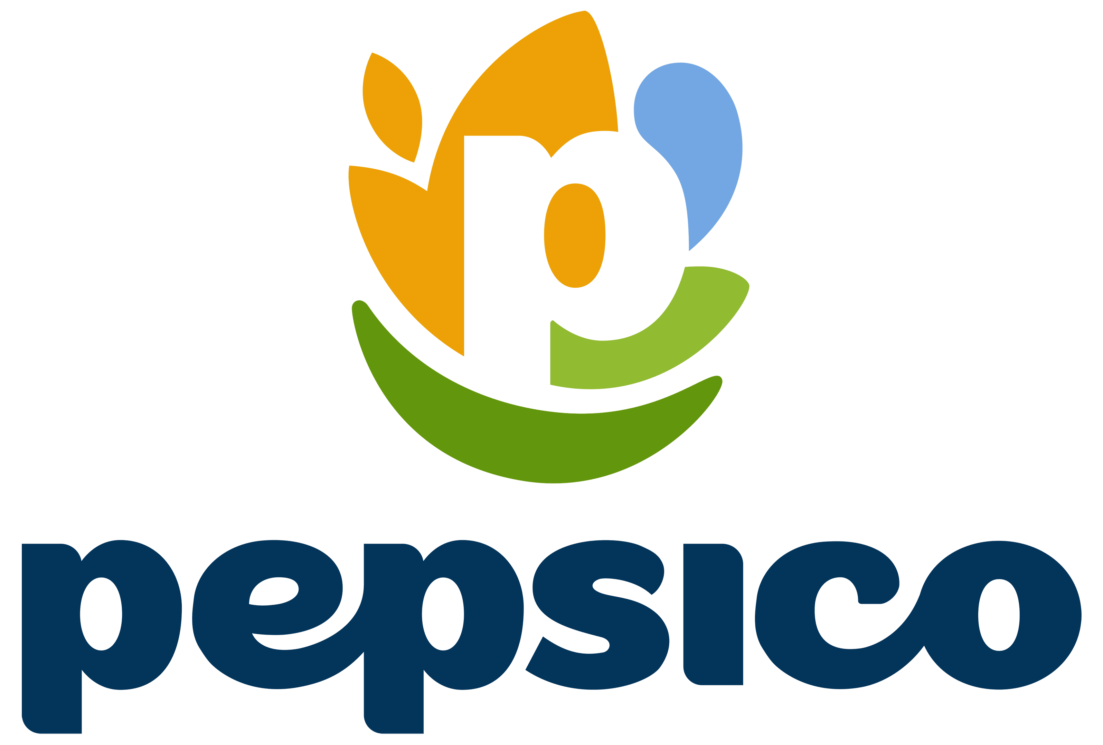




Key Players
Leading global beverage majors active in functional beverages
PepsiCo, Inc.
The Coca-Cola Company
Red Bull GmbH
Danone S.A.
Nestle S.A.
Suntory Holdings
Monster Beverage Corp.
Celsius Holdings, Inc.
GT's Living Foods
Others
GLOBAL FUNCTIONAL BEVERAGE MARKET | 2025 – 2036

Slide 93






Company Profile - PepsiCo, Inc. (1/3)
PepsiCo continues to strengthen its leadership in functional beverages through innovation, diversified brands, and a globally integrated distribution network.
2025 Total Revenue:
USD 93,925 Million
BUSINESS OVERVIEW
PepsiCo, Inc. is a global food and beverage company engaged in the manufacturing, marketing, and distribution of convenient foods and non-alcoholic beverages.
Its portfolio includes soft drinks, bottled water, sports and energy drinks, juices, cereals, snacks, and other food products marketed under brands such as Pepsi, Mountain Dew, Gatorade, Lay's, Frito-Lay, Quaker, Pepsi Max, and Yachak.
The company serves consumers through an extensive global distribution network across multiple retail channels.
COMPANY DETAILS
Year Founded: 1965
Website: https://www.pepsico.com/
Contact Details: 1-800-433-2652
BUSINESS STRATEGY
Headquarter: New York, USA
PepsiCo's strategy focuses on expanding healthier, science-backed beverage offerings through continuous innovation, portfolio transformation, and the PepsiCo Positive (pep+) framework.
The company leverages its global manufacturing and distribution network to drive sustainable growth in functional hydration, sports nutrition, and wellness beverages.
Employee Strength: 310,289 (2024)
Regional Presence: North America, Europe, Asia Pacific, Latin America, Middle East and Africa
GLOBAL FUNCTIONAL BEVERAGE MARKET | 2025 – 2036

Slide 94
Company Profile - PepsiCo, Inc. (2/3)
PepsiCo's broad portfolio spans energy, hydration, sports nutrition, and functional wellness, addressing evolving consumer preferences across beverage categories.
COMPANY OFFERING
Offering | Description
Energy Drinks | PepsiCo participates in the energy drink category through Rockstar Energy, offering beverages formulated with caffeine, B vitamins, and ingredients designed to support energy and mental focus. The brand portfolio includes original, zero-sugar, and performance-oriented variants, addressing a broad range of consumer preferences.
Sports & Performance Drinks | Gatorade is PepsiCo's flagship sports drink brand developed to help replenish fluids and electrolytes lost during physical activity. The portfolio includes sports drinks, zero-sugar beverages, hydration powders, protein recovery products, and supplements designed to support hydration and athletic performance.
Fortified Juices | PepsiCo offers fortified juice beverages through Tropicana, featuring products enriched with vitamins and nutrients to support everyday nutrition. The portfolio includes juices formulated with added Vitamin C and other essential nutrients, providing consumers with convenient nutrition alongside fruit-based beverages.
Functional Water | PepsiCo's functional hydration portfolio includes Propel and LIFEWTR. Propel contains electrolytes and vitamins with zero sugar to support active lifestyles, while LIFEWTR is purified water enhanced with electrolytes for taste, providing premium hydration for everyday consumption.
Others | PepsiCo continues expanding its wellness beverage portfolio through Muscle Milk ready-to-drink protein beverages and Poppi prebiotic soda. Muscle Milk provides protein to support muscle recovery and nutrition, while Poppi combines prebiotics with fruit juice and apple cider vinegar to offer a modern, low-sugar functional beverage option.
GLOBAL FUNCTIONAL BEVERAGE MARKET | 2025 – 2036

Slide 95
Company Profile - PepsiCo, Inc. (3/3)
Strong financial performance, strategic investments, and regional diversification reinforce PepsiCo's long-term growth in the global functional beverage market.
RECENT DEVELOPMENT
March 2026: PepsiCo achieved two key pep+ water milestones by replenishing 100% of the water used at company-owned facilities in high water-risk watersheds and implementing the Alliance for Water Stewardship (AWS) Standard across these sites, reinforcing its commitment to sustainable water management and environmental stewardship.
FINANCIAL ANALYSIS:
SEGMENTAL ANALYSIS:
REGIONAL ANALYSIS: (2025)
Financial Data | 2023 | 2024 | 2025
Net revenue (USD Million) | 91,471 | 91,854 | 93,925
Net Income (USD Million) | 9,155 | 9,626 | 8,295
Operating profit (USD Million) | 11,986 | 12,887 | 11,498
Business Segment | 2023 | 2024 | 2025
PFNA | - | - | 27,528
FLNA | 24,914 | 24,755 | -
QFNA | 3,101 | 2,676 | -
PBNA | 27,626 | 27,769 | 28,197
IB Franchise | - | - | 4,997
Europe | 13,234 | 13,874 | -
AMESA | 6,139 | 6,217 | -
EMEA | - | - | 18,025
LatAm Foods | 11,654 | 11,718 | 10,549
Asia Pacific Foods | 4,803 | 4,845 | 4,629
Total | 91,471 | 91,854 | 93,925
GLOBAL FUNCTIONAL BEVERAGE MARKET | 2025 – 2036

Slide 96
PART 06
Market Size & Forecast Analysis
Comprehensive market sizing, forecasting, segmentation, and regional analysis supporting strategic business decisions.
GLOBAL FUNCTIONAL BEVERAGE MARKET | 2025 – 2036

Slide 97
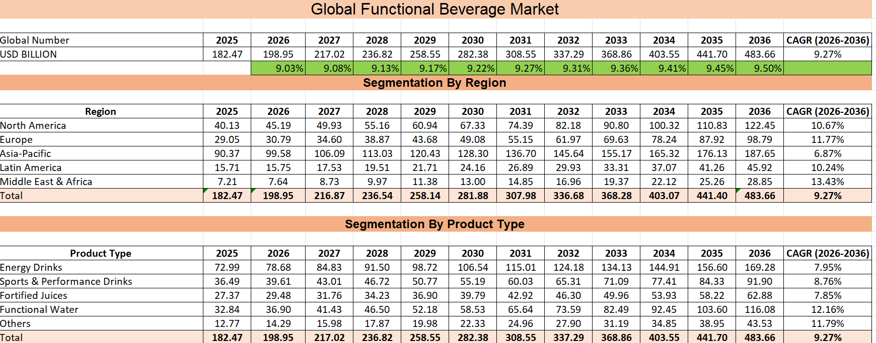
Approach Used:
Top-Down Market Estimation methodology supported by Bottom-Up Validation:
The global market size is established first using secondary research and forecast assumptions.
The global market is projected annually using variable YoY growth rates, resulting in an overall CAGR of 9.27% for 2026–2036.
The forecasted global revenue is then distributed across regions and product types based on market shares, demand patterns, maturity, and expected growth potential.
Each region and product segment is forecast independently using segment-specific CAGRs to reflect differing market dynamics.
Finally, the model is cross-validated, ensuring that the sum of all regional revenues and the sum of all product revenues reconcile with the global market value for every forecast year. This triangulation ensures internal consistency and improves the robustness of the market estimation model.
GLOBAL FUNCTIONAL BEVERAGE MARKET | 2025 – 2036

Slide 98
PART 07
Outlook & Recommendations
Investment landscape, innovation trends, and forward-looking guidance for stakeholders
GLOBAL FUNCTIONAL BEVERAGE MARKET | 2025 – 2036

Slide 99
Investment & Funding Landscape
Public research funding, nutrition innovation, and strategic industry investments continue to accelerate functional beverage development globally.
NIH
Increasing Government Support for Nutrition Research: Government agencies continue funding research on nutrition, gut microbiome science, food innovation, and personalized nutrition, supporting the development of next-generation functional ingredients.
Public Funding Accelerating Functional Ingredient Innovation: Government-supported research programs continue investing in probiotics, botanicals, vitamins, proteins, and food biotechnology to improve public health and nutrition outcomes.
Strategic Industry Investments Continue Expanding: Major beverage manufacturers continue investing in product innovation, manufacturing expansion, digital capabilities, and healthier beverage portfolios to address evolving consumer demand.
Content
Largest public funder of biomedical research globally
Supporting nutrition, microbiome, and food innovation research.
SBIR & STTR
Federal innovation programs supporting commercialization of nutrition, biotechnology, and food innovation.
GLOBAL FUNCTIONAL BEVERAGE MARKET | 2025 – 2036

Slide 100
Technology & Innovation Trends
Emerging technologies are transforming functional beverage innovation by improving ingredient stability, accelerating product development, enhancing traceability, and enabling personalized nutrition solutions.
1
2
3
4
Fermentation Technology
Microencapsulation
AI-Driven R&D
Smart Packaging
Advanced fermentation technologies improve the production of probiotics, postbiotics, enzymes, and bioactive compounds while ensuring greater product consistency and stability.
Precision fermentation enables manufacturers to develop next-generation functional ingredients with enhanced nutritional value, improved scalability, and better production efficiency.
Microencapsulation protects sensitive ingredients such as probiotics, vitamins, omega-3 fatty acids, and botanical extracts from heat, oxygen, moisture, and light.
The technology improves ingredient stability, enhances bioavailability, extends shelf life, and maintains product quality throughout storage and distribution.
Artificial intelligence enables predictive formulation, ingredient optimization, sensory analysis, and consumer preference forecasting.
Machine learning accelerates product development, reduces formulation costs, improves manufacturing efficiency, and supports personalized nutrition through data-driven decision-making.
Smart packaging technologies including QR codes, digital labeling, and traceability systems improve product transparency, food safety, and consumer engagement.
These technologies enable ingredient authentication, supply chain visibility, regulatory compliance, and real-time access to nutritional information.
GLOBAL FUNCTIONAL BEVERAGE MARKET | 2025 – 2036

Slide 101
Impact of Inflation & Economic Slowdown
Inflationary pressures and economic uncertainty are reshaping consumer purchasing behavior, compelling manufacturers to optimize costs, strengthen supply chains, and deliver value-driven functional beverage innovations.
Rising Input Costs Increase Production Expenses:
Persistent inflation has increased the cost of key raw materials, including sugar, fruits, botanical extracts, packaging materials, energy, and transportation, placing pressure on manufacturers' operating margins and production costs.
Consumers Shift Toward Value-Oriented Purchases:
Economic uncertainty is encouraging consumers to prioritize value while continuing to seek healthier beverage options. Demand for affordable functional beverages, smaller pack sizes, and promotional offerings has increased across both developed and emerging markets.
Manufacturers Focus on Cost Optimization:
Manufacturers are improving supply-chain efficiency, increasing local sourcing, optimizing formulations, and adopting lightweight packaging to offset rising production costs while maintaining product quality and profitability.
Content
Content
GLOBAL FUNCTIONAL BEVERAGE MARKET | 2025 – 2036

Slide 102
Future Outlook to 2036
The functional beverage market is poised for sustained long-term growth, driven by health-conscious consumers, continuous innovation, personalized nutrition, and expanding demand across emerging global markets.
Functional Beverages Will Continue Outperforming Conventional Beverages: The market is expected to expand faster than the broader non-alcoholic beverage industry as consumers increasingly prioritize preventive healthcare, immunity, hydration, digestive wellness, and cognitive health. Continuous innovation in functional ingredients and healthier formulations will further strengthen long-term demand.
Premiumization and Personalized Nutrition Will Drive Innovation: Manufacturers are expected to invest in AI-enabled product development, personalized nutrition, microbiome-based formulations, and science-backed functional ingredients to meet evolving consumer preferences. Clean-label, reduced-sugar, plant-based, and protein-enriched beverages will remain key innovation areas.
Asia Pacific Will Remain the Largest Growth Engine: Asia Pacific is projected to remain the fastest-growing and largest regional market by 2036, supported by rising disposable incomes, rapid urbanization, increasing health awareness, expanding retail infrastructure, and growing demand for premium functional beverages across China, India, Japan, and Southeast Asia.
Sustainability and Digital Commerce Will Shape Future Competition: Manufacturers will increasingly focus on recyclable packaging, responsible ingredient sourcing, carbon reduction, and water stewardship while strengthening direct-to-consumer (DTC) platforms, e-commerce, and digital consumer engagement to improve market penetration and long-term competitiveness.
$483.66B
Forecast global market value by 2036
APAC
Expected largest region by value, 2036
GLOBAL FUNCTIONAL BEVERAGE MARKET | 2025 – 2036

Slide 103
Analyst Recommendations for Stakeholders
Strategic investments in innovation, sustainability, digital transformation, and regulatory compliance will enable stakeholders to strengthen competitiveness and capitalize on long-term market growth opportunities.
Prioritize Science-Backed Innovation: Invest in clinically supported functional ingredients such as probiotics, plant proteins, adaptogens, and botanical extracts while strengthening research and development to meet evolving consumer health needs.
Accelerate Clean-Label & Health-Focused Product Development: Expand portfolios with reduced-sugar, natural, plant-based, and nutrient-fortified beverages that align with changing consumer preferences and global nutrition guidelines
Strengthen Digital & Omnichannel Presence: Enhance e-commerce capabilities, direct-to-consumer (DTC) platforms, and data-driven marketing strategies to improve customer engagement, brand loyalty, and market reach.
Improve Supply Chain Resilience & Sustainability: Diversify sourcing, adopt recyclable packaging, improve water and energy efficiency, and strengthen supply chain transparency to reduce operational risks and support sustainability goals.
Expand Presence in High-Growth Markets: Increase investments in Asia Pacific and other emerging economies through localized product innovation, strategic partnerships, and expanded distribution networks to capitalize on rising health awareness and disposable incomes.
Maintain Regulatory Compliance & Consumer Trust: Continuously monitor evolving food safety regulations, nutrition labeling requirements, and health claim standards while ensuring transparency, product quality, and scientific validation across global markets.
GLOBAL FUNCTIONAL BEVERAGE MARKET | 2025 – 2036

Slide 104
Conclusion
The global functional beverage market is well positioned for sustained growth, supported by scientific innovation, evolving consumer preferences, regulatory advancements, and expanding wellness-focused opportunities worldwide.
The global functional beverage market is projected to grow from USD 182.47 billion in 2025 to USD 483.66 billion by 2036, registering a CAGR of 9.27%, driven by rising demand for preventive healthcare, immunity, hydration, and wellness-focused nutrition.
Product innovation centered on clean-label formulations, probiotics, plant-based ingredients, functional water, protein-enriched beverages, and personalized nutrition will continue to shape the competitive landscape and create new growth opportunities.
Asia Pacific is expected to remain the largest and fastest-growing regional market, while North America and Europe will continue leading premiumization, scientific innovation, and regulatory compliance.
Technological advancements, including AI-enabled product development, precision fermentation, microencapsulation, and smart packaging, will improve product quality, manufacturing efficiency, supply chain transparency, and consumer engagement.
Companies that prioritize science-backed innovation, sustainability, digital transformation, regulatory compliance, and consumer-centric product development will be best positioned to strengthen their competitive advantage and capture long-term growth opportunities through 2036.
GLOBAL FUNCTIONAL BEVERAGE MARKET | 2025 – 2036

Slide 105
Thank You
Global Functional Beverage Market Report, 2025–2036
GLOBAL FUNCTIONAL BEVERAGE MARKET | 2025 – 2036

