Slide 1
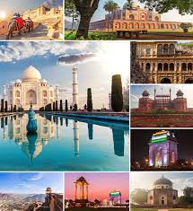
Exploratory Data Analysis OF Indian Tourism Industry
By : Tejal Bhatti

Slide 2
Objectives
Analysis of total number of tourists from different countries year wise and quarter wise
Most visited tourist places state wise
Finding the impact of tourism on Economy

Slide 3
Outcomes of Analysis
Finding | Proposed Solution
Quarter 3 and 4 less number of Visitors | Summer ---North India ---- hill stations
Less Visitors for medical purpose | Promote Ayurveda
Many part of the country are unseen | Encourage Tourists to have experience of hidden gems of India
Link to Tableau:
https://public.tableau.com/app/profile/tejal4338/viz/Final_Half_Year_Presentaion/Visitor_2020_Top_Monumnets

Slide 4

Thank You

