Slide 1
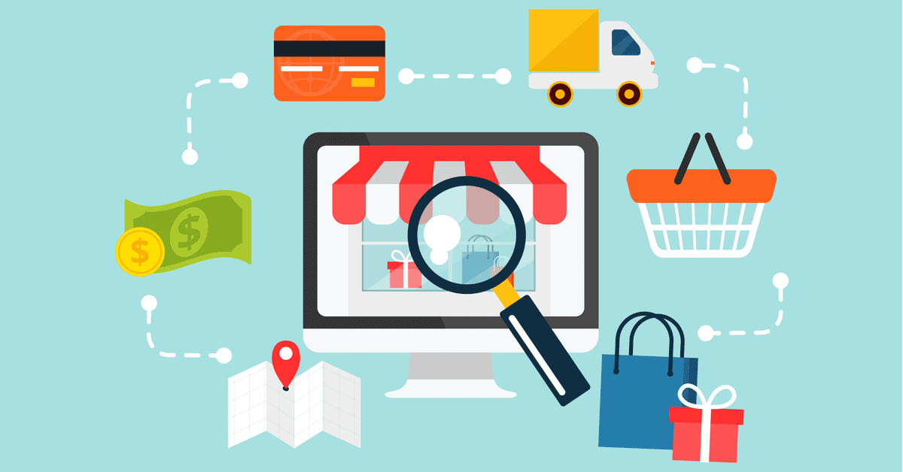
E-commerce Customer​
Purchasing Behavior ​Analysis

Slide 2

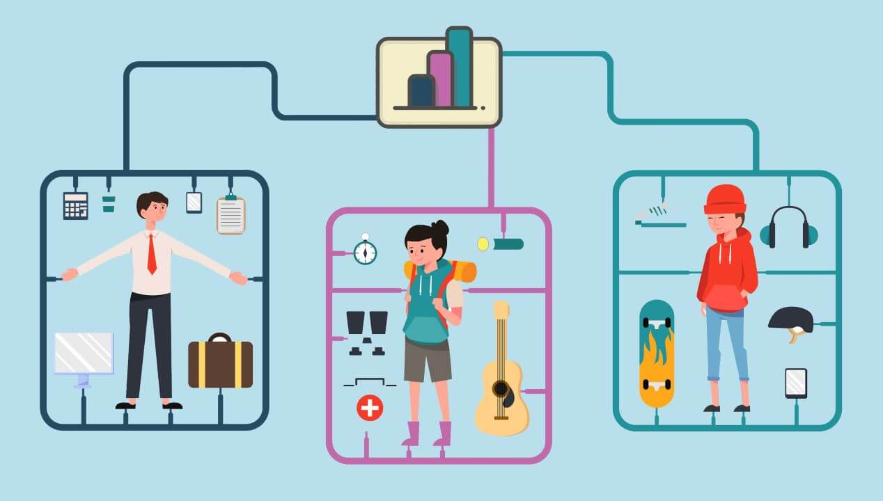
Why is it necessary to understand Customer Behavior
Customer retention Personalization

Slide 3
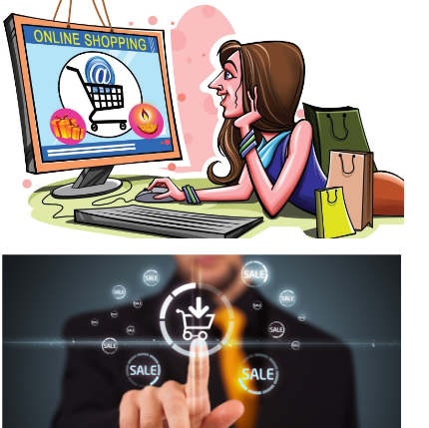
Objective
Building machine learning model to identify user behavior pattern and determine the likelihood of purchase

Slide 4
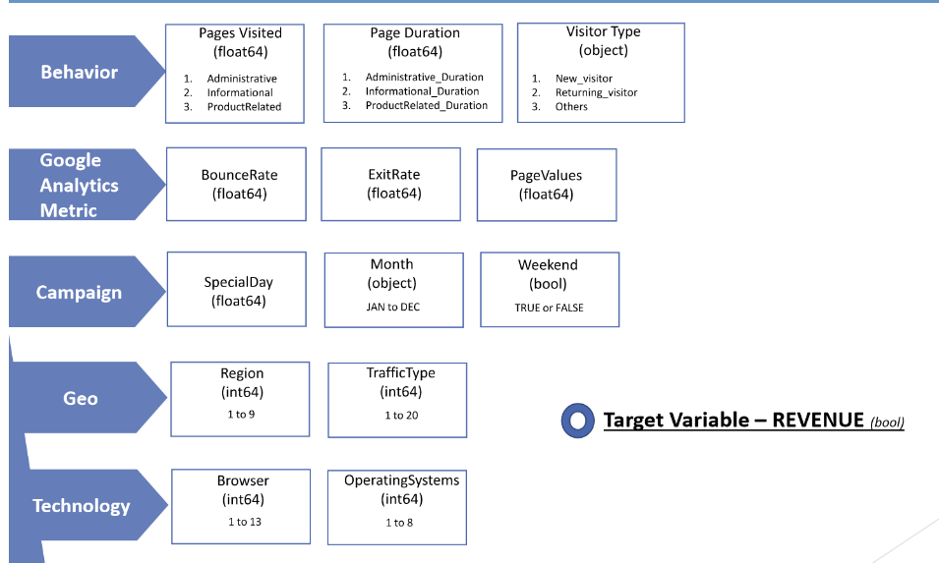
Dataset (https://archive.ics.uci.edu/dataset/468/online+shoppers+purchasing+intention+dataset)
84.5 % customers have not generated Revenue
15.5 % customers generated Revenue

Slide 5
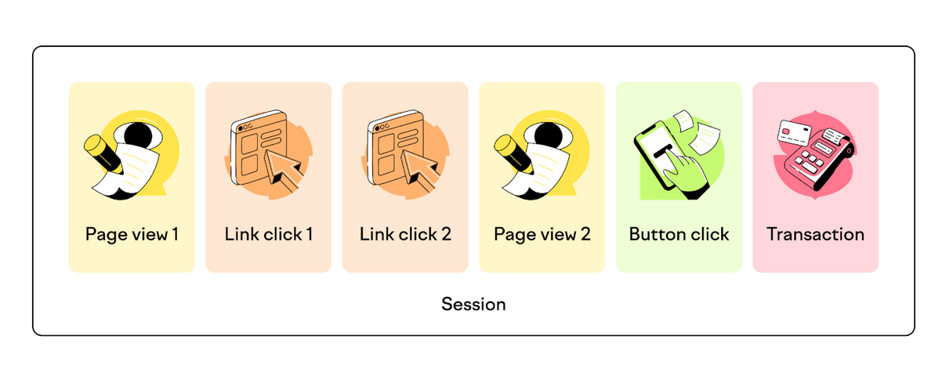
What Are Sessions in Google Analytics?
sessions are like containers which stores all the actions and activities users perform while on website

Slide 6
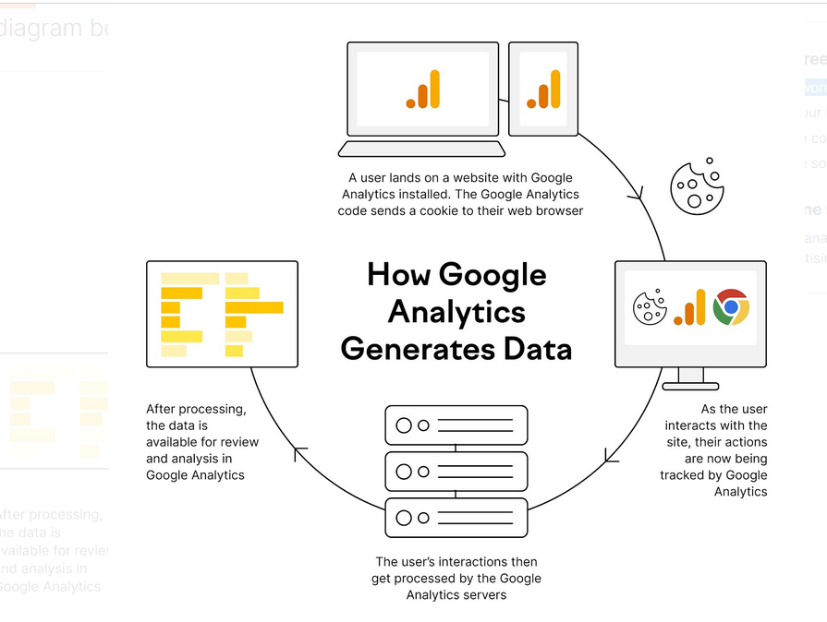
How Does Google Analytics Track Sessions?

Slide 7
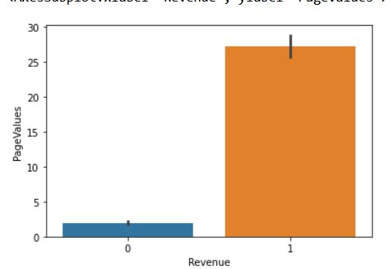
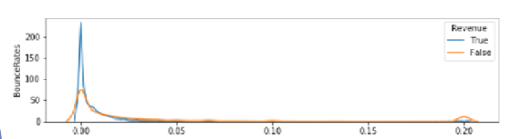
Exploratory Data Analysis
If the customer visited more pages it is likely that he will purchase
For effective revenue generation low bounce rate and high page values hold the key
There are many customers who just left after vising first page --- need to improve website

Slide 8
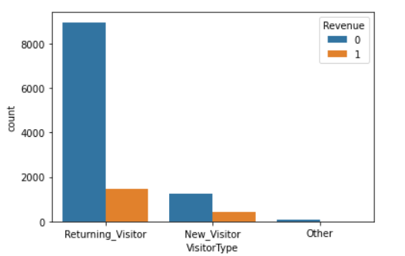
Exploratory Data Analysis
About ¼ th of the new visitors made the purchase as compared to ~ 15% of returning visitors
There are more returning visitors among those who do not complete the purchase

Slide 9
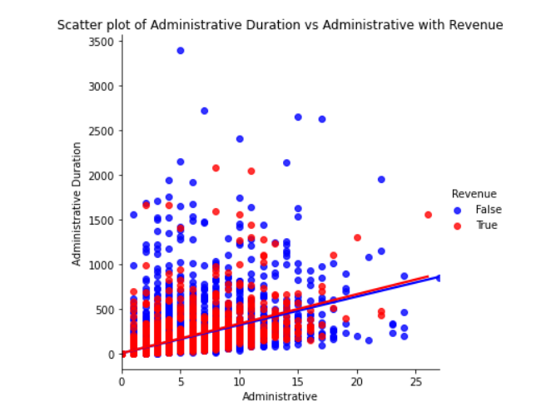
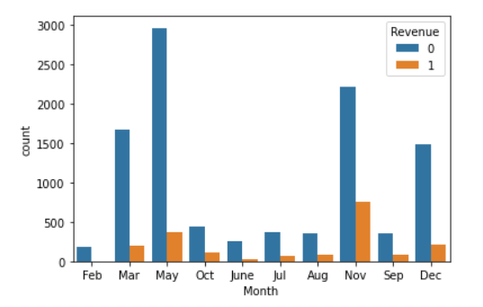
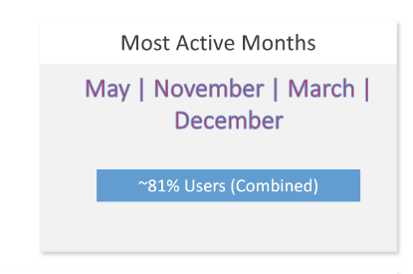
Exploratory Data Analysis​
On administrative pages 2 to 15 ,visitors have spent more than 500 seconds( approx 8 min) , which is generally quite higher than normal
It suggest that visitors are having trouble logging in or it's taking too much time to process the request

Slide 10




Comparision of Models
Model | Precision | Recall | Accuracy | Confusion Matrix
Logistic Regression | 0.53 | 0.76 | 0.84
KNeighborsClassifier | 0.46 | 0.68 | 0.82
DecisionTreeClassifier | 0.55 | 0.62 | 0.85
RandomForestClassifier | 0.58 | 0.81 | 0.87

Slide 11
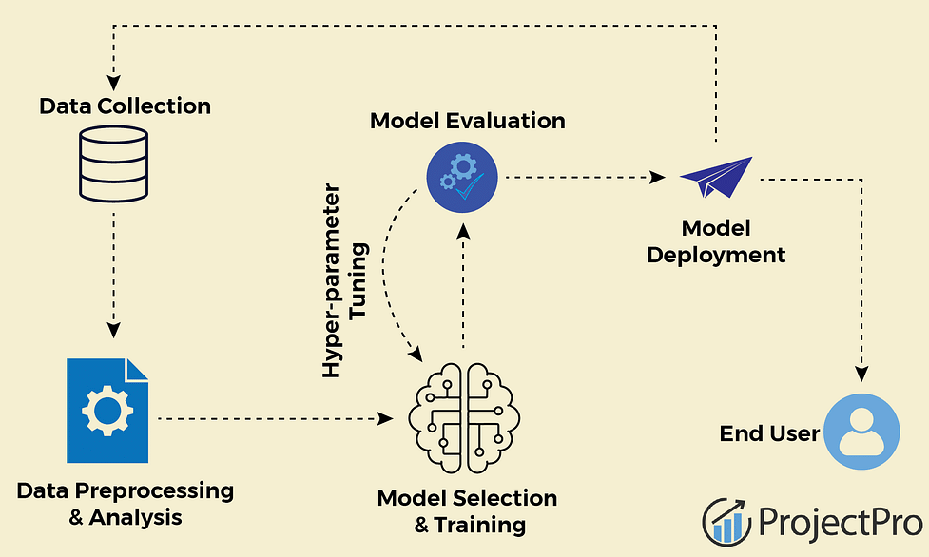
Deployment of model
Transitioning from a prototype to a fully functional application makes machine learning models valuable to end-users and systems.

Slide 12
Overview of Deployment​
Flask: Framework for building web application in python
User give data (features)
Flask app
prdiction

Slide 13
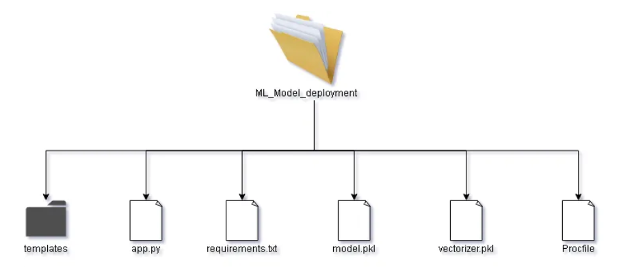
Overview of Deployment
templates :- This folder contains the html files (index.html, predict.html) that would be used by our main file (app.py) to generate the front end of our application
app.py :- This is the main application file, where all our code resides and it binds everything together.
requirements.txt :- This file contains all the dependencies/libraries that would be used in the project
model.pkl :- This is pickle file , which is trained already.

Slide 14
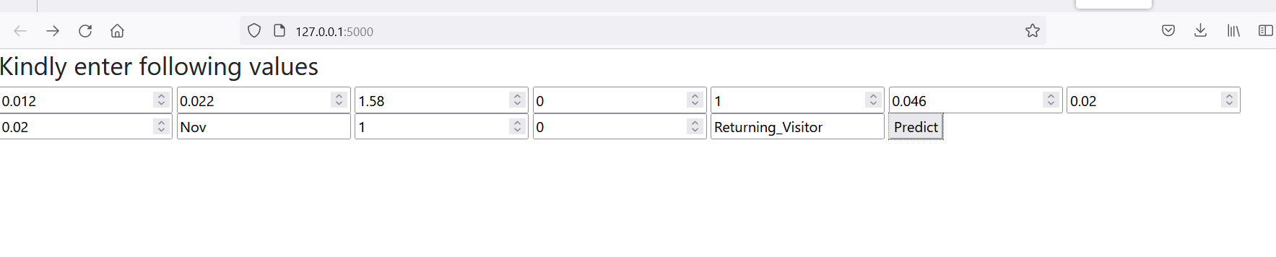
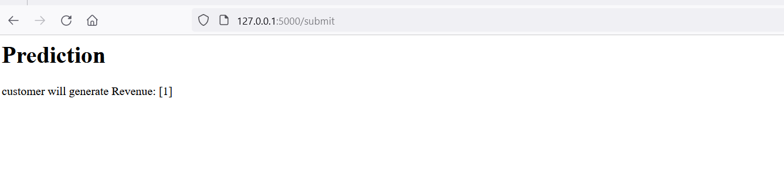
Output screen short of deployment part

Slide 15
Thank you

