Slide 1
Smart Crop Disease warning system
Tejal Joshi (x24199991)
MSc Cloud Computing
National College of Ireland

Slide 2
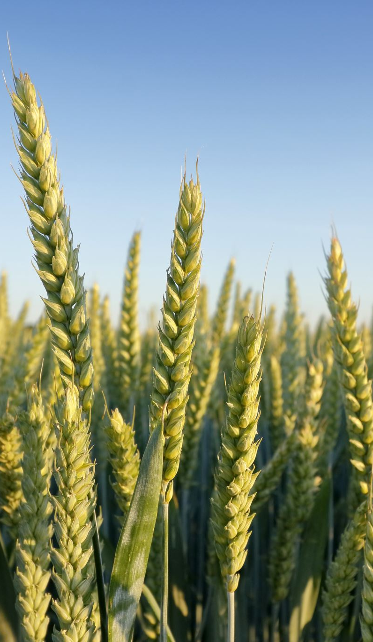
Problem Statement
Crop diseases cause major losses
Manual monitoring is slow and inaccurate
No real-time alerts
Difficult to track multiple conditions

Slide 3
Objective
Real-time farm monitoring
Use multiple sensors
Early disease detection
Scalable cloud solution
User friendly dashboard

Slide 4
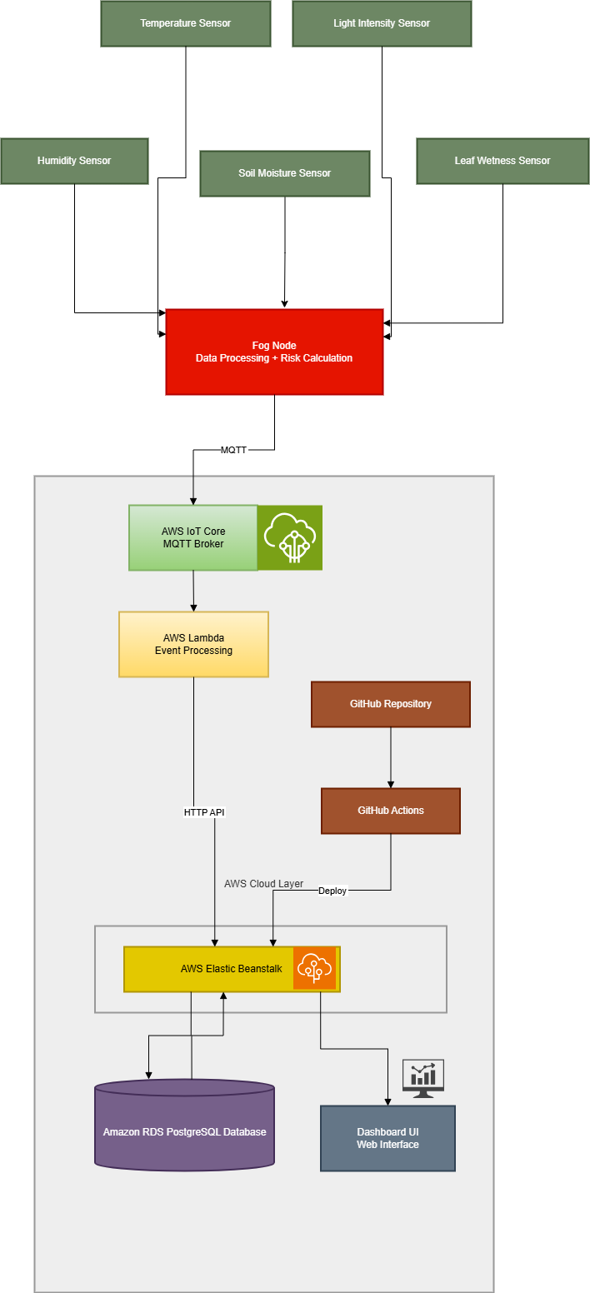
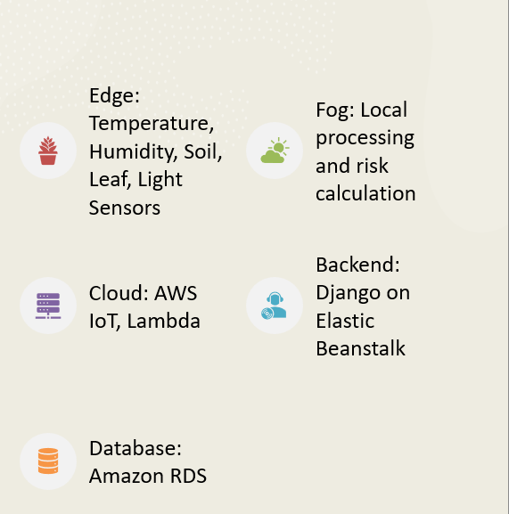
Architecture

Slide 5
Conclusion & Future Work
Real-time monitoring Achieved
Fog reduces latency
Cloud ensures scalability
Future: ML integration, real sensors, mobile app

Slide 6
Thank You

