Slide 1
Restaurant Recommender System for Pune City
CT-21013 DATA SCIENCE LABORATORY
Anjali Dofe - 111903137
Tejal Khairnar - 111903157
Yash Dhake - 111903160

Slide 2
INTRODUCTION
In today's digital age, we are bombarded with number of options for any given activity. These options are so vast that analysing each of them and making an informed decision becomes impossible. People casually decide to look for a similar restaurant all the time because they are addicted to a specific category of food. People who rarely use restaurants would prefer to have the most rated restaurants nearby them and all this could be easily handled by a recommendation system. This project is designed for the residents of Pune and tourists visiting Pune. The purpose of this project is to build a recommendation system to predict which restaurant customers are most likely to order from, given the customer location, budget of the customer, the rating of the restaurant and cuisine preference of the customer.

Slide 3
BUSINESS REQUIREMENTS
Various studies related to recommendation systems have been carried out. A lack of concentration means that restaurants are in general very diverse in terms of cuisine, hours, categories, service and even ambience. People still heavily rely on recommendations from their social circles, or just must adventure new options themselves. Given the challenge in finding individualized and desirable restaurants, it is thus critical to the platform’s success to provide customers with filtered, prioritized, and personalized recommendations. Recommendation systems are an effective way to help users to get information that is useful and in accordance with user interests.

Slide 4
Data Required
We require the following data:
1. Location of the restaurant.
2. Cuisine offered by the restaurant.
3. Rating of the restaurant.
4. Average cost for per person.
5. Average cost for two people.
The authentic dataset used for this project was obtained by performing web scraping of the website https://www.swiggy.com/city/pune by our group members. The various libraries and modules used for this purpose include Selenium and BeautifulSoup.

Slide 5
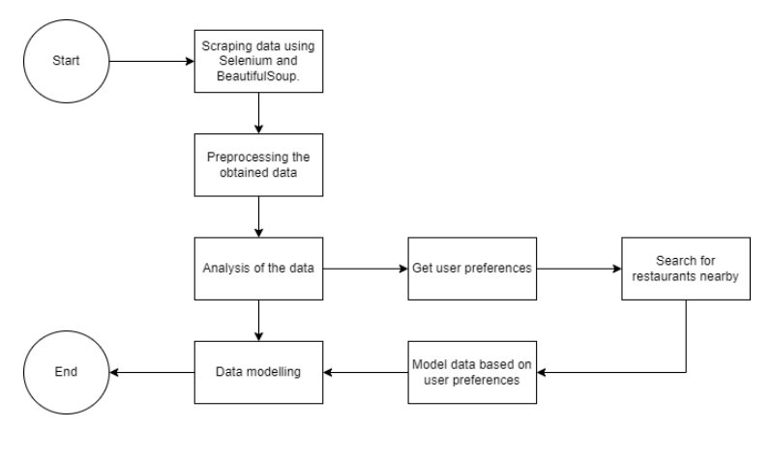
DESIGN MODEL

Slide 6
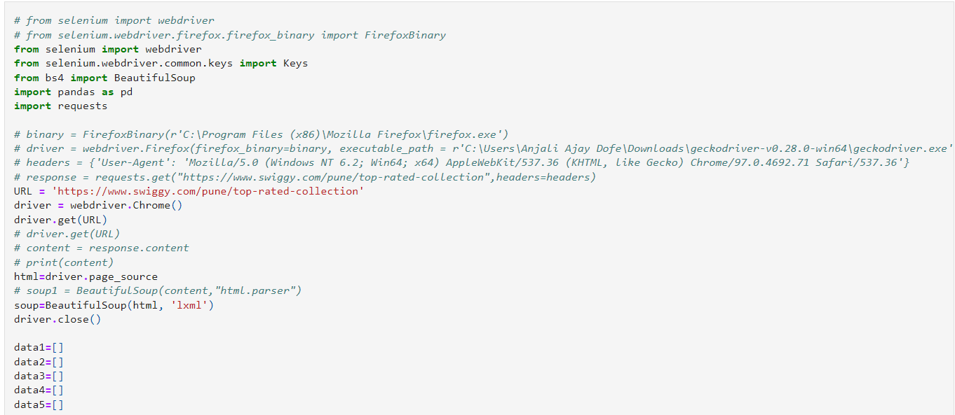
Web Scraping
WEB SCRAPING

Slide 7
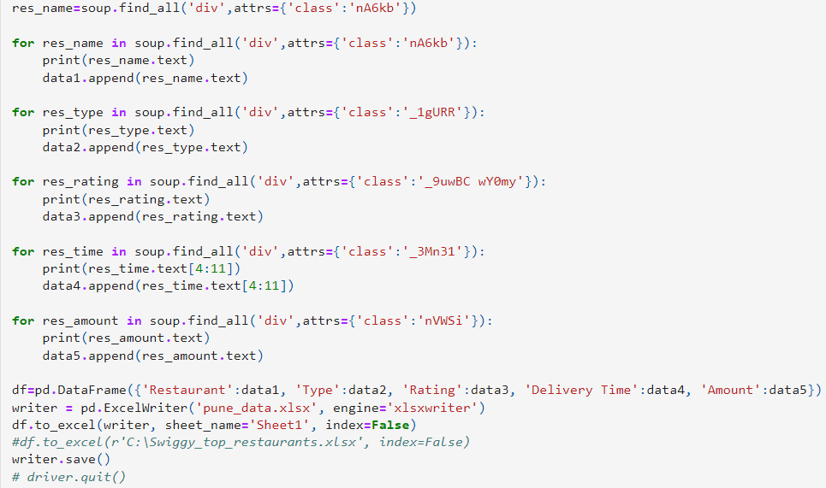

Slide 8
Exploratory Data Analysis
After gathering the data by web scraping, the next step we followed was to carry out Exploratory Data Analysis. It is a process of examining or understanding the data and extracting insights or main characteristics of the data. EDA is generally classified into two methods, i.e., graphical analysis and non-graphical analysis.
We examined the distribution of data and performed normalizing and scaling after handling missing values of the dataset. Data visualization was carried out using different types of charts for analysing and presenting the data. Various libraries such as NumPy, pandas and seaborn were used to perform EDA.

Slide 9
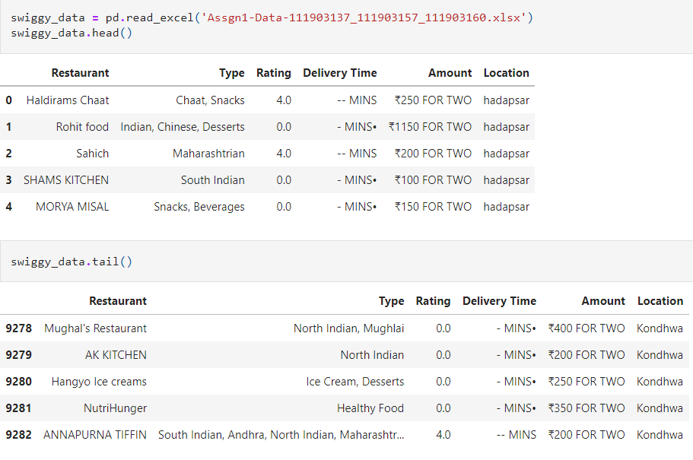

Slide 10
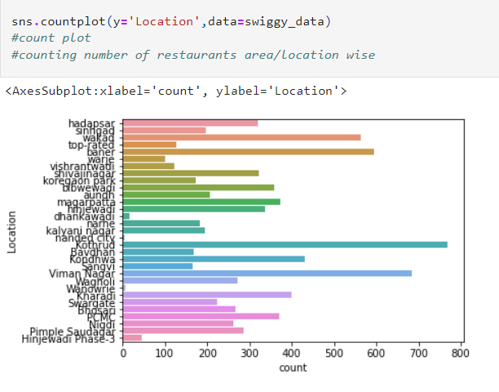
A count plot showing the number of restaurants in a particular location was plotted.

Slide 11
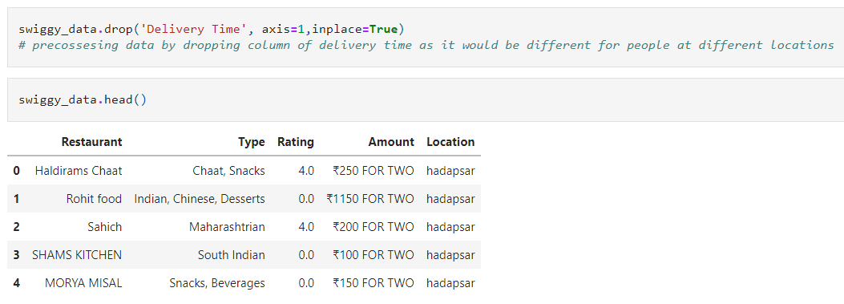
We then preprocessed the data by dropping the column of DELIVERY TIME as it would be of no use in our recommender system as delivery time varies for each customer as each of them live in a different locality and is also influenced by factors such as weather conditions and traffic.

Slide 12
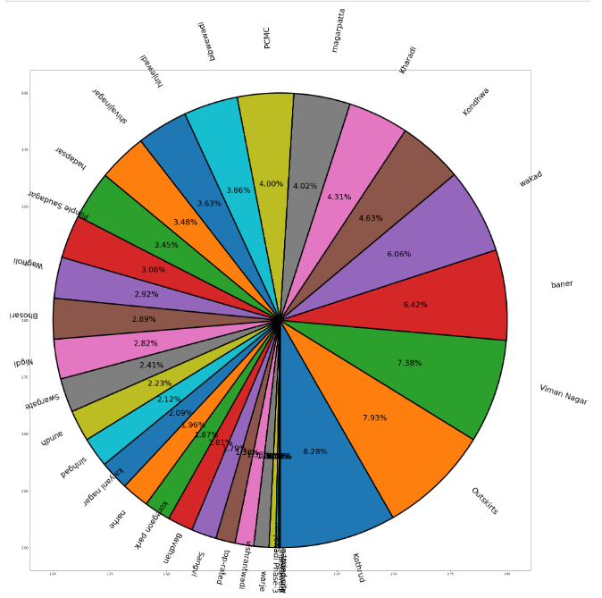
After handling all the null values again, we obtained a pictorial representation of the number of restaurants locality wise using pie chart representation.

Slide 13
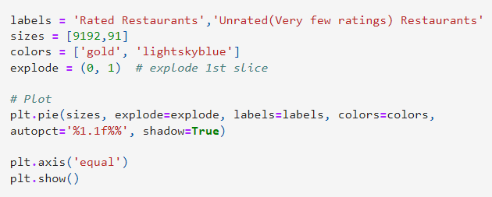
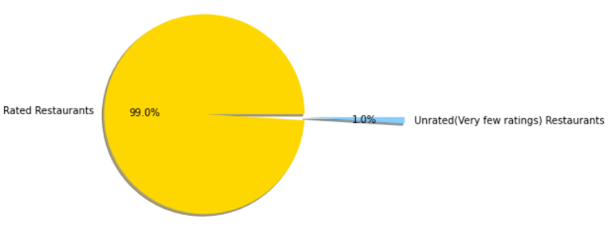

Slide 14
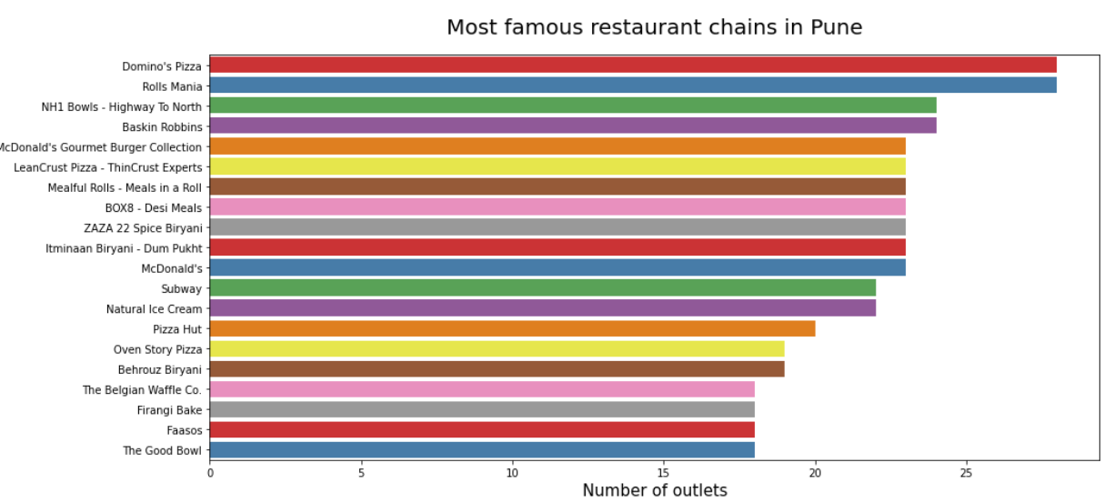

Slide 15
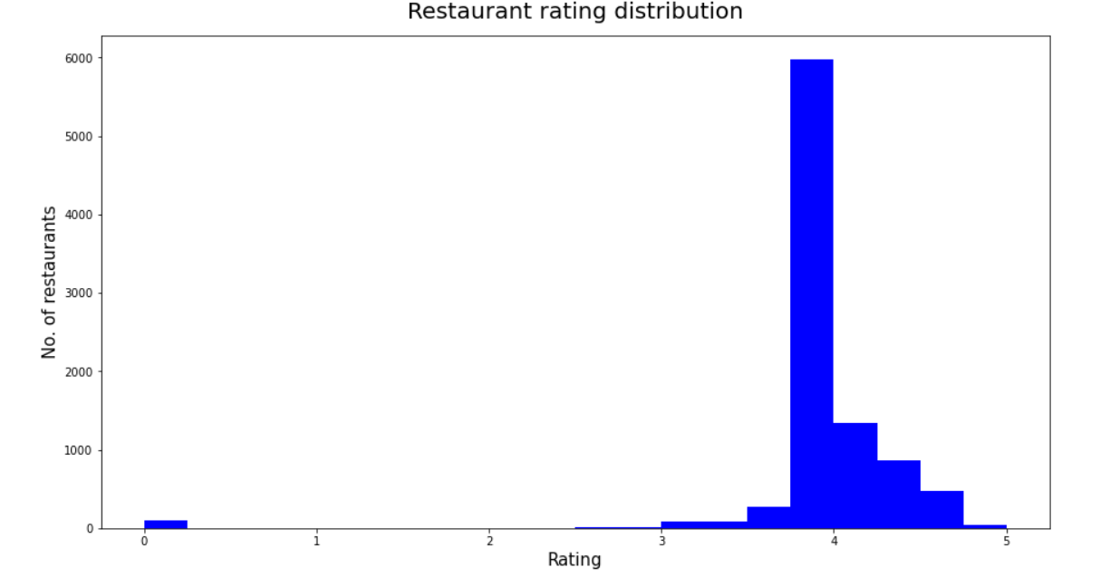

Slide 16
DATA MODELING and THE RECOMMENDER SYSTEM
The two most common types of recommendation systems are content-based and collaborative filtering recommender systems. In collaborative filtering, the behaviour of a group of users is used to make recommendations to other users. The recommendation is based on the preference of other users. Content-based systems are based on the idea that if you liked a certain item, you are most likely to like something that is like it.
In our project we have tried to have elements of both content-based filtering as well as collaborative filtering.

Slide 17
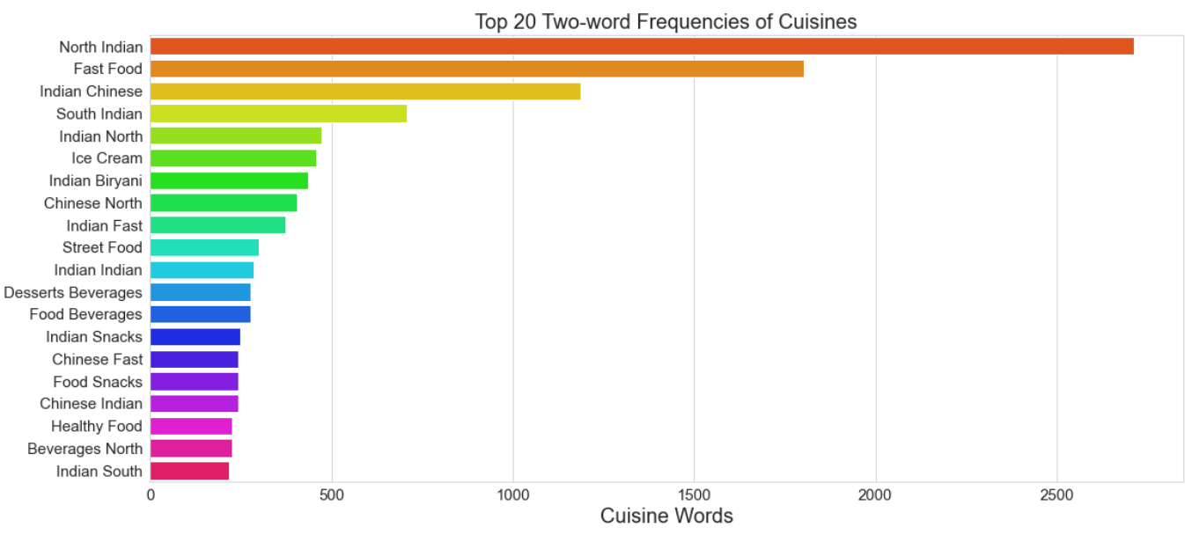

Slide 18
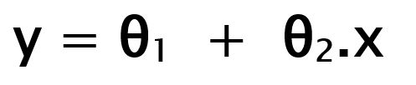
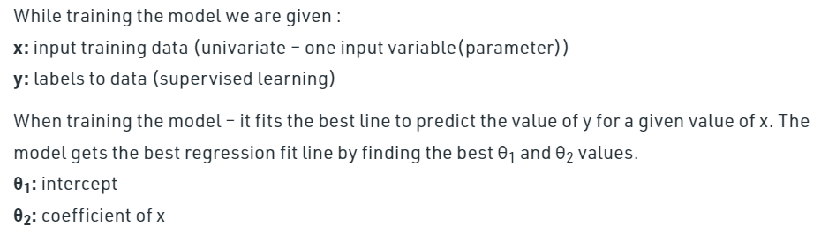
Linear Regression Model

Slide 19
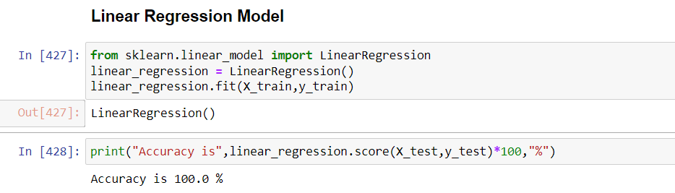
Linear Regression Model

Slide 20

Decision Tree Classifier

Slide 21
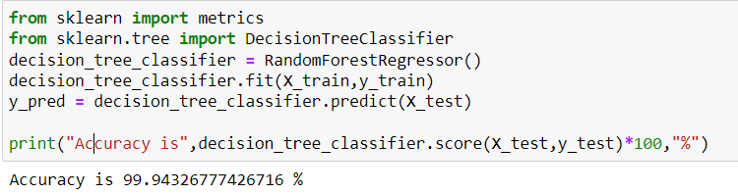
Decision Tree Classifier

Slide 22
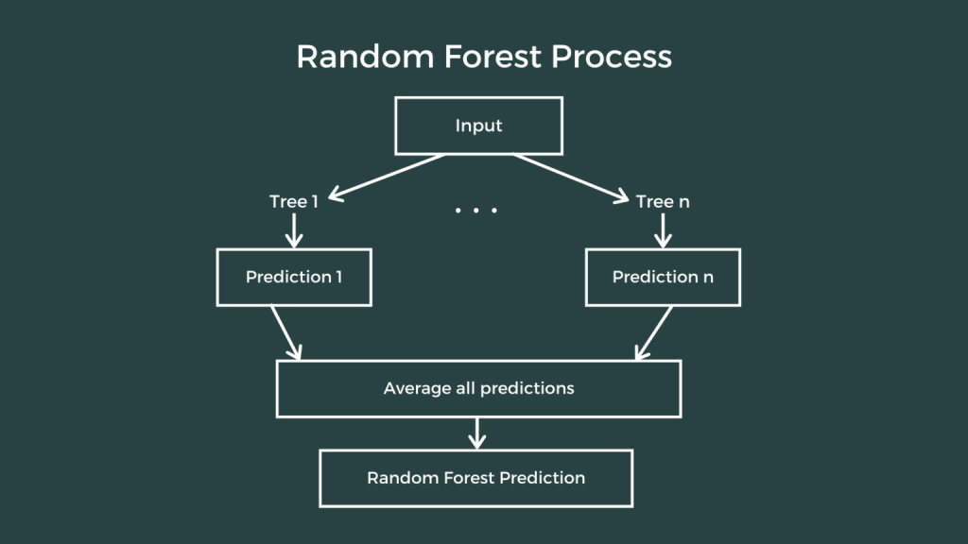
Random Forest Regression

Slide 23
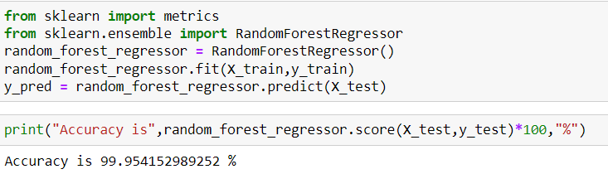
Random Forest Regression

Slide 24
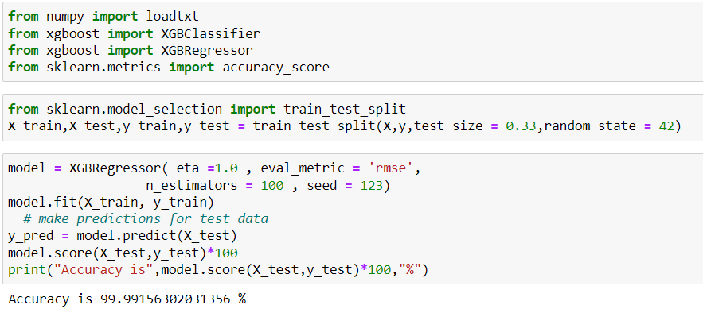
XgBoost Model

Slide 25
Recommendation

Slide 26
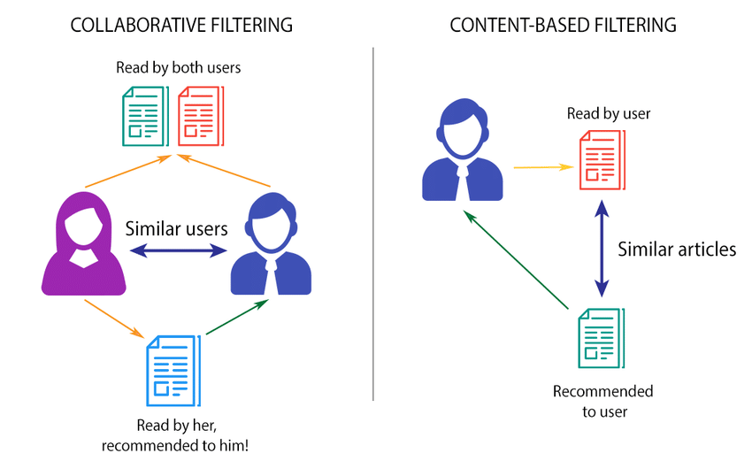

Slide 27
Content Based Filtering
Makes recommendations by using keywords and attributes assigned to objects in a database
Content-based filtering relies on assigning attributes to database objects so the algorithm knows something about each object.

Slide 28
Why Content Based Filtering?
No data from other users is required to start making recommendations : Unlike collaborative filtering, content-based filtering doesn’t need data from other users to create recommendations.
Recommendations are highly relevant to the user : Content-based recommenders can be highly tailored to the user’s interests.
Recommendations are transparent to the user : Highly relevant recommendations project a sense of openness to the user, bolstering their trust level in offered recommendations.

Slide 29
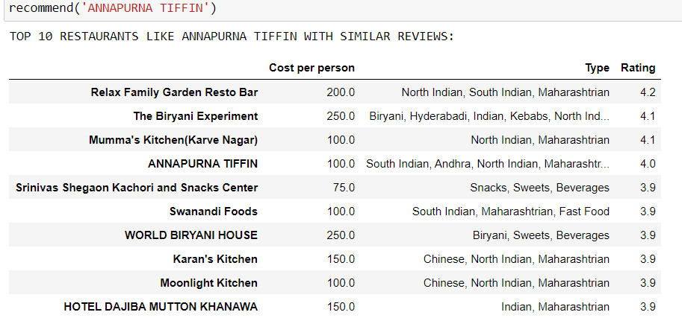

Slide 30
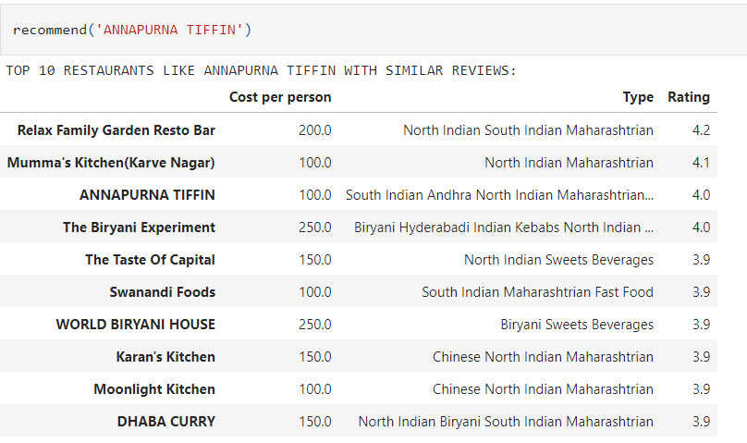
We have created a function recommend() which recommends the user Top 10 restaurants based on cosine similarity values which are similar to the restaurant specified by the user in terms of name and cuisine. This is a part of content-based filtering.

Slide 31
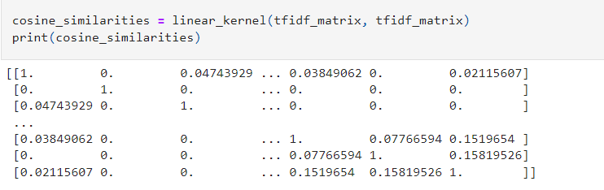
The matrix Factorization we used were using Tf-Idf matrix values to carry out content-based filtering.

Slide 32
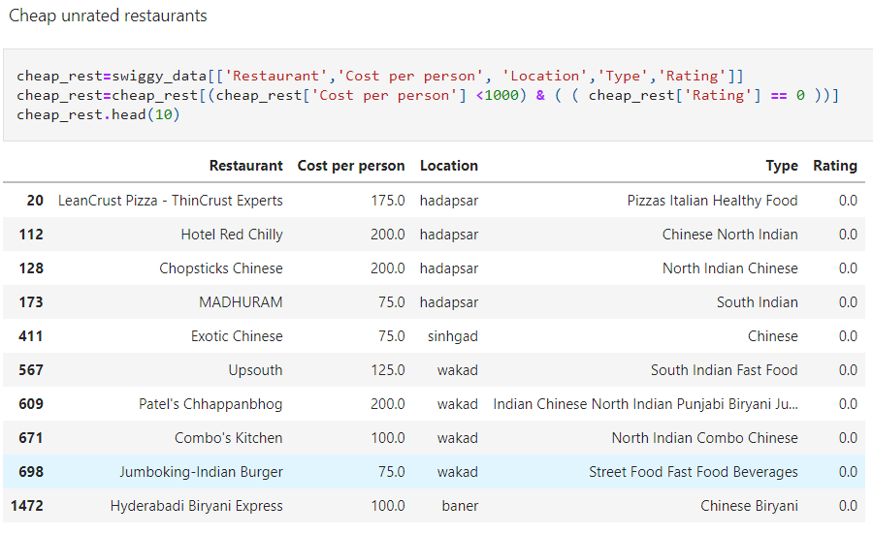
We also had one of our objectives to recommend unrated restaurants to users in order to increase their base and popularity, so people try them out too.

Slide 33
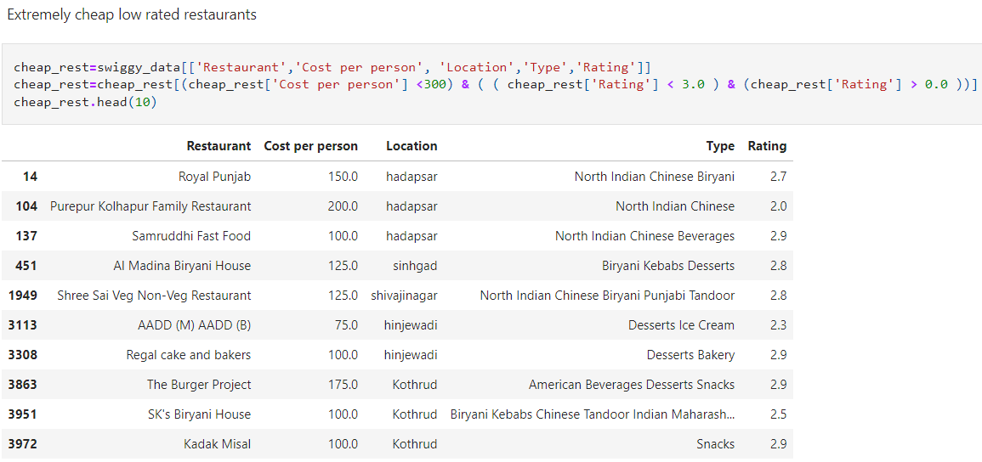
Extremely cheap low rated restaurants are the best for someone tight on their budget and not quite concerned with or particular about the food they want to eat.

Slide 34
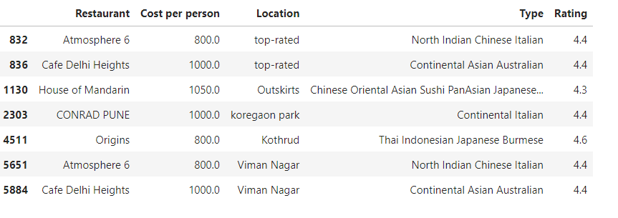
High rated expensive restaurants for the ones who are more concerned about maintaining their social image and quality of the food.

