Slide 1
Should ENIAC apply discounts?
Tejal Sungra tejalsungra@gmail.com
Zhanna Borodaeva zhborodaeva@gmail.com
Thomas Termine thomasthermine39@gmail.com
René Wollny wollny.rene@gmail.com

Slide 2

Task
Marketing wants to apply discounts, because they help the company to grow
Board is unsure about applying discounts, because they want to position the company in the quality segment and revenue decreased in last quarter while orders increased
Our task: Check the data to see, whether discounts should be applied or not, to increase revenue

Slide 3
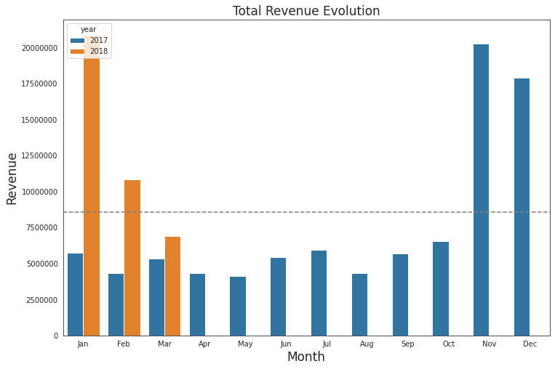
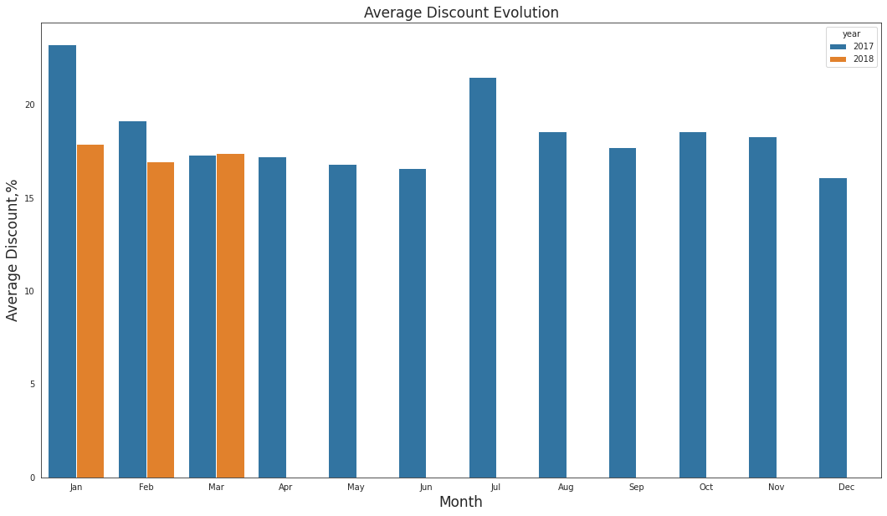
Q1 2018 Revenue is Twice as much as Q1 2017 Revenue
Q1 2018 Average Discount ≊ Q1 2017 Average Discount
Comparison Q1 2018 with Q4 2017 is not applicable: Christmas Sales Season

Slide 4
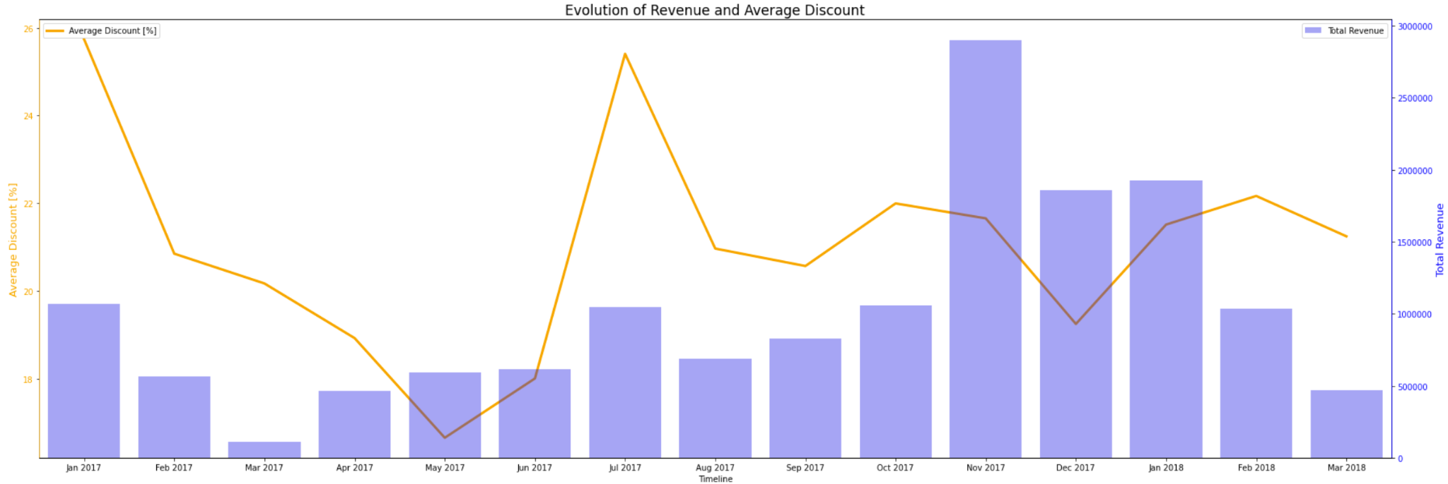
Total revenue and average discount

Slide 5
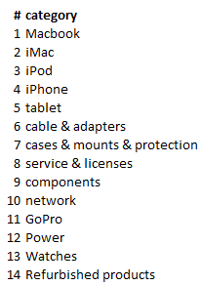
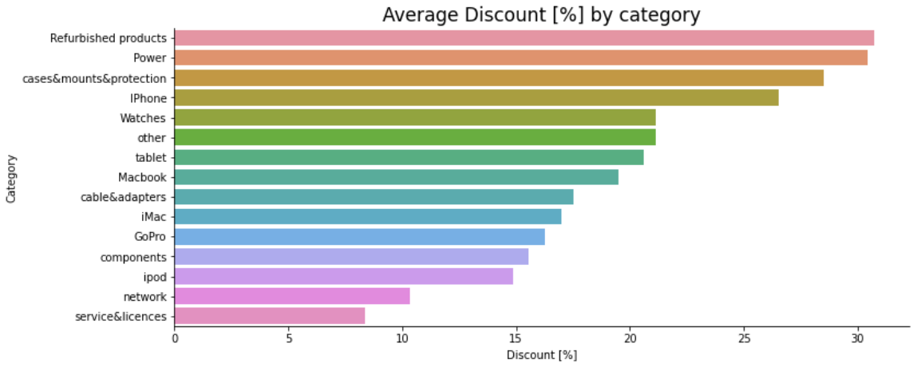
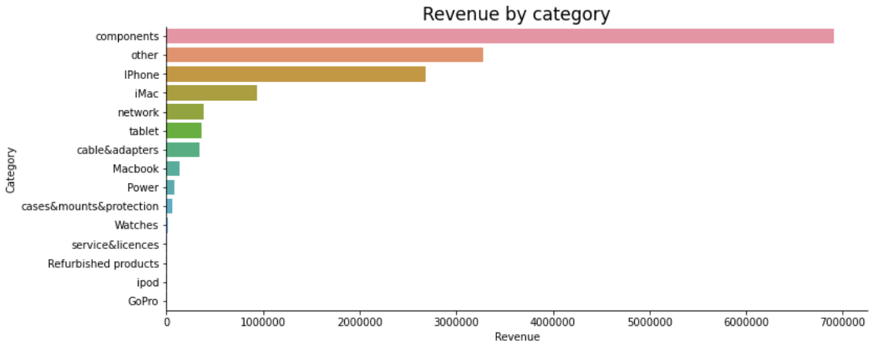
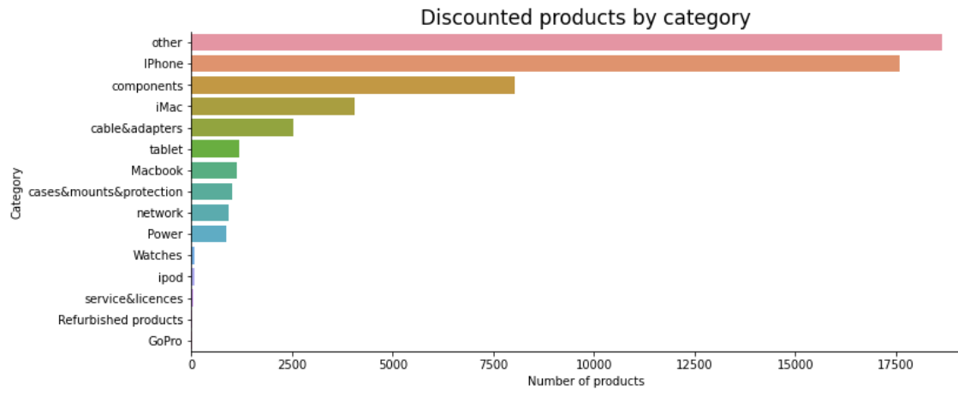
Categories
20% of categories make up 80% of revenue

Slide 6
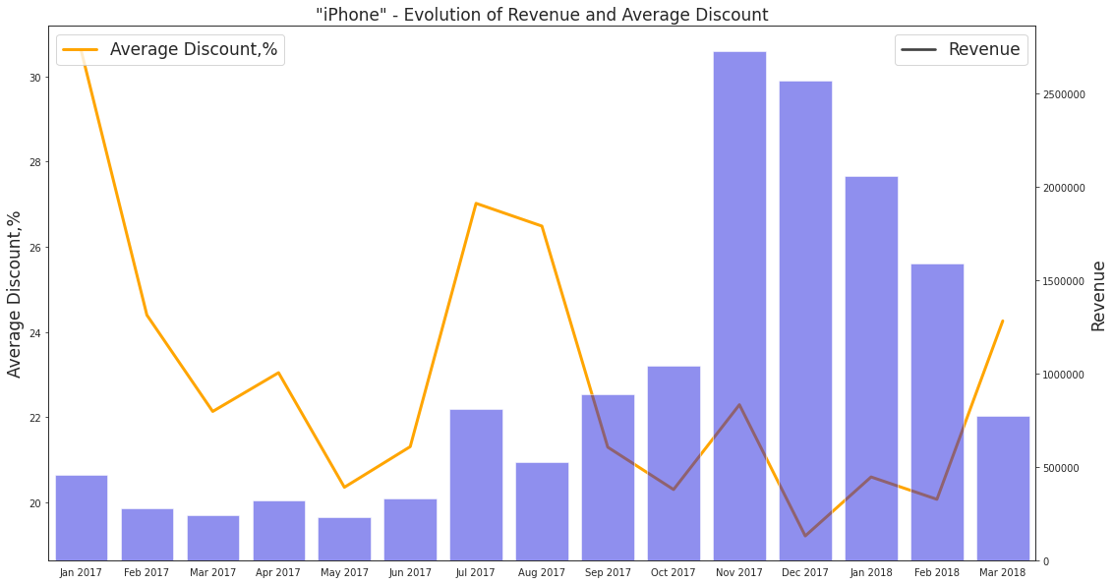
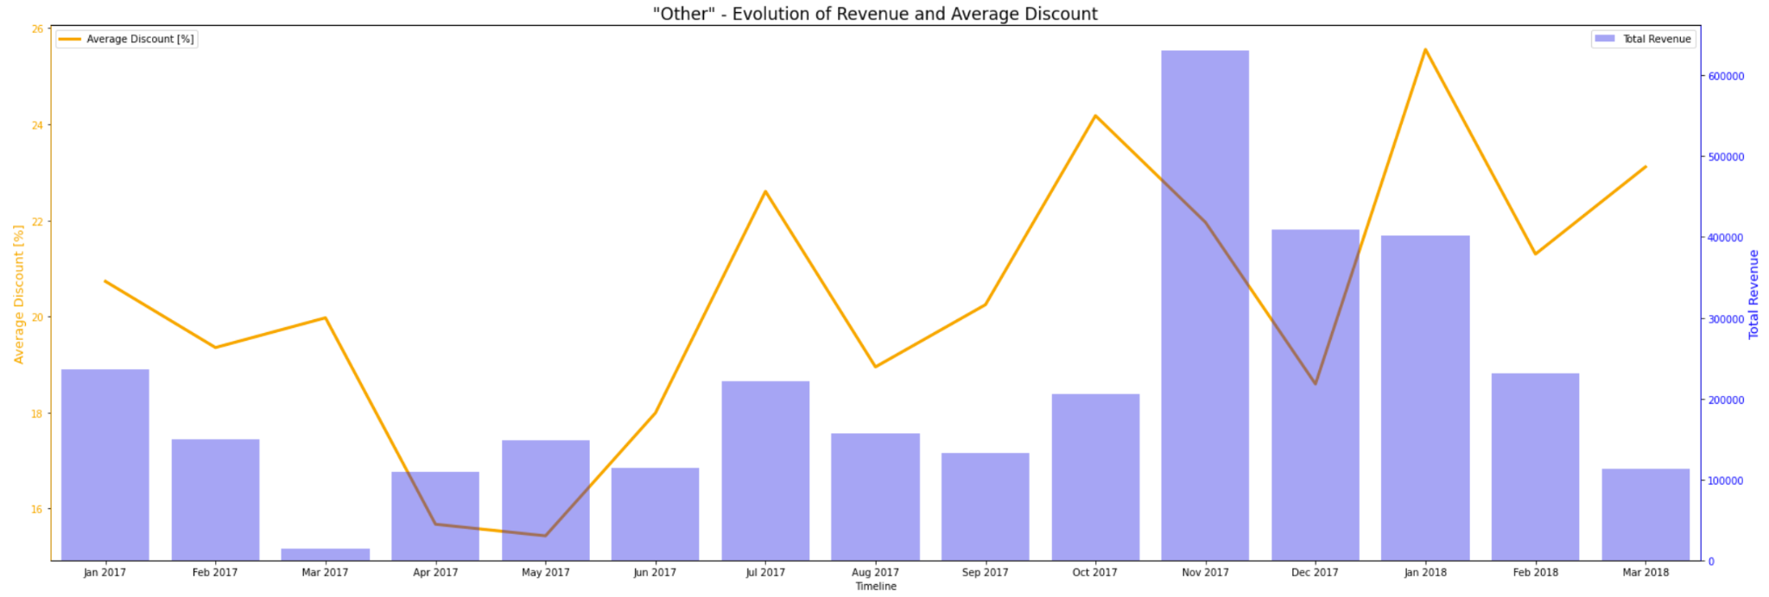
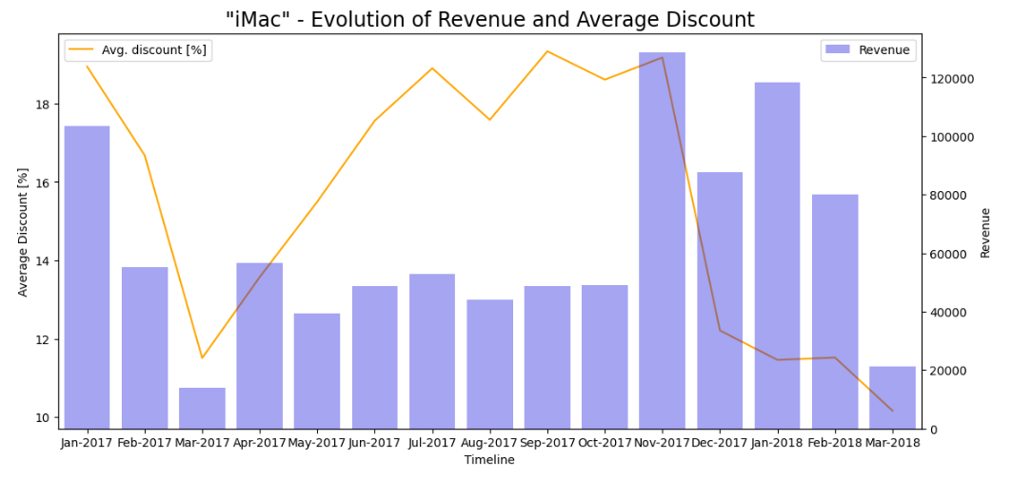
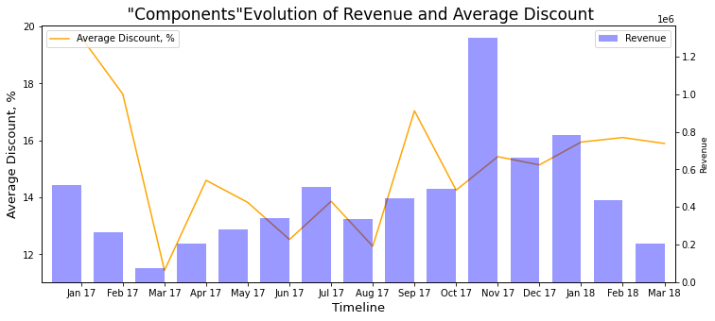

Slide 7
Conclusion
There’s no specific correlation between discount and revenue
ENIAC’s business is a seasonal business focused heavily on November/December

Slide 8
Recommendation
Keep applying discounts
For January - October:
Keep average discount for loyal big companies
Decrease discounts for new, individual customers, but keep discount close to average of competitors
Better data collection:
Implement customer id
Implement categories and subcategories
Repetition of order_id and id_order should be avoided

