Slide 1
International Summer Internship Program – 2024
(ISIP – 2024)
Project Review Presentation
on
Development of an Autonomous Drone for Indoor Navigation, Object Detection, and Face Recognition
Name & Affiliation of Students
Mr. Adyansh Gupta (Student, BTech Mechanical Engineering, Vishwakarma Institute of Information Technology, India)
Miss Tejal Dattu Ubale (Student, Bsc computer science, Pillia college, India)
Miss Anushka Kadam (Graduated , Computer engineering, MGMCET , India)
Under the guidance of
Dr Abderrahim Benslimane (Professor, Computer Science Department, University of Avignon, France)
Prof. Pallavi Dongare (Assistant Professor, Civil Engineering Department, Vishwaniketan’s iMEET, India)

Slide 2
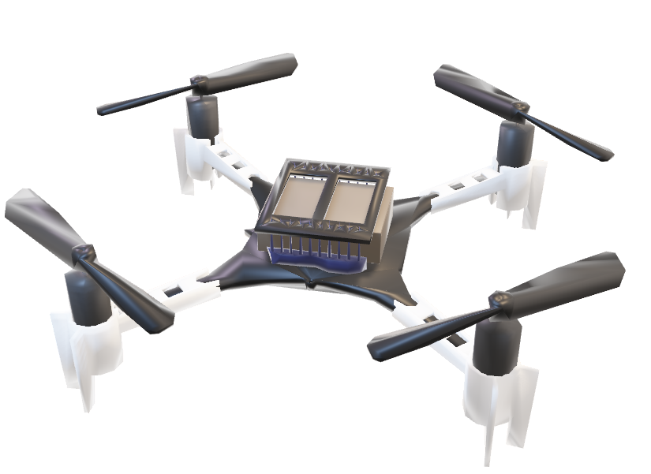
Problem Overview
Platform: Crazyflie 2.1 Drone - This small, programmable drone provides a maneuverable base for our autonomous system.
Expansion Decks:
Multiranger Deck: Provides distance measurements from all four directions (front, back, left, right) and the top of the drone, crucial for obstacle detection and safe navigation.
Flow Deck: Measures distance from the bottom of the drone and its direction of movement, enhancing stability and low-altitude control.
AI Deck: Enables on-board processing for computer vision tasks. This allows the drone to directly utilize a camera for object detection and facial recognition.
Computer Vision: We will leverage YoloV8, a deep learning model, for object detection and facial recognition tasks using the camera and AI Deck.
SLAM (Simultaneous Localization and Mapping): The drone's distance sensors will be used to build a real-time 2D map of its environment, including obstacles and walls. This map is essential for path planning.
Path Planning - A Algorithm: This efficient search algorithm will analyze the generated 2D map and identify the shortest path for the drone to navigate towards its target while avoiding obstacles.

Slide 3
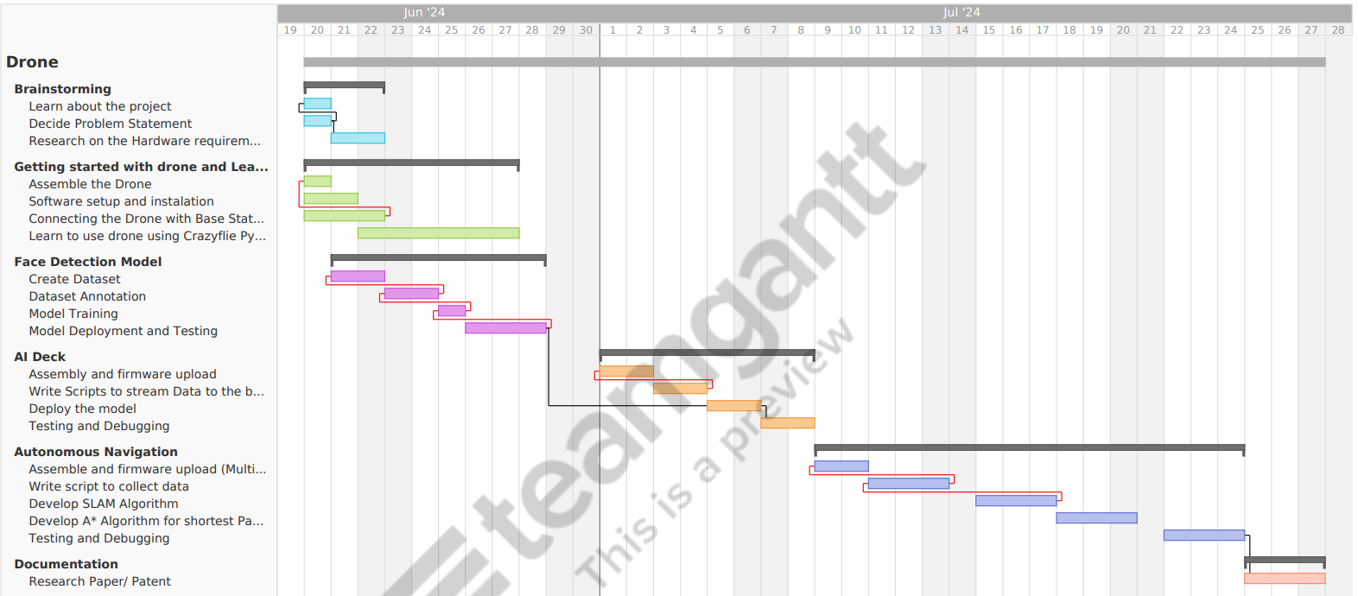
Gantt Chart

Slide 4
