Slide 1
Monitoring Deployed Machine Learning models:
Identifying Hidden: A Machine Learning
Perspective
Supervised By
Dr. Swati
Tejanshu Sethi (2210992462)
Department of Computer Science and Engineering, Chitkara University, Punjab

Slide 2
Abstract
This project focuses on recognizing human activities using smartphone sensors.
Data from accelerometer and gyroscope is used.
Machine learning models classify activities like walking, sitting, etc.
Different models are compared to find the best one.
Results show high accuracy and practical applications in real life.

Slide 3
Introduction
Today, machine learning models are widely used in real applications but their performance can decrease over time due to changes in data patterns and real application.
Machine Learning model monitoring is a system that continuously tracks deployed walking, sitting, or running using data from phone sensors.
Sensors like the accelerometer and gyroscope track movement and orientation.
By using machine learning, we can train systems to automatically recognize these activities.
This technology is widely used in fitness apps, healthcare monitoring, and smart living systems.

Slide 4
Tools and Technology
Programming Language: Python
Libraries: NumPy, Pandas, Scikit-learn, Matplotlib
Platform: Jupyter Notebook
Metric: Accuracy, Precision,Recall,F1-score,Data Drift detection

Slide 5
Implementation
Collected and cleaned sensor data.
Extracted useful features from raw data.
Trained multiple machine learning models.
Compared model performance using evaluation metrics.
Generated graphs for visualization.

Slide 6
Objective
The main goal of this project is to build a system that can recognize human activities using smartphone data.
We aim to apply machine learning techniques to classify different activities accurately.
Another objective is to compare different models and find out which one performs best.
Ultimately, we want a system that is reliable, efficient, and easy to use.

Slide 7
Problem Statement
Observing and recording human activities manually is time-consuming and not always accurate.
The data collected from sensors can be complex and noisy.
So, the challenge is to create a system that can:
Automatically detect activities
Work efficiently in real-time
Maintain high accuracy without human effort

Slide 8
Methodology
First, we collect data from smartphone sensors like the accelerometer and gyroscope.
Then, we clean and process this data to remove noise and make it usable.
After that, we extract important features such as average values and variations in movement
Next, we train different machine learning models like Decision Tree, Random Forest, SVM, and KNN.
Finally, we test these models and evaluate their performance

Slide 9
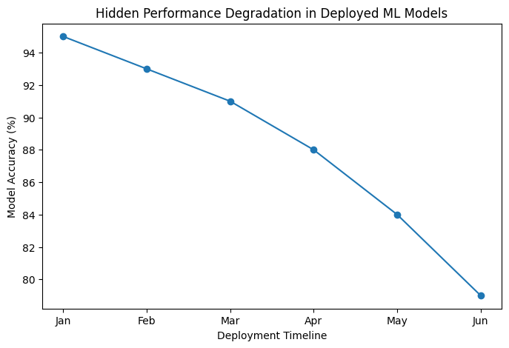
Class Distribution

Slide 10
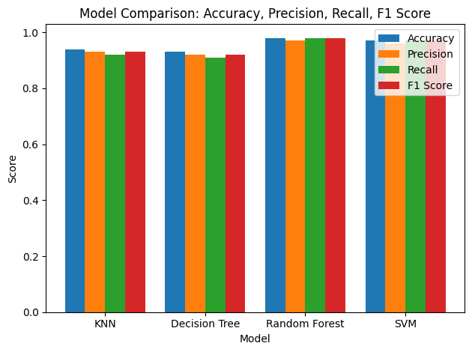
Model comparison

Slide 11
Results & Discussion
The models were tested, and we achieved high accuracy (around 90–95%, depending on the model).
Random Forest performed the best in most cases.
Using multiple sensors together improved the results.
However, some activities like sitting and standing are harder to distinguish because they are very similar.

Slide 12
Conclusion and Future scope
Monitoring deployed machine learning models is important for accuracy.
Machine learning models can accurately classify activities.
Random Forest is the most balanced model.
Future Scope:
Use deep learning models like CNN, LSTM
Develop real-time mobile applications
Improve accuracy with better sensors

Slide 13
Conclusion
1. This project shows that smartphones can effectively recognize human activities.
2. Machine learning plays a key role in making this possible.
3. Random Forest and SVM are strong models for this task.
4. In the future, we can improve this system using deep learning techniques and real-time mobile applications.

Slide 14
References Hidden Technical Debt in Machine Learning Systems Authors: D. Sculley et al. Focuses on challenges in maintaining deployed ML systems and performance degradation over time. Concept Drift: A Review Authors: João Gama et al. Explains concept drift detection methods used in monitoring changing machine learning environments. Monitoring Machine Learning Models in Production Discusses techniques for tracking model accuracy, data quality, and system reliability in real-world deployment. Studies on Hidden Performance Degradation in ML Systems Research articles on AI Reliability and Model Maintenance

Slide 15
Appendices
Sample dataset details
Additional graphs and charts
Code snippets (if required)

Slide 16
Thank You
3

