Slide 1
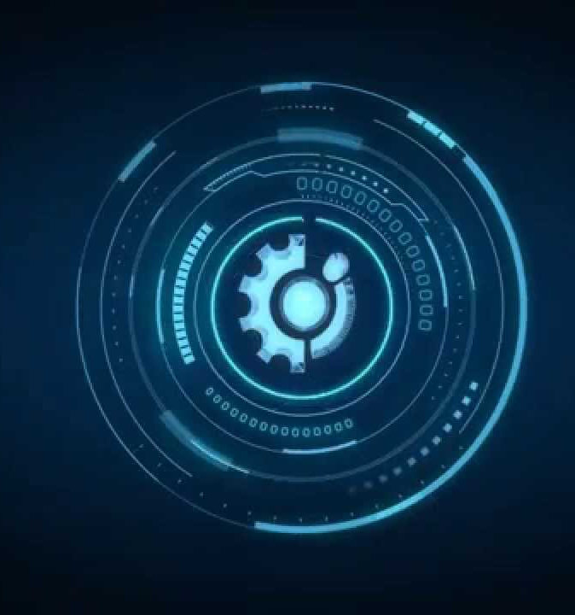

Dialogue Generation
Using
Deep Learning

Slide 2
Contents

Slide 3
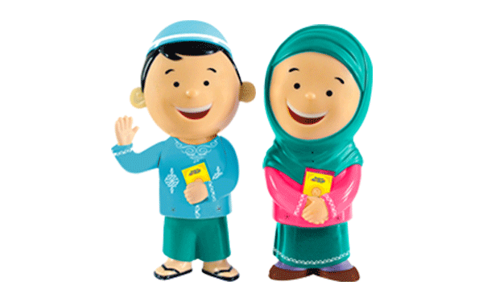
Objective
To make Dolls Speak

Slide 4
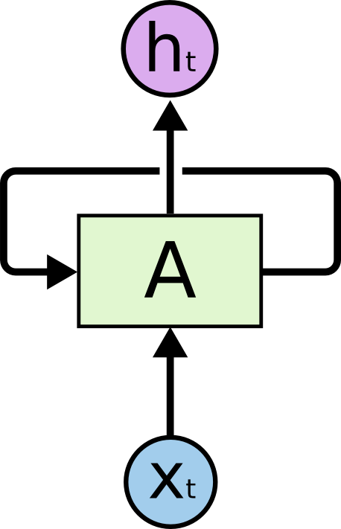
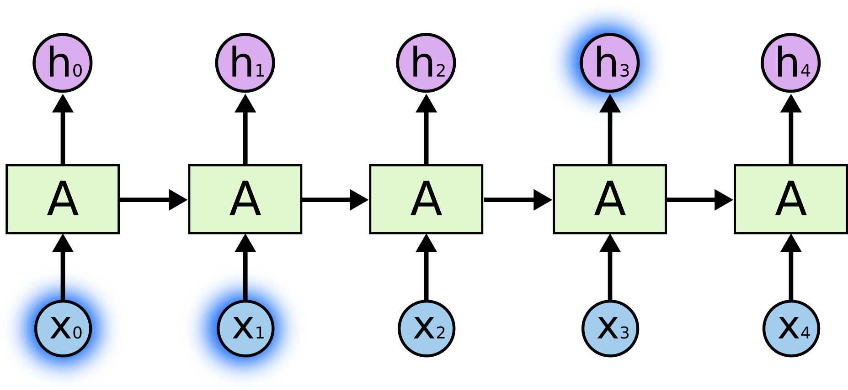
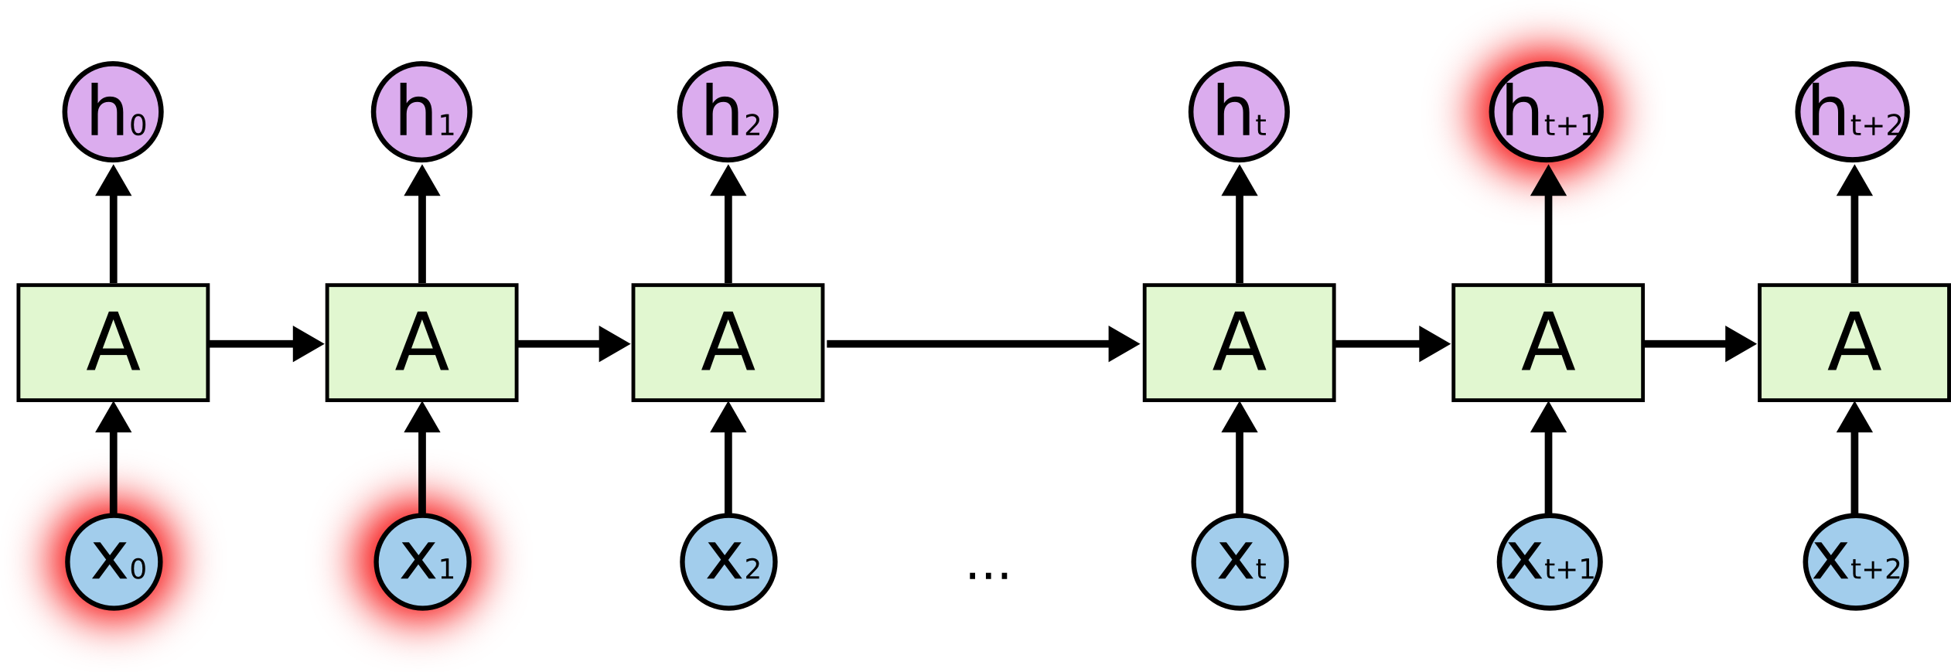
Introduction RNN
The colour of a leaf is Green.
I am White. The colour of my skin is

Slide 5
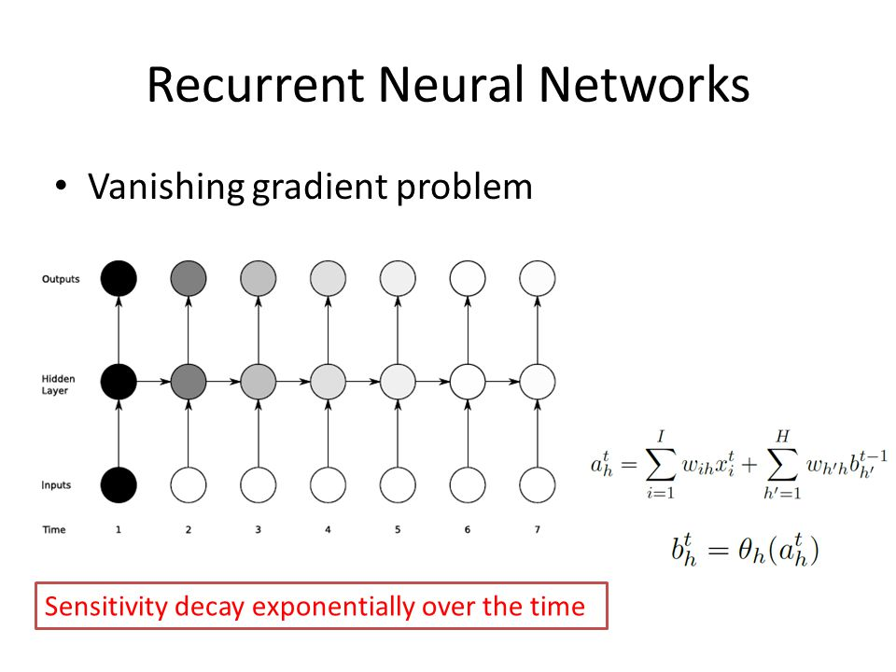
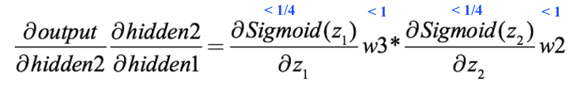
Problems associated with RNN

Slide 6
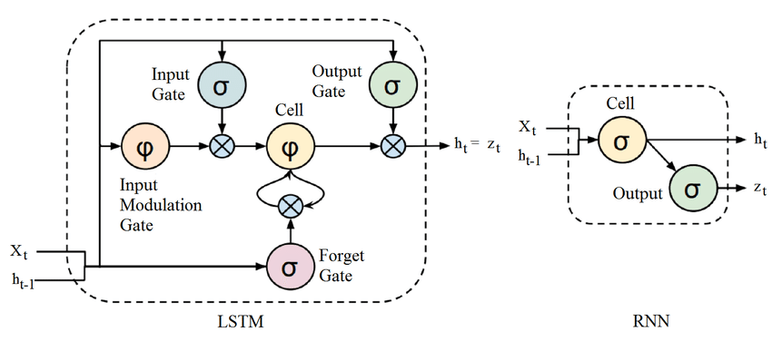
LSTM

Slide 7
Work Done
Understanding why use LSTM and what the gates are for?
Implemented LSTM to generate Random Numbers
Implemented LSTM using encoder-Decoder to echo sequences of random numbers.

Slide 8
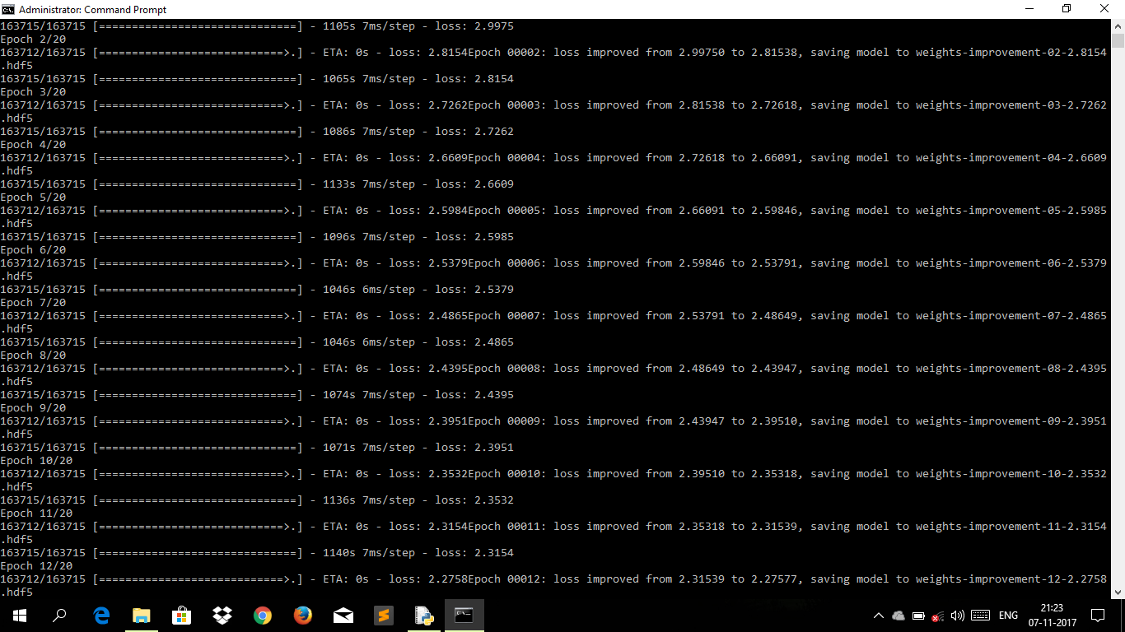
Conclusion
This Project implements the generation of text from an initial seed which can then be extended to a conversation that can be simulated to fit many applications. This is also a subproblem of NLP (Natural Language Processing) where semantics and clarity are the most important concern. But here we rather focus on the generation of the text with least log loss as discussed above. Further work can be added by implementing the simulation to two agent environments and then improve the semantics of the result provided above by further training.

Slide 9
Future Work
We can implement a personal assistant to reply to our queries and thoughts.
The model can also be used to predict audio i.e. next utterance
It can be used to predict the whole song from the initial seed lyrics.

Slide 10
References
[1] Jiwei Li, Will Monroe, Alan Ritter, Michel Galley, Jianfeng Gao and Dan Jurafsky, “Deep Reinforcement Learning for Dialogue Generation” 29th Sept 2016
[2] Oriol Vinyals, Quoc V. Le, “A Neural Conversational Model” 22nd July 2015
[3] Ilya Sutskever, Oriol Vinyals, Quoc V. Le, “Sequence to Sequence Learning with Neural Networks” 14th Dec 2014
[4] Alex Graves, “Generating Sequences with Recurrent Neural Networks” 5th June 2014

