Slide 1






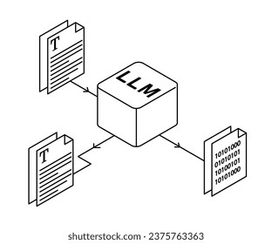






Input
Transcription
Processing
Storage
Services
Consumers
Notes:
Layered architecture

Slide 2
Input
Transcription
Processing
Storage
Services
Consumers

Slide 3
