Slide 1

ANALYSIS ON AIR CONDITIONERS AVAILABLE
ON FLIPKART WEBSITE

Slide 2
About us
Vemuri Ramya Maheshwari(BTech-Civil Engineering)
Fresher
Batch-314
Kumpatla Uma Lakshmi (Btech-Civil Engineering)
Fresher
Batch-314

Slide 3
Problem Statement:
Analyzing and identifying the best air conditioners available in flipkart based on their features and customer ratings and reviews.

Slide 4
Objective of the Project:
The objective of this exploratory data analysis (EDA) project is to analyze and identify the best air conditioners available on Flipkart based on their features, customer ratings, and reviews. This involves evaluating various attributes of air conditioners to determine which brand offer the best value, performance, and customer satisfaction.

Slide 5
Libraries Used :
Requests
BeautifulSoup
Re
Pandas
Matplotlib
Seaborn

Slide 6
Web Scraping – Details:
Website –https://www.flipkart.com/
Sending requests to access the data.
Parsing the data from website using BeautifulSoup.
Using the regex pattern to get the required datapoints.

Slide 7
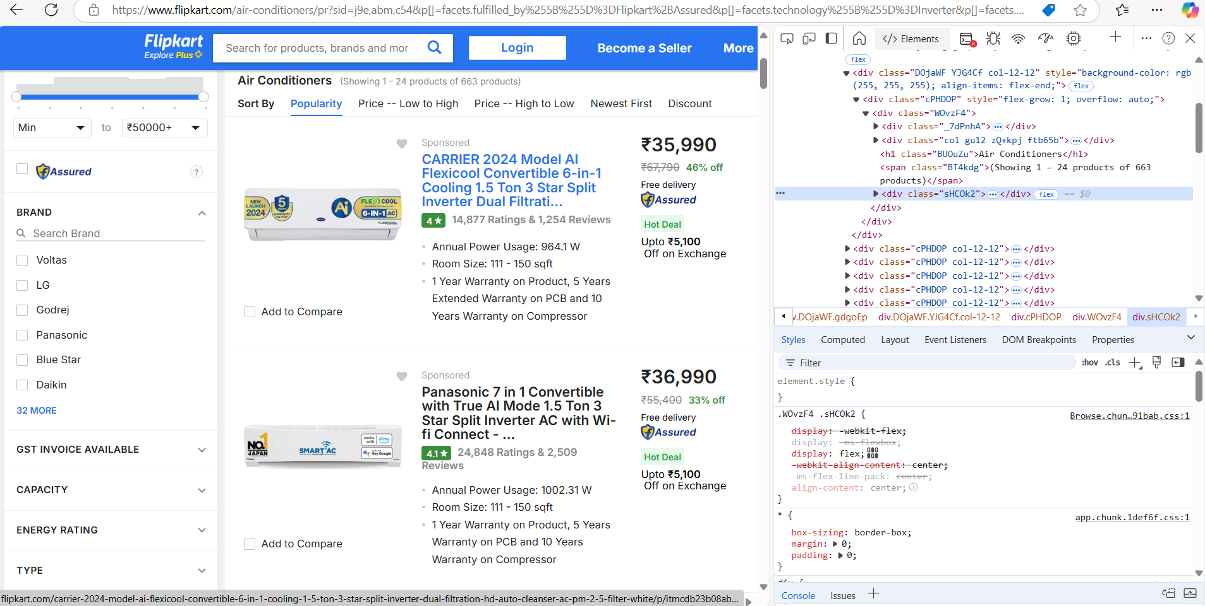
Website’s URL for scraping:

Slide 8
Description of Features :
Cooling Capacity (Ton): This indicates the efficiency of the air conditioner in cooling a room. Higher tonnage is generally better for larger rooms.
Star Rating: This shows the energy efficiency of the AC. A higher star rating (e.g., 5 stars) means better energy efficiency, which can reduce long-term operating costs.
Annual Power Usage (kWh):This is an important factor to consider, as it directly affects electricity consumption and running costs. Lower values are more efficient.
Average Room Size:This can be used to compare the suitability of the air conditioner for specific room sizes.
Warranty:A longer warranty indicates better confidence in the product's durability.
Price:Helps to compare the value for money, keeping in mind the other features and performance.
Ratings:The average customer rating can indicate product quality and user satisfaction.
Number of Ratings:A higher number of ratings suggests the product is popular and has been tried by many users.
Reviews:The sentiment expressed in reviews can provide insights into the air conditioner's real-world performance.

Slide 9
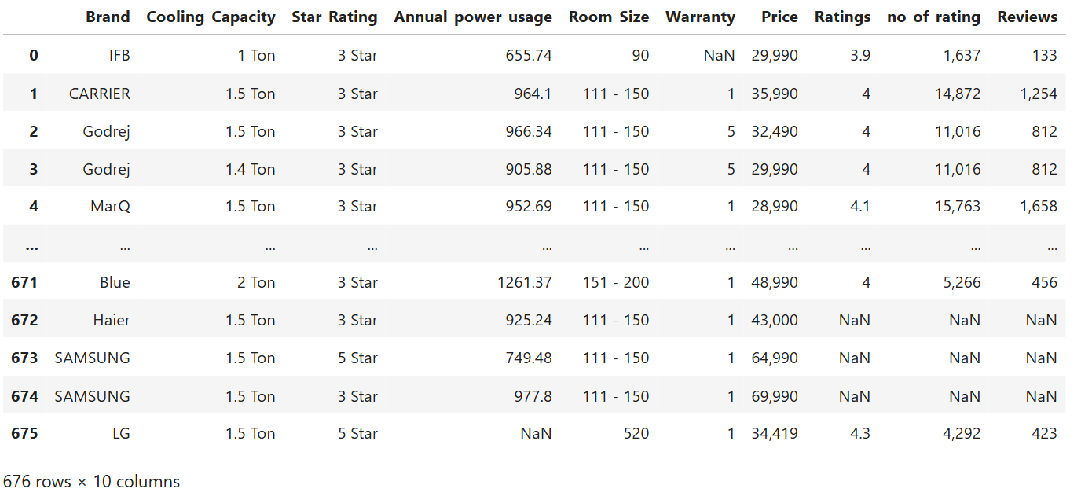
Raw Data From a Website:
Insights : We have 676 rows and 10 columns from raw data.

Slide 10
Data cleaning steps:
Dropping the unnamed column “Unnamed :0”.
Checking for the missing values.
Replacing the special characters with empty string.
Data type conversion.
Final DataFrame Structure – Shape(476,10)

Slide 11
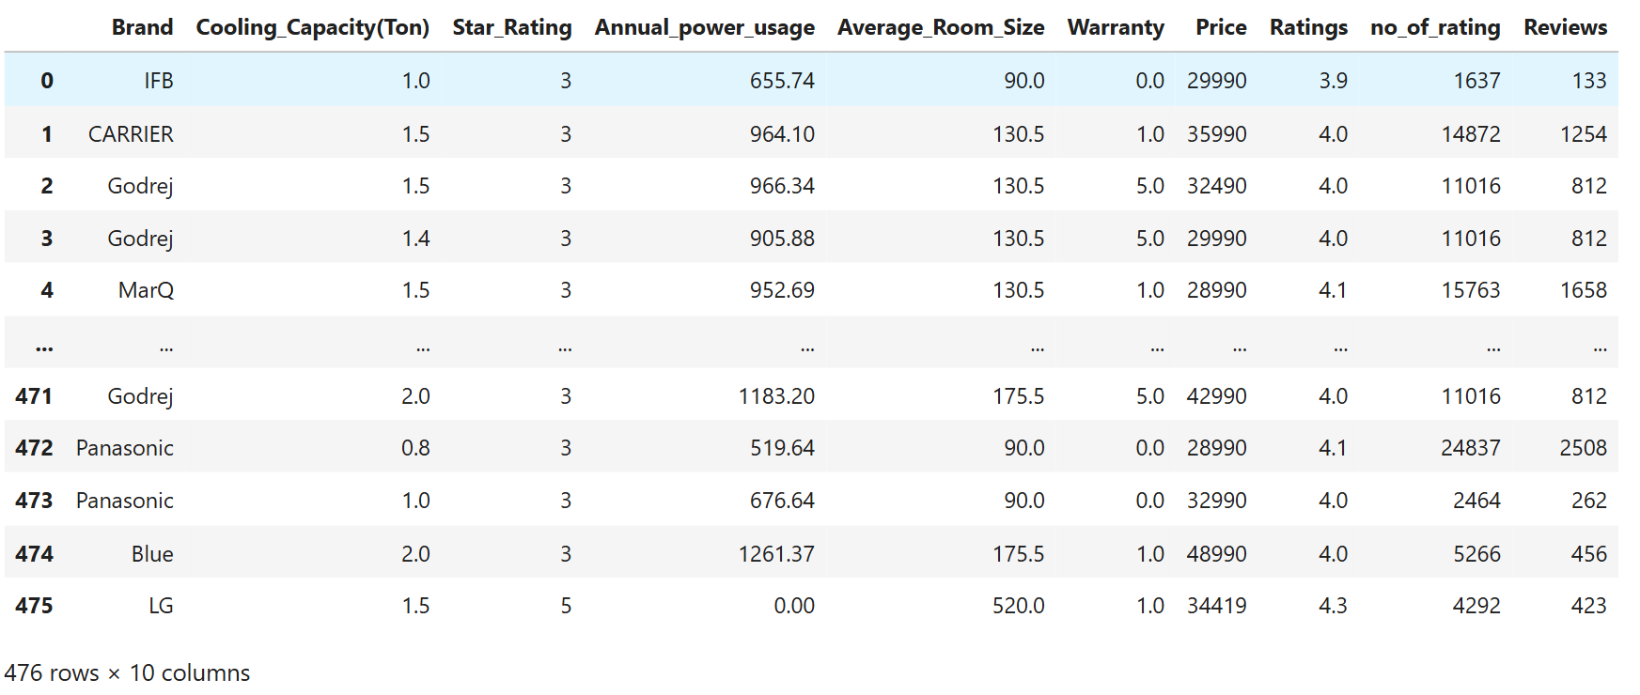
Final Data after cleaning :

Slide 12
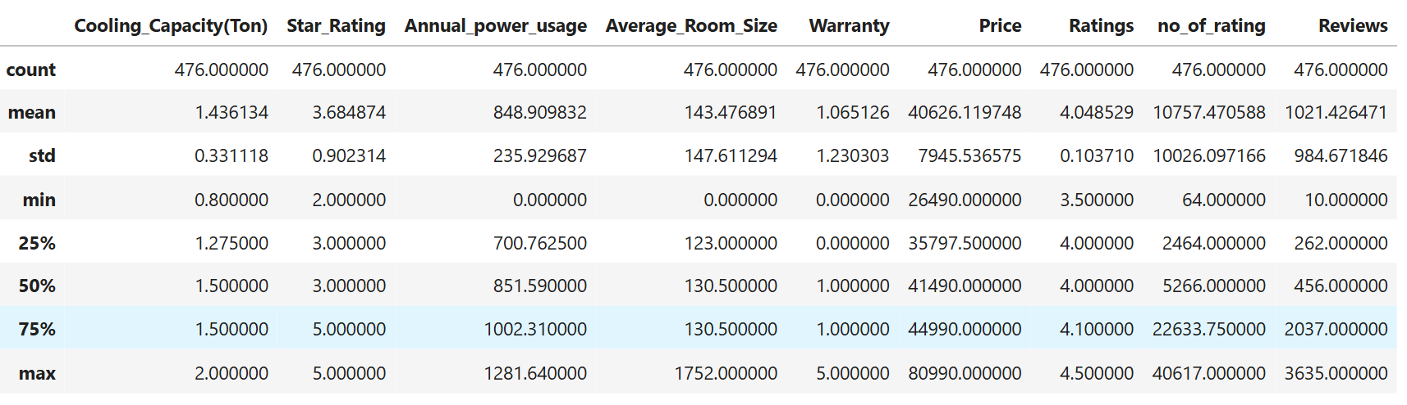
Statistical Analysis(Non-Viz) :

Slide 13
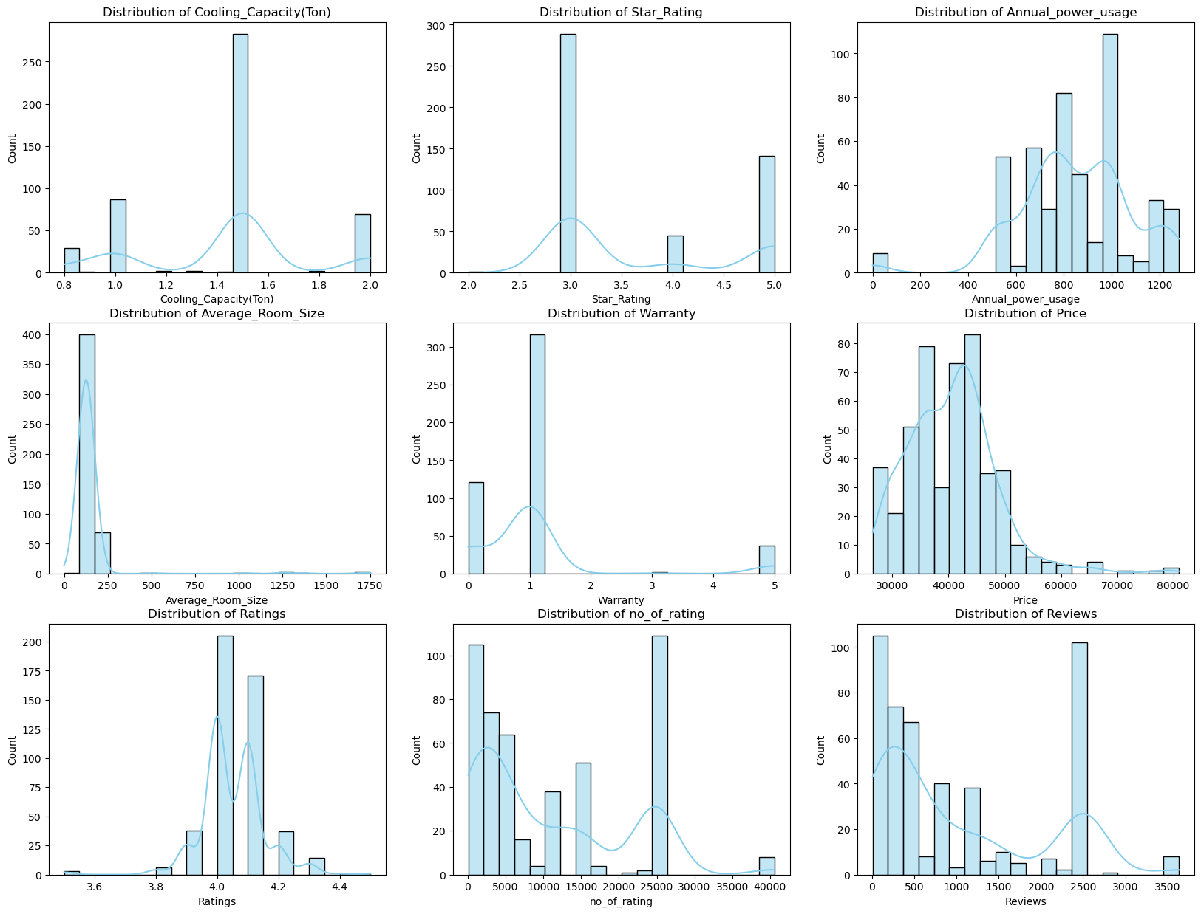
Univariate Analysis:(Subplot)

Slide 14
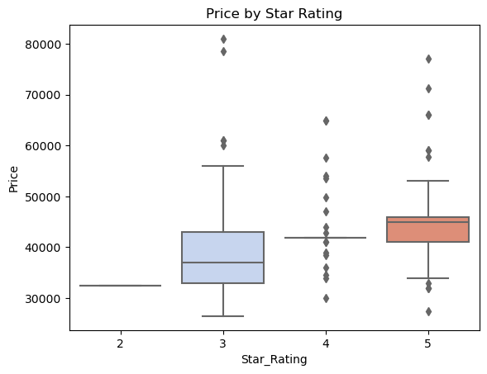
Univariate Analysis:(Boxplot)
Insights:
2-Star Rating: There is only one data point, so no box is formed.
3-Star Rating: Prices are more spread out, with a median around 40,000 INR.
4-Star Rating: Prices are even more spread out, with many outliers.
5-Star Rating: Prices are more concentrated, with a median around 50,000 INR

Slide 15
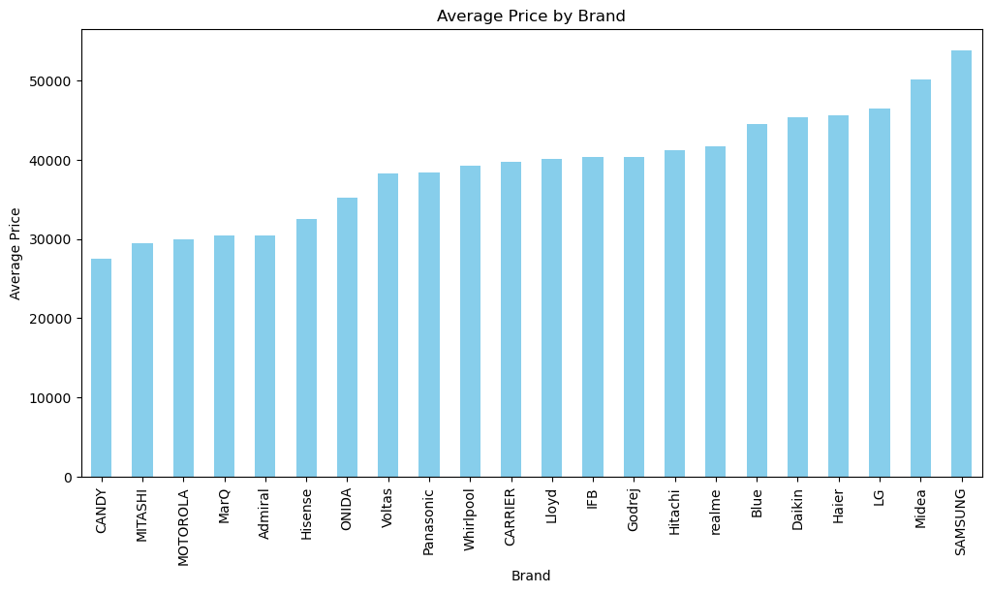
Univariate Analysis:
Insights:
Brand Comparison: The plot allows for a visual comparison of the average prices across different brands.
Price Range: The average prices range from approximately 30,000 to over 50,000 INR.
Highest and Lowest Prices:
SAMSUNG has the highest average price.
CANDY has the lowest average price.

Slide 16
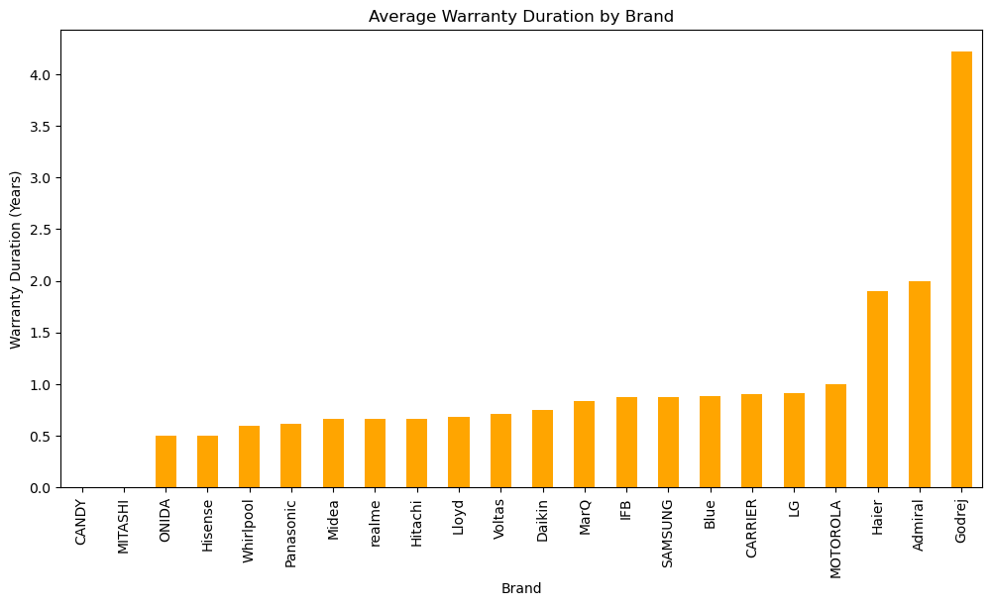
Univariate Analysis:
Insights:
Godrej has a significantly higher
Average warranty duration
Compared to the others, indicating a
Notable difference in warranty policies
among the brands

Slide 17
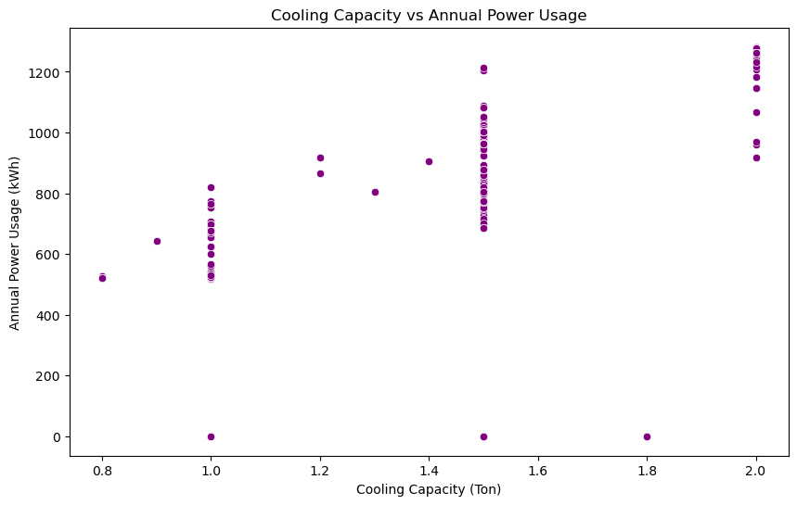
Bivariate Analysis:(Scatterplot)
Insights:
The scatter plot reveals that air conditioners with higher cooling capacities generally use more power annually. There are noticeable clusters at 1.0, 1.4, and 2.0 tons. Some points show zero power usage, which could be outliers or special cases.

Slide 18
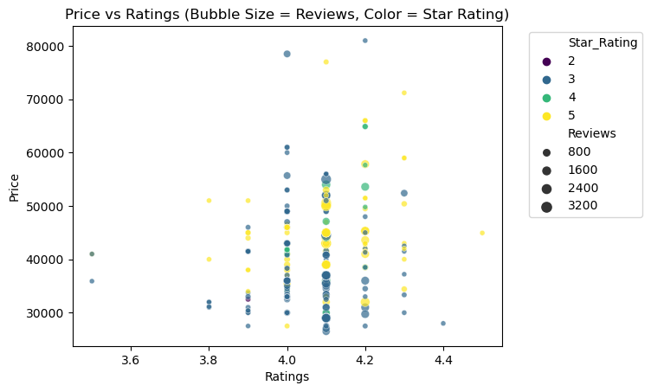
Bivariate Analysis:(Scatterplot)
Insights:
The scatter plot shows how cooling capacity relates to air conditioner prices:
Each dot represents an air conditioner, positioned by its cooling capacity and price.
Colors indicate star ratings: blue for lower ratings, red for higher ratings.
Higher cooling capacities (around 2.0 tons) generally have higher prices.
Prices cluster around certain capacities, like 1.0, 1.4, and 2.0 tons.
Higher star ratings (4 and 5 stars) are often linked to higher prices.

Slide 19
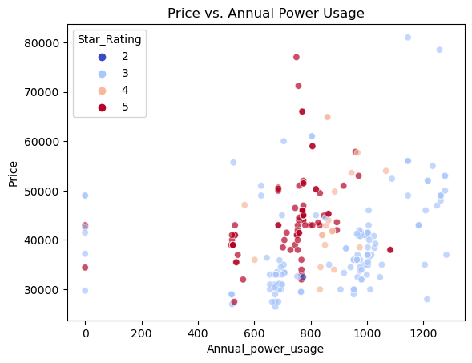
Bivariate Analysis:(Scatterplot)
Insights:
This scatter plot shows the relationship between the price of air conditioners and their annual power usage.
Each point represents an air conditioner, with its position determined by its annual power usage and price.
The color of the points indicates the star rating of the air conditioner, with blue representing lower star ratings and red representing higher star ratings.
The plot suggests that there is no clear linear relationship between price and annual power usage. However, higher star ratings (red points) tend to cluster around lower power usage values, indicating better energy efficiency.

Slide 20
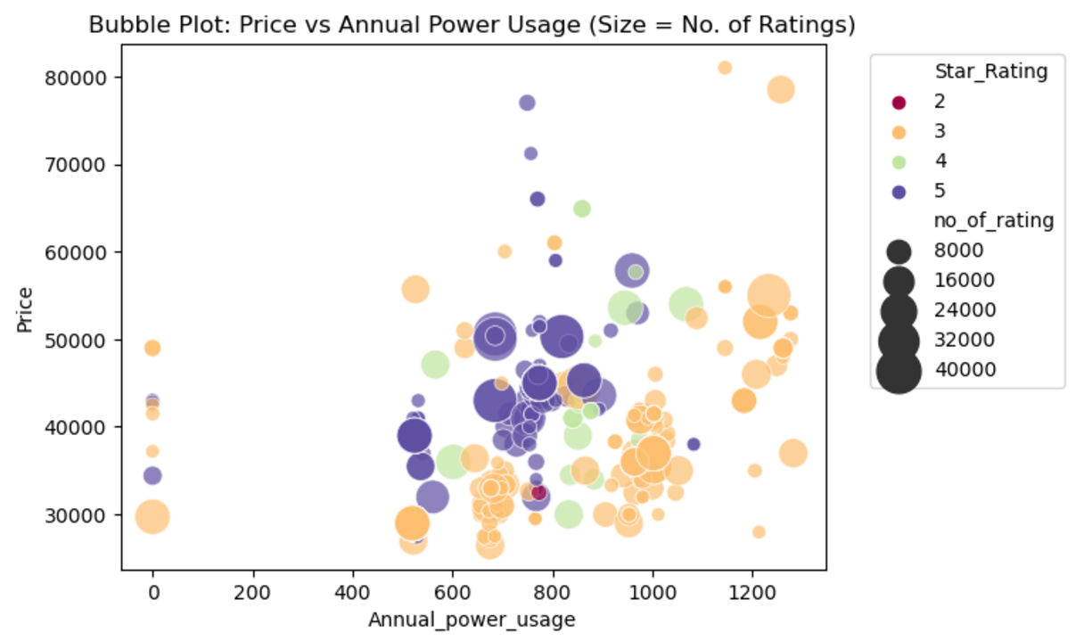
Multivariate Analysis:
Insights:
Annual Power Usage vs. Price: The plot shows the relationship between the annual power usage and the price of the items.
Bubble Size: Larger bubbles indicate items with more ratings, suggesting popularity or higher sales.
Bubble Color: The color coding helps to identify the star rating of each item, providing insights into the energy efficiency and quality of the items.

Slide 21
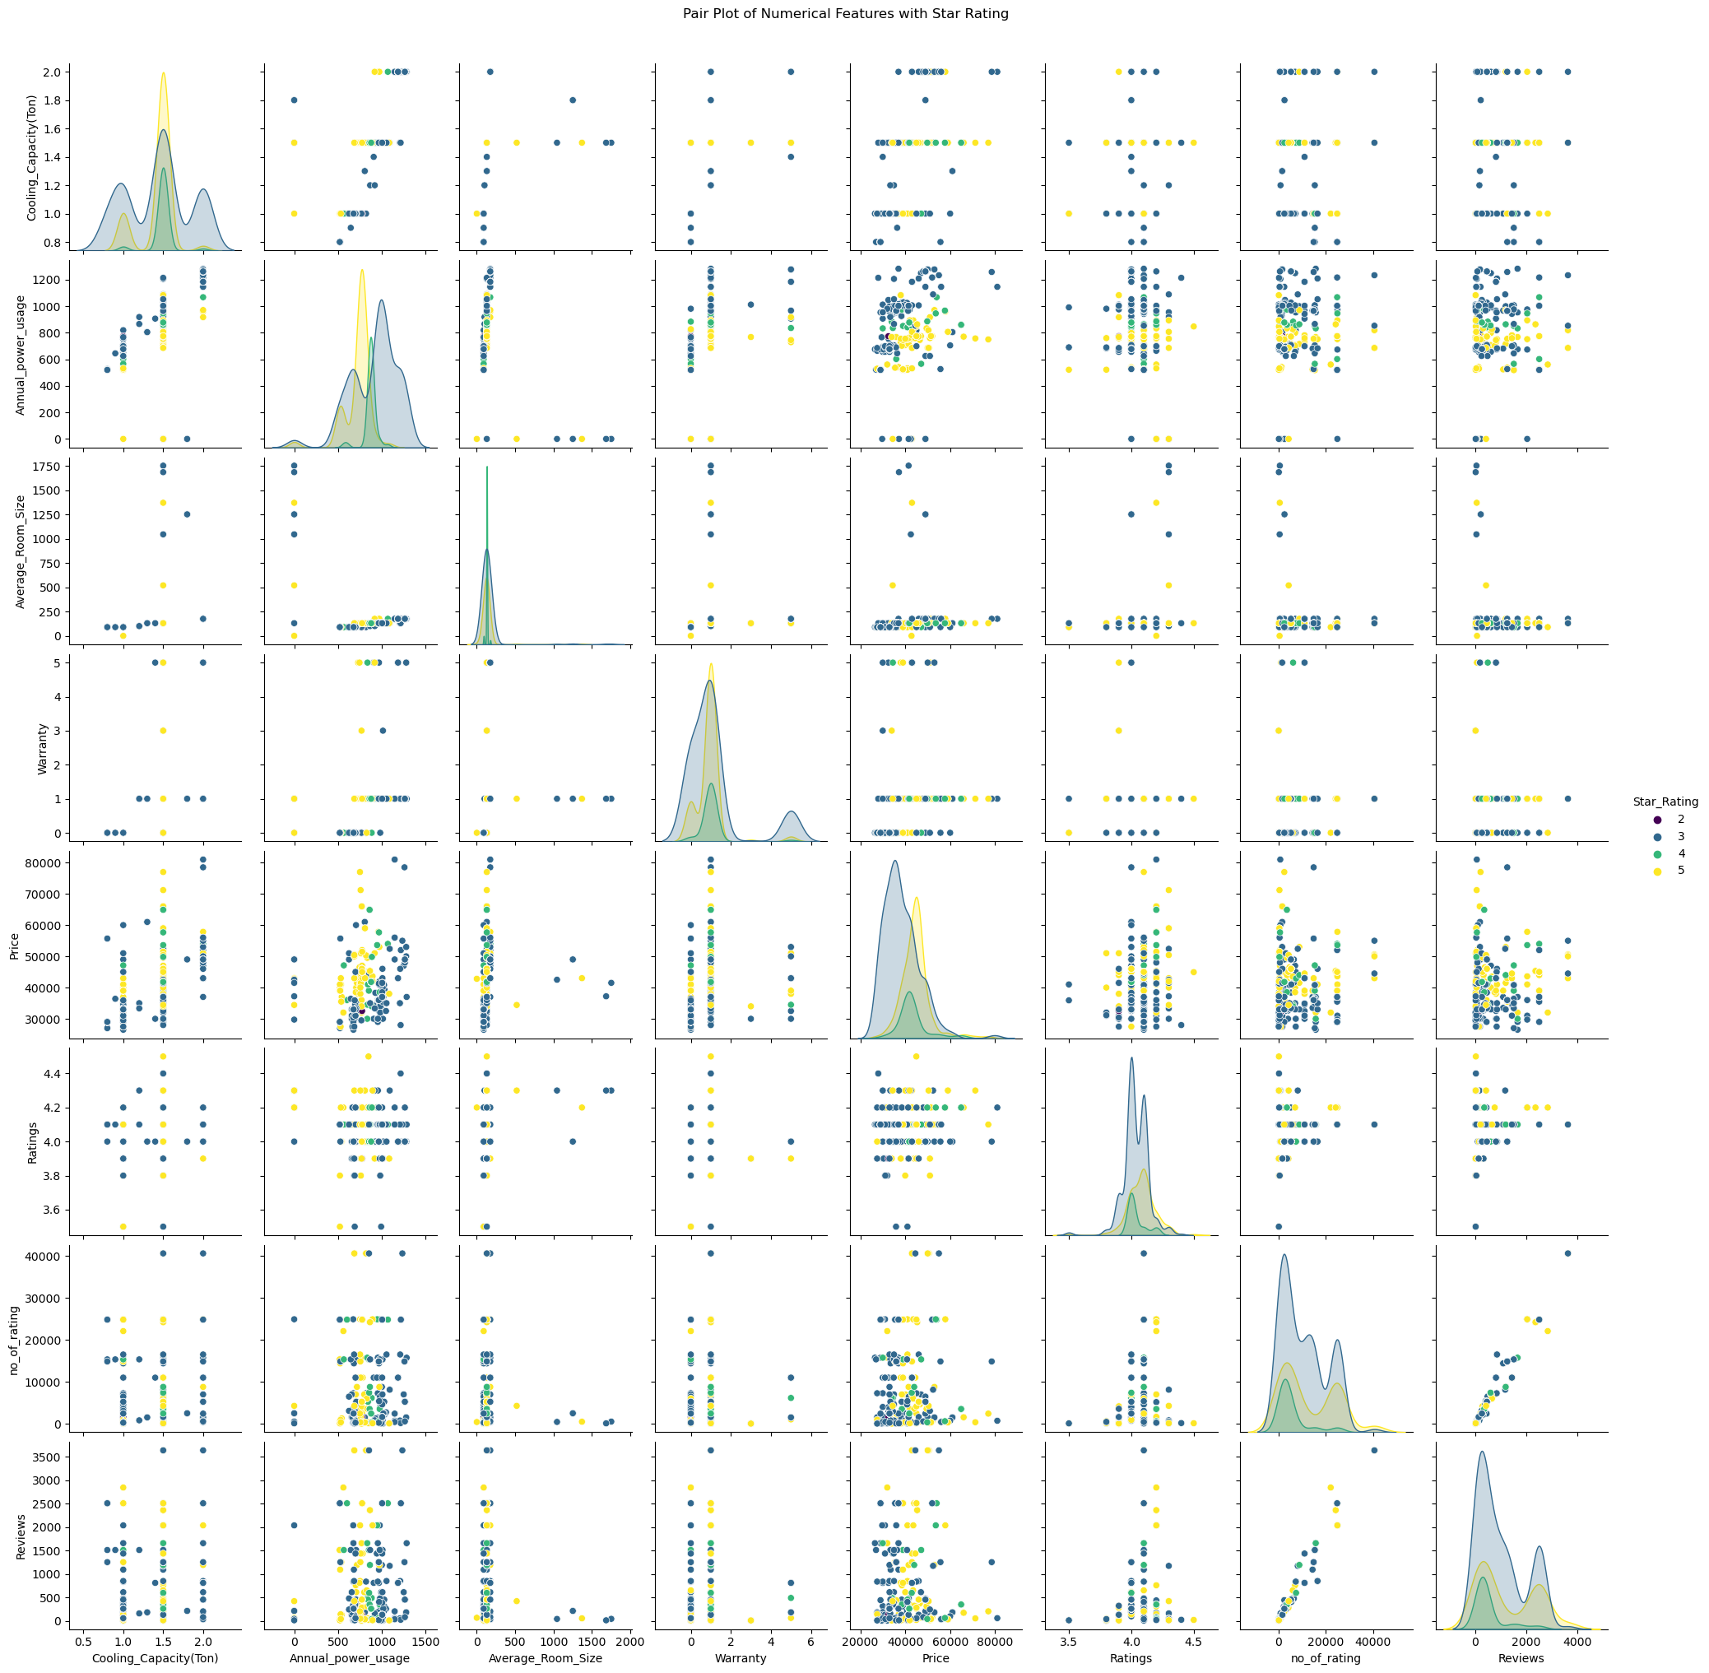
Multivariate Analysis:(Pairplot)
Insights:
Relationships: The scatter plots help identify potential correlations and patterns between different numerical features. For example, you might see how cooling capacity relates to price or how annual power usage relates to ratings.
Distributions: The KDE plots on the diagonal show the distribution of each variable, helping to understand the spread and central tendency of the data.
Star Ratings: The color coding by star rating provides insights into how different features relate to the quality of the air conditioners, as indicated by their star ratings.

Slide 22
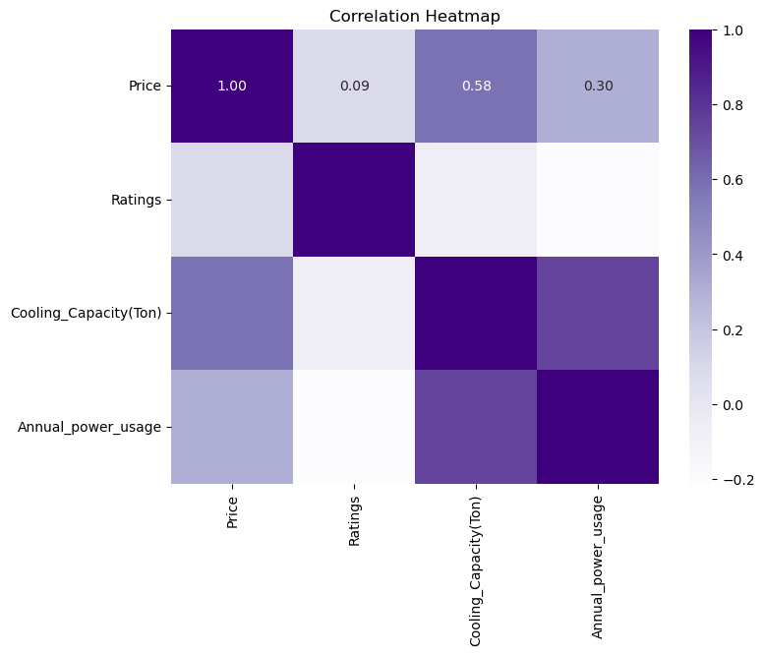
Correlation Heatmap:
Insights:
Price vs. Cooling Capacity(Ton):
There is a moderate positive correlation (0.58), indicating that as the cooling capacity increases, the price tends to increase as well.
Price vs. Annual power usage:
There is a weaker positive correlation (0.30), suggesting that higher-priced air conditioners tend to have higher annual power usage.
Ratings: The ratings have very low correlations with the other variables, indicating that customer ratings are not strongly influenced by price, cooling capacity, or annual power usage.

Slide 23
Conclusion:
The visualizations and their insights enable us to:
The analysis reveals that air conditioners with higher cooling capacities and star ratings generally have higher prices and better energy efficiency.
Brands like SAMSUNG have the highest average prices, while CANDY has the lowest. Godrej stands out with a significantly higher average warranty duration.
There is a moderate positive correlation between cooling capacity and price, and a weaker positive correlation between price and annual power usage.
Customer ratings are not strongly influenced by price, cooling capacity, or annual power usage, but higher star ratings tend to cluster around lower power usage values, indicating better energy efficiency.

Slide 24
Q&A:
Q: Which brand has the highest average price for air conditioners?
A: SAMSUNG has the highest average price for air conditioners.
Q: Which brand offers the lowest average price for air conditioners?
A: CANDY offers the lowest average price for air conditioners.
Q: What is the relationship between cooling capacity and price?
A: Air conditioners with higher cooling capacities (around 2.0 tons) generally have higher prices.
Q: How do star ratings affect the price of air conditioners?
A: Higher star ratings (4 and 5 stars) are often linked to higher prices.
Q: Which brand has the highest average warranty duration?
A: Godrej has a significantly higher average warranty duration compared to other brands.
Q: What does the scatter plot reveal about the relationship between cooling capacity and annual power usage?
A: The scatter plot reveals that air conditioners with higher cooling capacities generally use more power annually.
Q: Is there a clear linear relationship between price and annual power usage?
A: No, there is no clear linear relationship between price and annual power usage.
However, higher star ratings tend to cluster around lower power usage values, indicating better energy efficiency.
Q: How do customer ratings correlate with the price of air conditioners?
A: Customer ratings are not strongly influenced by price, cooling capacity, or annual power usage.
Q: What does the pair plot show about the relationships between different numerical features?
A: The pair plot helps identify potential correlations and patterns between different numerical features,
such as how cooling capacity relates to price or how annual power usage relates to ratings.
Q: Which air conditioners tend to have higher ratings and prices?
A: Higher-priced products tend to have higher ratings, and products with more reviews are more likely to have higher ratings and prices.

Slide 25

THANK
YOU

