Slide 1

A Data-Driven Analysis of Smartphones Pricing and Consumer Ratings on Flipkart Website

Slide 2
About us
Member-1:
NIKHIL KARNATI
I have recently completed my B.tech in the stream of computer science and engineering specialized in Data Science. Now I have done my Data Analytics course at INNOMATICS RESEARCH LABS.
Member-2:
NALLAM SAI MANIKANTA
I have recently completed my B.tech in the stream of Electronics and communication engineering. Now I have done my Data Analytics course at INNOMATICS RESEARCH LABS.

Slide 3
OBJECTIVE
The goal of this project is to perform a comprehensive analysis of mobile phones listed on Flipkart to gain insights into pricing, features, and customer reviews. By analyzing the available data, the project aims to:
Identify the pricing trends of different mobile phone brands and models.
Analyze the features (such as RAM, storage, camera quality , etc.) that contribute to the pricing differences.
Understand customer preferences and sentiment by analyzing ratings and reviews.
Compare the performance of various brands and models based on price-to-feature ratios.
Provide data-driven recommendations for both consumers (choosing the best mobile) and sellers (optimizing product listings and pricing).

Slide 4
Webscrapping
For this project, we employed a web scraping technique to extract smartphone data from Flipkart. Below is a breakdown of the tools, libraries, and the process we followed to gather the relevant data:
Tools and Libraries Used :
Selenium : A powerful browser automation tool used to navigate through the Flipkart pages, load the content, and interact with dynamic elements.
Beautiful Soup : A Python library used for parsing HTML content to extract specific information from the webpage .
Regular Expressions (Regex) : Used to extract specific patterns like prices, RAM, ROM, display size, and other smartphone features.

Slide 5
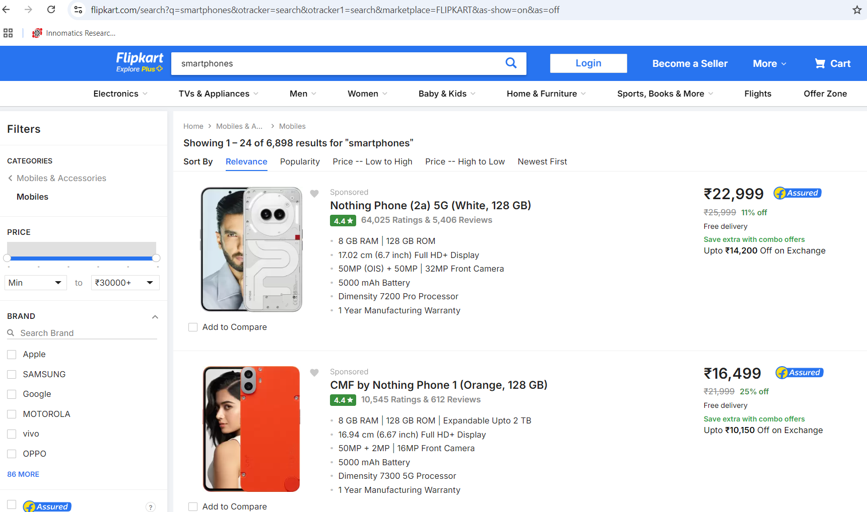
WEBSITE We scraped smartphone data from Flipkart, a leading e-commerce platform in India, to analyze consumer preferences and trends based on various product attributes and ratings.

Slide 6
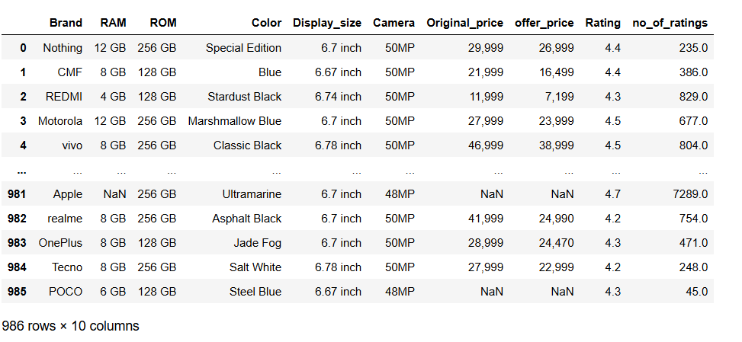
Uncleaned DataFrame
This data frame contains raw smartphone information extracted from Flipkart, including various attributes such as brand, RAM, ROM, display size, camera specifications, prices, and ratings, which requires further cleaning and preprocessing for analysis.

Slide 7
Exploratory Data Analysis
Data Cleaning Steps:
Remove Duplicates: Eliminate duplicate entries to ensure each smartphone is unique.
Handle Missing Values: Identify and fill or drop missing values to maintain data integrity.
Data Type Conversion: Convert columns to appropriate data types (e.g., strings to floats or integers).
Standardize Text Data: Clean and standardize string values by converting to lowercase and stripping whitespace.
Remove Unwanted Characters: Clean numerical columns by removing currency symbols and extra characters.

Slide 8
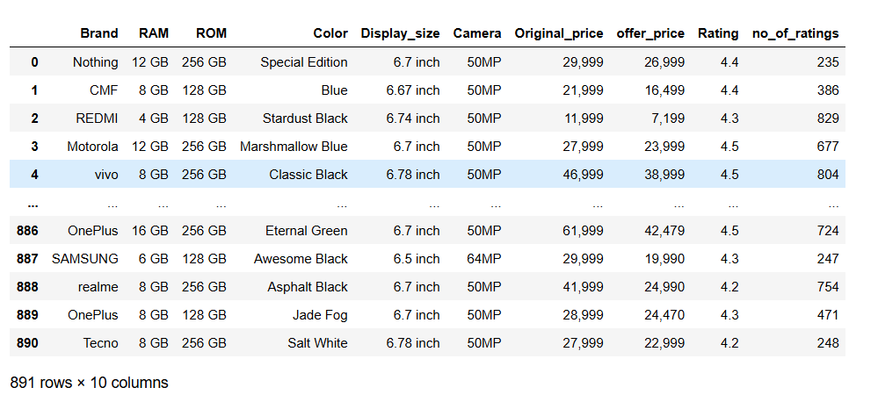
Cleaned DataFrame
This data frame contains raw smartphone information extracted from Flipkart, including various attributes such as brand, RAM, ROM, display size, camera specifications, prices, and ratings, which requires further cleaning and preprocessing for analysis.

Slide 9
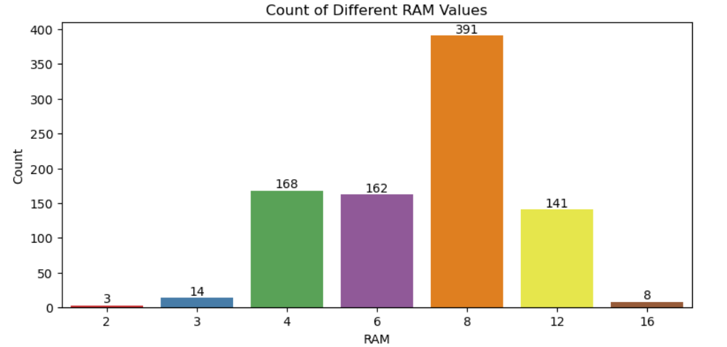
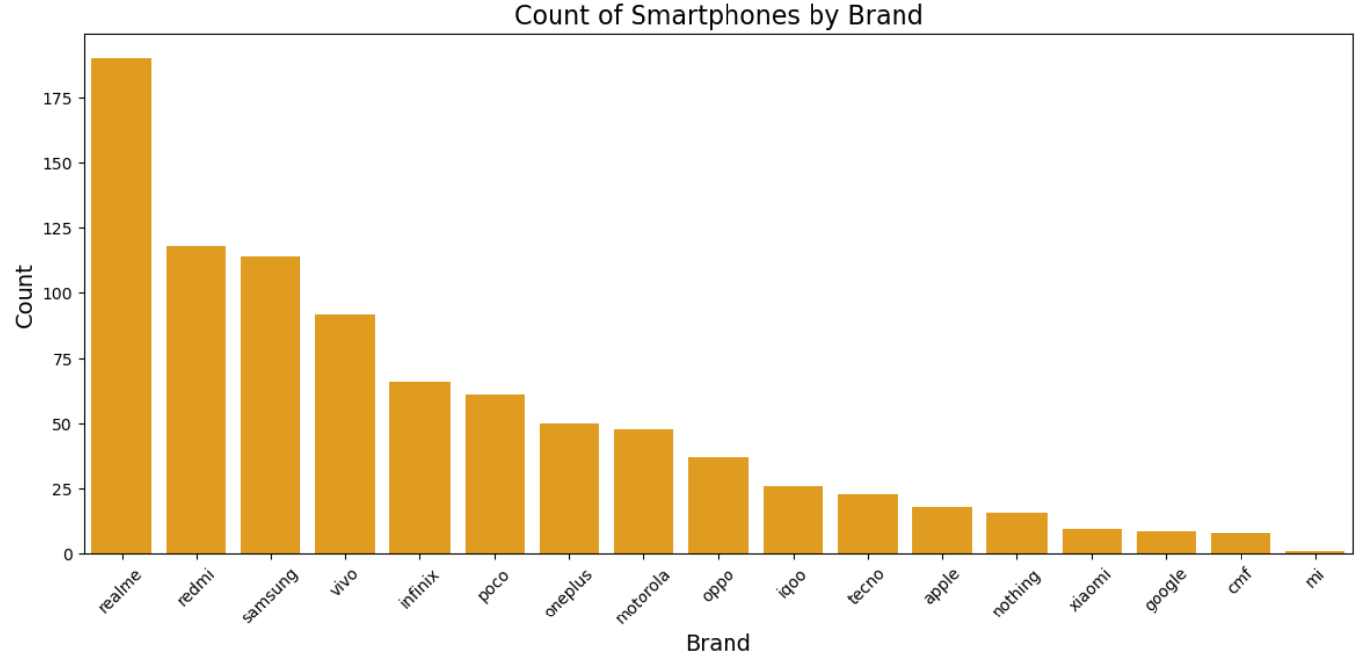
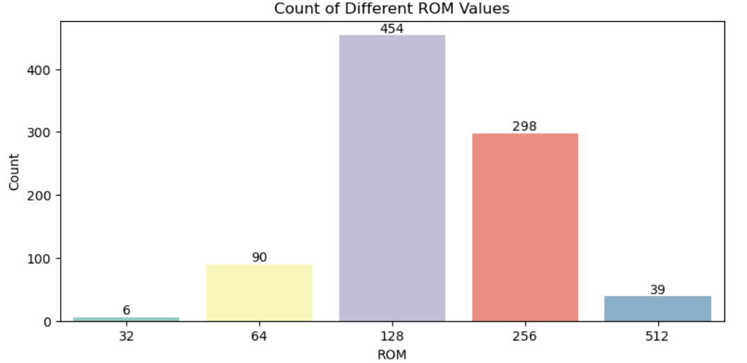
Univariate Analysis
a. Categorical Data
Value count for RAM and ROM respectively
Value count for each brand in our data

Slide 10
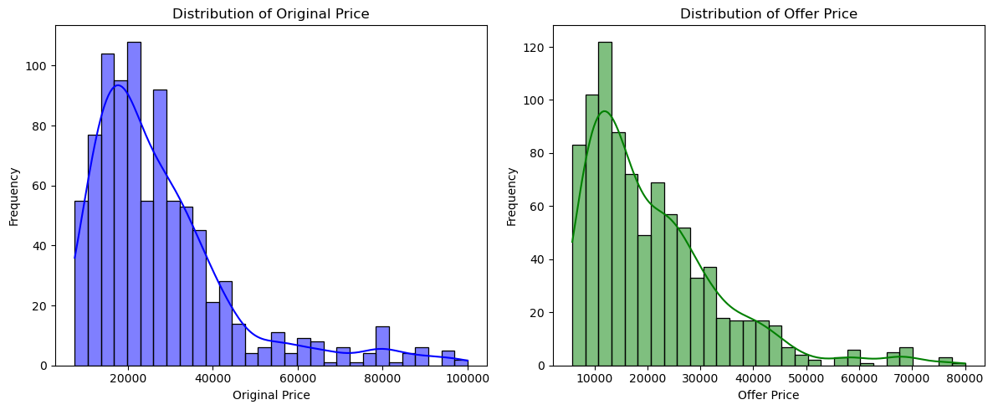
b. Continuous Data
The distribution of Original Price shows a right-skewed pattern, indicating that a majority of smartphones fall within the lower to mid-price range (around ₹20,000 to ₹40,000).
The Offer Price distribution appears to be similarly right-skewed, with the majority of smartphones priced between ₹10,000 and ₹40,000, indicating strong sales potential in this segment

Slide 11
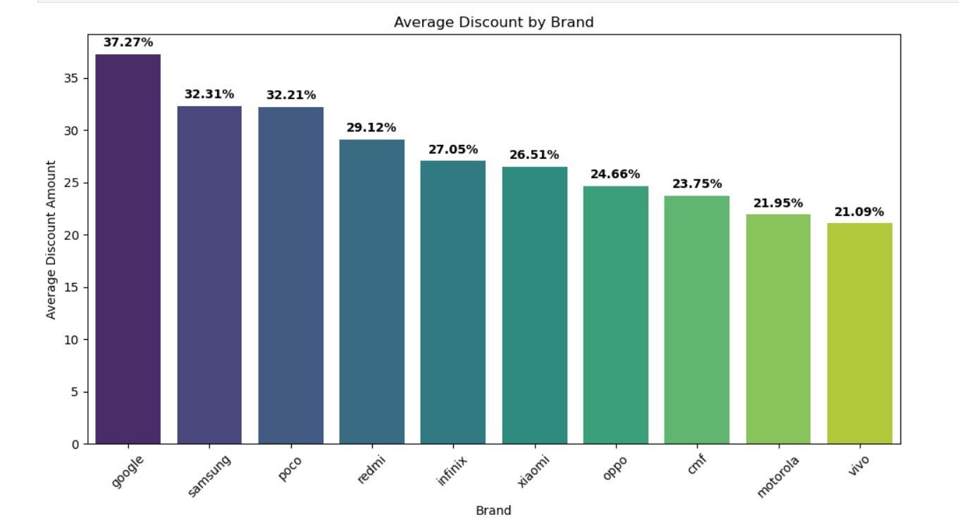
Bivariate Analysis
a. Categorical Data vs Continuous Data
Promotional Strategies: Brands like Google and Samsung offer significantly higher average discounts, suggesting aggressive promotional strategies to attract consumers.

Slide 12
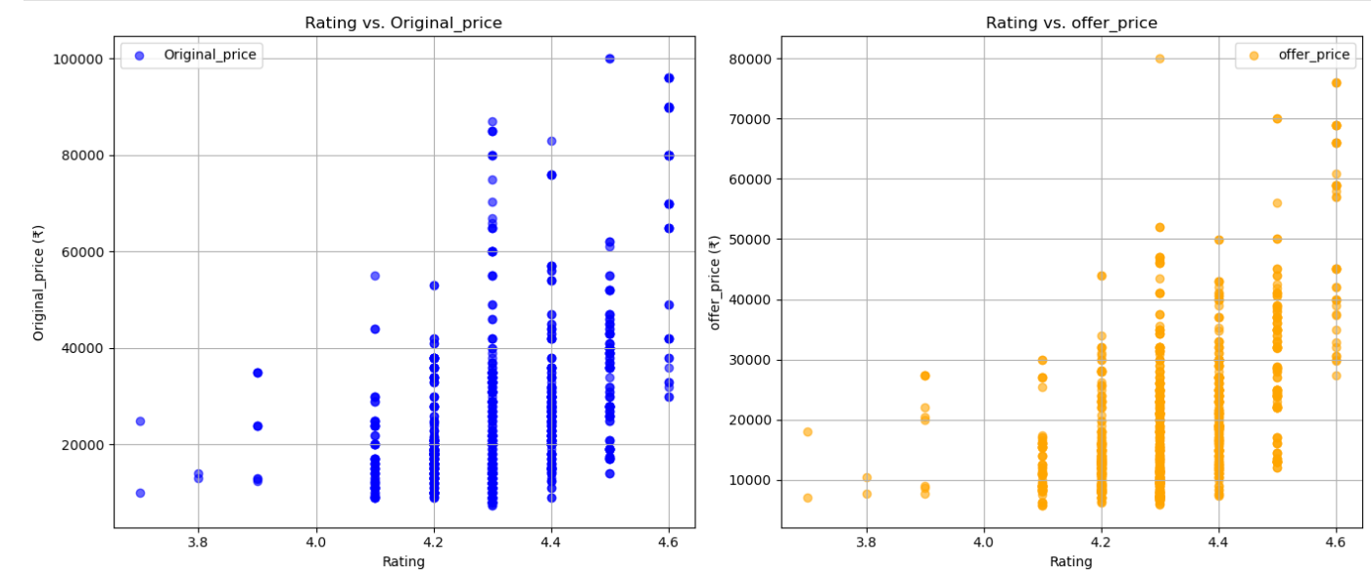
b. Continuous Data vs Continuous Data
The analysis shows a strong correlation between ratings and both Original and Offer prices, indicating that consumers are willing to pay more for higher-rated products.
This consistency suggests that even with discounts, well-rated items maintain their perceived value, allowing businesses to justify higher price points for quality offerings.

Slide 13
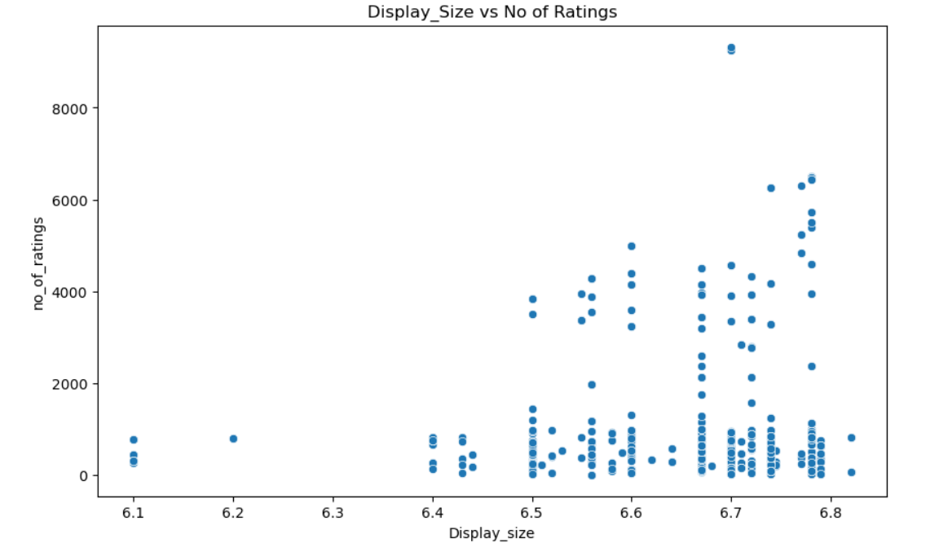
c. Categorical Data vs Categorical Data
Clustering of Data Points: A majority of the data points are clustered around the display sizes of 6.5 to 6.8 inches.
There are fewer devices with smaller display sizes (around 6.1 to 6.4 inches).
Devices with display sizes between 6.5 and 6.8 inches tend to have a higher number of ratings, with some having more than 8000 ratings.

Slide 14
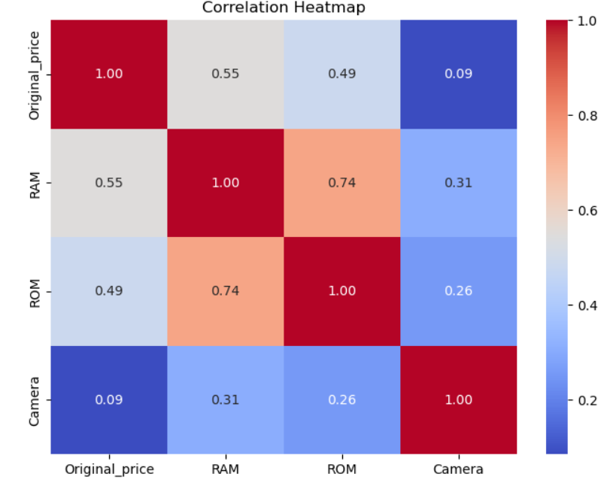
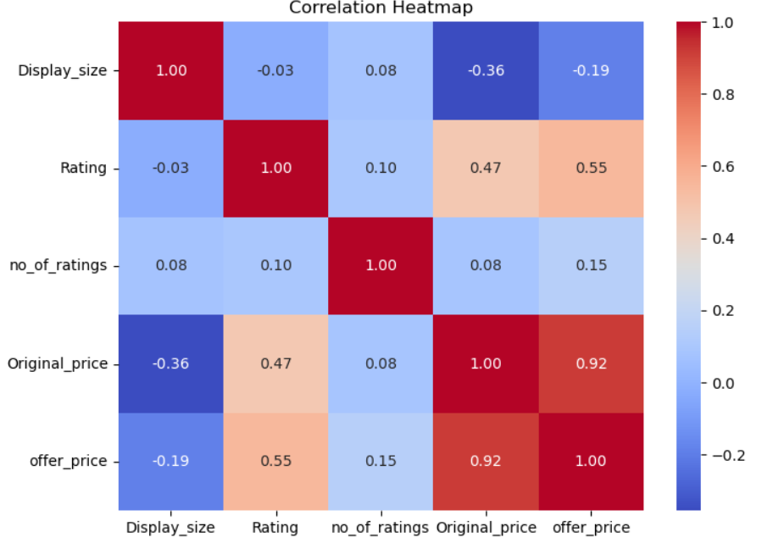
RAM and ROM: Phones with more RAM tend to have more storage (ROM), and both contribute to higher prices.
Price and Ratings: More expensive phones usually have higher ratings and better discounts (offer price).
Display Size: The size of the display has little impact on the phone's price, ratings, or the number of ratings.
Camera: The camera quality does not strongly influence the phone's price or other features like RAM or ROM.

Slide 15
Conclusion
The analysis of smartphones on Flipkart reveals that premium brands generally have higher prices, while budget brands offer competitive features at lower costs. Key specifications like RAM, ROM, and camera quality significantly impact pricing, with phones offering higher configurations commanding premium prices. Discount patterns vary across brands, with some offering significant reductions, likely as part of marketing strategies. Highly-rated smartphones tend to have fewer discounts, as strong reviews drive sales without the need for promotions. Consumer preferences, reflected in ratings and color choices, also play a role in shaping market trends. Overall, the analysis helps consumers make informed decisions and provides insights for brands to optimize their offerings.

Slide 16

THANK YOU

