Slide 1
LENDING CLUB CASE STUDY SUBMISSION
Name: Ravi Teja K and Mukul Kumar

Slide 2
Abstract
Lending Club specialises in lending various types of loans to urban customers. When the company receives a loan application, the company has to make a decision for loan approval based on the applicant’s profile.
As an employee of Lending club our aim is to analyse the past data. The data given contains the information about past loan applicants and whether they ‘defaulted’ or not.
The aim is to identify patterns which indicate if a person is likely to default, which may be used for taking actions such as denying the loan, reducing the amount of loan, lending (to risky applicants) at a higher interest rate, etc.
Our approach is to find the driver variables for the defaulting and find the patterns using the Univariate and Bivariate analysis.

Slide 3
Problem solving methodology – Flow chart
Data Understanding
Univariate Analysis
Conclusion
Read the loan dataset. Check the shape, sample data and datatypes. Find out the Target variable
Find out and analyse the important variables. Create bins for continuous variables. Plot bar plot with loan status and find out the impact.
Using univariate analysis conclude the high impact variables which results in loan default. Similarly conclusion is drawn by analyzing the combination of variable impacting loan default.
Data Preparation
Univariate Analysis
Conclusion
Data Cleaning
Bivariate Analysis
Data Cleaning
Bivariate Analysis
Missing value treatment, correcting data type, cleaning the data depending on the domain requirements
Plot pair plots, heat map, scatter plots. Find out the impact of combination of variables on loan status.

Slide 4
Data Understanding
Check sample data
Head, tail, sample
Read the loan dataset -
No encoding require
Check the columns using describe function
Shape of dataset
Row – 39717, column - 111
Identify the target column - Loan_status
Drop ‘current’ records and change the default to 1 and non-default as 0

Slide 5
Data Cleaning
1
Original Loan dataset
Original data set – Loan dataset
Shape: Row – 39717, Column - 111
2
Drop all the columns with > 80% null value
Updated data set
Shape: Row – 38577, Column - 55
3
Dropping non imp columns
Updated data set
Shape: Row – 38577, Column - 30
Updated data set
Shape: Row – 37869, Column - 26
4
Removing rows & column with missing value
5
Imputing null value and correcting datatypes
Final data set – Clean loan dataset
Shape: Row – 37869, Column – 26
We manage to retain 90% data (row wise)

Slide 6
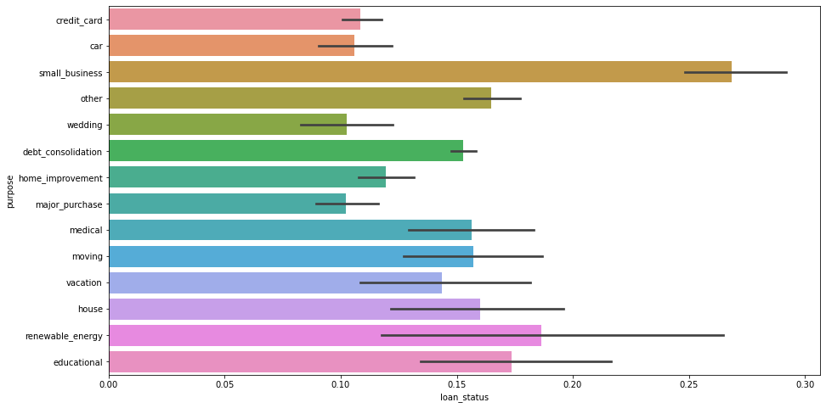
Univariate Analysis
Purpose vs loan status bar plot
Deleted the columns which has same data in all the rows (i.e. pymnt_plan, application_type etc).
Created the function to bin the continuous variable. Bins are created using quantile function. For 0, 20%, 40%, 60%, 80%, 100% bins are created as Very Low(VL), Low(L), Medium(M), High(H), Very High(VH).
Created the function to find out the high impact variables
After analysing all the high impact variables we found below important variables (including derived variables)
int_rate_bins
purpose
term
annual_inc_bin
dti_bins
funded_amnt_inv_bins
home_ownership
Plotted bar plot between loan status and important variables
For the Bivariate analysis we have considered all the purpose and not top 4/5 purposes.

Slide 7
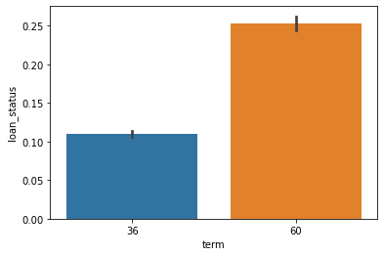
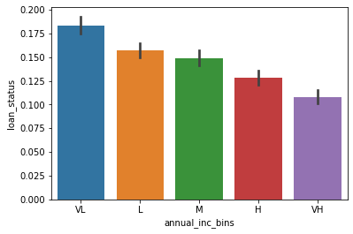
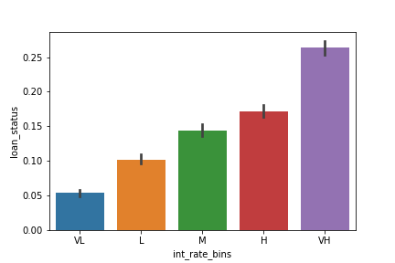
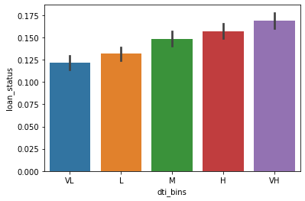
Univariate Analysis …contd.
Term vs loan status bar plot
Annual income vs loan status bar plot
dti vs loan status bar plot
Interest rate vs loan status bar plot

Slide 8
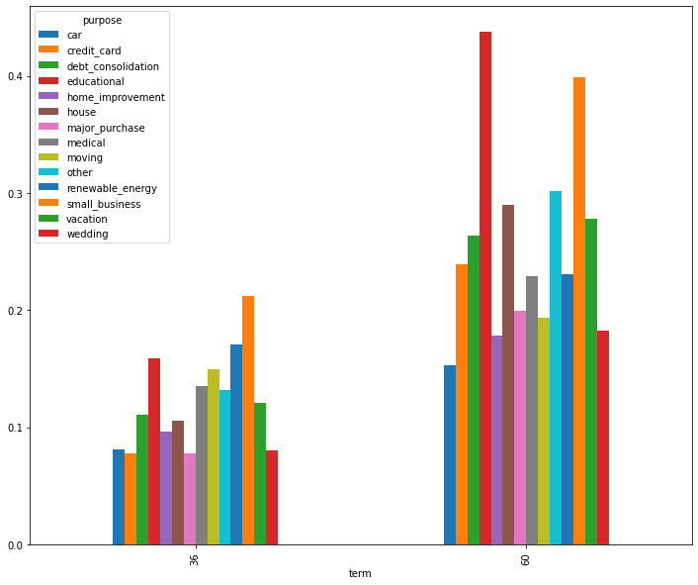
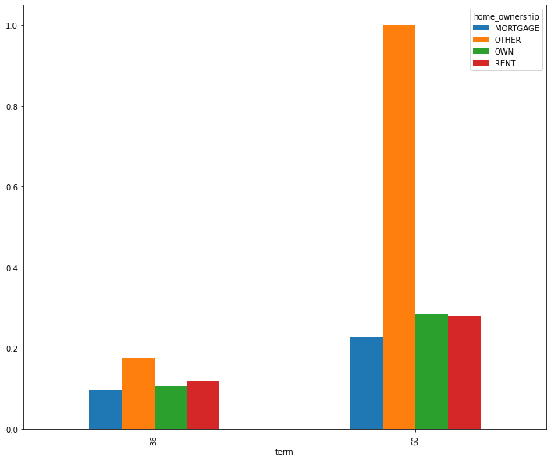
Bivariate Analysis
In bivariate analysis we plotted bar graph and heat map with combination from the 5-6 important variables identified during univariate analysis and loan status.
From the univariate analysis, we have seen that the default probability is changing heavily with the purpose. In the bivariate analysis, we can see the patterns of the default probability against the purpose and the remaining important derived variables one-by-one.
Bar plot for Term and Purpose vs loan status
Bar plot for Term and home ownership vs loan status

Slide 9
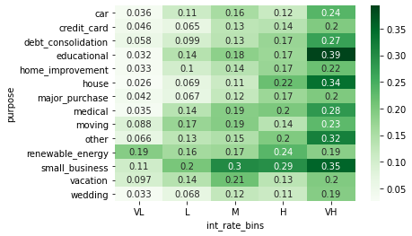
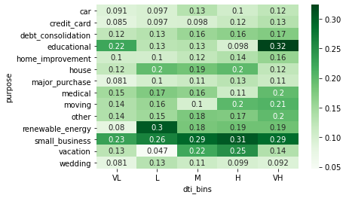
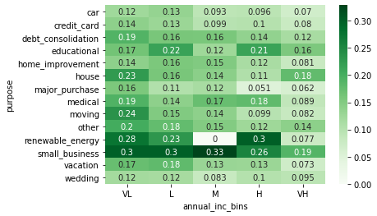
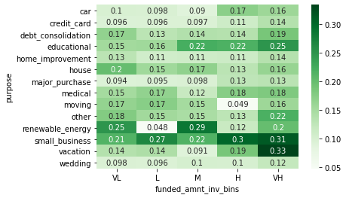
Bivariate Analysis…contd.
1. Heat map for purpose and interest vs loan status
2. Heat map for purpose and dti vs loan status
3. Heat map for purpose and annual income vs loan status
4. Heat map for purpose and loan amount vs loan status

Slide 10
Conclusions
As per analysis below are the important conclusion:
Sl.no | Conclusion
1 | On an average the default rate is 15%. The default rate is high (25%) when loan term is 60 months as compare to loan term of 36 months (11%).
2 | The default probability is monotonically increasing with the interest rate i.e. Higher the interest rate higher the chance of default.
3 | In the general when the loan purpose is “small business” the default rate is quite high (26%).
4 | Default probability is inversely proportional to the annual income. Higher the income lesser the chance of default.
5 | Default probability is increasing with the increase in the debt-to-income ratio.
6 | Default probability is directly proportional to the loan amount. Also, probability of default is more when the home_ownership is "other“.
7 | Analysis confirm that chances of default is high when purpose is small_business and the term is 36 months. Also for 60 month term the default probability is high when purposes are debt_consolidation, educational, house, other, small business and the vacation purposes.
8 | The trend clearly shows the default probability is 100% when the home_ownership status is other and the term is 60 months. Even when the term is 36 months, the default probability in the high when the home_ownership status is other. But there is only one entry in this configuration (term = 60 months and home_ownership = other), and very less entries in the other home_ownership. So it is better to avoid the loans when the home_ownership is others.
9 | In general Educational loan, house, other and the small_business with very high interest rate, small business with medium and high interest rate and renewal energy and house with high interest rate are showing more default probability.
10 | The high income group for all purpose is relatively safe to lend money. The small_business is showing high default probability in all income group except very high income group. Loan with purpose renewal_energy is showing high chance of default with very low, low and high income bracket.
11. | Loan with purpose car, credit card, home improvement, medical and wedding is showing less chances of default among various category and one of the safest purpose to lend. On the other hand loan with purpose small business, debt consolidation, renewal energy, educational, house and other is showing high chances of default.

